Slide 1
Data-viz-02, bar charts
Steve Simon

Slide 2
Data-viz-02, Outline
Preparation
Colors
Group exercises
Perception
Barchart fundamentals
Barchart recommendations
Notes:
Here is an outline of what you will learn today.

Slide 3
Preparation, overview
Follow these steps to get ready for lecture #2 in data visualization.
Download and import Titanic data
Download and import scotus data

Slide 4
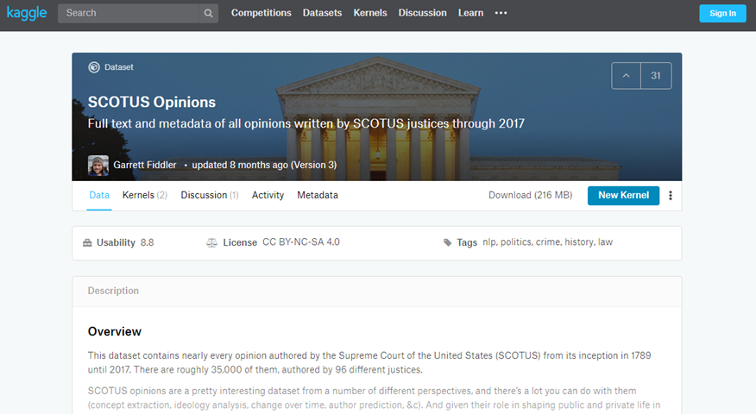
Preparation, kaggle website
Kaggle datasets webpage

Slide 5
Preparation, download scotus data
Download the scotus_cases.csv data set, or go to the original source, the Kaggle datasets repository.
Import the data and create a bar chart showing the frequency of opinions written by year_filed. Note that there are a few typos and a few rows that do not belong. You can remove these, but they will not affect any of the analyses we are considering.

Slide 6
Preparation, Python code
((Add later))

Slide 7
Preparation, R code
((Add later))

Slide 8
Preparation, Tableau steps
((Add later))

Slide 9
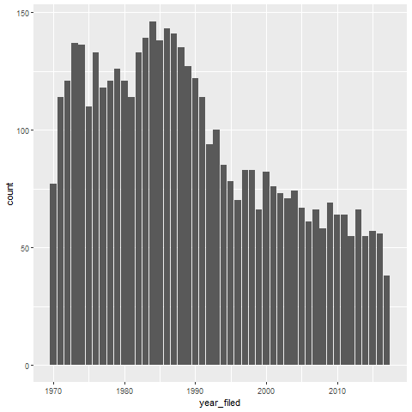
Preparation, This is what your bar chart should look like
Bar chart

Slide 10
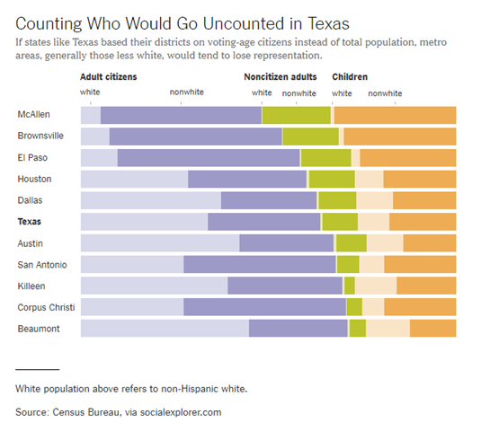
Group exercise (1 of 2)
Bar chart of demographics of selected Texas counties
Notes:
This is one of two graphs. It was published in
Badger, E. (2019). People Who Can’t Vote Still Count Politically in America. What if That Changes?. Retrieved June 24, 2019, from The New York Times website: https://www.nytimes.com/2019/06/22/upshot/america-who-deserves-representation.html
Split into pairs. Review the article briefly (about 5 minutes) and look at the graph. Explain to your partner what the graph is trying to show. Your partner will get a different graph and do the same thing with you listening this time.

Slide 11
Group exercise (2 of 2)
((Image is not yet available.))

Slide 12
Colors, introductory tutorial
Kindergarten view of colors
Review hexadecimal codes
RGB color system

Slide 13
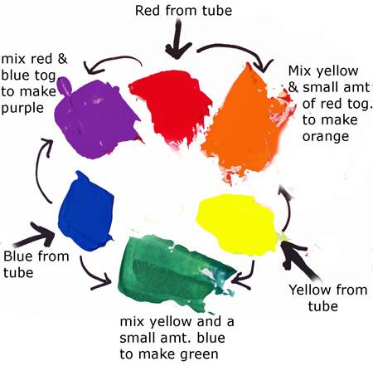
COlors, Everything I know about colors, I learned in Kindergarten.

Slide 14
Colors, Hexadecimal codes
“There are 10 types of programmers in the world, those who undestand binary and those who don’t.”
1001 1100 (base 2)
= $1*2^{7}+0*2^{6}+0*2^{5}+1*2^{4}+1*2^{3}+1*2^{2}+0*2^{1}+0*2^{0}$
= 128+16+8+4 = 156
Hexadecimal digits (base 16)
0-9, A=10, B=11, C=12, D=13, E=14, F=15
1001 1100 (base 2)
= 9C (base 16)
= $9*{16}^{1}+12*{16}^{0}$
Two hexadecimal digits represent the numbers 0-255.
00 (base 16) = 0, FF (base 16) = 255

Slide 15
Colors, Codes for colors
#rrggbb format
#000000 is pure black
#FFFFFF is pure white
#FF0000 is pure red
#00FF00 is pure green
#0000FF is pure blue
You can mix and match to get 16,777,216 colors
#800080 is purple, #FF69B4 is pink, #40e0d0 is turquoise

Slide 16
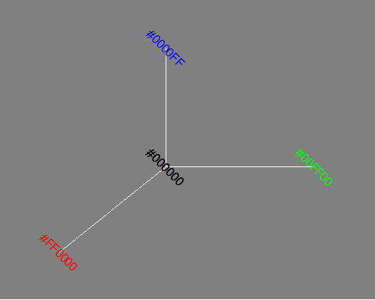
Colors, The color cube (1/2)

Slide 17
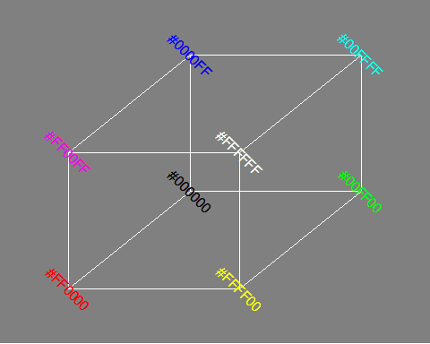
Colors, The color cube (2/2)

Slide 18
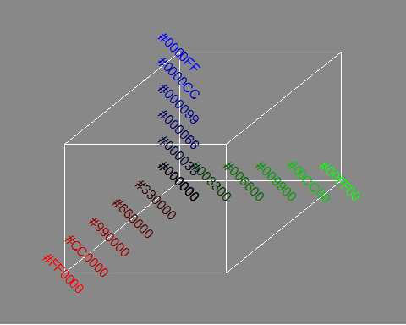
Colors, Gradients (1/5)

Slide 19
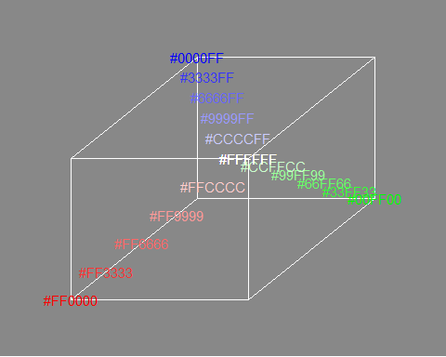
Colors, Gradients (2/5)

Slide 20
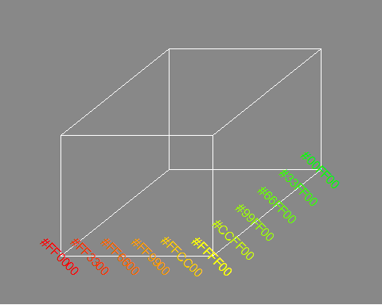
Colors, Gradients (3/5)

Slide 21
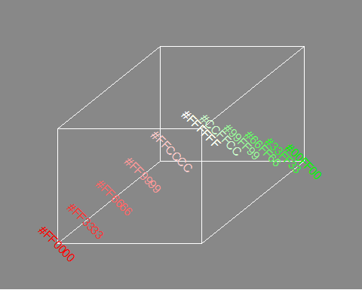
Colors, Gradients (4/5)

Slide 22
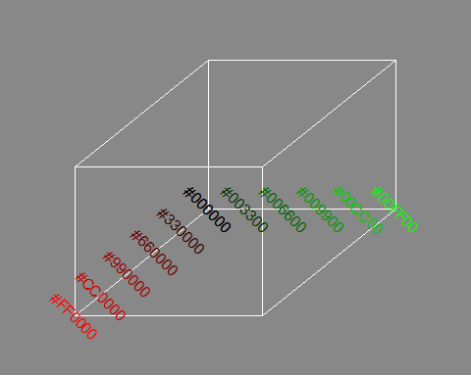
Colors, Gradients (5/5)

Slide 23
Colors, RGB combinations
Additive color mixing: adding red to green yields yellow; adding green to blue yields cyan; adding blue to red yields magenta; adding all three primary colors together yields white.

Slide 24
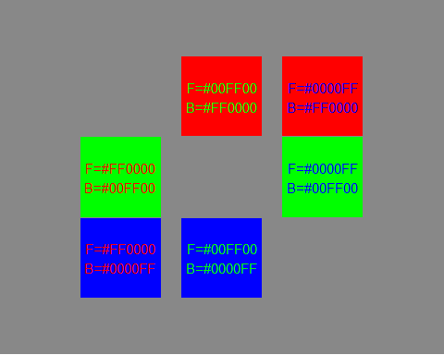
Colors, Contrasting pure colors often appear too intense

Slide 25
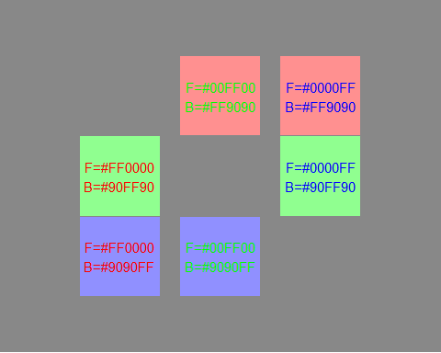
Colors, Lighten the background

Slide 26
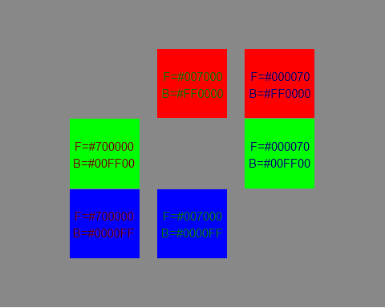
Colors, Darken the foreground

Slide 27
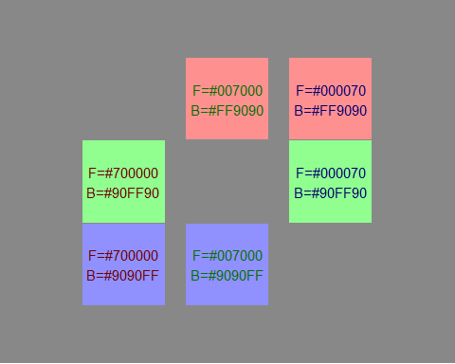
Colors, or both

Slide 28
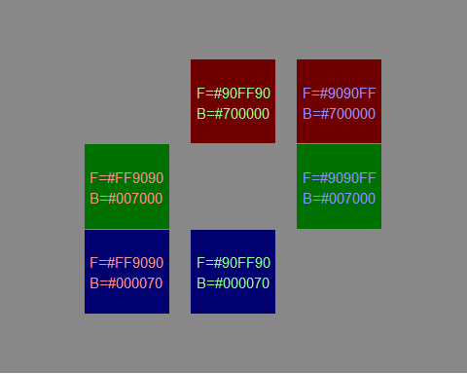
Colors, or the reverse

Slide 29
Perception, introductory tutorial
Visual tasks
Hierarchy of perception

Slide 30
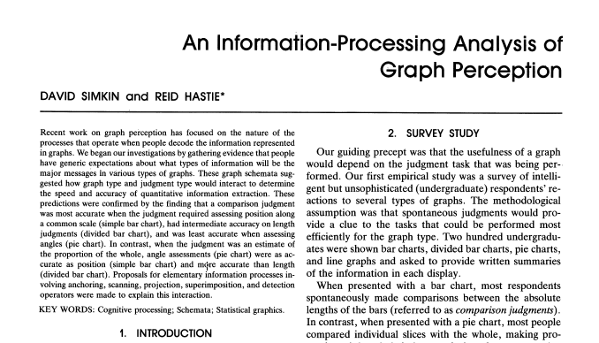
Perception, A framework for graph perception
Part of first page from Simkin and Hastie journal article
Notes:
Much of the work on the psychology of perception that I will be discussing next is drawn from this 1987 article by Simkin and Hastie.

Slide 31
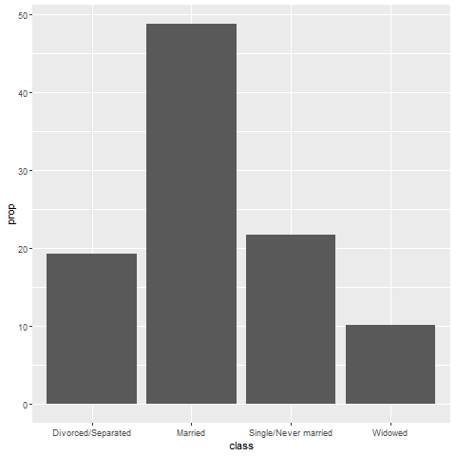
Perception, Which is better? A bar chart…
Bar chart

Slide 32
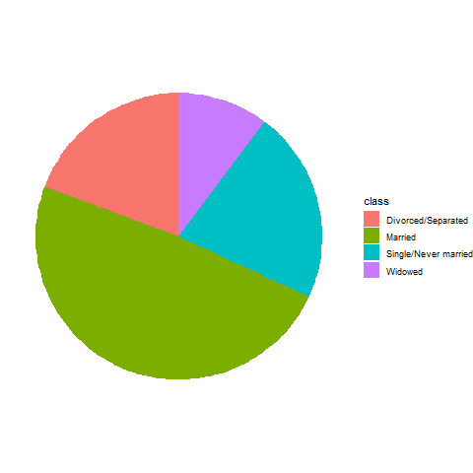
Perception, … or a pie chart
Pie chart

Slide 33
Perception, Answer. It depends.
What question are you trying to answer?
What proportion of the patients are single?
Are there more single or divorced patients?
Notes:
The answer really depends on what question you are asking. There are a variety of questions that you might ask. Two are illustrated above.
You can run an experiment (people have done this) where randomize and show half of them a bar chart and half of them a pie chart. Then you ask a question, like one of the questions above. Then you note the speed and accuracy of the response. Depending on the question, sometimes pie charts give faster and more accurate answers. Sometimes bar charts give faster and more accurate answers. It turns out that the results match up nicely with what we know about the psychology of perception.

Slide 34
Perception, Visual processing (1 of 3)
Projection
Shifting an object in a horizontal or vertical direction to make a comparison
Superimposition
Shifting in other directions (e.g., diagonal shifts, rotation) in order to make a comparison
Much harder than projection

Slide 35
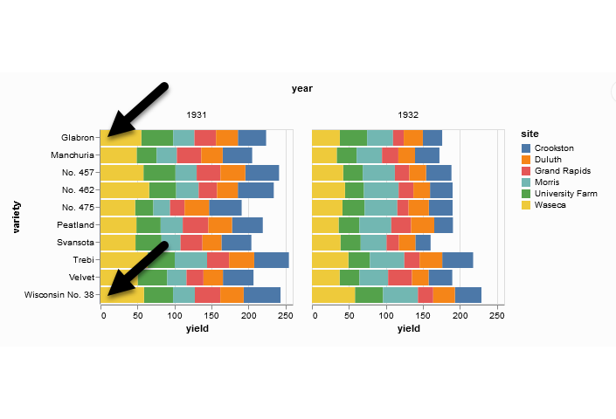
Perception, Projection (first yellow bar versus last yellow bar)
Stacked bar chart of crop yields
Notes:
The position means the vertical or horizontal location. Does the first yellow bar in 1931 (Glabron seeds planted in Wasica) extend further to the right than the last yellow bar (Wisconsin No. 38 seeds planted in Wasica)?

Slide 36
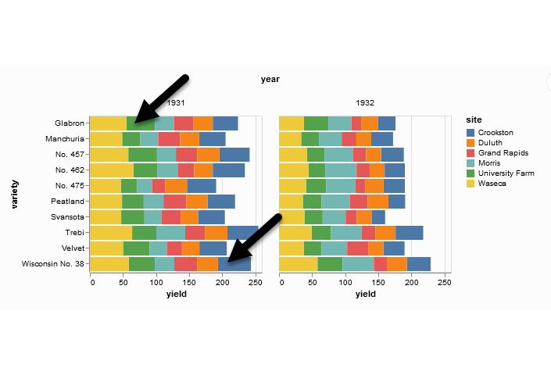
Perception, Superimposition (first green bar versus last blue bar)
Stacked bar chart of crop yields
Notes:
The length means either the width or the height. Does the first green bar in 1931 (Glabron seeds planted in University Farm) extend further to the right than the last yellow bar (Wisconsin No. 38 seeds planted in Crookston)?

Slide 37
Perception, Visual processing (2 of 3)
Scanning
Quantifying distance throug the use of a mental tape measure
Shorter distances are easier
Anchoring
Implicit or explicit development of reference points
Assists with scanning

Slide 38
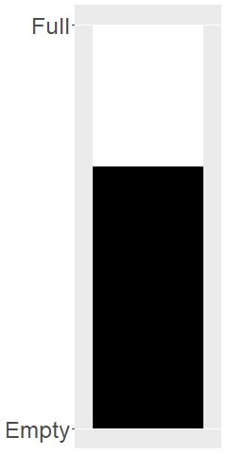
Perception, Scanning
Image of a fuel gauge, 65% full
Notes:
To understand scanning, think of a gas gauge. Usually it is a semicircular dial, but let’s set up the gas gauge as a rectangle. If the level is at the top, you have a full tank. If the level is at the bottom, you have an empty tank. This gauge shows a tank that is 65% full. Trust me, I drew the gauge. It is at 65%. Now how would you estimate the gas level?
You would take a mental tape measure, starting at the bottom and measure up to where the black box ends.
Now if you were smart, you’d start at the top and scan downwards. Less distance means that you can do this faster and more accurately.
Now if you were Albert Einstein, you’d split the gauge at the halfway point and measure from the halfway point to the top of the black box. Actually, there’s a little of Albert Einstein in all of us. That halfway point is something that all of us do subconciously. You did, because you recognized almost immediately that the tank was more than half full.

Slide 39
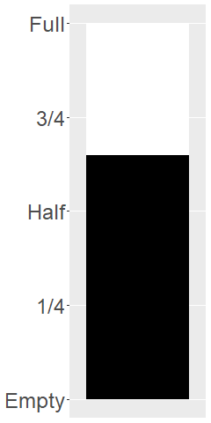
Perception, Assisting scanning with anchors
Image of a fuel gauge, anchors at 1/4, half, 3/4
Notes:
Here’s the same gas gauge, still at 65% full, but now we have added anchors at 1/4, half, and 3/4. You can read this gauge faster and more accurately, because you can scane from half up to 65% or from 3/4 down to 65%.

Slide 40
Perception, Visual processing (3 of 3)
Visually simple tasks
Position
Length
Angle/slope
Visually demanding tasks
Area
Volume
Density/Saturation/Hue
Notes:
There are a variety of perceptual tasks that you use when making comparisons within an image. These are arranged on this slide roughly in order of difficulty, with the easiest tasks at the top.

Slide 41
Perception, Position (first yellow bar versus last yellow bar)
Stacked bar chart of crop yields
Notes:
The comparison of the two yellow bars is a comparison of position. Which yellow bar extends further to the right?

Slide 42
Perception, Length (first green bar versus last blue bar)
Stacked bar chart of crop yields
Notes:
The comparison of the green and blue bars is a length comparison. The two bars start at different spots, so the position can’t help you.
Length is harder to judge than position, because it involves a superimposition rather than a projection.

Slide 43
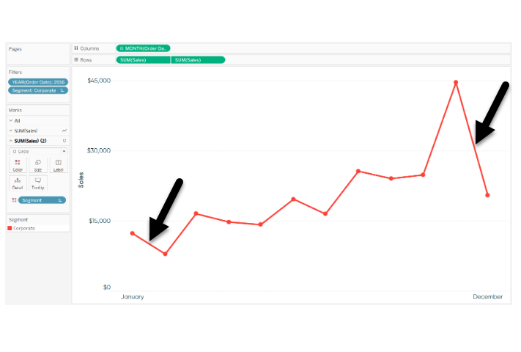
Perception, Angle/slope (first month decline versus last month decline)
Sales trend shown with a line graph
Notes:
This graph shows sales trends over a twelve month span. If you want to assess whether the first month decline (the dip in sales between January and February) was worse than the last month decline (the dip in sales between November and December), you would probably do this by judging the angle of the first line segment to the angle of the second line segment. This is not quite as easy as a position or length judgement, but it isn’t too bad either.

Slide 44
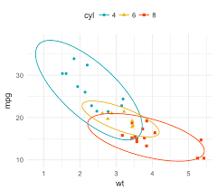
Perception, Area
Three ellipses

Slide 45
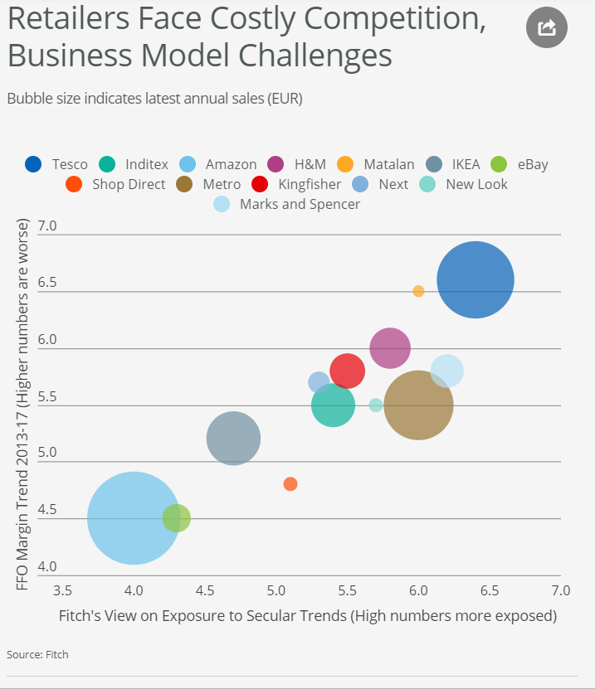
Perception, Area
Bubble plot
Notes:
This graph shows exposure and margin trends on the x and y axes. Larger values are worse on both axes. The size of the bubble is the size of the company (annual sales). There is some ambiguity here–is size measured in terms of diameter or in terms of area. Which is bigger, the brown circle (Metro) or the dark blue circle (Tesco)?

Slide 46
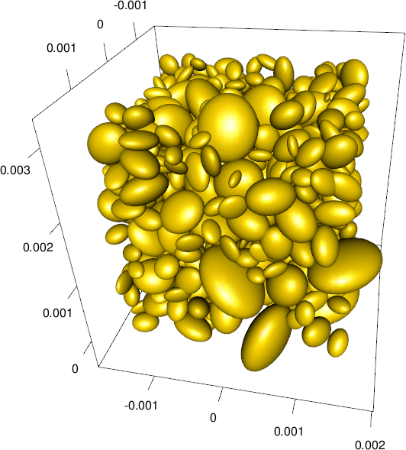
Perception, Volume
Ellipsoid plot

Slide 47
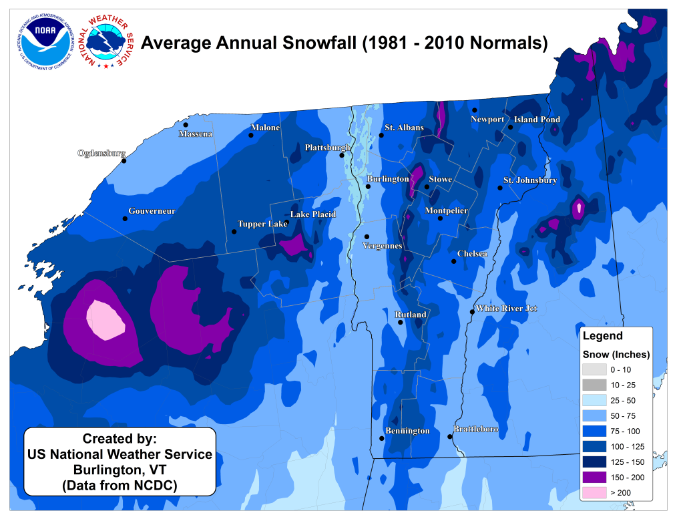
Perception, Color
Weather map of annual snowfall
Notes:
What city gets more snowfall, Remington, in the southwester corner of the state, or Newport, in the northeast corner of the state?

Slide 48
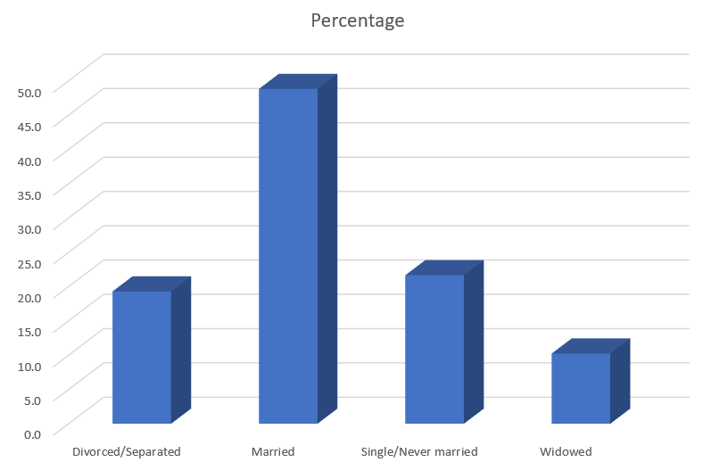
Perception, Adding depth (1/4)
THree dimensional bar chart
Notes:
Some sotware packages allow you to add some depth to your pie chart. This can catch your eye, at first, but almost all experts hate this approach. The most common complaint is that the three dimensional effects make a graph worse.
Worse means that it slows you down and it decreases the accuracy of your response. So here’s a question. What percentage of your sample is single/never married? THe three dimensional effects slow you down. So for this three dimensional bar chart, do you measure the height of the single/never married bar by projecting the front of the bar to the axis on the left or by projecting the back of the bar? Actually, you need to first project to the back “wall” because the bars are placed a small distance in front.

Slide 49

Perception, Adding depth (2/4)
Projection lines for a three dimensional bar chart
Notes:
Once you realize that you need to project to the back wall, you have to do this accurately. Notice that it is not a simple horizontal or vertical projection. Instead you have to do a couple of superimpositions, shifts at a 45 degree angle. You can do this, but it degrades your accuracy.

Slide 50
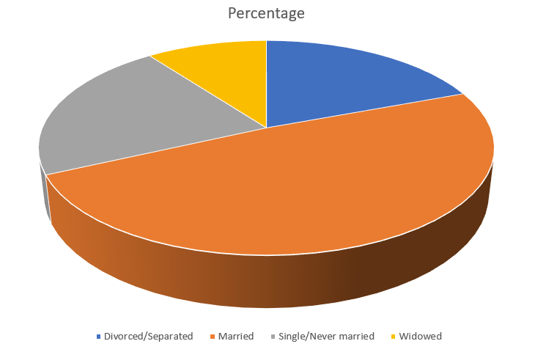
Perception, Adding depth (3/4)
Three dimensional pie chart

Slide 51
Perception, Adding depth (4/4)
Notes:
There are several issues with the three dimensional pie chart, and you can see this best when you split this pie chart into four equal pieces. Notice that the angles are no longer 90 degrees because the perspective view distorts the angles. So you lose the big advantage (and possibly the only advantage) of the pie chart, the ability to divide it easily into four pieces.
Also notice that the wedge in the foreground looks bigger than the wedge in the background, because you can see the side of the foreground wedge, but you can’t see the side of the background wedge.

Slide 52
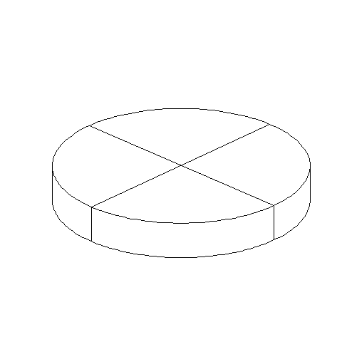
Three dimensional pie chart split into four equal pieces

Slide 53
Barchart fundamentals, Bars
Fewer in numbers than points
Usually a summary statistic
Count
Percent
Average
Total
A bar chart is NOT a histogram
Notes:
Bar charts are different than point charts. There are usually only a few bars. These bars usually represent a summary statistic, like a count, percent, average, or total.
There is a technical distinction between a bar chart and a histogram. Histograms are a great diagnostic tool, but usually ends up on the cutting room floor. So I won’t be talking about it much, if at all, in this workshop.

Slide 54
Barchart fundamentals, Aesthetics for bars
Review
Location
Size
Color
NOT shape!!!
Notes:
Recall that aesthetics are visual attributes associated with a geometry/mark. You can map variables to the location, size, and/or color of bars, but you cannot assign a variable to the shape of a bar.

Slide 55
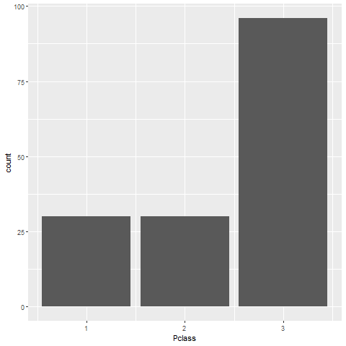
Barchart fundamentals, Location
Horizontal bar chart
Notes:
This is data from the Titanic, a ship that was as massive as its name. It was considered unsinkable, but on its maiden voyage in 1912, the ship hit an iceberg and sank. It sank during an era where people really believed in women and children first, and this shows quite clearly in the mortality statistics. There was a difference, though, between third class passengers like Leonardo diCaprio and first class passengers like Kate Winslet.
This shows a simple bar chart. The x-axis is passenger class and the y-axis is count. Note that there are about the same number of first and second class passengers, but the two combined does not come close to the number of third class passengers.

Slide 56
Barchart fundamentals, Gender barchart
Draw a bar chart showing the number of people in each gender (use the Sex variable).

Slide 57
Barchart fundamentals, Gender barchart, Python code
Python code
ch = alt.Chart(df).mark_bar().encode( x='Sex', y='count()' )

Slide 58

Barchart fundamentals, Gender barchart, Python results

Slide 59
Barchart fundamentals, Gender barchart, R code
R code
ggplot(titanic, aes(Pclass)) + geom_bar()

Slide 60
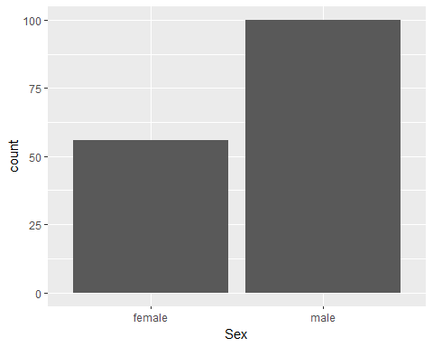
Barchart fundamentals, Gender barchart, R results

Slide 61
Barchart fundamentals, Gender barchart, Tableau steps
((Tableau steps))

Slide 62
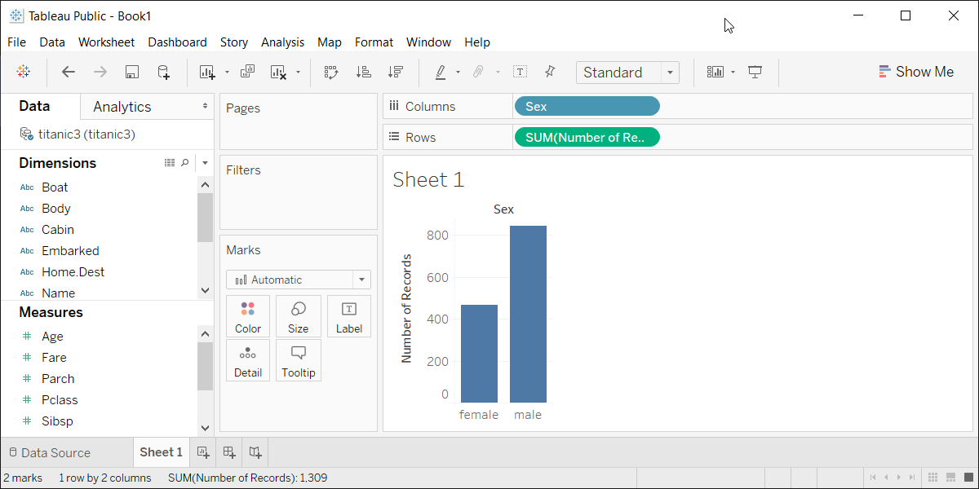
Barchart fundamentals, Gender barchart, Tableau results
Tableau barchart

Slide 63
Barchart fundamentals, Size
Length varies, width doesn’t
Exception, mosaic plots
Think about gaps between bars

Slide 64
Barchart fundamentals, Color

Slide 65
Barchart fundamentals, Color
Use for emphasis in simple bar charts
Very important for stacked or side-by-side bar charts
Notes:
For simple bar charts like all the ones we’ve seen so far, color is not really needed. You already can distinguish between the passenger classes using the location. If you do use color in a simple bar chart, it is often to emphasize a point. In the previous bar chart, I used red for third class, because Kate Winslet, a rich first class passenger, found true love in third class, with the adorable Leonardo di Caprio.
Color becomes very important in just a minute when we add another layer of complexity.

Slide 66
Barchart fundamentals, First class red
Make the first class bar red to show Leonardo di Caprio’s perspective on the Titanic.

Slide 67
Barchart fundamentals, First class red
((Python code))
((R code))
((Tableau steps))

Slide 68
Barchart fundamentals, What your visualization might look like
((Show visualization))

Slide 69
Barchart fundamentals, Color
Use for emphasis in simple bar charts
Very important for stacked or side-by-side bar charts
Notes:
For simple bar charts like all the ones we’ve seen so far, color is not really needed. You already can distinguish between the passenger classes using the location. If you do use color in a simple bar chart, it is often to emphasize a point. In the previous bar chart, I used red for third class, because Kate Winslet, a rich first class passenger, found true love in third class, with the adorable Leonardo di Caprio.
Color becomes very important in just a minute when we add another layer of complexity.

Slide 70
Barchart fundamentals, On your own
Revise this visualization so the first class bar is red.

Slide 71
Barchart fundamentals, Wait before showing
((Python code))
((R code))
((Tableau steps))

Slide 72
Barchart fundamentals, What your visualization might look like
((Show visualization))

Slide 73
Barchart fundamentals, On your own
Draw a bar chart showing counts involving both mortality and gender. Use a panel, then stacking, then dodging. Which do you like best?
Notes:
Mortality on the Titanic reflects the fact that this was an era when people really did believe in the concept of “women and children first.” Someone like me, I’d be shoving the little kids aside so I could get on one of the lifeboats.
Anyway, examine how mortality is related to gender. It’s a spoiler alert, but on the Titanic, Kate survives, but Leonardo, I am so sad to say this, didn’t make it.

Slide 74
Barchart fundamentals, Wait a bit before showing the code
Did you make the panel/stack/dodge Survived or did you make it Sex? Here’s some code, but yours might be different.
((Show Python code))
R code
fn <- initiate_image() titanic %>% ggplot(aes(x=Sex, fill=Survived)) + geom_bar() + facet_grid(cols=vars(Survived)) finalize_image()
((Show Tableau))

Slide 75
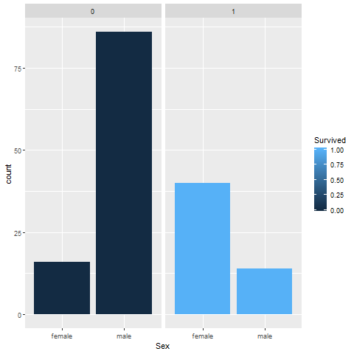
Barchart fundamentals, Panel, one approach
Bar chart

Slide 76
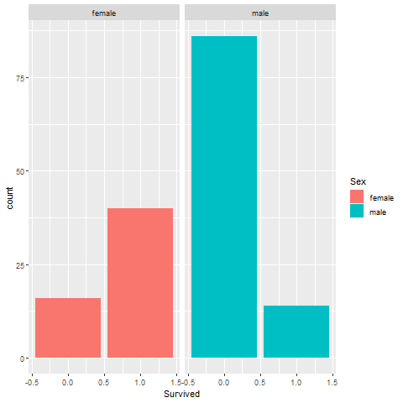
Barchart fundamentals, Panel, alternate approach
Bar chart

Slide 77
Barchart fundamentals, Stack, one approach

Slide 78
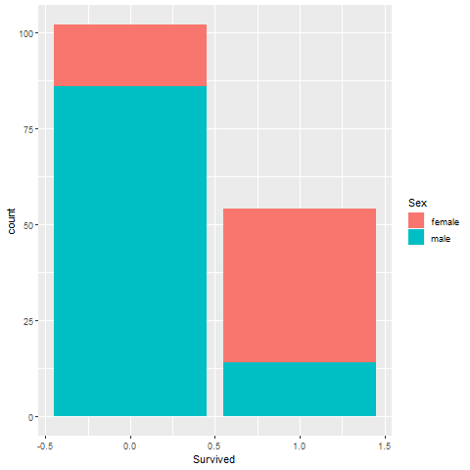
Barchart fundamentals, Stack, alternate approach
Bar chart

Slide 79
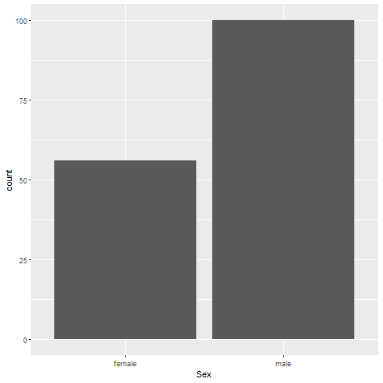
Barchart fundamentals, Dodge, one approach
Bar chart

Slide 80
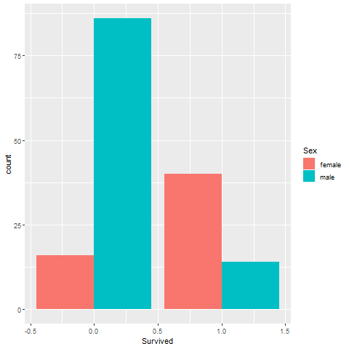
Barchart fundamentals, Dodge, alternate approach
Bar chart

Slide 81
Barchart fundamentals, Stack versus dodge
Summarize by two categories
Facet
Separate plots
Dodge
Side by side
Stack
One on top, one on bottom
Notes:
Bar charts that represent a summary across a single categorical variable are fairly simple and easy to handle. But when you want to summarize by two categories simultaneously, things get interesting. Interesting in a good way.

Slide 82
Barchart fundamentals, Titanic passenger count by gender
Bar chart

Slide 83
Barchart fundamentals, Titanic passenger count by passenger class
Bar chart

Slide 84
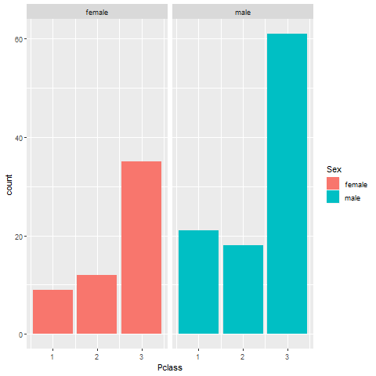
Barchart fundamentals, Titanic facet
Bar chart

Slide 85
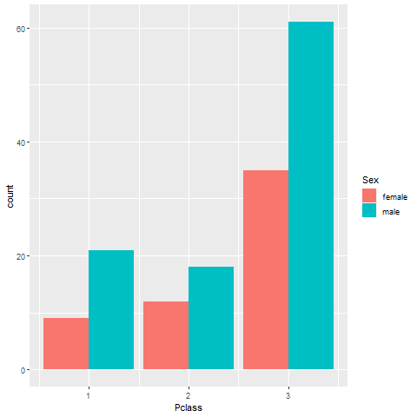
Barchart fundamentals, Titanic dodge
Bar chart

Slide 86
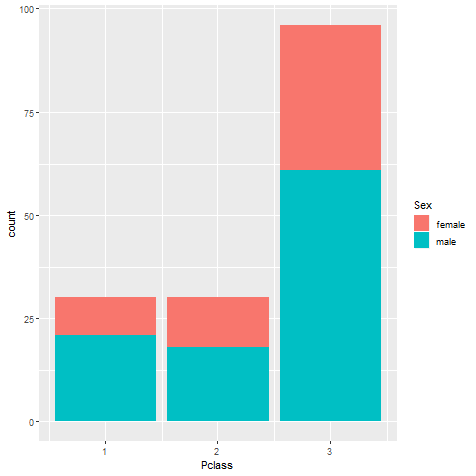
Barchart fundamentals, Titanic stack
Bar chart

Slide 87
Barchart fundamentals, Mortality by gender
Draw a bar chart showing counts involving both mortality and gender. Use a panel, then stacking, then dodging. Which do you like best?
Notes:
Mortality on the Titanic reflects the fact that this was an era when people really did believe in the concept of “women and children first.” Someone like me, I’d be shoving the little kids aside so I could get on one of the lifeboats.
Anyway, examine how mortality is related to gender. It’s a spoiler alert, but on the Titanic, Kate survives, but Leonardo, I am so sad to say this, didn’t make it.

Slide 88
Barchart fundamentals, Mortality by gender, Python code
((Python code))

Slide 89
Barchart fundamentals, Mortality by gender, Python results
((Python results))

Slide 90
Barchart fundamentals, Mortality by gender, R code
titanic %>% ggplot(aes(x=Sex, fill=Survived)) + geom_bar() + facet_grid(cols=vars(Survived))

Slide 91
Barchart fundamentals, Mortality by gender, R results

Slide 92
Barchart fundamentals, Mortality by gender, Tableau steps
((Tableau steps))

Slide 93
Barchart fundamentals, Mortality by gender, Tableau results
((Tableau results))

Slide 94
Barchart fundamentals, Group exercise
Review the following visualization in your group
Summarize what aesthetics appear in the graph
What variables map to each aesthetic?
((Provide visualization. Maybe use the visualization from the earlier exercise?))

Slide 95
Barchart fundamentals, Summarizations
One number summary (mean or percentage)
Two number summary (error bars)
Five number summary (boxplots)
All the data
Jittering
Opacity
Notes:
((note to myself: maybe this goes better in the talk about lines.))

Slide 96
Barchart fundamentals, Switching from count to percent
((Show the code in Python, R, and Tableau. Explain why you might want counts versus percents.))

Slide 97
Barchart fundamentals, Example with means
((Need to find the right data set to illustrate this. Maybe the Saratoga house prices?))

Slide 98
Barchart fundamentals, Example with totals
((Same data. What means tell you versus totals.))

Slide 99
Barchart fundamentals, Boxplots example
((Include an explanation of what a boxplot is))

Slide 100
Barchart fundamentals, Jittering example
((Include an explanation on when it doesn’t work.))

Slide 101
Barchart fundamentals, Opacity example
((Note the computational expense.))

Slide 102
Barchart fundamentals, On your own
((Find a totally different data set and get the students to draw four different visualizations. Have them divide into groups that like the same visualization software and have each person do a different visualization.))

Slide 103
Barchart fundamentals, Summary
“A mapping of data to the visual aesthetics of geometries/marks”
Bars are a type of geometry/mark
Aesthetics for bars include location, size, color
Stack versus dodge
Basic tips
Place comparators close
Use axis ticks, light grid lines

Slide 104
Barchart fundamentals, On your own
((Find a totally different data set and get the students to draw four different visualizations. Have them divide into groups that like the same visualization software and have each person do a different visualization.))

Slide 105
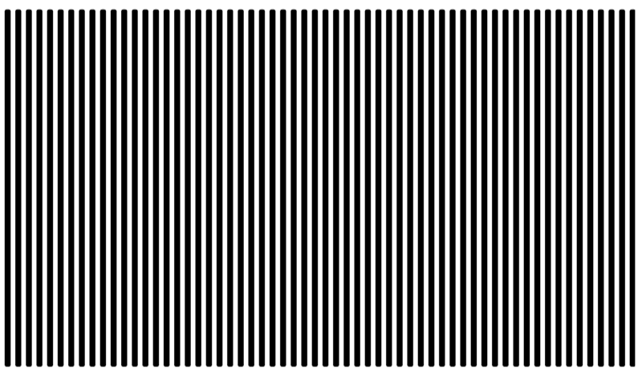
Barchart recommendations, Don’t make gaps equal to widths (1/2)
Alternate white and black lines showing a Moire effect
Notes:
If the space between the bars is equal to the width of the bars themselves, you get an unsettling vibratory effect. This is because your eye is constantly shifting perspective. Sometimes it perceives the black as the foreground and the white as the background. Sometimes it perceives the white as the foreground and the black as the background.
“I’m ten years old, my life’s half over. And I don’t even know if I’m black with white stripes or white with black stripes.” Marty the Zebra in the movie Madagascar.

Slide 106
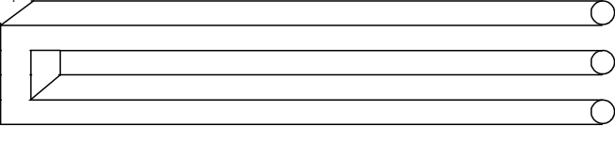
Barchart recommendations, Don’t make gaps equal to widths (2/2)
Optical illusion showing two bars becoming three

Slide 107
If the widths are the same and the bars are empty, then you can get a differnt problem. You might get confused as to what is the bar and what is the gap, as in this optical illusion.
As a general rule, the gap between bars should be about 10 to 20 percent of the width of the bars. Most visualization software has sensible defaults, but beware when you have a very large number of bars. There’s always a bit of rounding when you place pixels on a screen or on a page. Your software is trying to fill the available plotting area, so it may have to squeeze or stretch one gap or another. This unevenness can become noticeable when the gaps are only a few pixels wide.
((Show an example of this using the scotus data))

Slide 108
Barchart fundamentals, Thoughts on location
Axis labels often fit better on vertical location
Cannot vary both X and Y
Notes:
The default for most visualization software is vertical bars, but you should give thoughtful consideration to horizontal bars. The labels often fit better when the bars are horizontal. You also often have more room left to right than you do up and down in a graph, so the bars can stretch out more, allowing you to more easily discern small and subtle differences.
Remember the fault of default principle. Always try different ways of displaying your data. It costs nothing other than a few electrons to display a horizontal alternative to the typical vertical bar chart format, so why not indulge yourself?

Slide 109
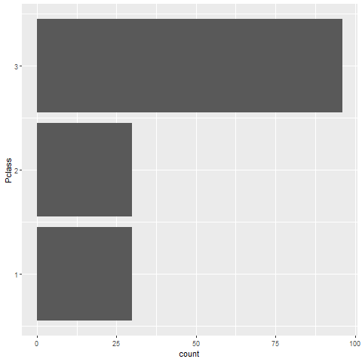
Barchart recommendations, Turn the chart sideways
Vertical bar chart
Notes:
Labels often fit better on a vertical bar chart.

