Slide 1
Colors, recommendations
Steve Simon

Slide 2
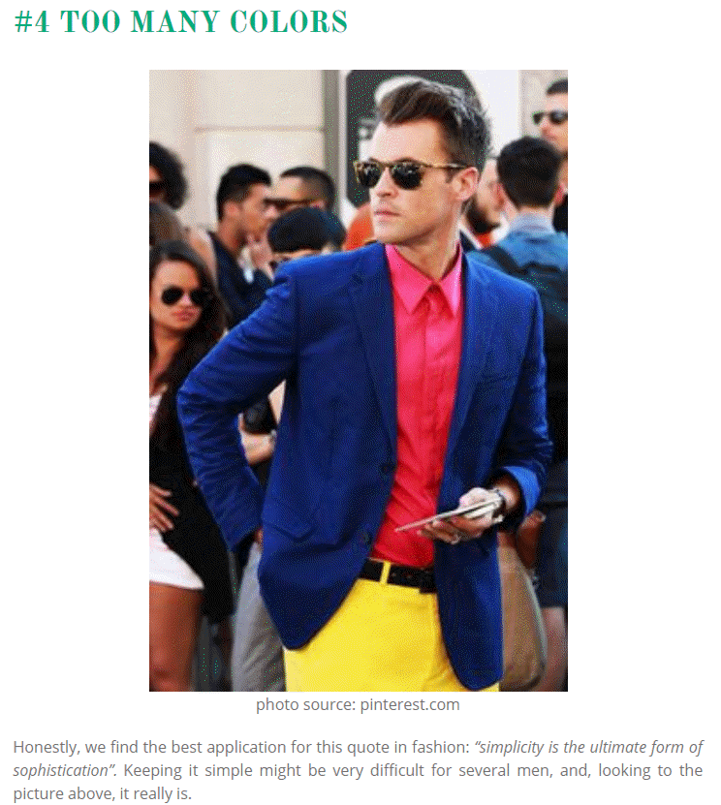
Color recommendations, lessons from the world of fashion
Image of man wearing three bold colors
Notes:
It’s a well known fasion mistake to wear too many colors at the same time. Maybe this guy could get away with it, but most of us would look like idiots if we tried to dress that way.
There’s a similar lesson for data visualization.

Slide 3
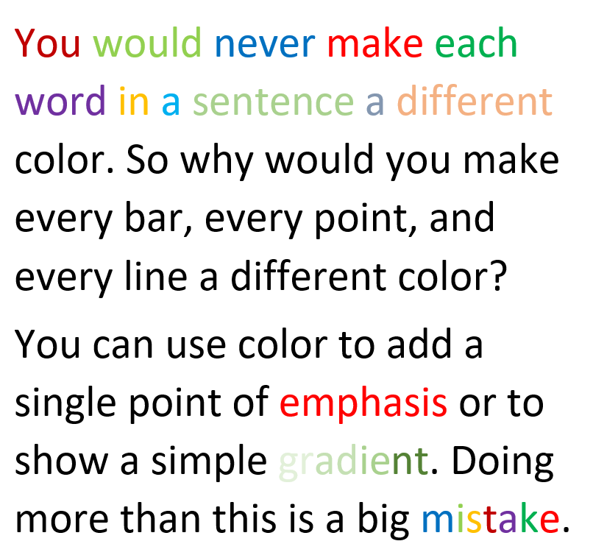
Barchart recommendations, Don’t overuse colors.
Text with a variety of colors
Notes:
Naomi Robbins, an expert on data visualization, made an interesting observation. You would never make each word in a sentence a different color. So why would you make every bar, every point, and every line a different color?
Too many colors dilutes the impact that color can have.
You can use a second color to add emphasis. Or maybe a gradient between two different colors could work. Doing more than this is usually a big mistake.

Slide 4
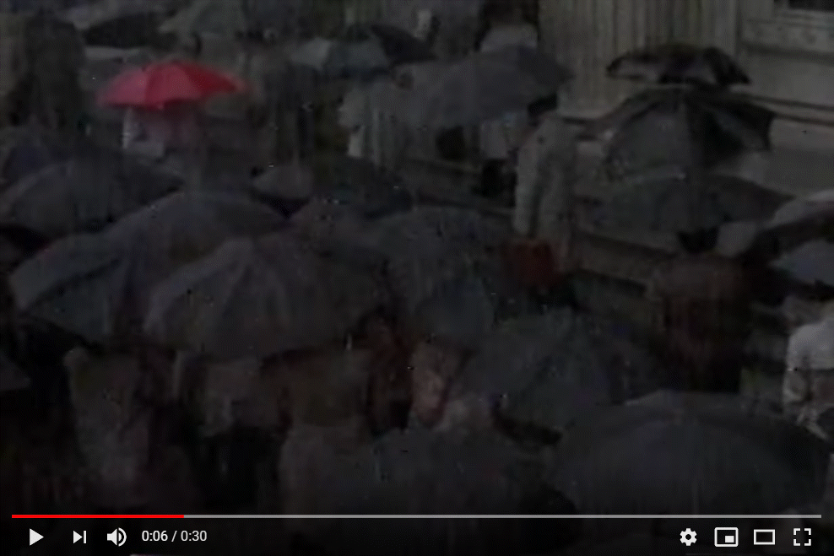
The power of a single color
Clip of a red umbrella in a sea of black umbrellas

Slide 5
Graphic designers have known for quite a while that a restrained use of colors can be very effective. Here is an image from a YouTube video clip,
The Travelers - Look under the Umberella commercial (1986). Retrieved 2019-09-07 from https://www.youtube.com/watch?v=3zQX66jd_c0.
The single red umbrella in a sea of black umbrellas stands out. Your eye can’t help but follow this umbrella as it travels across the screen from left to right. It’s a very powerful image.
A small dollop of color in your visualizations can be far more effective than using a whole bunch of different colors.

Slide 6
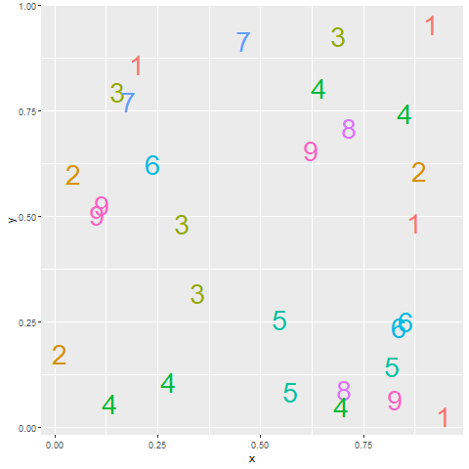
Count the fives
Notes:
Here’s an exercise that adapted from Olson and Bergen.
How many fives are there in this picture. I’ve used a different color for each number to make it easier for you to pick out any particular number. It takes a while, but you can see that there are three 5’s, clustered in the lower right corner of the graph.
Did the colors help? Well, not all that much. It is hard to pick out nine colors and not have a few of them look very similar. In particular, the 5’s and the 6’s are pretty close, as are the 8’s and the 9’s.

Slide 7
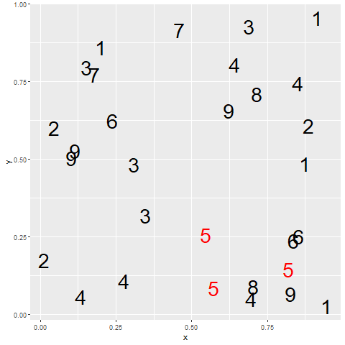
Count the fives
Notes:
When you use a bit of restraint and only show two colors, you make the process of identifying all the fives much easier. The red fives are like the red umbrella in the Traveller’s commercial.

Slide 8
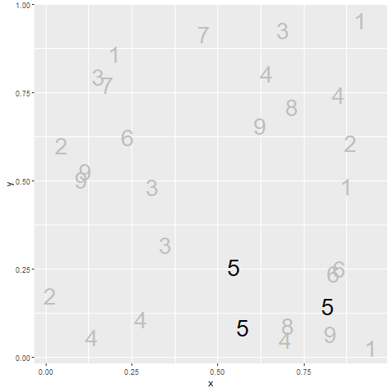
Count the fives
Notes:
The same trick works with black versus gray. By making some features of your graph gray, you help them to fade into the background, making what remains in black more prominent.
Now why would you want to make something fade into the background? Why not just eliminate it? Sometimes that makes sense, but often you want to see the overall range that the emphasized points lie in.

Slide 9
Problems with emphasis
Don’t always know what to emphasize
Solution: interactivity
Let the data speak for itself
But sometimes data speaks too subtly
Potential for deception
Bias potential in EVERY visualization choice
Notes:
Now, if you feel a bit of unease about this example, it is a feeling I share. I used bold colors for the 5’s. Red versus black or black versus gray. Doesn’t this hurt the feelings of the other numbers? I hear the 6 has a fragile ego.
Seriously, the effort to emphasize one group always results in the de-empahsis of other groups. You may feel uncomfortable with this because you don’t really know what group is worth emphasizing. Fair enough. If you don’t know, then there are interactive features like mouseover that allow the end user to change the emphasis on the fly to what they find intersting. Mouseover is a feature where the graph changes as you let the mouse hover over certain features of the graph. It is a very effective tool, but beyond the scope of this workshop.
There’s also a common refrain, “LEt the data speak for itself.” It sounds nice in theory, but in practice, data doesn’t speak very well. It has a soft voice. It mumbles. It’s message gets lost in the noise. You job as a data visualizer is to amplify the message. If you are afraid to do this, you are in the wrong job.
The other thing to keep in mind is that if you have the power to emphasize (or de-emphasize) certain features of the data, you have the power to deceive your reader. And this happens a lot. I won’t share any deceptive plots with you, but you can find them easily with a Google search.

Slide 10
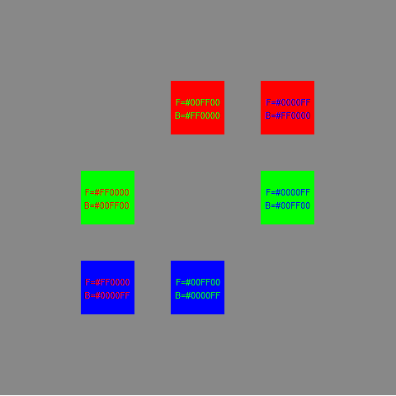
Colors, Contrasting pure colors often appear too intense

Slide 11
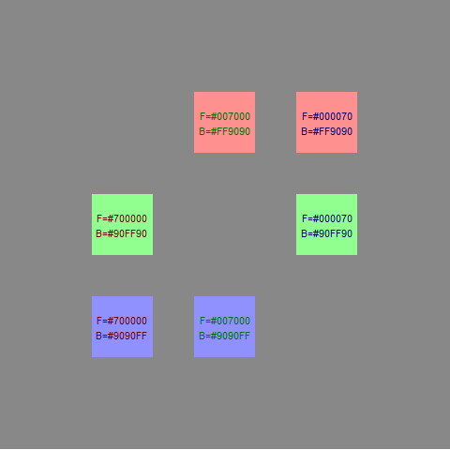
Colors, Lighter background, darker foreground

Slide 12
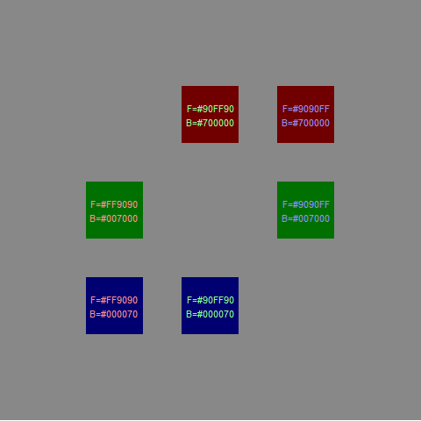
Colors, or the reverse

Slide 13
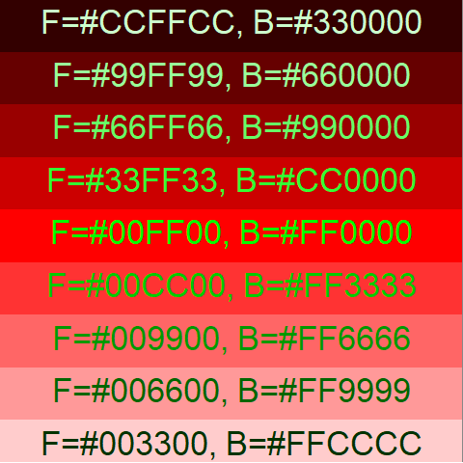
Colors, Contrasting pure colors often appear too intense

Slide 14
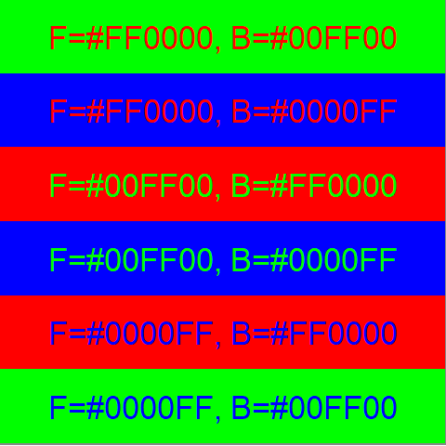
Colors, Contrasting pure colors often appear too intense

Slide 15
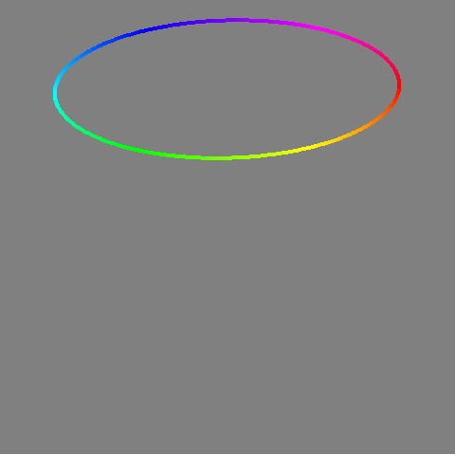
Colors, Pure color circle

Slide 16
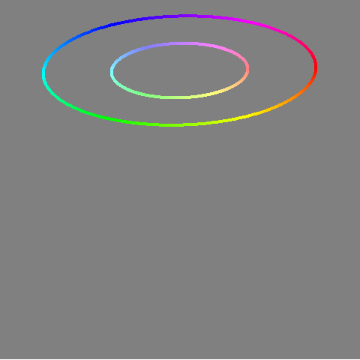
Colors, Lighter color circle

Slide 17
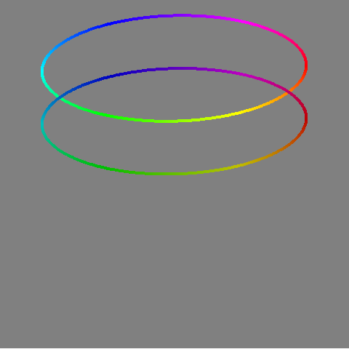
Colors, Darker color circle

Slide 18
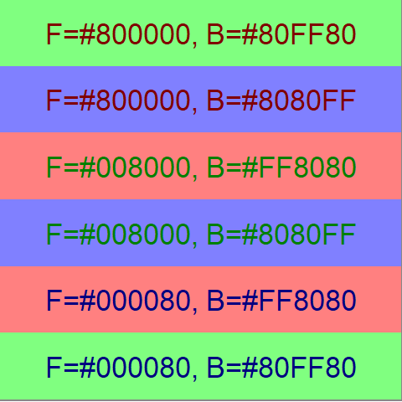
Colors, Contrasting pure colors often appear too intense

Slide 19
Avoid the rainbow gradient
(To be added)

Slide 20
When to use simple gradient
(To be added)

Slide 21
When to use divergent gradient
(To be added)

Slide 22
When to use circular gradient
(To be added)

Slide 23
Equal luminence
(To be added)

Slide 24
Avoid crosshatching
(To be added)

Slide 25
Varying hue and saturation
(To be added)

