Slide 1
Barchart fundamentals
Steve Simon

Slide 2
Barchart fundamentals, Bars
Fewer in numbers than points
Usually a summary statistic
Count
Percent
Average
Total
A bar chart is NOT a histogram
Notes:
Bar charts are different than point charts. There are usually only a few bars. These bars usually represent a summary statistic, like a count, percent, average, or total.
There is a technical distinction between a bar chart and a histogram. Histograms are a great diagnostic tool, but usually ends up on the cutting room floor. So I won’t be talking about it much, if at all, in this workshop.

Slide 3
Barchart fundamentals, Aesthetics for bars
Review
Location
Size
Color
NOT shape!!!
Notes:
Recall that aesthetics are visual attributes associated with a geometry/mark. You can map variables to the location, size, and/or color of bars, but you cannot assign a variable to the shape of a bar.

Slide 4
Barchart fundamentals, Notes about this talk
Do not include this slide in the final presentation
If I do a flipped classroom, here would be a good place to split with most of the material before this slide being in lectures to be viewed before the class. Then the classrom lecture would start from about here (after a very quick review) and focus on the “On your own” exercises.

Slide 5
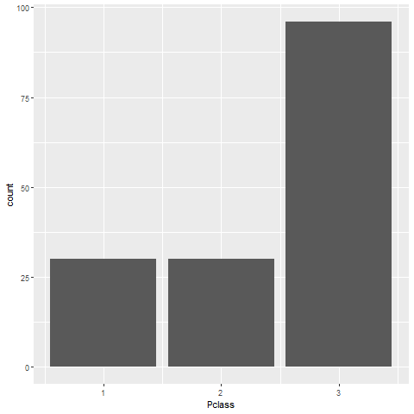
Barchart fundamentals, Location (1 of 2)
Horizontal bar chart

Slide 6
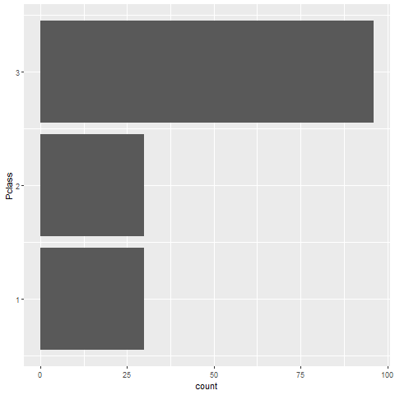
Barchart fundamentals, Location (2 of 2)
Vertical bar chart

Slide 7
Barchart fundamentals, On your own
Draw a horizontal and vertical bar chart showing the number of people in each gender (use the Sex variable).

Slide 8
Barchart fundamentals, Wait before showing
((Python code))
((R code))
((Tableau steps))

Slide 9
Barchart fundamentals, What your visualization might look like
((Show visualization))

Slide 10
Barchart fundamentals, Thoughts on location
Axis labels often fit better on vertical location
Cannot vary both X and Y
Notes:
The default for most visualization software is vertical bars, but you should give thoughtful consideration to horizontal bars. The labels often fit better when the bars are horizontal. You also often have more room left to right than you do up and down in a graph, so the bars can stretch out more, allowing you to more easily discern small and subtle differences.
Remember the fault of default principle. Always try different ways of displaying your data. It costs nothing other than a few electrons to display a horizontal alternative to the typical vertical bar chart format, so why not indulge yourself?

Slide 11
Barchart fundamentals, Size
Length varies, width doesn’t
Exception, mosaic plots
Think about gaps between bars

Slide 12
Barchart fundamentals, Color

Slide 13
Barchart fundamentals, On your own
Make the first class bar red to show Leonardo di Caprio’s perspective on the Titanic.

Slide 14
Barchart fundamentals, Wait before showing
((Python code))
((R code))
((Tableau steps))

Slide 15
Barchart fundamentals, What your visualization might look like
((Show visualization))

Slide 16
Barchart fundamentals, Color
Use for emphasis in simple bar charts
Very important for stacked or side-by-side bar charts
Notes:
For simple bar charts like all the ones we’ve seen so far, color is not really needed. You already can distinguish between the passenger classes using the location. If you do use color in a simple bar chart, it is often to emphasize a point. In the previous bar chart, I used red for third class, because Kate Winslet, a rich first class passenger, found true love in third class, with the adorable Leonardo di Caprio.
Color becomes very important in just a minute when we add another layer of complexity.

Slide 17
Barchart fundamentals, On your own
Revise this visualization so the first class bar is red.

Slide 18
Barchart fundamentals, Wait before showing
((Python code))
((R code))
((Tableau steps))

Slide 19
Barchart fundamentals, What your visualization might look like
((Show visualization))

Slide 20
Barchart fundamentals, Stack versus dodge
Summarize by two categories
Facet
Separate plots
Dodge
Side by side
Stack
One on top, one on bottom
Notes:
Bar charts that represent a summary across a single categorical variable are fairly simple and easy to handle. But when you want to summarize by two categories simultaneously, things get interesting. Interesting in a good way.

Slide 21
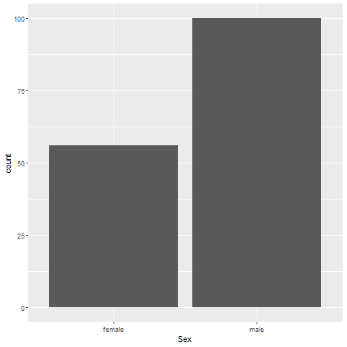
Barchart fundamentals, Titanic passenger count by gender
Bar chart

Slide 22
Barchart fundamentals, Titanic passenger count by passenger class
Bar chart

Slide 23
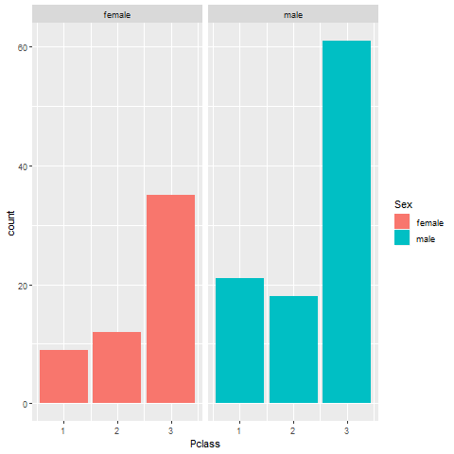
Barchart fundamentals, Titanic facet
Bar chart

Slide 24
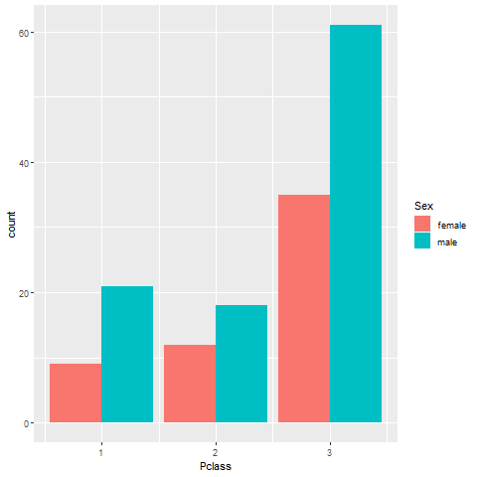
Barchart fundamentals, Titanic dodge
Bar chart

Slide 25
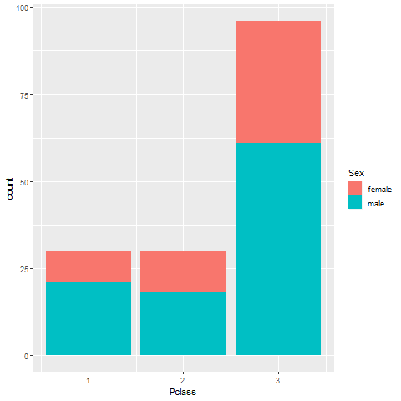
Barchart fundamentals, Titanic stack
Bar chart

Slide 26
Barchart fundamentals, On your own
Draw a bar chart showing counts involving both mortality and gender. Use a panel, then stacking, then dodging. Which do you like best?
Notes:
Mortality on the Titanic reflects the fact that this was an era when people really did believe in the concept of “women and children first.” Someone like me, I’d be shoving the little kids aside so I could get on one of the lifeboats.
Anyway, examine how mortality is related to gender. It’s a spoiler alert, but on the Titanic, Kate survives, but Leonardo, I am so sad to say this, didn’t make it.

Slide 27
Barchart fundamentals, Wait a bit before showing the code
Did you make the panel/stack/dodge Survived or did you make it Sex? Here’s some code, but yours might be different.
((Show Python code))
R code
fn <- initiate_image() titanic %>% ggplot(aes(x=Sex, fill=Survived)) + geom_bar() + facet_grid(cols=vars(Survived)) finalize_image()
((Show Tableau))

Slide 28
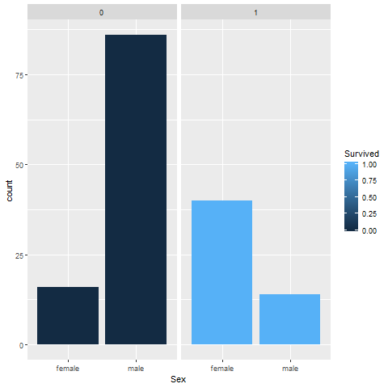
Barchart fundamentals, Panel, one approach
Bar chart

Slide 29
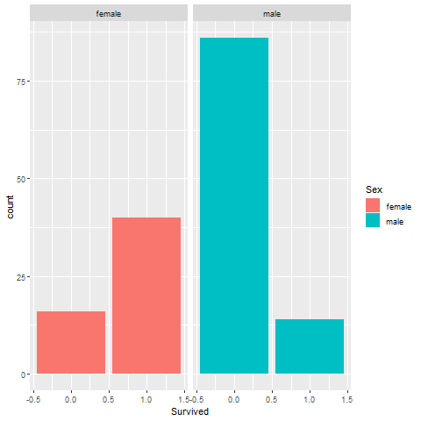
Barchart fundamentals, Panel, alternate approach
Bar chart

Slide 30
Barchart fundamentals, Stack, one approach

Slide 31
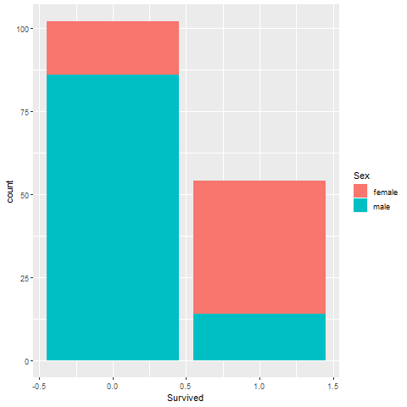
Barchart fundamentals, Stack, alternate approach
Bar chart

Slide 32
Barchart fundamentals, Dodge, one approach
Bar chart

Slide 33
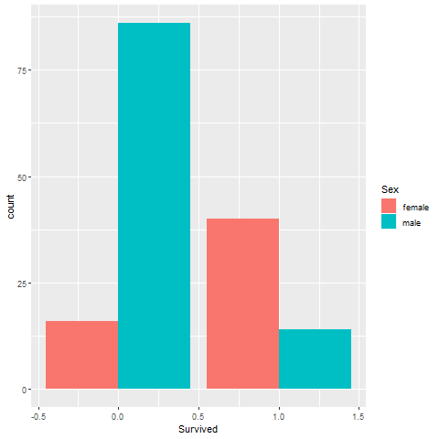
Barchart fundamentals, Dodge, alternate approach
Bar chart

Slide 34
Barchart fundamentals, Group exercise
Review the following visualization in your group
Summarize what aesthetics appear in the graph
What variables map to each aesthetic?
((Provide visualization. Maybe use the visualization from the earlier exercise?))

Slide 35
Barchart fundamentals, Summarizations
One number summary (mean or percentage)
Two number summary (error bars)
Five number summary (boxplots)
All the data
Jittering
Opacity
Notes:
((note to myself: maybe this goes better in the talk about lines.))

Slide 36
Barchart fundamentals, Switching from count to percent
((Show the code in Python, R, and Tableau. Explain why you might want counts versus percents.))

Slide 37
Barchart fundamentals, Example with means
((Need to find the right data set to illustrate this. Maybe the Saratoga house prices?))

Slide 38
Barchart fundamentals, Example with totals
((Same data. What means tell you versus totals.))

Slide 39
Barchart fundamentals, Boxplots example
((Include an explanation of what a boxplot is))

Slide 40
Barchart fundamentals, Jittering example
((Include an explanation on when it doesn’t work.))

Slide 41
Barchart fundamentals, Opacity example
((Note the computational expense.))

Slide 42
Barchart fundamentals, On your own
((Find a totally different data set and get the students to draw four different visualizations. Have them divide into groups that like the same visualization software and have each person do a different visualization.))

Slide 43
Barchart fundamentals, Summary
“A mapping of data to the visual aesthetics of geometries/marks”
Bars are a type of geometry/mark
Aesthetics for bars include location, size, color
Stack versus dodge
Basic tips
Place comparators close
Use axis ticks, light grid lines

Slide 44
Barchart fundamentals, On your own
((Find a totally different data set and get the students to draw four different visualizations. Have them divide into groups that like the same visualization software and have each person do a different visualization.))

