Slide 1
Data-viz-02, bar charts
Steve Simon

Slide 2
Lecture 02, initial preparation
Follow these steps to get ready for lecture #2 in data visualization.
Download and import Titanic data
Download and import scotus data

Slide 3
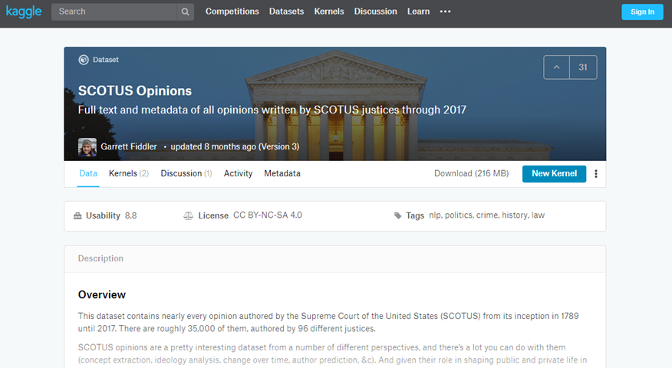
To prepare for this section
Kaggle datasets webpage

Slide 4
To prepare for this section
Download the scotus_cases.csv data set, or go to the original source, the Kaggle datasets repository.
Import the data and create a bar chart showing the frequency of opinions written by year_filed. Note that there are a few typos and a few rows that do not belong. You can remove these, but they will not affect any of the analyses we are considering.

Slide 5
Python code to get started
((Add later))

Slide 6
R code to get started
((Add later))

Slide 7
Tableau steps to get started
((Add later))

Slide 8
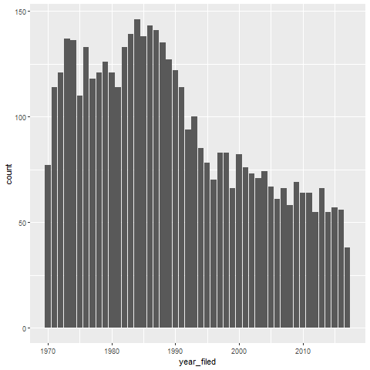
This is what your bar chart should look like
Bar chart

Slide 9
A tutorial on colors, introduction
Kindergarten view of colors
Review hexadecimal codes
RGB color system

Slide 10
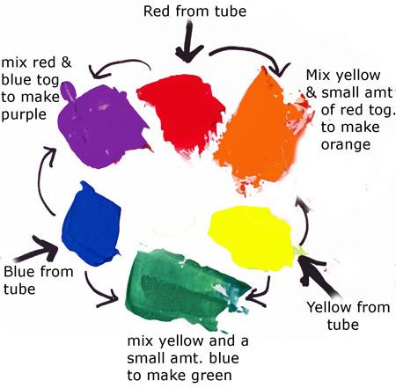
Everything I know about colors, I learned in Kindergarten.

Slide 11
Hexadecimal codes
“There are 10 types of programmers in the world, those who undestand binary and those who don’t.”
1001 1100 (base 2)
= $1*2^{7}+0*2^{6}+0*2^{5}+1*2^{4}+1*2^{3}+1*2^{2}+0*2^{1}+0*2^{0}$
= 128+16+8+4 = 156
Hexadecimal digits (base 16)
0-9, A=10, B=11, C=12, D=13, E=14, F=15
1001 1100 (base 2)
= 9C (base 16)
= $9*{16}^{1}+12*{16}^{0}$
Two hexadecimal digits represent the numbers 0-255.
00 (base 16) = 0, FF (base 16) = 255

Slide 12
Codes for colors
#rrggbb format
#000000 is pure black
#FFFFFF is pure white
#FF0000 is pure red
#00FF00 is pure green
#0000FF is pure blue
You can mix and match to get 16,777,216 colors
#800080 is purple, #FF69B4 is pink, #40e0d0 is turquoise

Slide 13
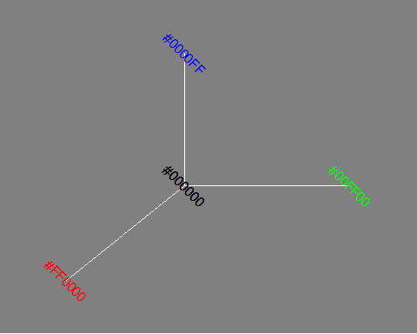
The color cube (1/2)

Slide 14
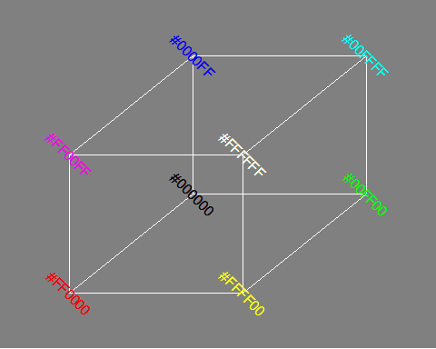
The color cube (2/2)

Slide 15
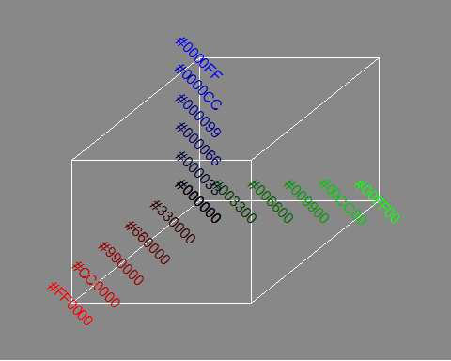
Gradients (1/4)

Slide 16
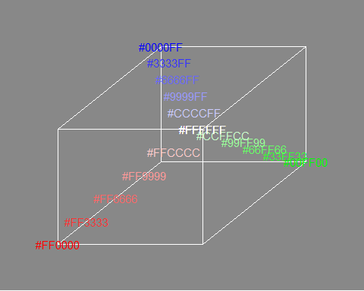
Gradients (2/4)

Slide 17
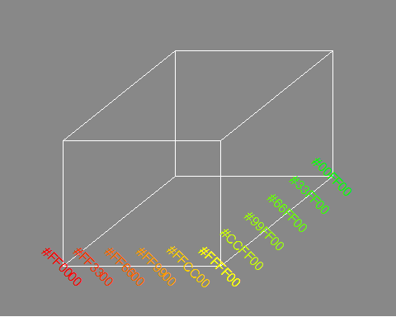
Gradients (3/4)

Slide 18
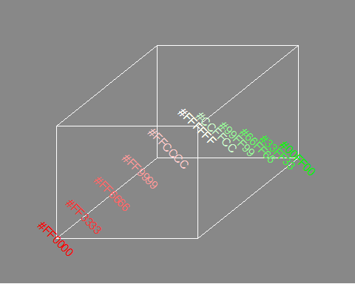
Gradients (4/4)

Slide 19
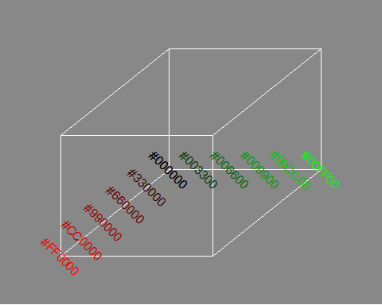
Gradients (5/5)

Slide 20
RGB combinations
Additive color mixing: adding red to green yields yellow; adding green to blue yields cyan; adding blue to red yields magenta; adding all three primary colors together yields white.

Slide 21
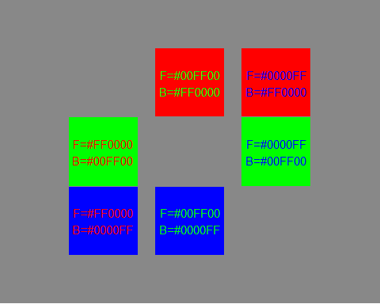
Contrasting pure colors often appear too intense

Slide 22
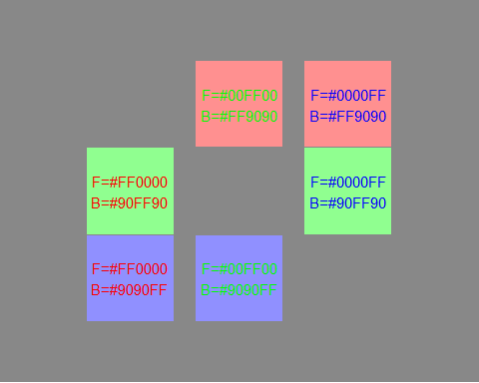
Lighten the background

Slide 23
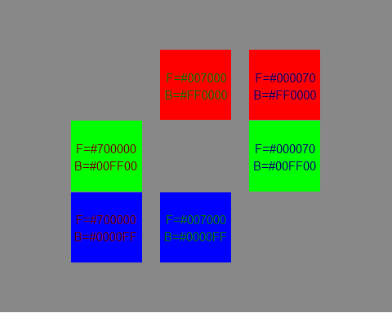
Darken the foreground

Slide 24
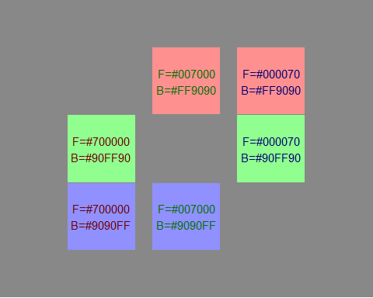
or both

Slide 25
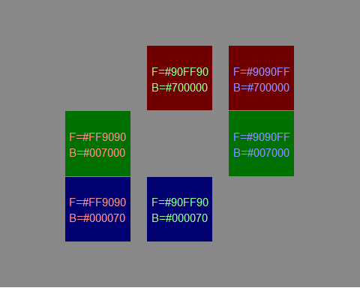
or the reverse

Slide 26
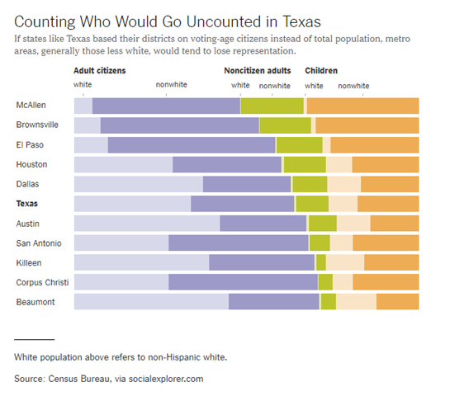
Group exercise (1 of 2)
Bar chart of demographics of selected Texas counties
Notes:
This is one of two graphs. It was published in
Badger, E. (2019). People Who Can’t Vote Still Count Politically in America. What if That Changes?. Retrieved June 24, 2019, from The New York Times website: https://www.nytimes.com/2019/06/22/upshot/america-who-deserves-representation.html
Split into pairs. Review the article briefly (about 5 minutes) and look at the graph. Explain to your partner what the graph is trying to show. Your partner will get a different graph and do the same thing with you listening this time.

Slide 27
Group exercise (2 of 2)
((Image is not yet available.))

Slide 28
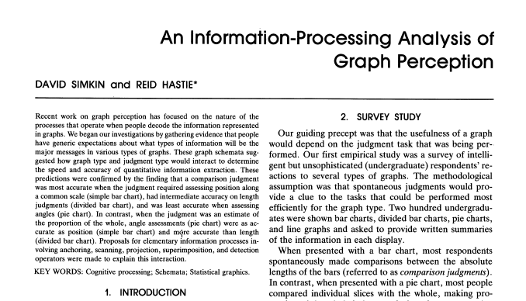
A framework for graph perception
Part of first page from Simkin and Hastie journal article
Notes:
Much of the work on the psychology of perception that I will be discussing next is drawn from this 1987 article by Simkin and Hastie.

Slide 29
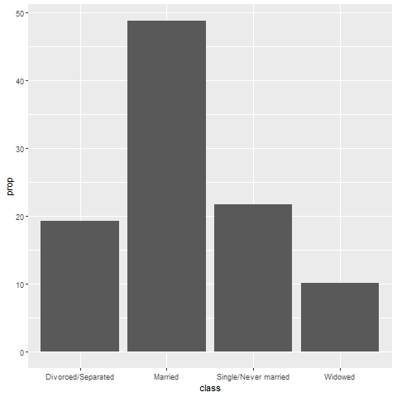
Which is better? A bar chart…
Bar chart

Slide 30
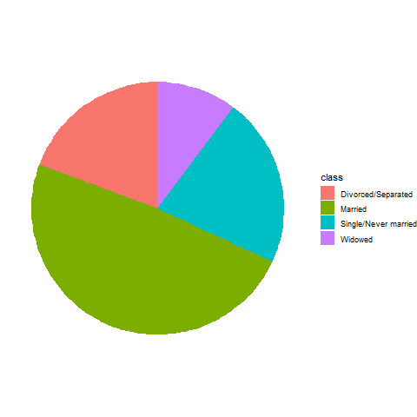
… or a pie chart
Pie chart

Slide 31
Answer. It depends.
What question are you trying to answer?
What proportion of the patients are single?
Are there more single or divorced patients?
Notes:
The answer really depends on what question you are asking. There are a variety of questions that you might ask. Two are illustrated above.
You can run an experiment (people have done this) where randomize and show half of them a bar chart and half of them a pie chart. Then you ask a question, like one of the questions above. Then you note the speed and accuracy of the response. Depending on the question, sometimes pie charts give faster and more accurate answers. Sometimes bar charts give faster and more accurate answers. It turns out that the results match up nicely with what we know about the psychology of perception.

Slide 32
Visual processing (1 of 3)
Projection
Shifting an object in a horizontal or vertical direction to make a comparison
Superimposition
Shifting in other directions (e.g., diagonal shifts, rotation) in order to make a comparison
Much harder than projection

Slide 33
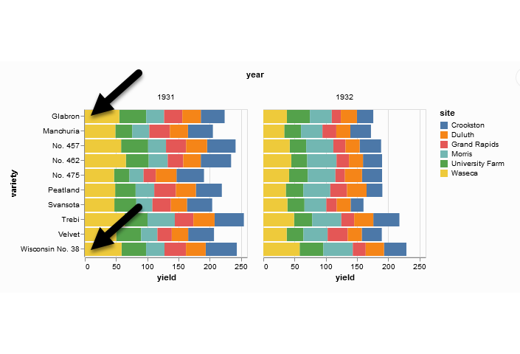
Projection (first yellow bar versus last yellow bar)
Stacked bar chart of crop yields
Notes:
The position means the vertical or horizontal location. Does the first yellow bar in 1931 (Glabron seeds planted in Wasica) extend further to the right than the last yellow bar (Wisconsin No. 38 seeds planted in Wasica)?

Slide 34
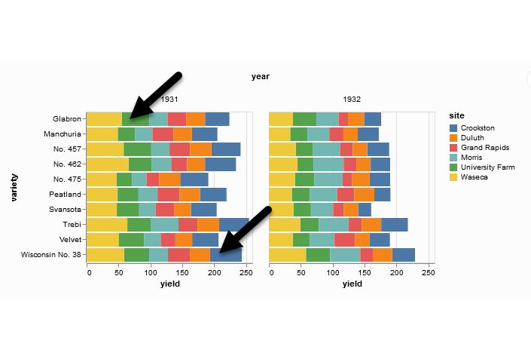
Superimposition (first green bar versus last blue bar)
Stacked bar chart of crop yields
Notes:
The length means either the width or the height. Does the first green bar in 1931 (Glabron seeds planted in University Farm) extend further to the right than the last yellow bar (Wisconsin No. 38 seeds planted in Crookston)?

Slide 35
Visual processing (2 of 3)
Scanning
Quantifying distance throug the use of a mental tape measure
Shorter distances are easier
Anchoring
Implicit or explicit development of reference points
Assists with scanning

Slide 36
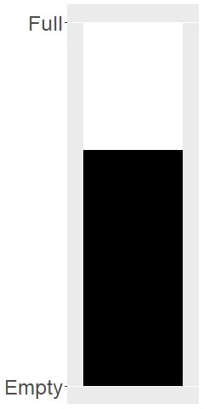
Scanning
Image of a fuel gauge, 65% full
Notes:
To understand scanning, think of a gas gauge. Usually it is a semicircular dial, but let’s set up the gas gauge as a rectangle. If the level is at the top, you have a full tank. If the level is at the bottom, you have an empty tank. This gauge shows a tank that is 65% full. Trust me, I drew the gauge. It is at 65%. Now how would you estimate the gas level?
You would take a mental tape measure, starting at the bottom and measure up to where the black box ends.
Now if you were smart, you’d start at the top and scan downwards. Less distance means that you can do this faster and more accurately.
Now if you were Albert Einstein, you’d split the gauge at the halfway point and measure from the halfway point to the top of the black box. Actually, there’s a little of Albert Einstein in all of us. That halfway point is something that all of us do subconciously. You did, because you recognized almost immediately that the tank was more than half full.

Slide 37
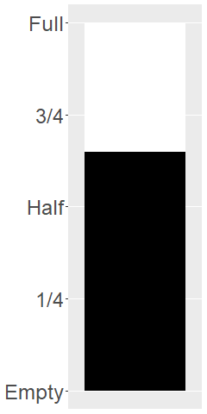
Assisting scanning with anchors
Image of a fuel gauge, anchors at 1/4, half, 3/4
Notes:
Here’s the same gas gauge, still at 65% full, but now we have added anchors at 1/4, half, and 3/4. You can read this gauge faster and more accurately, because you can scane from half up to 65% or from 3/4 down to 65%.

Slide 38
Visual processing (3 of 3)
Visually simple tasks
Position
Length
Angle/slope
Visually demanding tasks
Area
Volume
Density/Saturation/Hue
Notes:
There are a variety of perceptual tasks that you use when making comparisons within an image. These are arranged on this slide roughly in order of difficulty, with the easiest tasks at the top.

Slide 39
Position (first yellow bar versus last yellow bar)
Stacked bar chart of crop yields
Notes:
The comparison of the two yellow bars is a comparison of position. Which yellow bar extends further to the right?

Slide 40
Length (first green bar versus last blue bar)
Stacked bar chart of crop yields
Notes:
The comparison of the green and blue bars is a length comparison. The two bars start at different spots, so the position can’t help you.
Length is harder to judge than position, because it involves a superimposition rather than a projection.

Slide 41
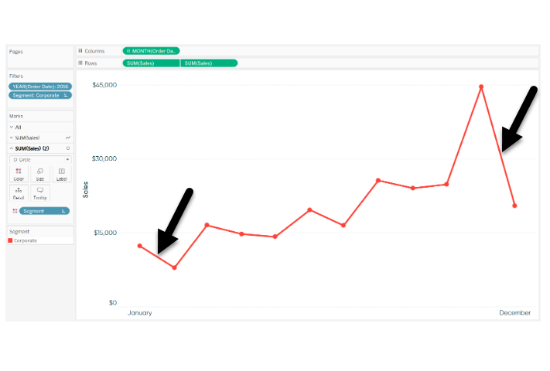
Angle/slope (first month decline versus last month decline)
Sales trend shown with a line graph
Notes:
This graph shows sales trends over a twelve month span. If you want to assess whether the first month decline (the dip in sales between January and February) was worse than the last month decline (the dip in sales between November and December), you would probably do this by judging the angle of the first line segment to the angle of the second line segment. This is not quite as easy as a position or length judgement, but it isn’t too bad either.

Slide 42
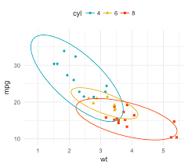
Area
Three ellipses

Slide 43
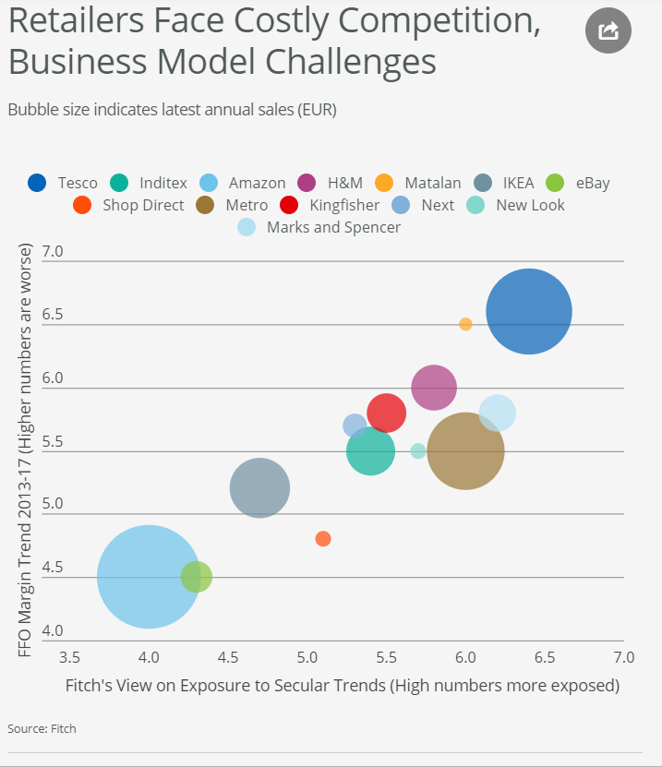
Area
Bubble plot
Notes:
This graph shows exposure and margin trends on the x and y axes. Larger values are worse on both axes. The size of the bubble is the size of the company (annual sales). There is some ambiguity here–is size measured in terms of diameter or in terms of area. Which is bigger, the brown circle (Metro) or the dark blue circle (Tesco)?

Slide 44
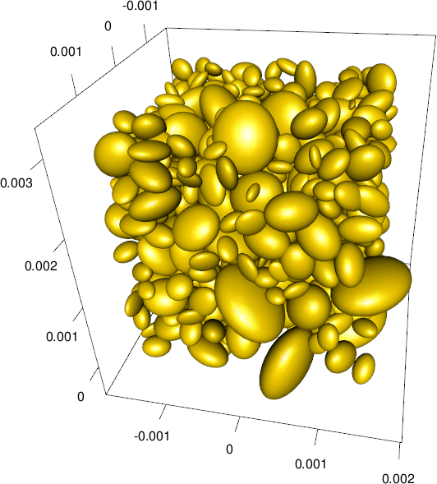
Volume
Ellipsoid plot

Slide 45
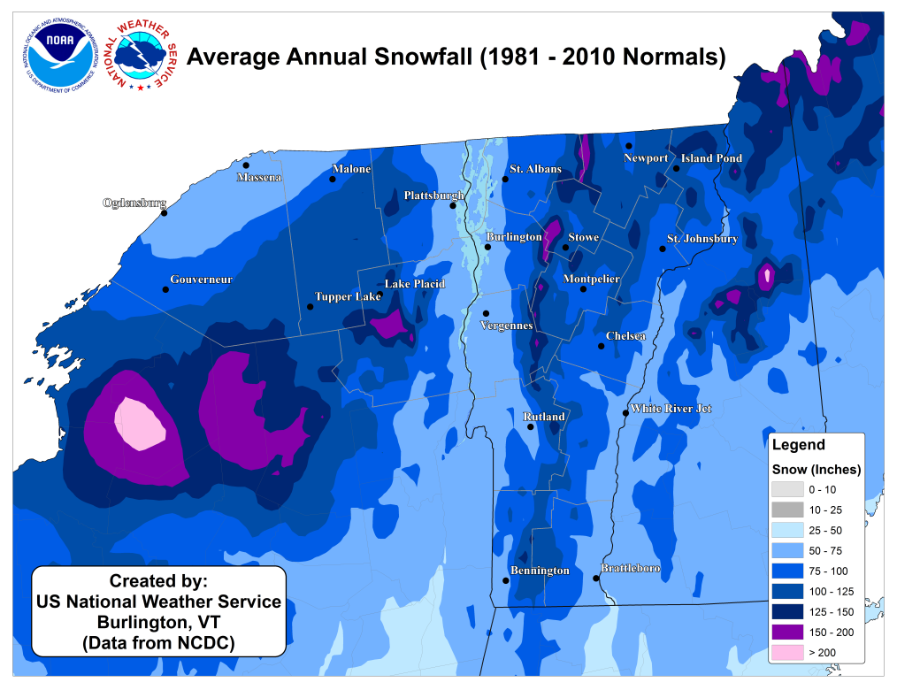
Color
Weather map of annual snowfall
Notes:
What city gets more snowfall, Remington, in the southwester corner of the state, or Newport, in the northeast corner of the state?

Slide 46
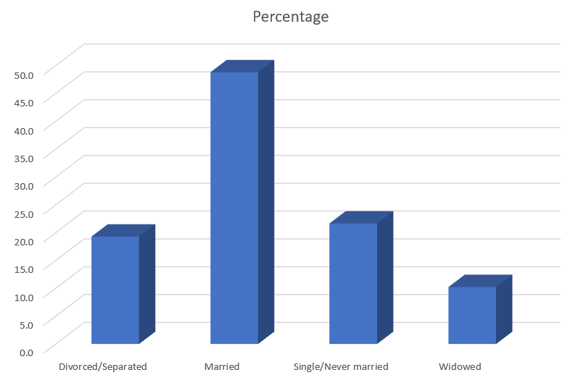
Adding depth (1/4)
THree dimensional bar chart
Notes:
Some sotware packages allow you to add some depth to your pie chart. This can catch your eye, at first, but almost all experts hate this approach. The most common complaint is that the three dimensional effects make a graph worse.
Worse means that it slows you down and it decreases the accuracy of your response. So here’s a question. What percentage of your sample is single/never married? THe three dimensional effects slow you down. So for this three dimensional bar chart, do you measure the height of the single/never married bar by projecting the front of the bar to the axis on the left or by projecting the back of the bar? Actually, you need to first project to the back “wall” because the bars are placed a small distance in front.

Slide 47

Adding depth (2/4)
Projection lines for a three dimensional bar chart
Notes:
Once you realize that you need to project to the back wall, you have to do this accurately. Notice that it is not a simple horizontal or vertical projection. Instead you have to do a couple of superimpositions, shifts at a 45 degree angle. You can do this, but it degrades your accuracy.

Slide 48
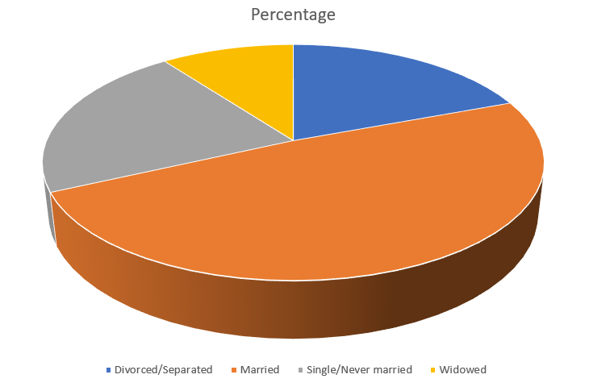
Adding depth (3/4)
Three dimensional pie chart

Slide 49
Adding depth (4/4)
Notes:
There are several issues with the three dimensional pie chart, and you can see this best when you split this pie chart into four equal pieces. Notice that the angles are no longer 90 degrees because the perspective view distorts the angles. So you lose the big advantage (and possibly the only advantage) of the pie chart, the ability to divide it easily into four pieces.
Also notice that the wedge in the foreground looks bigger than the wedge in the background, because you can see the side of the foreground wedge, but you can’t see the side of the background wedge.

Slide 50
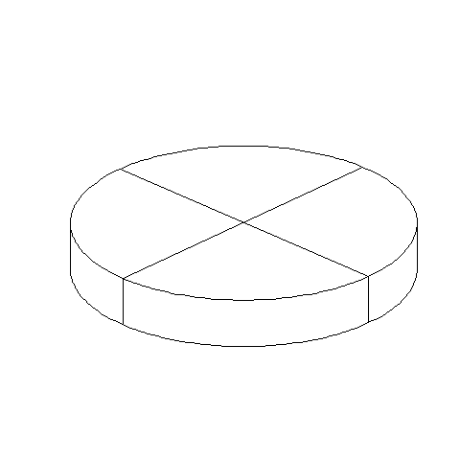
Three dimensional pie chart split into four equal pieces

Slide 51
Bars
Fewer in numbers than points
Usually a summary statistic
Count
Percent
Average
Total
A bar chart is NOT a histogram
Notes:
Bar charts are different than point charts. There are usually only a few bars. These bars usually represent a summary statistic, like a count, percent, average, or total.
There is a technical distinction between a bar chart and a histogram. Histograms are a great diagnostic tool, but usually ends up on the cutting room floor. So I won’t be talking about it much, if at all, in this workshop.

Slide 52
Aesthetics for bars
Review
Location
Size
Color
NOT shape!!!
Notes:
Recall that aesthetics are visual attributes associated with a geometry/mark. You can map variables to the location, size, and/or color of bars, but you cannot assign a variable to the shape of a bar.

Slide 53
Notes about this talk
Do not include this slide in the final presentation
If I do a flipped classroom, here would be a good place to split with most of the material before this slide being in lectures to be viewed before the class. Then the classrom lecture would start from about here (after a very quick review) and focus on the “On your own” exercises.

Slide 54
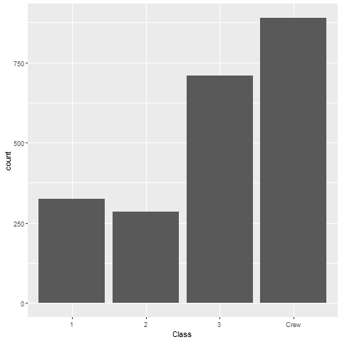
Location (1 of 2)
Horizontal bar chart

Slide 55
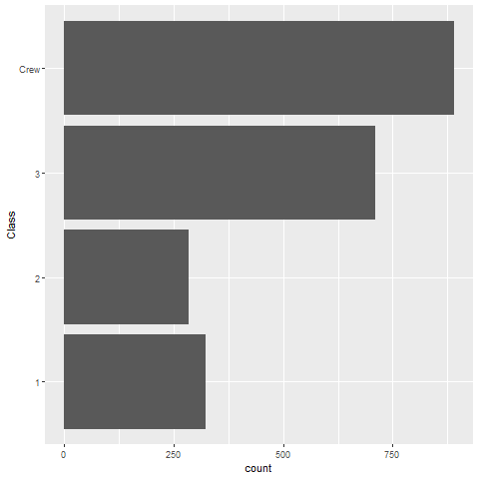
Location (2 of 2)
Vertical bar chart

Slide 56
On your own
Draw a horizontal and vertical bar chart showing the number of people in each gender (use the Sex variable).

Slide 57
Wait before showing
((Python code))
((R code))
((Tableau steps))

Slide 58
What your visualization might look like
((Show visualization))

Slide 59
Thoughts on location
Axis labels often fit better on vertical location
Cannot vary both X and Y
Notes:
The default for most visualization software is vertical bars, but you should give thoughtful consideration to horizontal bars. The labels often fit better when the bars are horizontal. You also often have more room left to right than you do up and down in a graph, so the bars can stretch out more, allowing you to more easily discern small and subtle differences.
Remember the fault of default principle. Always try different ways of displaying your data. It costs nothing other than a few electrons to display a horizontal alternative to the typical vertical bar chart format, so why not indulge yourself?

Slide 60
Size
Length varies, width doesn’t
Exception, mosaic plots
Think about gaps between bars

Slide 61
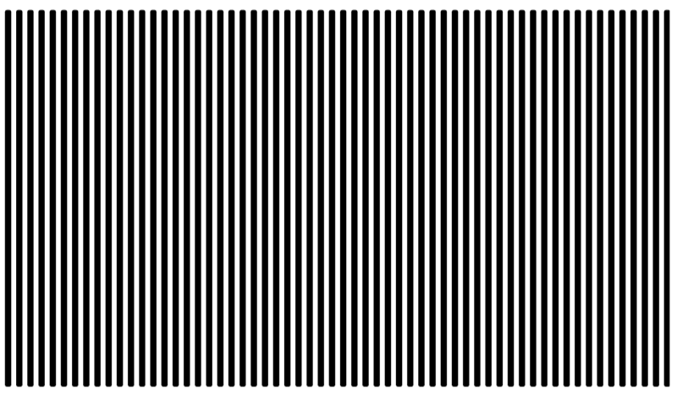
Don’t make gaps equal to widths
Alternate white and black lines showing a Moire effect
Notes:
If the space between the bars is equal to the width of the bars themselves, you get an unsettling vibratory effect. This is because your eye is constantly shifting perspective. Sometimes it perceives the black as the foreground and the white as the background. Sometimes it perceives the white as the foreground and the black as the background.
“I’m ten years old, my life’s half over. And I don’t even know if I’m black with white stripes or white with black stripes.” Marty the Zebra in the movie Madagascar.

Slide 62
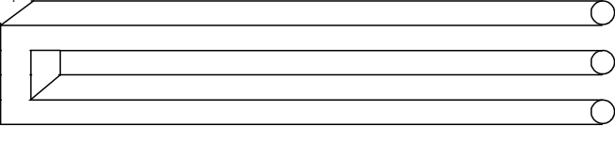
Optical illusion
Optical illusion showing two bars becoming three

Slide 63
If the widths are the same and the bars are empty, then you can get a differnt problem. You might get confused as to what is the bar and what is the gap, as in this optical illusion.
As a general rule, the gap between bars should be about 10 to 20 percent of the width of the bars. Most visualization software has sensible defaults, but beware when you have a very large number of bars. There’s always a bit of rounding when you place pixels on a screen or on a page. Your software is trying to fill the available plotting area, so it may have to squeeze or stretch one gap or another. This unevenness can become noticeable when the gaps are only a few pixels wide.
((Show an example of this using the scotus data))

Slide 64
Color

Slide 65
On your own
Make the first class bar red to show Leonardo di Caprio’s perspective on the Titanic.

Slide 66
Wait before showing
((Python code))
((R code))
((Tableau steps))

Slide 67
What your visualization might look like
((Show visualization))

Slide 68
Color
Use for emphasis in simple bar charts
Very important for stacked or side-by-side bar charts
Notes:
For simple bar charts like all the ones we’ve seen so far, color is not really needed. You already can distinguish between the passenger classes using the location. If you do use color in a simple bar chart, it is often to emphasize a point. In the previous bar chart, I used red for third class, because Kate Winslet, a rich first class passenger, found true love in third class, with the adorable Leonardo di Caprio.
Color becomes very important in just a minute when we add another layer of complexity.

Slide 69
On your own
Revise this visualization so the first class bar is red.

Slide 70
Wait before showing
((Python code))
((R code))
((Tableau steps))

Slide 71
What your visualization might look like
((Show visualization))

Slide 72
Stack versus dodge
Summarize by two categories
Facet
Separate plots
Dodge
Side by side
Stack
One on top, one on bottom
Notes:
Bar charts that represent a summary across a single categorical variable are fairly simple and easy to handle. But when you want to summarize by two categories simultaneously, things get interesting. Interesting in a good way.

Slide 73
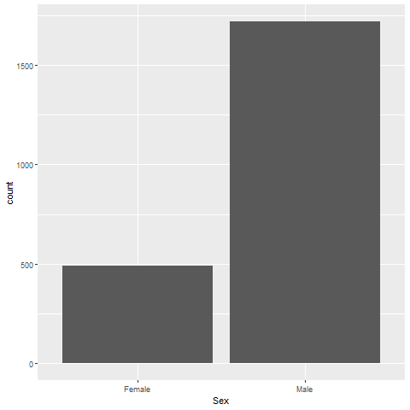
Titanic passenger count by gender
Bar chart

Slide 74
Titanic passenger count by passenger class
Bar chart

Slide 75
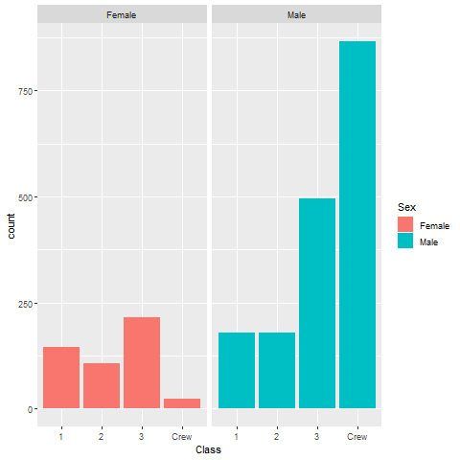
Titanic facet
Bar chart

Slide 76
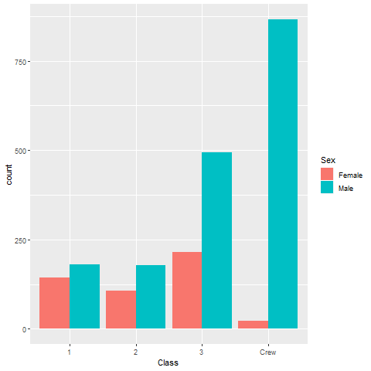
Titanic dodge
Bar chart

Slide 77
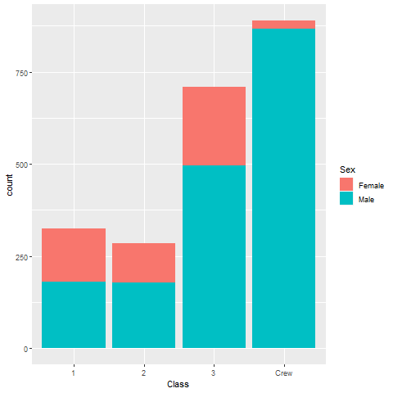
Titanic stack
Bar chart

Slide 78
On your own
Draw a bar chart showing counts involving both mortality and gender. Use a panel, then stacking, then dodging. Which do you like best?
Notes:
Mortality on the Titanic reflects the fact that this was an era when people really did believe in the concept of “women and children first.” Someone like me, I’d be shoving the little kids aside so I could get on one of the lifeboats.
Anyway, examine how mortality is related to gender. It’s a spoiler alert, but on the Titanic, Kate survives, but Leonardo, I am so sad to say this, didn’t make it.

Slide 79
Wait a bit before showing the code
Did you make the panel/stack/dodge Survived or did you make it Sex? Here’s some code, but yours might be different.
((Show Python code))
R code
fn <- initiate_image() titanic %>% ggplot(aes(x=Sex, fill=Survived)) + geom_bar() + facet_grid(cols=vars(Survived)) finalize_image()
((Show Tableau))

Slide 80
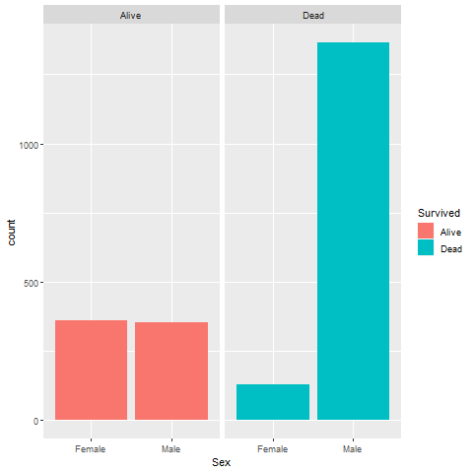
Panel, one approach
Bar chart

Slide 81
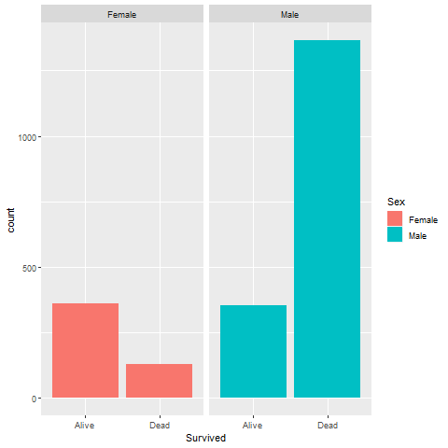
Panel, alternate approach
Bar chart

Slide 82
Stack, one approach

Slide 83
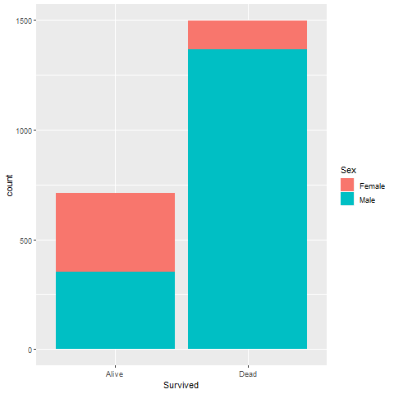
Stack, alternate approach
Bar chart

Slide 84
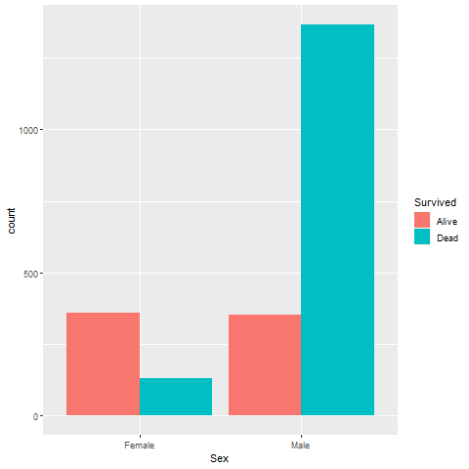
Dodge, one approach
Bar chart

Slide 85
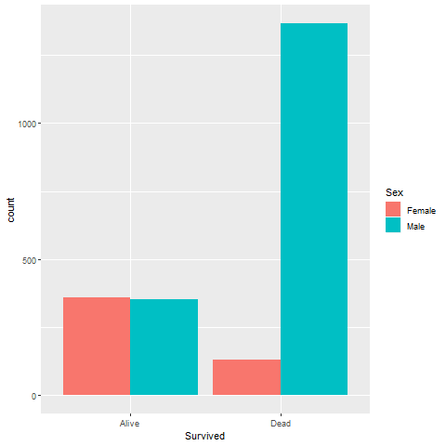
Dodge, alternate approach
Bar chart

Slide 86
Group exercise
Review the following visualization in your group
Summarize what aesthetics appear in the graph
What variables map to each aesthetic?
((Provide visualization. Maybe use the visualization from the earlier exercise?))

Slide 87
Summarizations
One number summary (mean or percentage)
Two number summary (error bars)
Five number summary (boxplots)
All the data
Jittering
Opacity
Notes:
((note to myself: maybe this goes better in the talk about lines.))

Slide 88
Switching from count to percent
((Show the code in Python, R, and Tableau. Explain why you might want counts versus percents.))

Slide 89
Example with means
((Need to find the right data set to illustrate this. Maybe the Saratoga house prices?))

Slide 90
Example with totals
((Same data. What means tell you versus totals.))

Slide 91
Boxplots example
((Include an explanation of what a boxplot is))

Slide 92
Jittering example
((Include an explanation on when it doesn’t work.))

Slide 93
Opacity example
((Note the computational expense.))

Slide 94
On your own
((Find a totally different data set and get the students to draw four different visualizations. Have them divide into groups that like the same visualization software and have each person do a different visualization.))

Slide 95
Summary
“A mapping of data to the visual aesthetics of geometries/marks”
Bars are a type of geometry/mark
Aesthetics for bars include location, size, color
Stack versus dodge
Basic tips
Place comparators close
Use axis ticks, light grid lines

Slide 96
On your own
((Find a totally different data set and get the students to draw four different visualizations. Have them divide into groups that like the same visualization software and have each person do a different visualization.))

