Slide 1
Recommendations, Gestalt principles
Steve Simon

Slide 2
Experiment with gestalt principles
Some features are stronger than others
Different groupings lead to different messages
Limitations of high frequency data

Slide 3
Gestalt recommendations, Fictional data set
Ficitonal data on three individuals
## id name exam score ## 1 1 Able 1 80 ## 2 1 Able 2 50 ## 3 1 Able 3 20 ## 4 1 Able 4 22 ## 5 2 Baker 1 90 ## 6 2 Baker 2 70 ## 7 2 Baker 3 30 ## 8 2 Baker 4 28 ## 9 3 Charlie 1 20 ## 10 3 Charlie 2 30 ## 11 3 Charlie 3 70 ## 12 3 Charlie 4 73
Notes:
These ideas drawn from the Bergen and Iverson workshop. The data is purely fictional, but it is a great example of how you can emphasize different features of your data in a visualization.

Slide 4
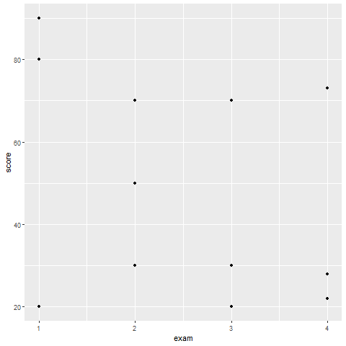
Gestalt recommendations, How do you establish groupings
Notes:
Here are the data points without any indication of which values belong to which individuals. How can you best show the individual values?

Slide 5
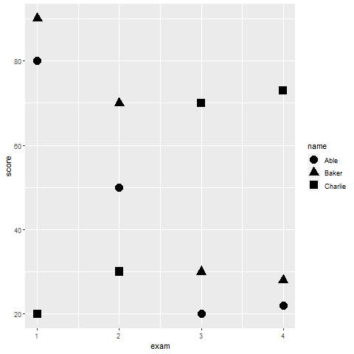
Gestalt recommendations, Using shape to establish groupings
Notes:
You are relying on the principle of similarity, and there needs to be sufficient dissimilarity in the different symbols to make this work. A closed circle, a closed square, and a closed triangle all loop pretty much alike. How can you get more contrast?

Slide 6
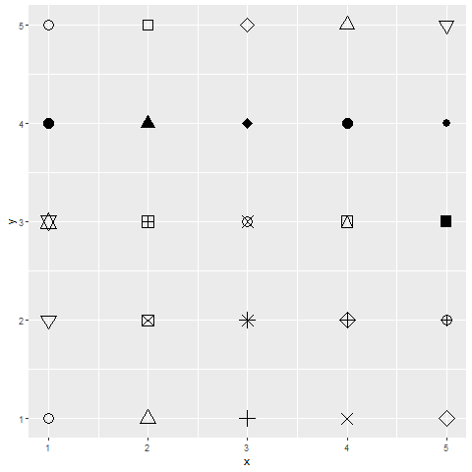
Gestalt recommendations, shape choices in R

Slide 7
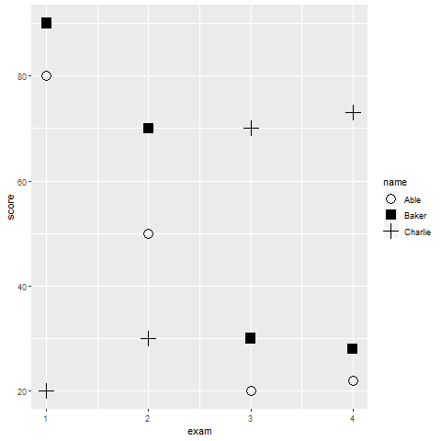
Gestalt recommendations, Better contrasting shapes
Notes:
You are relying on the principle of similarity, and there needs to be sufficient dissimilarity in the different symbols to make this work. A closed circle, a closed square, and a closed triangle all loop pretty much alike. How can you get more contrast?

Slide 8
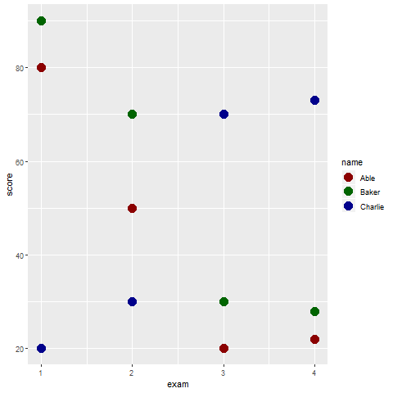
Gestalt recommendations, Color
Notes:
You are relying on the principle of similarity, and there needs to be sufficient dissimilarity in the different symbols to make this work. A closed circle, a closed square, and a closed triangle all loop pretty much alike. How can you get more contrast?

Slide 9
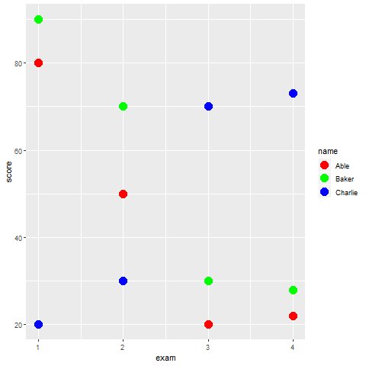
Gestalt recommendations, Color
Notes:
You are relying on the principle of similarity, and there needs to be sufficient dissimilarity in the different symbols to make this work. A closed circle, a closed square, and a closed triangle all loop pretty much alike. How can you get more contrast?

Slide 10
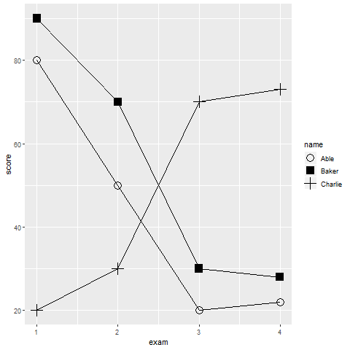
Gestalt recommendations, Connectedness
Notes:
Connectedness provides a much stronger sense of gestalt than similarity.

Slide 11
Gestalt, Text versus legend
Legends
Violates the rule of proximity
Use color cues, if possible
Replace with text labels on the graph
Use letter codes

Slide 12
Gestalt, Color cues
(Use color in legend names)

Slide 13
Gestalt, Letter codes
(Show text symbols A, B, and C)

Slide 14
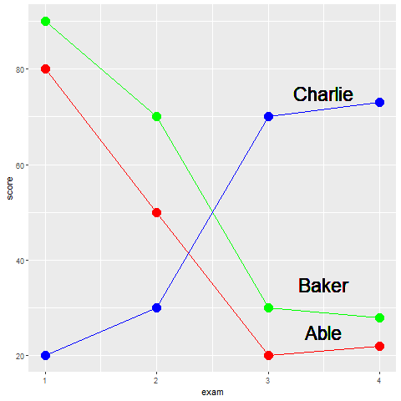
Gestalt, text labels
Notes:
By putting the labels directly on the graph, you minimize the distance that your eye has to travel. No more back and forth between the legend and the graph.
You can improve further on these labels. You might have had a moment of hesitation when you saw the label for Abel. Does it belong with the line just above or the line just below. It only slows you down for a second, because by process of elimination, you can quickly decide that it belongs with the line just below it.
But you can improve the sense of belongingness by using some of your Gestalt principles.

Slide 15
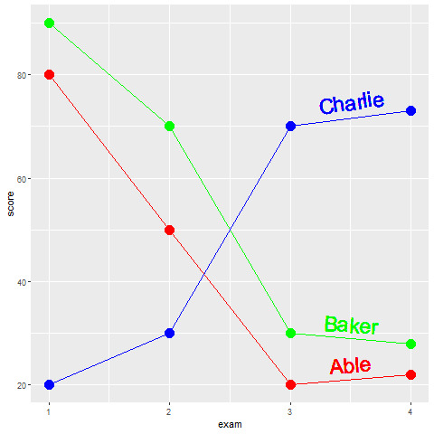
Gestalt, text labels
Notes:
Notice how the labels in this example have been moved closer to the lines. The exploits the Gestalt principle of proximity. Notice how the names have the same colors as the lines. Thie exploits the Gestalt principle of similarity. It would be very hard to incorrectly assign the red label of Abel with the green line of Baker. Notice further that the labels have a slope that roughly matches the lines they are attached to. This exploits the Gestalt principle of common fate.

Slide 16
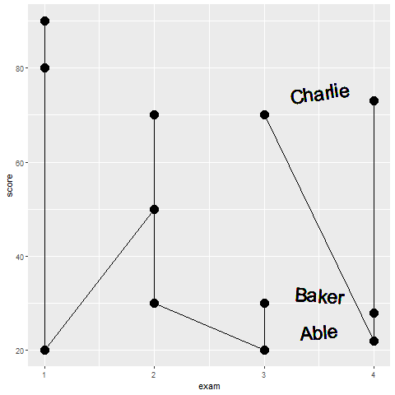
What patterns do you see in this graph?
Notes:
There are at least two messages hiding in this graph. What are they?

