Slide 1
Data-viz-03, Recommendations
Steve Simon

Slide 2
Aesthetics for lines
Location
Size
Shape (not what you think it is!)
Color
Notes:
A line could mean a straight line or a curved line, a single line segment, a connected series of line segments or a polygon. It’s a pretty complex thing, but generally a line represents a two dimensional relationship.
You can vary the size, shape, and color of a line. Shape is not what you think it is.

Slide 3
Show different types and locations of lines
((Show a curved line, a straight line, a line segment, a series of line segments, and a polygon.))

Slide 4
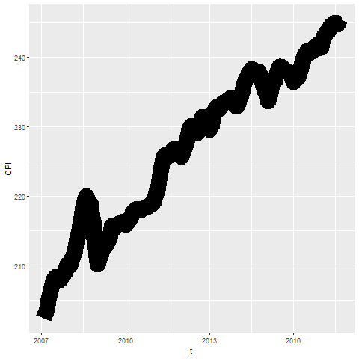
Size

Slide 5
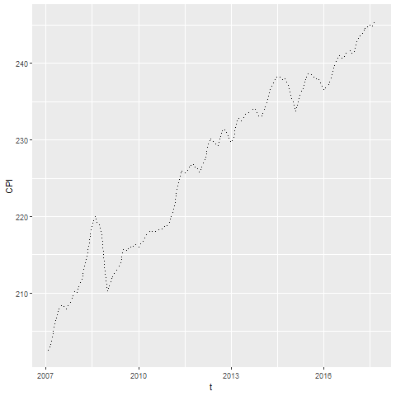
Shape

Slide 6
On your own
change the line to a dashed line.
Make the width equal to 3
Make the color green

Slide 7
Wait before showing
((Python code))
# R code ggplot(cpi, aes(x=t, y=CPI)) + geom_line(size=3, linetype="dashed", color="green")
((Tableau steps))

Slide 8
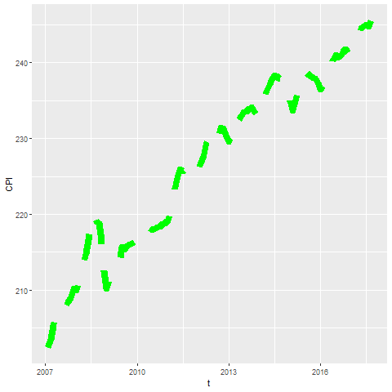
What your visualization might look like

Slide 9
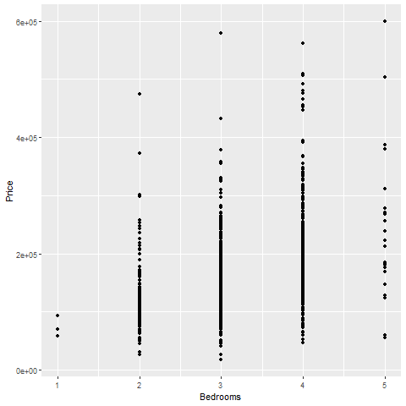
Lines as summary statistics

Slide 10
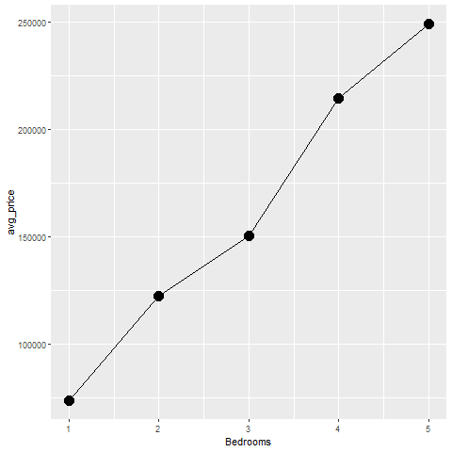
Lines as averages

Slide 11
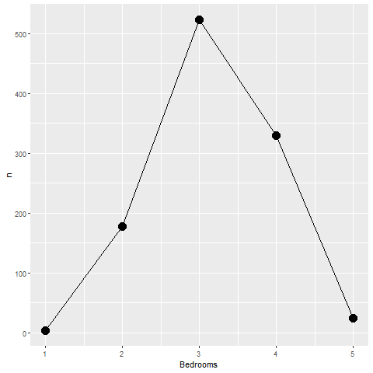
Lines as counts

Slide 12
On your own
Draw a line graph showing the relationship between the number of bathrooms and price.

Slide 13
Wait before showing
((Add code here))

Slide 14
What your visualization might look like
((Add visualization here))

Slide 15
Boxplots
((Draw example and ask students to do a similar example))

Slide 16
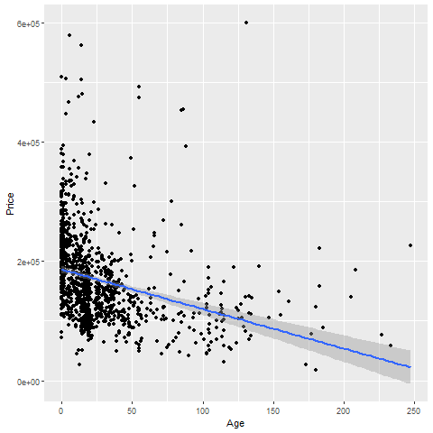
Trend lines (linear)

Slide 17
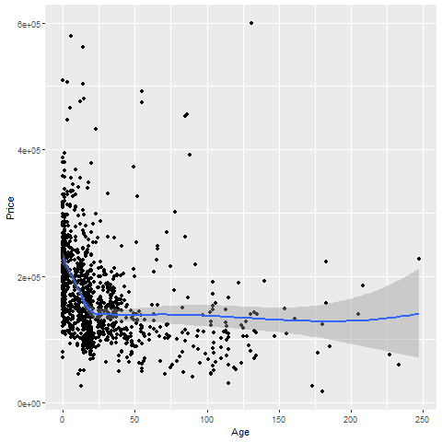
Trend lines (spline)

Slide 18
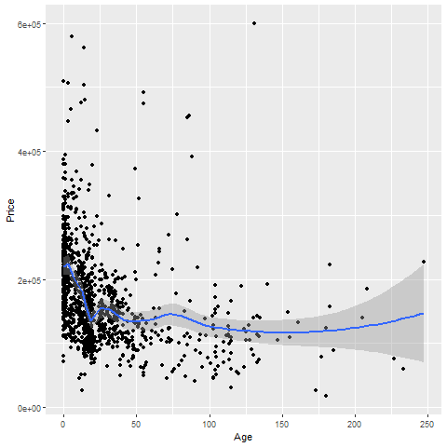
Trend lines (spline), not so smooth

Slide 19
On your own
Fit a linear trend line looking at Living.Area versus Price.
Fit a smooth curve

Slide 20
Wait before showing

Slide 21
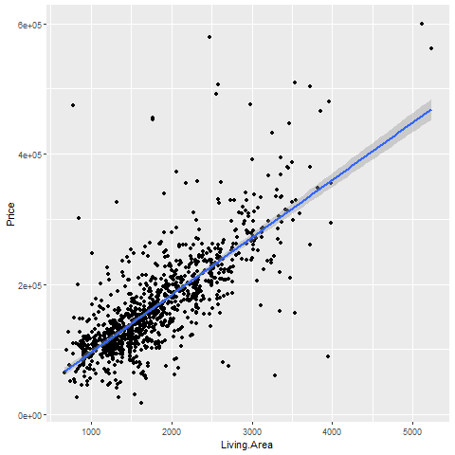
What your visualization might look like

Slide 22
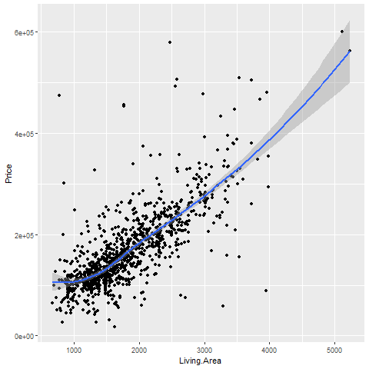
What your visualization might look like

Slide 23
Trend lines (logistic)
((Need a different data set here. Titanic???))

Slide 24
Helpful tips
((Add three or four slides here. Maybe talk about opacity.))

Slide 25
Group exercise
Review the following visualization in your group.
Summarize what aesthetics (location, size, shape, color) appear in the graph
What variables map to each aesthetic?
((Find new images or use the ones from earlier))

Slide 26
Summary (1 of 2)
Gestalt principles
((List here))
Aesthetics for lines
Size, Shape, Color
Lines as summary statistics
One number summary (mean, total, count, percent)
Two number summary (error bars)
Five number summary (boxplots)

Slide 27
Summary (2 of 2)
Trend lines (linear, logistic, spline)
Helpful tips
((List here))

