Slide 1
Data visualization - 02 - bars
Steve Simon

Slide 2
Notes about this talk
This slide should not to be included in the final presentation
01-points MUST come before
03-lines could come before or after

Slide 3
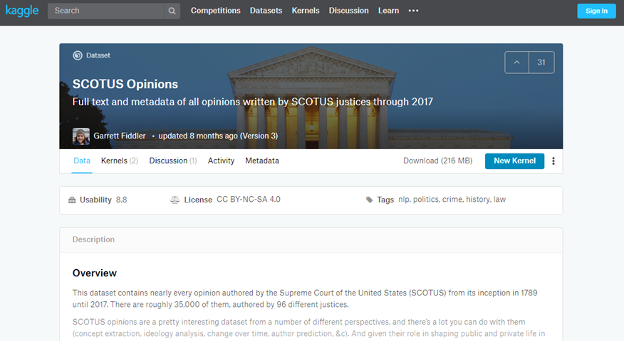
To prepare for this section
Kaggle datasets webpage

Slide 4
To prepare for this section
Download the scotus_cases.csv data set, or go to the original source, the Kaggle datasets repository.
Import the data and create a bar chart showing the frequency of opinions written by year_filed. Note that there are a few typos and a few rows that do not belong. You can remove these, but they will not affect any of the analyses we are considering.
## `curl` package not installed, falling back to using `url()`

Slide 5
Python code to get started
((Add later))

Slide 6
R code to get started
((Add later))

Slide 7
Tableau steps to get started
((Add later))

Slide 8
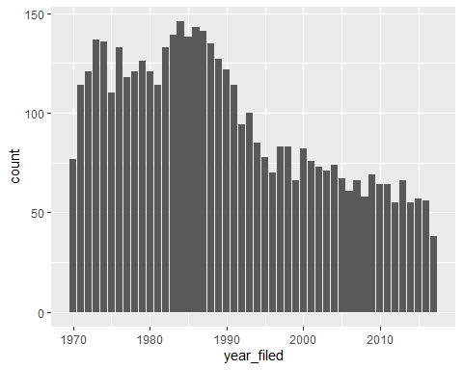
This is what your bar chart should look like

Slide 9
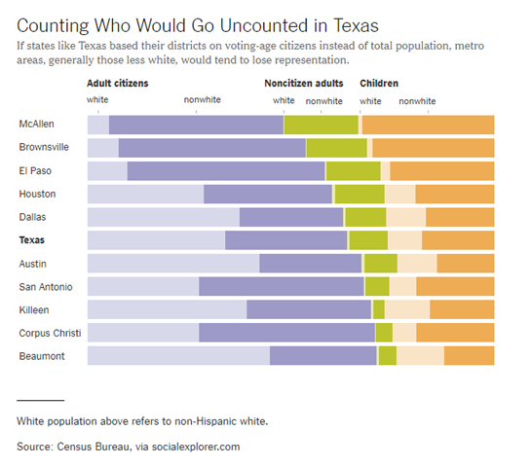
Group exercise (1 of 2)
Bar chart of demographics of selected Texas counties
Notes:
This is one of two graphs. It was published in
Badger, E. (2019). People Who Can’t Vote Still Count Politically in America. What if That Changes?. Retrieved June 24, 2019, from The New York Times website: https://www.nytimes.com/2019/06/22/upshot/america-who-deserves-representation.html
Split into pairs. Review the article briefly (about 5 minutes) and look at the graph. Explain to your partner what the graph is trying to show. Your partner will get a different graph and do the same thing with you listening this time.

Slide 10
Group exercise (2 of 2)
((Image is not yet available.))

Slide 11
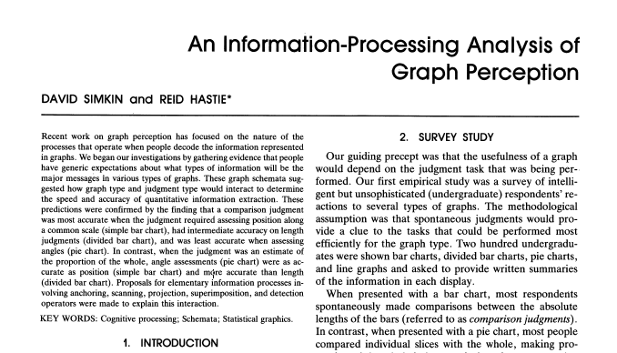
A framework for graph perception
Part of first page from Simkin and Hastie journal article
Notes:
Much of the work on the psychology of perception that I will be discussing next is drawn from this 1987 article by Simkin and Hastie.

Slide 12
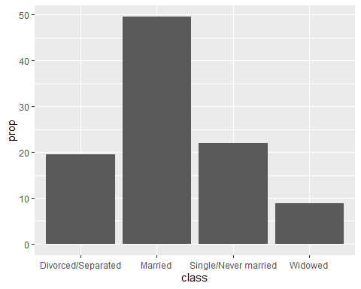
Which is better? A bar chart…

Slide 13
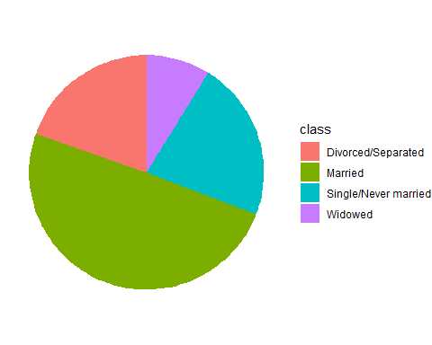
… or a pie chart

Slide 14
Answer. It depends.
What question are you trying to answer?
What proportion of the patients are single?
Are there more single or divorced patients?
Notes:
The answer really depends on what question you are asking. There are a variety of questions that you might ask. Two are illustrated above.
You can run an experiment (people have done this) where randomize and show half of them a bar chart and half of them a pie chart. Then you ask a question, like one of the questions above. Then you note the speed and accuracy of the response. Depending on the question, sometimes pie charts give faster and more accurate answers. Sometimes bar charts give faster and more accurate answers. It turns out that the results match up nicely with what we know about the psychology of perception.

Slide 15
Visual processing (1 of 3)
Projection
Shifting an object in a horizontal or vertical direction to make a comparison
Superimposition
Shifting in other directions (e.g., diagonal shifts, rotation) in order to make a comparison
Much harder than projection

Slide 16
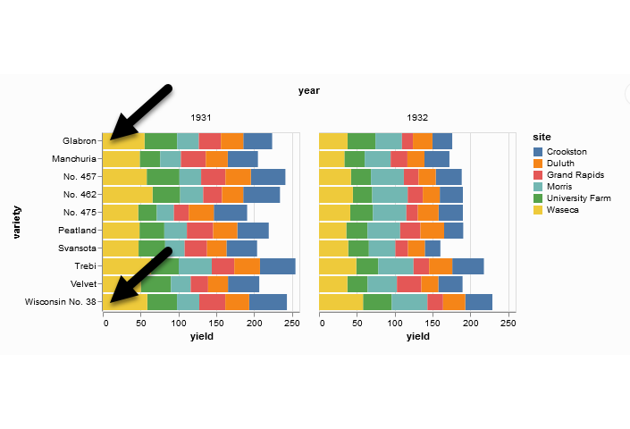
Projection (first yellow bar versus last yellow bar)
Stacked bar chart of crop yields
Notes:
The position means the vertical or horizontal location. Does the first yellow bar in 1931 (Glabron seeds planted in Wasica) extend further to the right than the last yellow bar (Wisconsin No. 38 seeds planted in Wasica)?

Slide 17
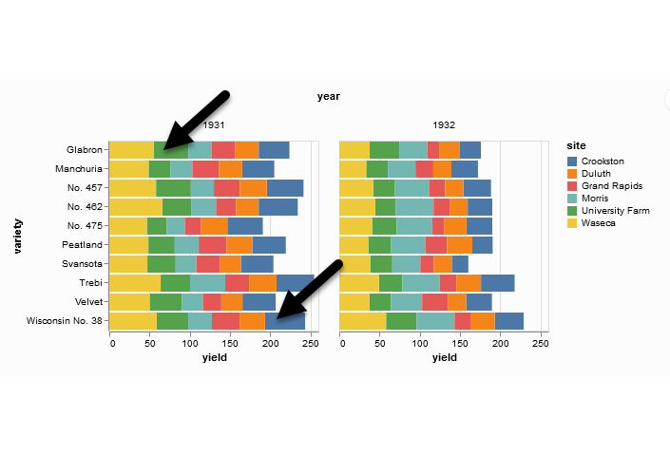
Superimposition (first green bar versus last blue bar)
Stacked bar chart of crop yields
Notes:
The length means either the width or the height. Does the first green bar in 1931 (Glabron seeds planted in University Farm) extend further to the right than the last yellow bar (Wisconsin No. 38 seeds planted in Crookston)?

Slide 18
Visual processing (2 of 3)
Scanning
Quantifying distance throug the use of a mental tape measure
Shorter distances are easier
Anchoring
Implicit or explicit development of reference points
Assists with scanning

Slide 19
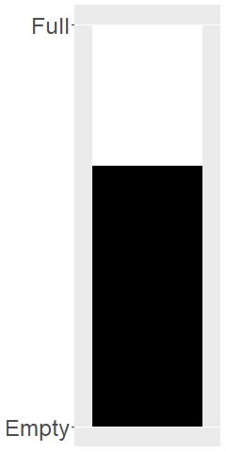
Scanning
Image of a fuel gauge, 65% full
Notes:
To understand scanning, think of a gas gauge. Usually it is a semicircular dial, but let’s set up the gas gauge as a rectangle. If the level is at the top, you have a full tank. If the level is at the bottom, you have an empty tank. This gauge shows a tank that is 65% full. Trust me, I drew the gauge. It is at 65%. Now how would you estimate the gas level?
You would take a mental tape measure, starting at the bottom and measure up to where the black box ends.
Now if you were smart, you’d start at the top and scan downwards. Less distance means that you can do this faster and more accurately.
Now if you were Albert Einstein, you’d split the gauge at the halfway point and measure from the halfway point to the top of the black box. Actually, there’s a little of Albert Einstein in all of us. That halfway point is something that all of us do subconciously. You did, because you recognized almost immediately that the tank was more than half full.

Slide 20
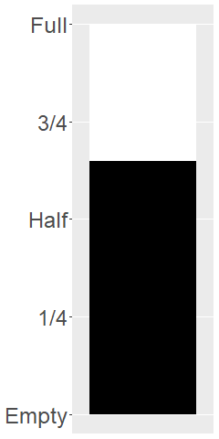
Assisting scanning with anchors
Image of a fuel gauge, anchors at 1/4, half, 3/4
Notes:
Here’s the same gas gauge, still at 65% full, but now we have added anchors at 1/4, half, and 3/4. You can read this gauge faster and more accurately, because you can scane from half up to 65% or from 3/4 down to 65%.

Slide 21
Visual processing (3 of 3)
Visually simple tasks
Position
Length
Angle/slope
Visually demanding tasks
Area
Volume
Density/Saturation/Hue
Notes:
There are a variety of perceptual tasks that you use when making comparisons within an image. These are arranged on this slide roughly in order of difficulty, with the easiest tasks at the top.

Slide 22
Position (first yellow bar versus last yellow bar)
Stacked bar chart of crop yields
Notes:
The comparison of the two yellow bars is a comparison of position. Which yellow bar extends further to the right?

Slide 23
Length (first green bar versus last blue bar)
Stacked bar chart of crop yields
Notes:
The comparison of the green and blue bars is a length comparison. The two bars start at different spots, so the position can’t help you.
Length is harder to judge than position, because it involves a superimposition rather than a projection.

Slide 24
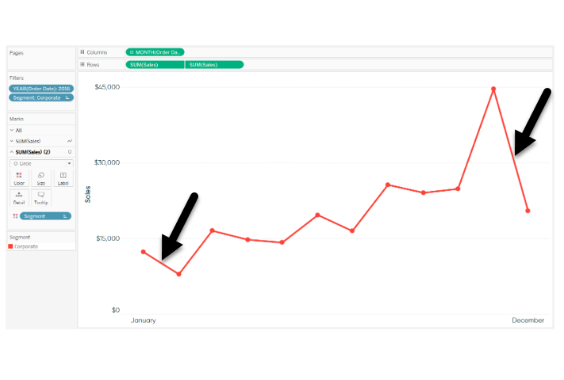
Angle/slope (first month decline versus last month decline)
Sales trend shown with a line graph
Notes:
This graph shows sales trends over a twelve month span. If you want to assess whether the first month decline (the dip in sales between January and February) was worse than the last month decline (the dip in sales between November and December), you would probably do this by judging the angle of the first line segment to the angle of the second line segment. This is not quite as easy as a position or length judgement, but it isn’t too bad either.

Slide 25
Area

Slide 26
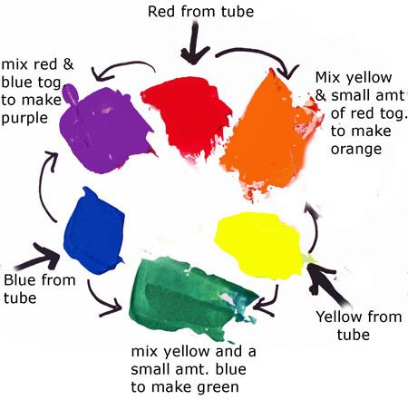
Everything I know about colors, I learned in Kindergarten.

Slide 27
### Hexadecimal codes for RGB + Hexadecimal digits (base 16) + 0-9, A-F + Two hexadecimal digits represent the numbers 0-255. + #rrggbb format + #000000 is pure black + #FFFFFF is pure white + #FF0000 is pure red + #00FF00 is pure green + #0000FF is pure blue + You can mix and match to get 16,777,216 colors + #800080 is purple, #FF69B4 is pink, #40e0d0 is turquoise

Slide 28
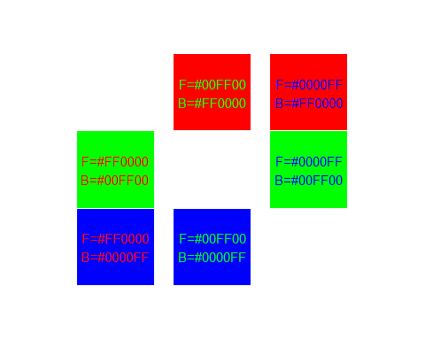
Contrasting pure colors often appear too intense

Slide 29
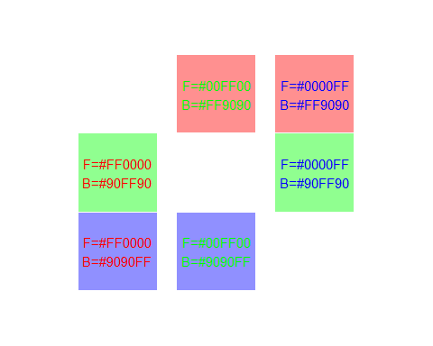
Lighten the background

Slide 30
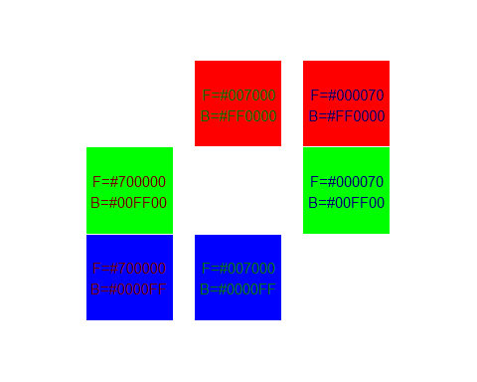
Darken the foreground

Slide 31
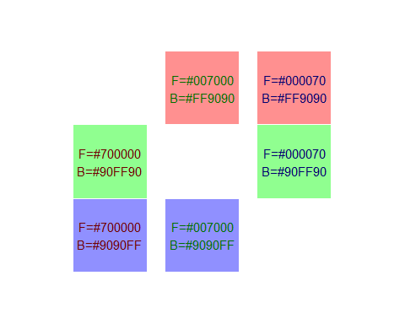
or both

Slide 32
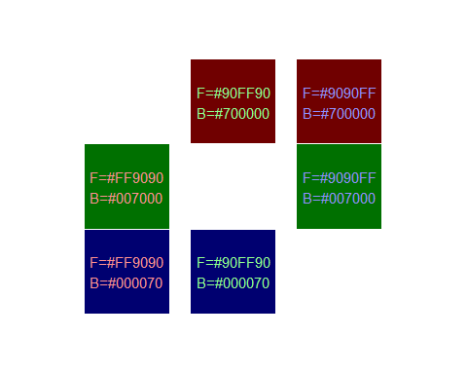
or the reverse

Slide 33
Density/saturation/hue

Slide 34
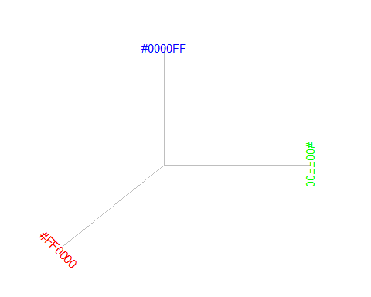
Gradients

Slide 35
Gradients
## function (...) .Primitive("c")

Slide 36
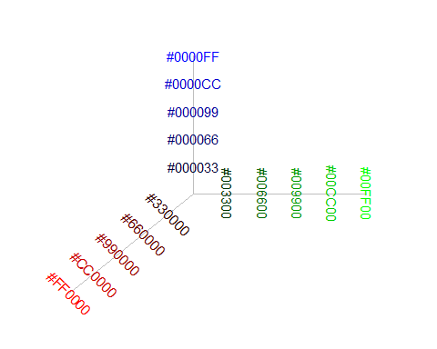

Slide 37
Notes:
Additive color mixing: adding red to green yields yellow; adding green to blue yields cyan; adding blue to red yields magenta; adding all three primary colors together yields white.

Slide 38
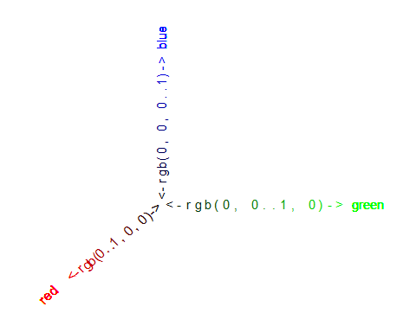
Transitions

Slide 39
### A quick tutorial on colors

Slide 40
Bars
Fewer in numbers than points
Usually a summary statistic
Count
Percent
Average
Total
A bar chart is NOT a histogram
Notes:
Bar charts are different than point charts. There are usually only a few bars. These bars usually represent a summary statistic, like a count, percent, average, or total.
There is a technical distinction between a bar chart and a histogram. Histograms are a great diagnostic tool, but usually ends up on the cutting room floor. So I won’t be talking about it much, if at all, in this workshop.

Slide 41
Aesthetics for bars
Review
Location
Size
Color
NOT shape!!!
Notes:
Recall that aesthetics are visual attributes associated with a geometry/mark. You can map variables to the location, size, and/or color of bars, but you cannot assign a variable to the shape of a bar.

Slide 42
Notes about this talk
Do not include this slide in the final presentation
If I do a flipped classroom, here would be a good place to split with most of the material before this slide being in lectures to be viewed before the class. Then the classrom lecture would start from about here (after a very quick review) and focus on the “On your own” exercises.

Slide 43
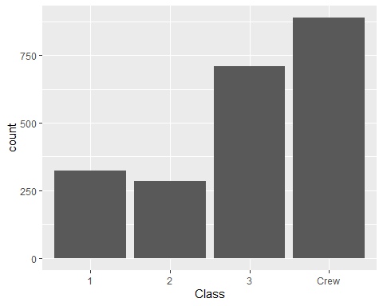
Location (1 of 2)

Slide 44
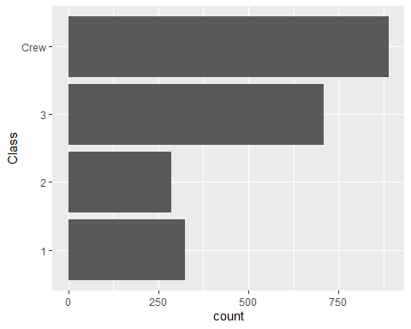
Location (2 of 2)

Slide 45
On your own
Draw a horizontal and vertical bar chart showing the number of people in each gender (use the Sex variable).

Slide 46
Wait before showing
((Python code))
((R code))
((Tableau steps))

Slide 47
What your visualization might look like
((Show visualization))

Slide 48
Thoughts on location
Axis labels often fit better on vertical location
Cannot vary both X and Y
Notes:
The default for most visualization software is vertical bars, but you should give thoughtful consideration to horizontal bars. The labels often fit better when the bars are horizontal. You also often have more room left to right than you do up and down in a graph, so the bars can stretch out more, allowing you to more easily discern small and subtle differences.
Remember the fault of default principle. Always try different ways of displaying your data. It costs nothing other than a few electrons to display a horizontal alternative to the typical vertical bar chart format, so why not indulge yourself?

Slide 49
Size
Length varies, width doesn’t
Exception, mosaic plots
Think about gaps between bars

Slide 50
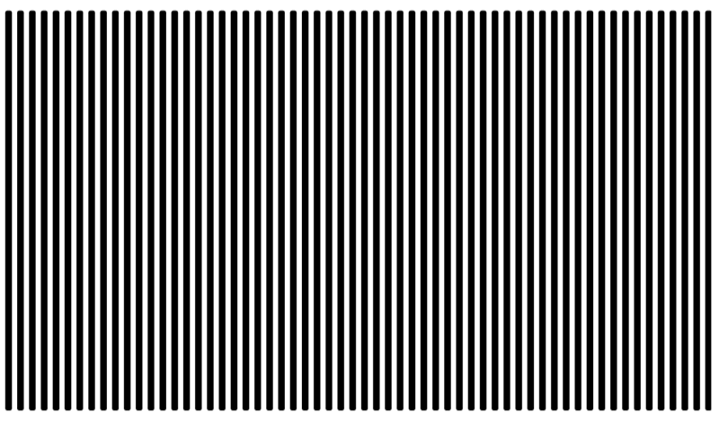
Don’t make gaps equal to widths
Alternate white and black lines showing a Moire effect
Notes:
If the space between the bars is equal to the width of the bars themselves, you get an unsettling vibratory effect. This is because your eye is constantly shifting perspective. Sometimes it perceives the black as the foreground and the white as the background. Sometimes it perceives the white as the foreground and the black as the background.
“I’m ten years old, my life’s half over. And I don’t even know if I’m black with white stripes or white with black stripes.” Marty the Zebra in the movie Madagascar.

Slide 51
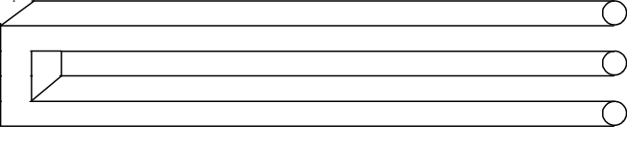
Optical illusion
Optical illusion showing two bars becoming three

Slide 52
If the widths are the same and the bars are empty, then you can get a differnt problem. You might get confused as to what is the bar and what is the gap, as in this optical illusion.
As a general rule, the gap between bars should be about 10 to 20 percent of the width of the bars. Most visualization software has sensible defaults, but beware when you have a very large number of bars. There’s always a bit of rounding when you place pixels on a screen or on a page. Your software is trying to fill the available plotting area, so it may have to squeeze or stretch one gap or another. This unevenness can become noticeable when the gaps are only a few pixels wide.
((Show an example of this using the scotus data))

Slide 53
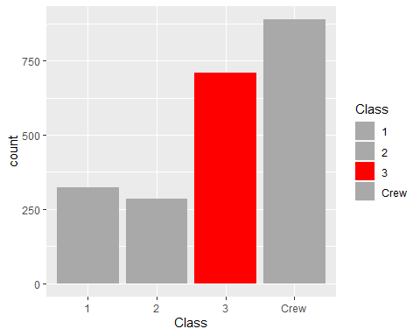
Color

Slide 54
On your own
Make the first class bar red to show Leonardo di Caprio’s perspective on the Titanic.

Slide 55
Wait before showing
((Python code))
((R code))
((Tableau steps))

Slide 56
What your visualization might look like
((Show visualization))

Slide 57
Color
Use for emphasis in simple bar charts
Very important for stacked or side-by-side bar charts
Notes:
For simple bar charts like all the ones we’ve seen so far, color is not really needed. You already can distinguish between the passenger classes using the location. If you do use color in a simple bar chart, it is often to emphasize a point. In the previous bar chart, I used red for third class, because Kate Winslet, a rich first class passenger, found true love in third class, with the adorable Leonardo di Caprio.
Color becomes very important in just a minute when we add another layer of complexity.

Slide 58
On your own
Revise this visualization so the first class bar is red.

Slide 59
Wait before showing
((Python code))
((R code))
((Tableau steps))

Slide 60
What your visualization might look like
((Show visualization))

Slide 61
Stack versus dodge
Summarize by two categories
Facet
Separate plots
Dodge
Side by side
Stack
One on top, one on bottom
Notes:
Bar charts that represent a summary across a single categorical variable are fairly simple and easy to handle. But when you want to summarize by two categories simultaneously, things get interesting. Interesting in a good way.

Slide 62
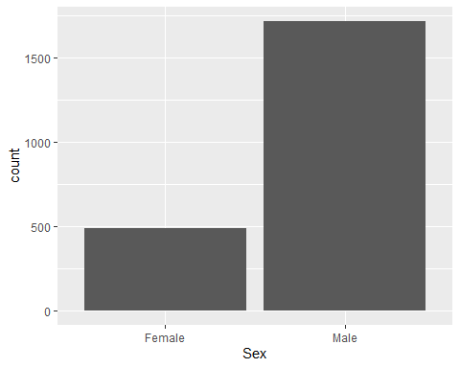
Titanic passenger count by gender

Slide 63
Titanic passenger count by passenger class

Slide 64
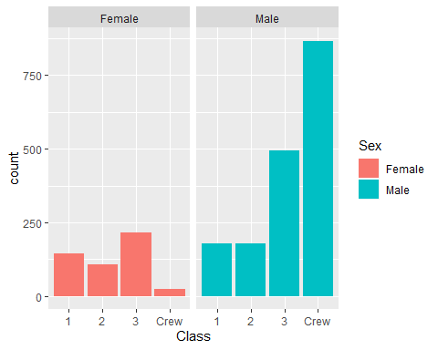
Titanic facet

Slide 65
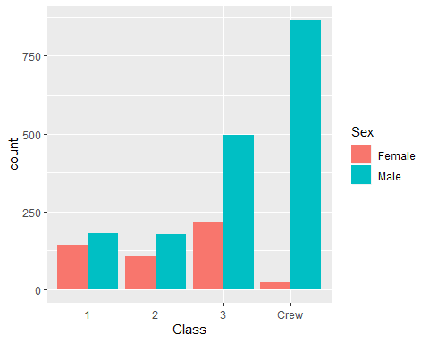
Titanic dodge

Slide 66
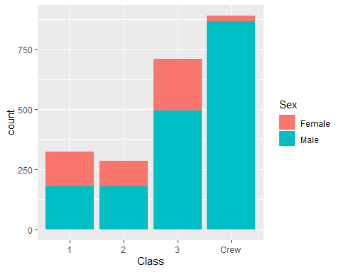
Titanic stack

Slide 67
On your own
Draw a bar chart showing counts involving both mortality and gender. Use a panel, then stacking, then dodging. Which do you like best?
Notes:
Mortality on the Titanic reflects the fact that this was an era when people really did believe in the concept of “women and children first.” Someone like me, I’d be shoving the little kids aside so I could get on one of the lifeboats.
Anyway, examine how mortality is related to gender. It’s a spoiler alert, but on the Titanic, Kate survives, but Leonardo, I am so sad to say this, didn’t make it.

Slide 68
Wait a bit before showing the code
Did you make the panel/stack/dodge Survived or did you make it Sex? Here’s some code, but yours might be different.
((Show Python code))
R code
titanic %>% ggplot(aes(x=Sex, fill=Survived)) + geom_bar() + facet_grid(cols=vars(Survived))
((Show Tableau))

Slide 69
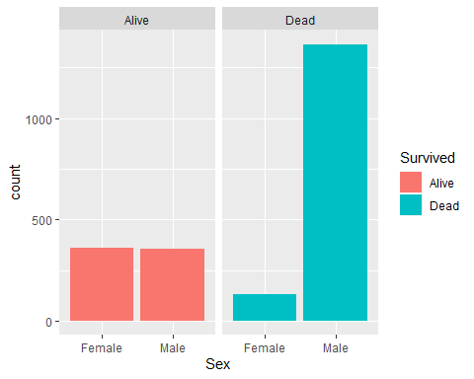
Panel, one approach

Slide 70
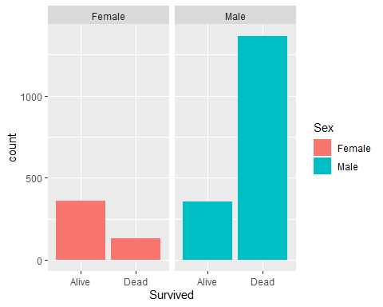
Panel, alternate approach

Slide 71
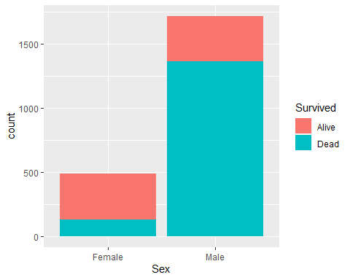
Stack, one approach

Slide 72
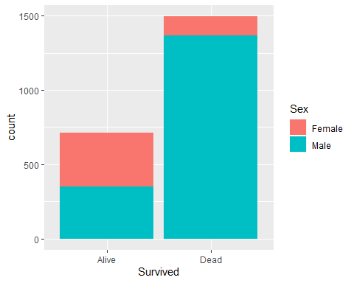
Stack, alternate approach

Slide 73
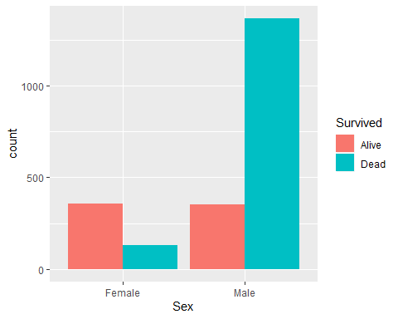
Dodge, one approach

Slide 74
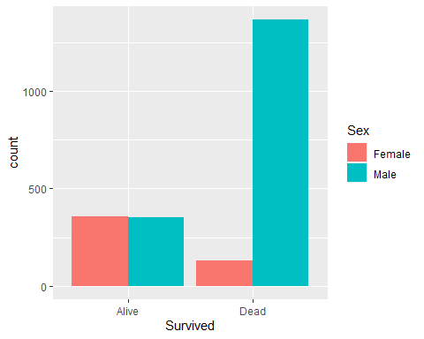
Dodge, alternate approach

Slide 75
Group exercise
Review the following visualization in your group
Summarize what aesthetics appear in the graph
What variables map to each aesthetic?
((Provide visualization. Maybe use the visualization from the earlier exercise?))

Slide 76
Summarizations
One number summary (mean or percentage)
Two number summary (error bars)
Five number summary (boxplots)
All the data
Jittering
Opacity
Notes:
((note to myself: maybe this goes better in the talk about lines.))

Slide 77
Switching from count to percent
((Show the code in Python, R, and Tableau. Explain why you might want counts versus percents.))

Slide 78
Example with means
((Need to find the right data set to illustrate this. Maybe the Saratoga house prices?))

Slide 79
Example with totals
((Same data. What means tell you versus totals.))

Slide 80
Boxplots example
((Include an explanation of what a boxplot is))

Slide 81
Jittering example
((Include an explanation on when it doesn’t work.))

Slide 82
Opacity example
((Note the computational expense.))

Slide 83
On your own
((Find a totally different data set and get the students to draw four different visualizations. Have them divide into groups that like the same visualization software and have each person do a different visualization.))

Slide 84
Summary
“A mapping of data to the visual aesthetics of geometries/marks”
Bars are a type of geometry/mark
Aesthetics for bars include location, size, color
Stack versus dodge
Basic tips
Place comparators close
Use axis ticks, light grid lines

Slide 85
On your own
((Find a totally different data set and get the students to draw four different visualizations. Have them divide into groups that like the same visualization software and have each person do a different visualization.))

