Slide 1
v01 Basic exercise - size
Steve Simon

Slide 2
Basic exercise - size
Use the Saratoga housing data set.
Draw a plot where the location is x=Age and y=Price and the size represents the living area.

Slide 3
Here’s the Python code.
ch6 = alt.Chart(df).mark_point().encode( x='Age',y='Price', size='Size')

Slide 4
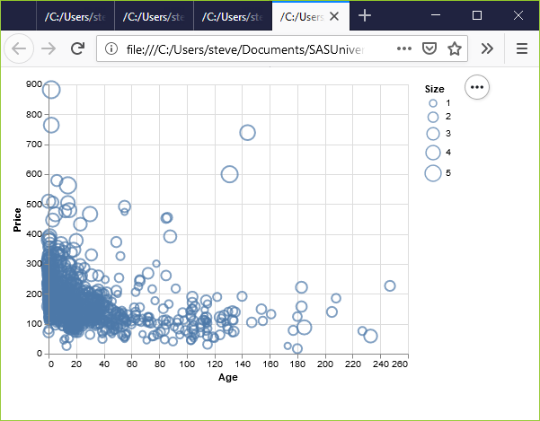
Here’s the result in Python.
Python scatterplot mapping living area to size

Slide 5
Here’s the R code.
ggplot(saratoga_houses, aes(x=Age, y=Price)) + geom_point(aes(size=Living.Area))

Slide 6
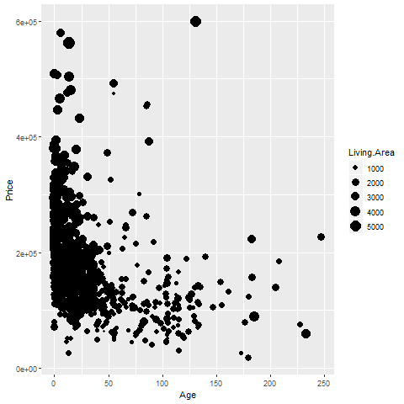
Here’s the result in R.
R graph using size to represent Living.Area

Slide 7
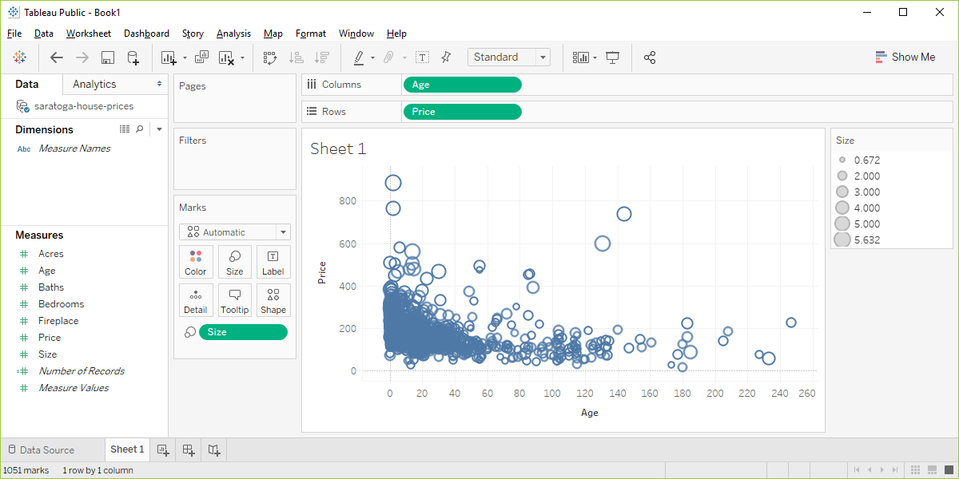
Here’s the result in Tableau.
Visualizaion using Living.Area as the size

