Slide 1
Scatterplots exercise, change location
Steve Simon

Slide 2
Exercise, change the location
Use the Saratoga housing data set.
Revise the plot so that the location of the points represents X=Bedrooms and Y=Price.
Notes:
Go back to the plot you just drew. Modify it so that the x location is Bedrooms and not Age.

Slide 3
Exercise, Python code
Here’s the Python code.
ch = alt.Chart(df).mark_point().encode( x='Bedrooms',y='Price')
Notes:
You specify the x and y locations inside the encode function.

Slide 4
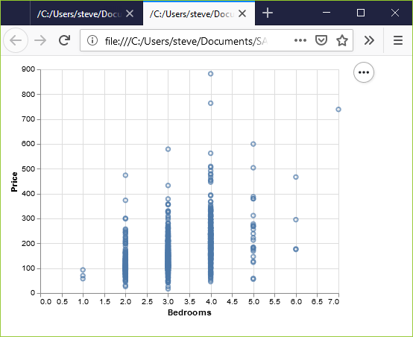
Exercise, Python output
Python scatterplot of bedrooms and price
Notes:
This is what the Python graph should look like. There is a general upward trend. Houses with more bedrooms tend to cost more.

Slide 5
Exercise, R code
Here’s the R code
ggplot( saratoga_houses, aes(x=Bedrooms, y=Price)) + geom_point())
Notes:
In R, the X and Y locations go inside the aes function. Normally the aes function sits insider the ggplot function.

Slide 6
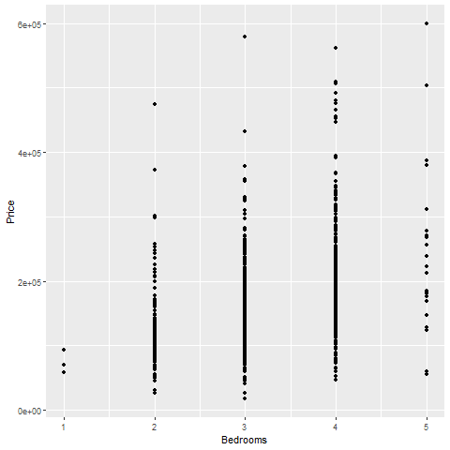
Exercise, R output
Scatterplot of bedrooms and price
Notes:
This is the plot in R. It shows a general upward trend.

Slide 7
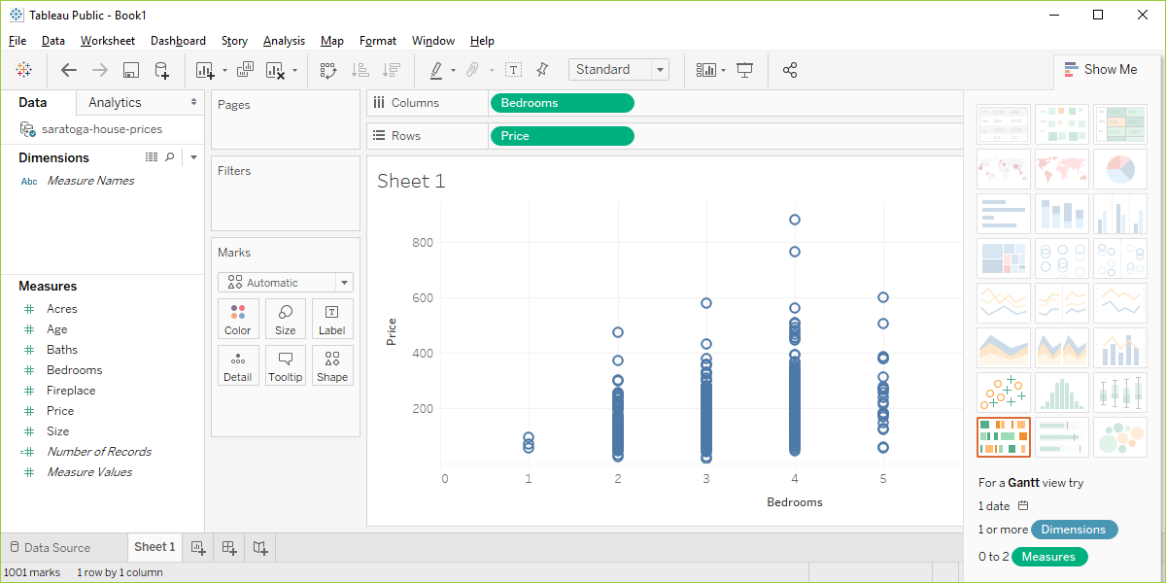
Exercise, Tableau output
Tableau scatterplot of Bedrooms and Price
Notes:
In Tableau, click on Age in the Columns field and choose the remove option. The graph looks a bit weird with no columns, but ignore it. Drag Bedrooms over to the Columns field. Tableau wants to use a sum, but you want individual data points. So click on SUM(Bedrooms) and change it to a Dimension.

