Slide 1
Data-viz-01, Recommendations
Steve Simon

Slide 2
Solutions to excessive overprinting
Opacity
Small points
Open symbols
Log scale
Notes:
The plots that you have drawn tend to have difficulty with overprinting. Too many data points crammed into a small area produces a large solid blob that is hard to interpret. There are three possible solutions: opacity, small points, and a log scale.

Slide 3
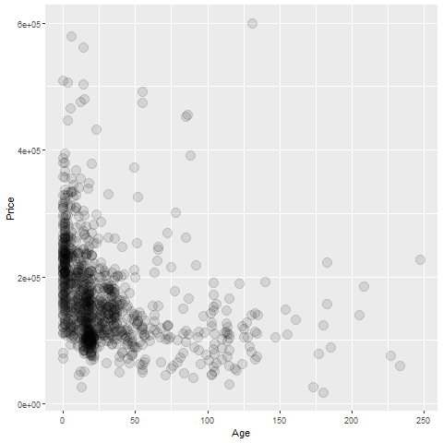
Overprinting - opacity
R graph using opacity
Notes:
If you make the data points somewhat translucent, so that you can see what it behind it, this prevents a massive black blob from forming. You have to experiement a bit with the level of translucence.

Slide 4
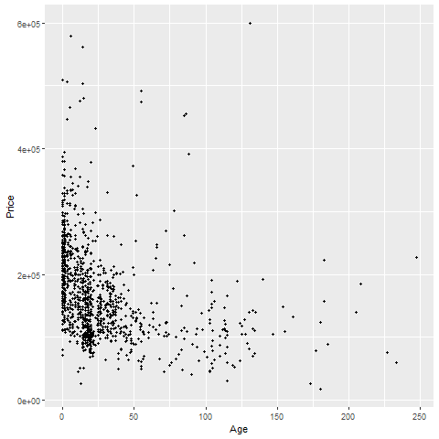
Overprinting - small points
R graph using small points
Notes:
Smaller data points have less trouble with overprinting.

Slide 5
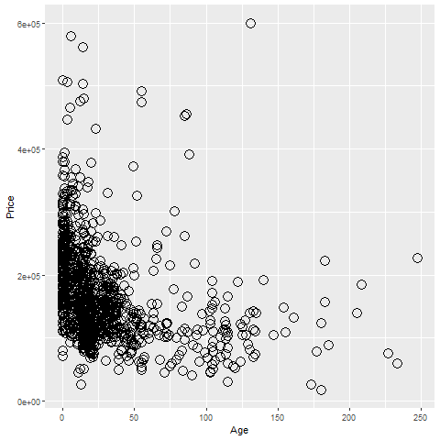
Overprinting - open symbols
R graph using open circles
Notes:
Smaller data points have less trouble with overprinting.

Slide 6
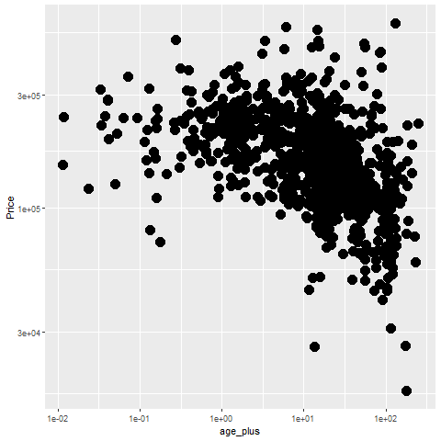
Overprinting - log scale
R graph using log scales

Slide 7
Some tips
Don’t try to squeeze in too much
Double up to emphasize
Shape is only good for categories
Shape and size don’t mix

Slide 8
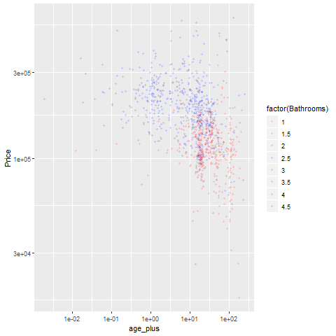
Don’t try to squeeze in too much.
R graph using only two colors

Slide 9
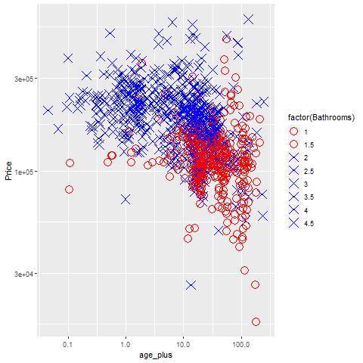
Double up to emphasize
R graph using colors and shapes
Notes:
It’s okay to map a single variable to more than one aesthetic. In fact, this often helps emphasize that variable.

Slide 10
Some restrictions
Shape is only good for categories
Shape and size don’t mix
Notes:
There are some practical limits to aesthetics of points. First, shape makes sense only for categorical data. If you have a large number of values, as is typical for a continuous variable, you run out of symbols before you run out of categories.
Also size and shape don’t mix. You can really compare two diffent shapes, such as an X and an O on size. Is the size related to the diameter, the area, or the perimeter? There’s no really good answer, so it’s asking to much of a graph that asks you to decide which is larger among points represent different shapes. Either vary the shape or vary the size, but not both.

