Slide 1
Data-viz-03, Preparation
Steve Simon

Slide 2
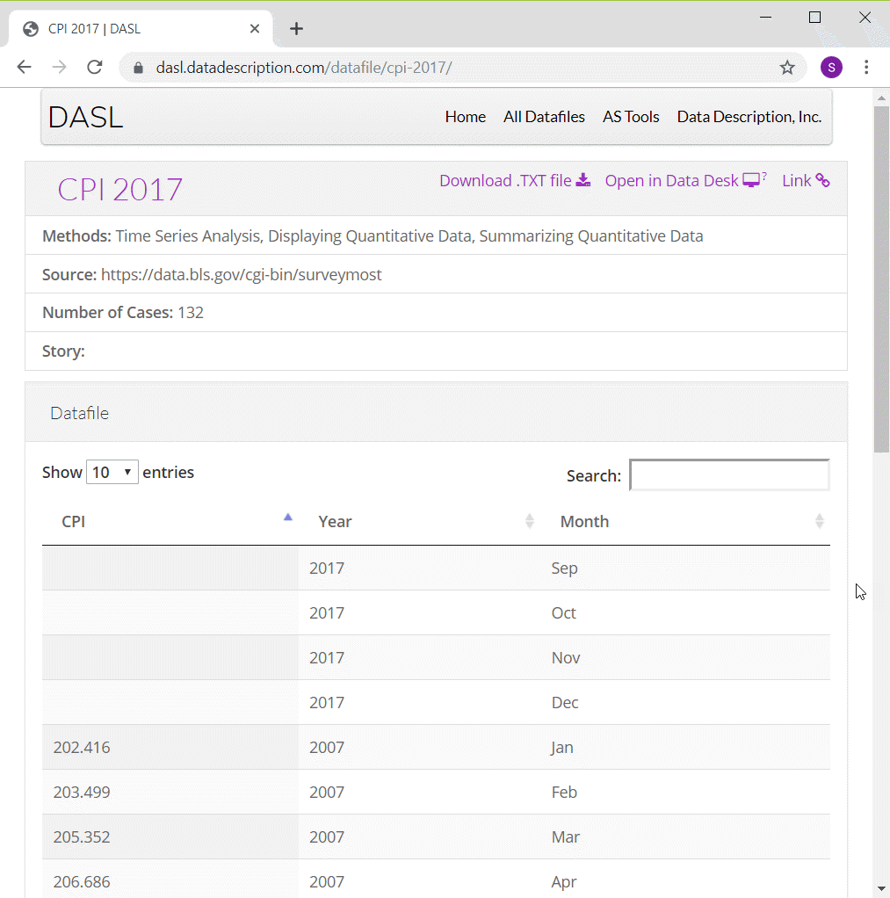
Preparation, DASL Consumer Price Index data
Screenshot of DASL website
Notes:
ONe of the data sets that I will use in this moldule on line graphs is monthly values of the Consumer Price Index from 2007 through 2016. I have to make some minor modifications to the data, adding a continuous variable for time and deleting four rows of data.
You can find information about this data set on the DASL website, but use the csv file that I created instead of the one from the DASL website.

Slide 3
Preparation, Pyhton code
Here’s the code in Python
import pandas as pd import altair as alt df = pd.read_csv("../../common-files/data/cpi.csv") ch = alt.Chart(df).mark_line().encode( x='t', y='CPI' ) ch.save("../images/python/basic-lineplot.html")
Notes:
Here is the Python code to read in the data and produce a simple line graph.

Slide 4
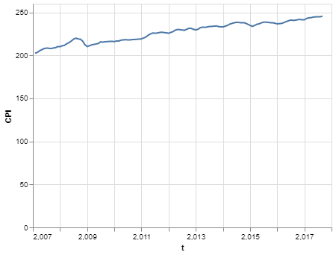
Preparation, Python graph
Line plot in Python
Notes:
This is what the graph would look like.

Slide 5
Preparation, R code
Here’s the code in R
cpi <- read.csv("../data/cpi-food.csv") ggplot(cpi, aes(x=t, y=CPI)) + geom_line(aes(color=index))
Notes:
Here is the R code to read in the data and produce a simple line graph.

Slide 6
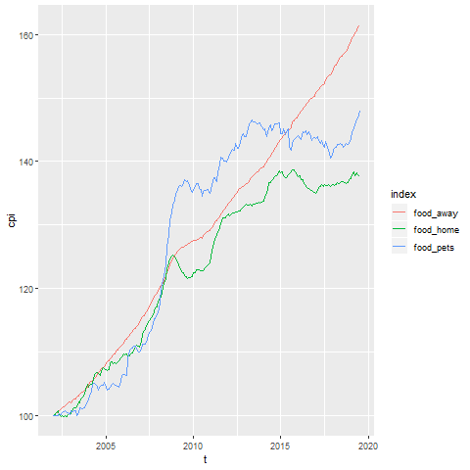
Preparation, R graph
Line graph showing increase over time of the consumer price index
Notes:
Here is what the graph looks like in R. See if you can reproduce it.

Slide 7
Preparation, Tableau steps
Import cpi.csv
Drag t to Columns
Change t to Dimension Continuous
Drag CPI to Rows
Chage CPI to Dimension Continuous
Change Marks to Line
Notes:
Here are the steps in creating a line graph in Tableau.

Slide 8
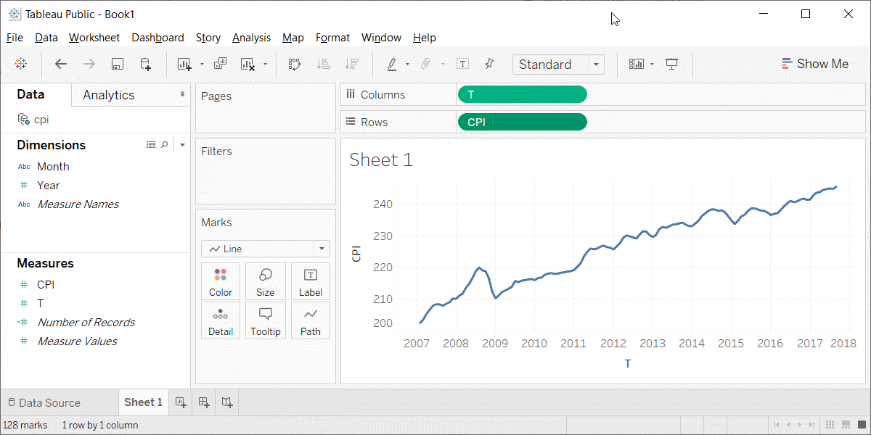
Preparation, Tableau graph
Line graph in Tableau
Notes:
This is what the Tableau graph looks like.

