Slide 1
Tutorial on Gestalt principles
Steve Simon

Slide 2
Gestalt, introduction
These ideas drawn from the Bergen and Iverson workshop.
Gestalt definition
“The whole is greater than the sum of the parts”
How do you draw someone’s eye to quickly make certain associations?
Notes:
The Gestalt school of Psychology developed several principles that are very useful in helping to make an effective visualization. A simple definition of Gestalt is that the whole is more than just the individual items. There is a lot to Gestalt psychology, but the portion that is relevant to you is the ability to draw someone’s eye not to individual components of a graph, but to a group of related components that allow the viewer to see patterns or associations.

Slide 3
Gestalt theory in artistic design
Many lesssons in effective artistic design
The Gestalt Principles Spokane Falls Community College.
Gestalt Theory Sophia.
Gestalt Principles Applied to Design The Graybox blog, January 19, 2015.
Gestalt Principles Interaction Design Foundation.
Notes:
The field of artistic design is more commonly called graphic design, but I use the former term to distinguish it from statistical graphics. Artistic design is the use of typography, photography, and illustration to effectively convey a message. Artistic designers work on commercial logos, magazines and brochures, and product packaging.
These are interesting, and well worth some time viewing, even though they don’t speak directly to the process of developing effective visualizations.

Slide 4
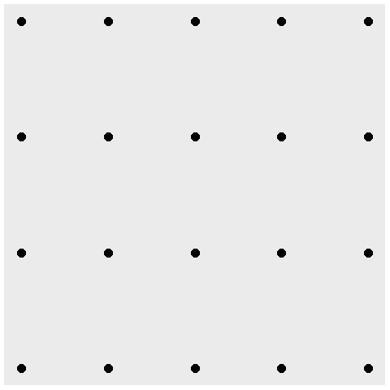
Gestalt, A block of points - no emphasis
Notes:
What you see in this graph is 20 individual points. When you design a graph, you want people to group things in a way to reveal patterns.

Slide 5
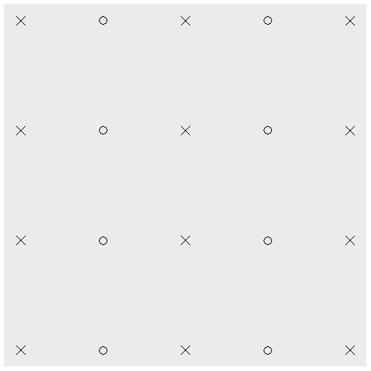
Gestalt, Similarity (shape)
Notes:
Items that are similar tend to be grouped together.
The use of common shapes causes you to see five columns rather than twenty individual data points.

Slide 6
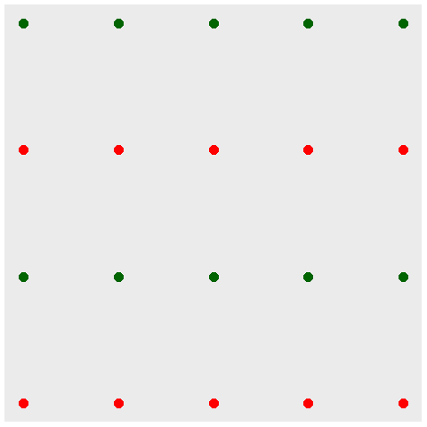
Gestalt, Similarity (color)
Notes:
Notice how the use of color tends to draw the eye in and see the graph as not 20 separate points, but rather four rows of points.
The effect of color is a lot stronger than the effect of shape.

Slide 7
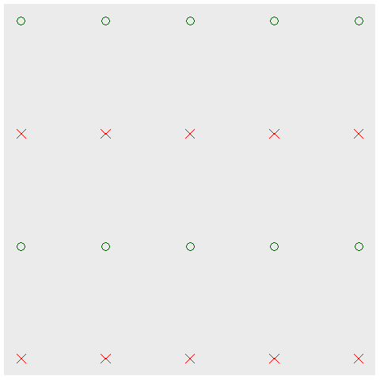
Gestalt, Double up for stronger emphasis
Notes:
You can double up by using a common shape AND a common color to develop an even stronger association.

Slide 8
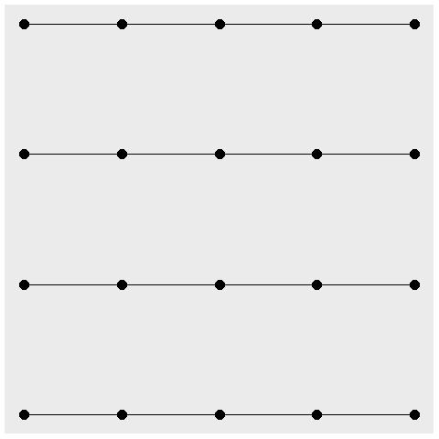
Gestalt, Connectedness
Notes:
A connection between individual points causes you to perceive those connected points as part of a single group. Here, you see four rows rather than five columns.

Slide 9
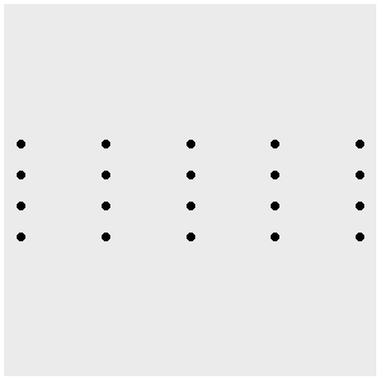
Gestalt, Proximity
Notes:
Points that are close to one another also tend to encourage their grouping. Notice that the scaling change caused the points within a column to be a lot closer than the points within a row. So you tend to see this as five columns rather than four rows.

Slide 10
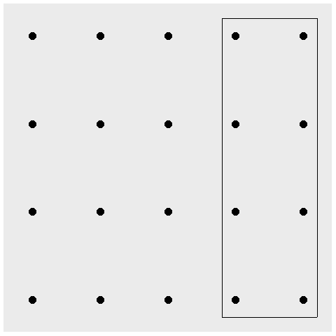
Gestalt, Enclosure for emphasis, eight special points
Notes:
An enclosure is a strong way to emphasize grouping. Here the box provides an emphasis on a special group of eight points.

Slide 11
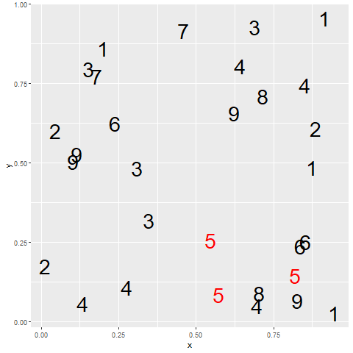
Gestalt, contrast
Red fives contrasted against all other colors
Notes:
The one pattern that deviates from the others tends to draw your eye toards it. There are nine different groups here, 1 through 9, but because of the contrast, you tend to view it as 5 versus all the other numbers.

Slide 12
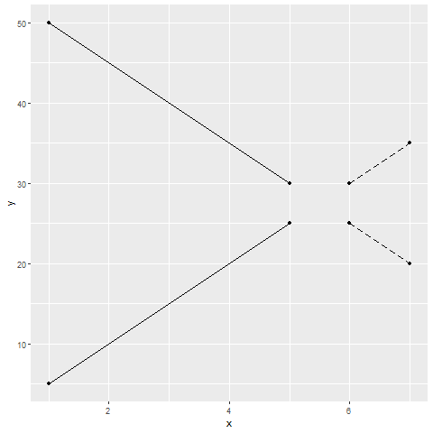
Gestalt, Continuity and common fate
Line graph showing present and future trends
Notes:
A consistent trend or pattern between two elements of a graph will encourage you to group those elements together.

Slide 13
Gestalt, Common fate
(Show an image of five upward trends with two downward trends)

