Slide 1
Exercise, draw gender
Steve Simon

Slide 2
Exercise, Gender barchart
Draw a bar chart showing the number of people in each gender (use the Sex variable).

Slide 3
Exercise, Python code
Here’s the Python code
ch = alt.Chart(df).mark_bar().encode( x='sex', y='count()' )

Slide 4

Exercise, Python output

Slide 5
Exercise, R code
Here’s the R code
ggplot(titanic, aes(sex)) + geom_bar()

Slide 6
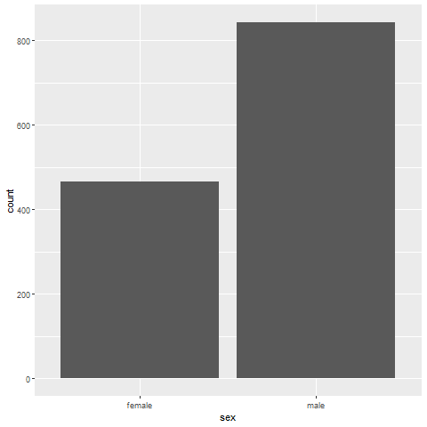
Exercise, R output

Slide 7
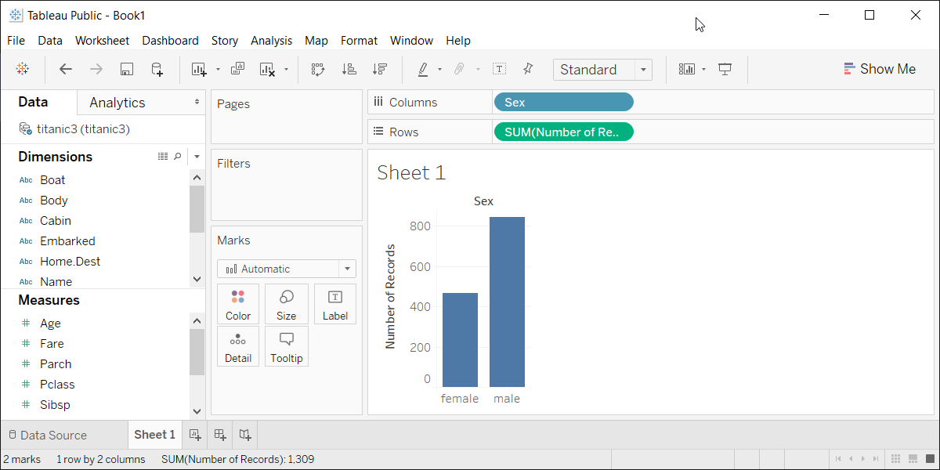
Exercise, Tableau output
Tableau barchart

