Slide 1
Data visualization, Barcharts
Steve Simon

Slide 2
Barcharts, Outline
Preparation
Group exercises
Colors
Perception
Barchart fundamentals
Barchart recommendations
Notes:
Here is an outline of what you will learn today.

Slide 3
Preparation, overview
Follow these steps to get ready for lecture #2 in data visualization.
Download and import Titanic data
Download and import scotus data

Slide 4
Preparation, Titanic data set
R code
read.csv("../../common-files/data/titanic3.csv")
Python code
(To be added)
Notes:
Make sure you can import the file titanic3.csv to Python, R or Tableau.

Slide 5
Preparation, Scotus data set
Python code
(To be added)
R code
(To be added)
Notes:
Also import the scotus (Supreme Court of the United States) data.

Slide 6
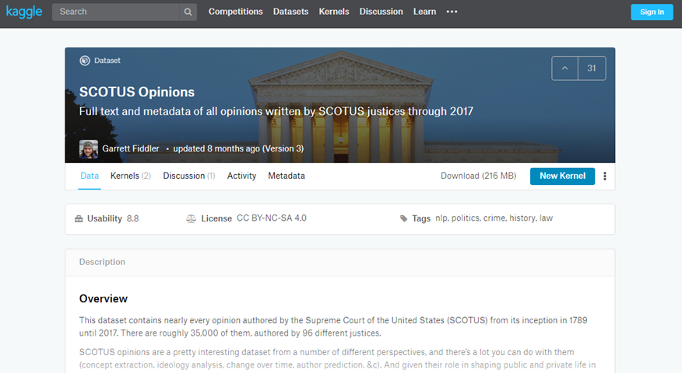
Preparation, kaggle website
Kaggle datasets webpage
Notes:
The scotus file comes originally from the Kaggle datasets webpages. I fixed a few small typos, but you can get pretty much the same results by downloading the original file and keeping the typos in there.

Slide 7
Preparation, Draw a simple bar chart
Import the data and create a bar chart showing the frequency of opinions written by year_filed. Note that there are a few typos and a few rows that do not belong. You can remove these, but they will not affect any of the analyses we are considering.

Slide 8
Preparation, Code
Python code
(Add later)
R code
(Add later)

Slide 9
Preparation, Python output
(Add later)

Slide 10
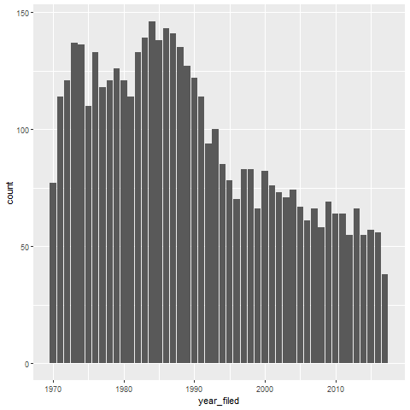
Preparation, R output

Slide 11
Preparation, Tableau output
(Add later)

Slide 12
Group exercise
These bar charts come from recent newspaper articles.
People Who Can’t Vote Still Count Politically in America. What if That Changes?
Attacks by White Extremists Are Growing. So Are Their Connections.
The Best VPN Service.
Notes:
The following images are taken from various newspaper articles or press releases. Look at the graph and read/skim the article.

Slide 13
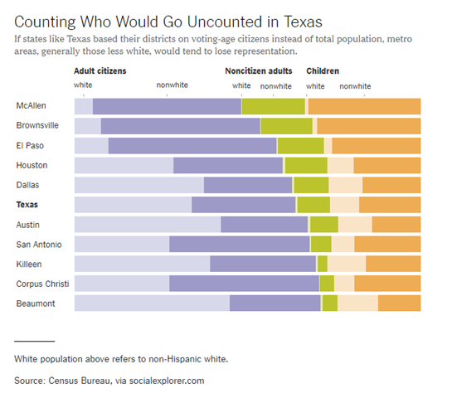
Graphs in the news, Voters in Texas
Bar chart of demographics of selected Texas counties
Notes:
This is one of two graphs. It was published in
Badger, E. (2019). People Who Can’t Vote Still Count Politically in America. What if That Changes?. Retrieved June 24, 2019, from The New York Times website: https://www.nytimes.com/2019/06/22/upshot/america-who-deserves-representation.html

Slide 14
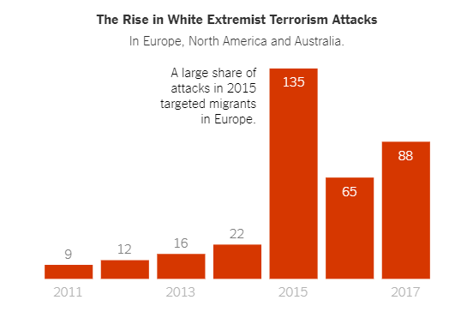
Graphs in the news, White extremist terrorism attacks
Bar chart counting white extremist terrorism attacks over time
Notes:
Weiyi Cai, Simone Landon. Attacks by White Extremists Are Growing. So Are Their Connections. The New York Times, April 3, 2019. Retrieved August 8, 2019 from https://www.nytimes.com/interactive/2019/04/03/world/white-extremist-terrorism-christchurch.html

Slide 15
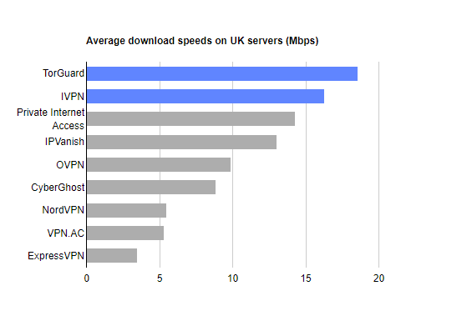
Graphs in the news, VPN speeds
Bar chart showing speeds of various VPN providers
Notes:
Mark Smirniotis. The Best VPN Service. Wirecutter, February 8, 2019. Retrieved August 14, 2019 from https://thewirecutter.com/reviews/best-vpn-service/.

Slide 16
Graphs in the news, what is the message?
Your group will be assigned one particular graph and newspaper article
Read/skim the article and examine the graph
What is the message?
Summarize in 25 words or less.
Notes:
The following images are taken from various newspaper articles or press releases. Look at the graph and read/skim the article.
What message do you think the journalist is trying to convey with this graph. Summarize this message in 25 words or less.

Slide 17
Colors, introductory tutorial
Kindergarten view of colors
Review hexadecimal codes
Color systems
RGB
HSV
CYMK
Notes:
There are three major color systems used on computers, RGB, HSV, and CYMK. I’ll discuss RGB in detail, and touch briefly on the other systems. But you need to realize that how colors work on a computer was not the way you learned in Kindergarten. A solid understanding of the RGB color system also requires you to work comfortably with hexadecimal codes, so I have a brief review of that as well.

Slide 18
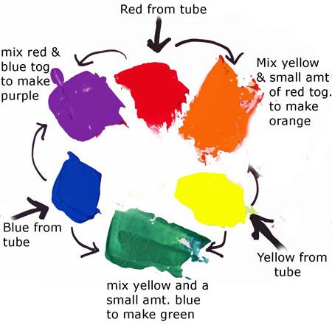
Colors, Everything I know about colors, I learned in Kindergarten.
Notes:
It was probably in Kindergarten where you learned the basic way to combine primary colors. Yellow plus red equals orange, Yellow plus blue equals green. Red plus blue equals purple/violoet.
It doesn’t work that way on a computer screen because the screen. Computer screens use light to create colors and lights blend in different ways than paints or crayons.
Before you tackle ths computer system for colors, you need to review binary and hexadecimal number systems.

Slide 19
Colors, Binary codes
“There are 10 types of programmers in the world, those who undestand binary and those who don’t.”
1001 1100 (base 2)
= $1*2^{7}+0*2^{6}+0*2^{5}+1*2^{4}+1*2^{3}+1*2^{2}+0*2^{1}+0*2^{0}$
= 128+16+8+4 = 156
Eight binary digits represent the numbers 0-255
Notes:
Let me share a bad joke about binary numbers. Actually, you need to read it because the digits “1”-“0” represent something entirely different in the world of binary numbers.
Here’s an example of how to decode the binary number 1001 1100.
Binary numbers use powers of two: 1, 2, 4, 8, 16, etc. Eight binary digits can represent any number from 0 to 255.

Slide 20
Colors, Hexadecimal codes
Hexadecimal digits (base 16)
0-9, A=10, B=11, C=12, D=13, E=14, F=15
1001 1100 (base 2)
= 9C (base 16)
= $9*{16}^{1}+12*{16}^{0}$
Two hexadecimal digits represent the numbers 0-255.
00 (base 16) = 0, FF (base 16) = 255
A # prefix implies hexadecimal in most computer languages.
Notes:
Binary representations get unwieldy very quickly, and the hexadecimal format provides a much tighter representation that still has the spirit of binary.
Hexadecimal means powers of 16 and you can represent numbers up to (but not including) 16 using four binary digits. The ehxadecimal digits start out like normal digits, 0, 1, 2, etc. but once you get up to nine you run out of single digits. So the value of 10 is represented by the letter A, the value of 11 by B, etc. through the letter F which represents 15. At sixten, you roll over to the next place.
So you count in hexadecimal like 0, 1, 2, 3, 4, 5, 6, 7, 8, 9, A, B, C, D, E, F, 10, 11, …
Split the eight digit binary number 1001 1100 into groups of four binary digits. The binary 1001 is equal to 9 and the binary 1100 is equal to 12 or C. So the hexadecimal equivalent is 9C. You can represent this using powers of 16, 9 times 16 to the first power plus twelve times 16 to the zeroth power. That works out to 156.
Tow hexadecimal digits just like eight binary digits can represent the numbers 0 to 255, with 00 hexadecimal equaling 0 and FF hexadecimal equaling 255 (15*16+15).
Use the prefix of a pound sign (has tag) to tell the computer that you are speaking to it in hexadecimal.

Slide 21
Colors, Codes for colors
#rrggbb format
#000000 is pure black
#FFFFFF is pure white
#FF0000 is pure red
#00FF00 is pure green
#0000FF is pure blue
You can mix and match to get 16,777,216 colors
#800080 is purple, #FF69B4 is pink, #40e0d0 is turquoise
Notes:
The RGB format uses six hexadecimal digits to represent colors. A hexidecimal of all zeros is pure black and at the other extreme, a hexidecimal of all F’s is pure white. The first two hexidecimal digits represent the red channel. The highest value FF for the red channel combined with zeros for the other two channels (#FF0000) equals pure red. The next two digits represent the green channel. #00FF00, giving the maximum to the green channel and the minimum to the other two channels produces a pure green. The last two digits represent the blue channel, and #0000FF represents pure blue.

Slide 22
Colors, RGB combinations
Red, green, and blue combinations produce yellow, magenta, and cyan.
#FF0000 (pure red) plus ##00FF00 (pure green) equals #FFFF00 (pure yellow)
#FF0000 (pure red) plus #0000FF (pure blue) equals #FF00FF (pure magenta)
#00FF00 (pure green) plus #0000FF (pure blue) equals #00FFFF (pure cyan)
Notes:
You can combine the red, green, and blue channels to produce three more colors: yellow, magenta, and cyan.

Slide 23
Colors, more RGB combinations
Add the third color to produce white
#FFFF00 (pure yellow) plus #0000FF (pure blue) equals #FFFFFF (pure white)
#FF00FF (pure magenta) plus #00FF00 (pure green) equals #FFFFFF (pure white)
#00FFFF (pure cyan) plus #FF0000 (pure red) equals #FFFFFF (pure white)
Notes:
Combine yellow, megenta, and cyan with the complementary colors (blue, green, and red, respectively) to get white.
The RGB color system is called an additive system because as you add more colors, you add to the brightness. Eventaully, you get all the way to white.

Slide 24
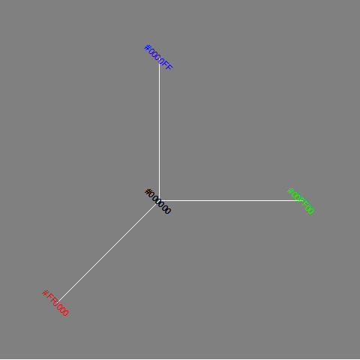
Colors, The color cube (1/2)
The three axes of the color cube
Notes:
The color cube shows the three dimensions (red, green, and blue) of the RGB color system as axes in a three dimensional space.

Slide 25
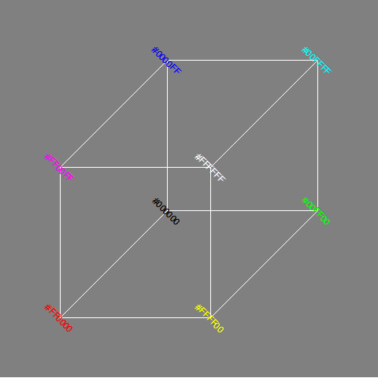
Colors, The color cube (2/2)
The full color cube with a front white vertex
Notes:
The combination colors of yellow, magenta, cyan, and white represent different vertices of the color cube.

Slide 26
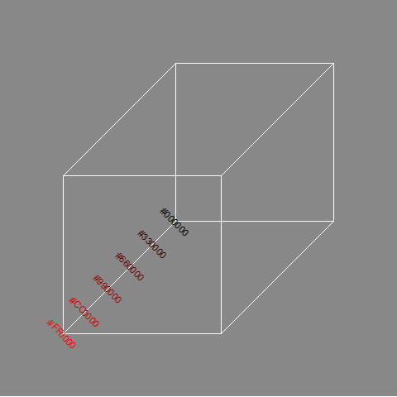
Colors, Gradients of black to red
Notes:
You can develop gradients, gradual and continuous changes in color, by varying the channels from lowest to highest. If you let the red channel range from 00 to FF and keep the other channels at zero, you get a gradient from black through dark shades of red to pure red.
The figure only shows six values for the gradient (red channels ranging from 00 to 33, to 66 to 99 to CC), but you can produce 255 different shades between black and red.

Slide 27
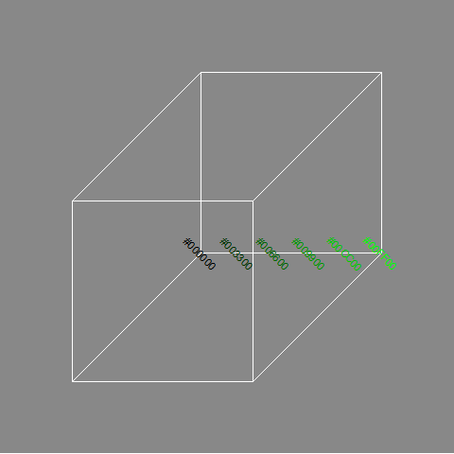
Colors, Gradients of black to green
Notes:
Similarly, if you let the green channel vary from 00 to FF and hold the red and blue channels at zero, you get a gradient that goes from black through dark shades of green to pure green.

Slide 28
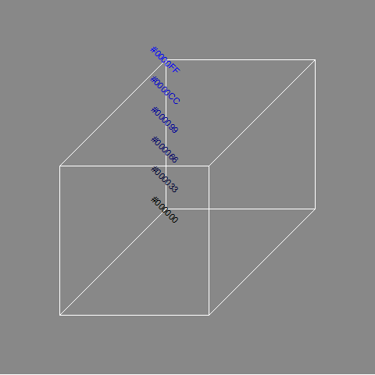
Colors, Gradients of black to blue
Notes:
Varying the blue channel from 00 to FF while keeping the red and green channels at zero will produce a gradient of black through dark shades of blue to pure blue.

Slide 29
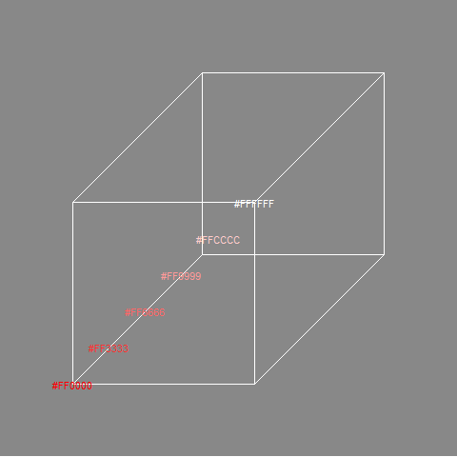
Colors, Gradients of red to white
Notes:
To create a gradient from red through the lighter shades of red (pinkish, actually) to white, keep the red channel at full strength (FF) and vary the green and blue channels from 00 to FF.

Slide 30
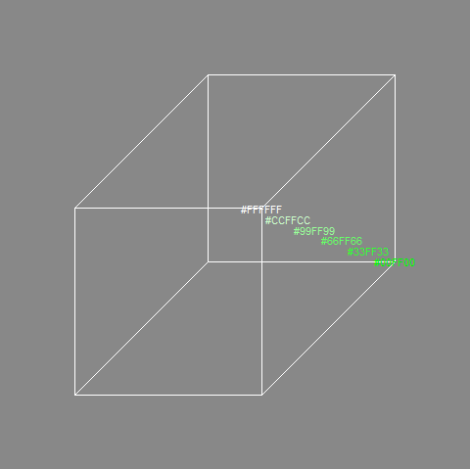
Colors, Gradient of green to white
Notes:
Similary, you can create a gradient from pure green through the lighter shades of green to white.

Slide 31
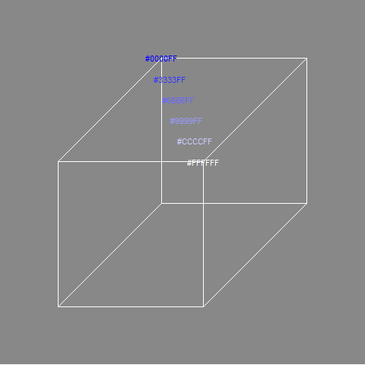
Colors, Gradient of blue to white
Notes:
And just as easily you can develop a gradient that goes from pure blue through the lighter shades of blue to white.

Slide 32
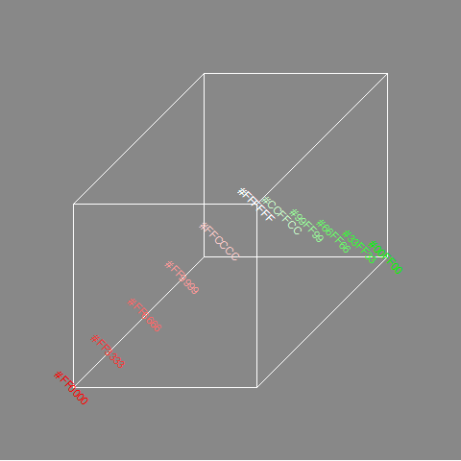
Colors, Gradients of red to green via white
Notes:
If you want to go from one pure color to another, there is more than one route that works. You can run red to white and then white to green.

Slide 33
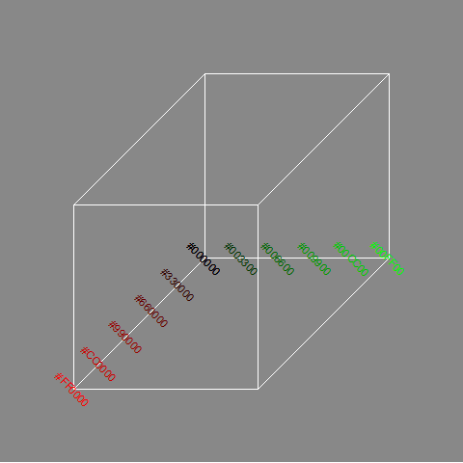
Colors, Gradients of red to green via yellow
Notes:
A common gradient for red to green relies on the fact that yellow is a combination of red and green. So start with red at full blast (FF), green at zero (and blue at zero). Move towards yellow by mixing in a bit more green. Once you get to pure yellow (FF in the green and red channels), reverse this process by keeping the green channel at full blast (FF) and gradually reduce the red channel to zero.

Slide 34
Colors, gradients of red to green through gray
(To be added)
Notes:
You cna just as easily go from red to green through gray.

Slide 35
Gradients in Python
(To be added)

Slide 36
Gradients in R
(To be added)

Slide 37
Gradients in Tableau
(To be added)

Slide 38
Colors, HSV system
(To be added)

Slide 39
Colors, discrete color palletes
(To be added)

Slide 40
Colors, CYMK system
(To be added)

Slide 41
Colors, review
Kindergarten view of colors
RGB color system
Gradients
HSV color system
Discrete color palettes
CYMK system
Notes:
The kindergarten view of colors (red plus yellow equals orange) doesn’t work on a computer screen because the screen uses mixtures of light to combine colors. We covered the RGB system including how to create gradients. The HSV system provides a more intuitive description of colors, while CMYK is used when printing, where a substractive rather than additive color system is needed.

Slide 42
Perception, introductory tutorial
Visual tasks
Projection,
Superimposition,
Scanning,
Anchoring
Notes:
Understanding perception is the key to making effective visualizations. There are several key visual tasks: projection, superimposition, scanning, and anchoring. You want to design visualizations that facilitate these perceptual tasks.

Slide 43
Perception, introductory tutorial
Hierarchy of comparisons
Position
Length
Angle
Area
Volume
Color
Notes:
Comparisons are the heart of most visualizations. Comparisons follow a hierarchy from easy to difficult. Position is the easiest comparison. Does one bar in a bar chart reach higher than another? Other comparisons: length, angle, and area comparisons become increasingly more difficult. Comparisons involving volume (requiring estimation in a three dimentional space) and color (comparing the relative brightness of two colors) are the most difficult comparisons to make.

Slide 44
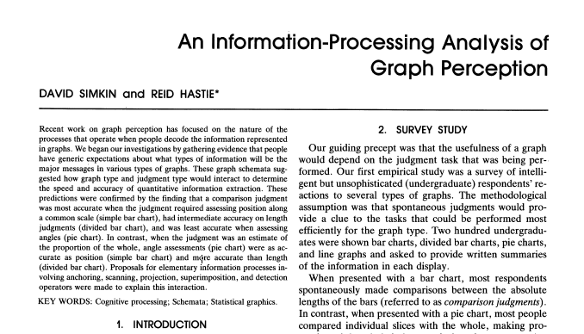
Perception, A framework for graph perception
Part of first page from Simkin and Hastie journal article
Notes:
Much of the work on the psychology of perception that I will be discussing next is drawn from this 1987 article by Simkin and Hastie.

Slide 45
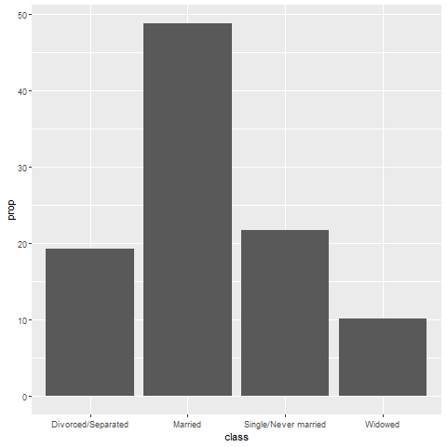
Perception, Which is better? A bar chart…
Bar chart

Slide 46
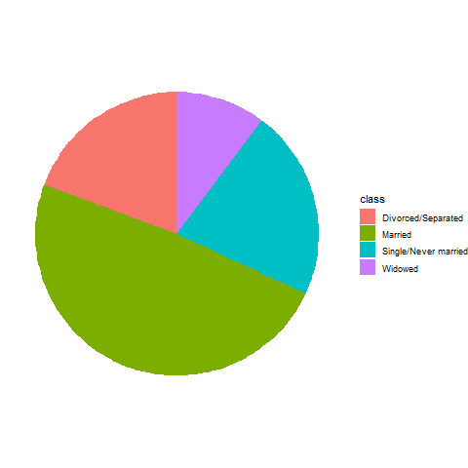
Perception, … or a pie chart
Pie chart

Slide 47
Perception, Answer. It depends.
What question are you trying to answer?
What proportion of the patients are single?
Are there more single or divorced patients?
Notes:
The answer really depends on what question you are asking. There are a variety of questions that you might ask. Two are illustrated above.
You can run an experiment (people have done this) where randomize and show half of them a bar chart and half of them a pie chart. Then you ask a question, like one of the questions above. Then you note the speed and accuracy of the response. Depending on the question, sometimes pie charts give faster and more accurate answers. Sometimes bar charts give faster and more accurate answers. It turns out that the results match up nicely with what we know about the psychology of perception.

Slide 48
Perception, Visual processing (1 of 3)
Projection
Shifting an object in a horizontal or vertical direction
Superimposition
Shifting in other directions (e.g., diagonal shifts, rotation) in order to make a comparison
Much harder than projection
Distance affects speed and accuracy of both projection and superimposition
Notes:
Your eye will try to move objects like bars in a bar chart to try to make comparisons. If these movements are solely in a horizontal or vertical direction, you are making a projection. If these movements are in a diagonal direction or if it involves rotation, you are making a superimposition.
Projections are easier than superimpositions. Both are affected by distance. The further the distance that you have to project, for exapmle, the more time it takes and the less accurate you get, on average.

Slide 49
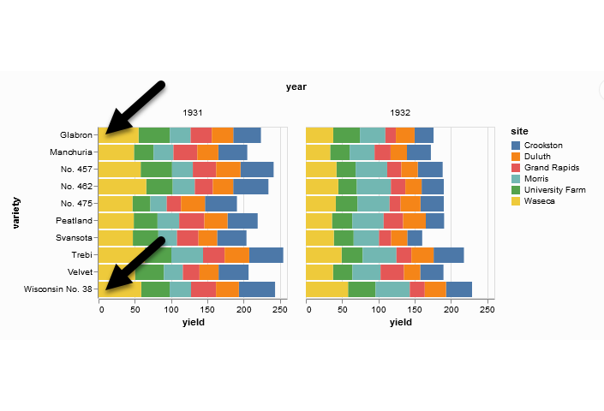
Perception, Projection (first yellow bar versus last yellow bar)
Stacked bar chart of crop yields
Notes:
The position means the vertical or horizontal location. Does the first yellow bar in 1931 (Glabron seeds planted in Wasica) extend further to the right than the last yellow bar (Wisconsin No. 38 seeds planted in Wasica)?

Slide 50
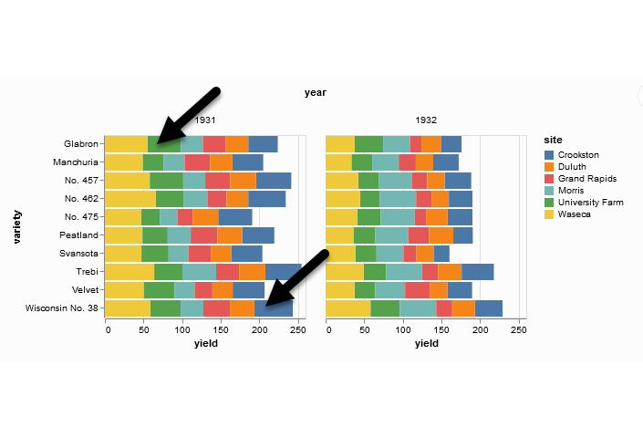
Perception, Superimposition (first green bar versus last blue bar)
Stacked bar chart of crop yields
Notes:
The length means either the width or the height. Does the first green bar in 1931 (Glabron seeds planted in University Farm) extend further to the right than the last yellow bar (Wisconsin No. 38 seeds planted in Crookston)?

Slide 51
Perception, Scanning and Anchoring
Scanning
Quantifying distance throug the use of a mental tape measure
Shorter distances are easier
Anchoring
Implicit or explicit development of reference points
Assists with scanning

Slide 52
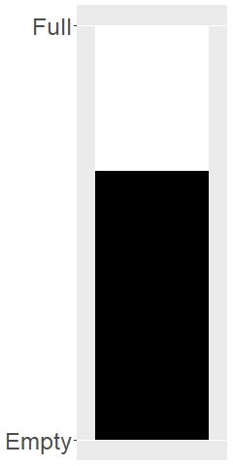
Perception, Scanning
Image of a fuel gauge, 65% full
Notes:
To understand scanning, think of a gas gauge. Usually it is a semicircular dial, but let’s set up the gas gauge as a rectangle. If the level is at the top, you have a full tank. If the level is at the bottom, you have an empty tank. This gauge shows a tank that is 65% full. Trust me, I drew the gauge. It is at 65%. Now how would you estimate the gas level?
You would take a mental tape measure, starting at the bottom and measure up to where the black box ends.
Now if you were smart, you’d start at the top and scan downwards. Less distance means that you can do this faster and more accurately.
Now if you were Albert Einstein, you’d split the gauge at the halfway point and measure from the halfway point to the top of the black box. Actually, there’s a little of Albert Einstein in all of us. That halfway point is something that all of us do subconciously. You did, because you recognized almost immediately that the tank was more than half full.

Slide 53
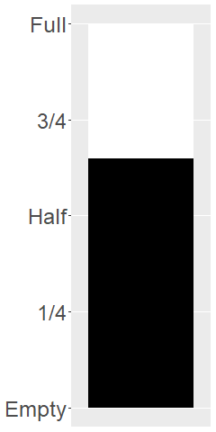
Perception, Assisting scanning with anchors
Image of a fuel gauge, anchors at 1/4, half, 3/4
Notes:
Here’s the same gas gauge, still at 65% full, but now we have added anchors at 1/4, half, and 3/4. You can read this gauge faster and more accurately, because you can scane from half up to 65% or from 3/4 down to 65%.

Slide 54
Perception, Visual processing (3 of 3)
Visually simple tasks
Position
Length
Angle/slope
Visually demanding tasks
Area
Volume
Density/Saturation/Hue
Notes:
There are a variety of perceptual tasks that you use when making comparisons within an image. These are arranged on this slide roughly in order of difficulty, with the easiest tasks at the top.

Slide 55
Perception, Position (first yellow bar versus last yellow bar)
Stacked bar chart of crop yields
Notes:
The comparison of the two yellow bars is a comparison of position. Which yellow bar extends further to the right?

Slide 56
Perception, Length (first green bar versus last blue bar)
Stacked bar chart of crop yields
Notes:
The comparison of the green and blue bars is a length comparison. The two bars start at different spots, so the position can’t help you.
Length is harder to judge than position, because it involves a superimposition rather than a projection.

Slide 57
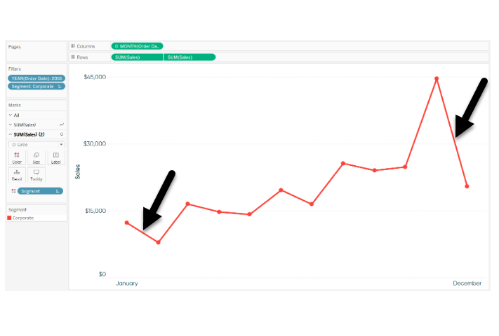
Perception, Angle/slope (first month decline versus last month decline)
Sales trend shown with a line graph
Notes:
This graph shows sales trends over a twelve month span. If you want to assess whether the first month decline (the dip in sales between January and February) was worse than the last month decline (the dip in sales between November and December), you would probably do this by judging the angle of the first line segment to the angle of the second line segment. This is not quite as easy as a position or length judgement, but it isn’t too bad either.

Slide 58
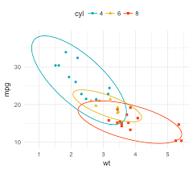
Perception, Area
Three ellipses

Slide 59
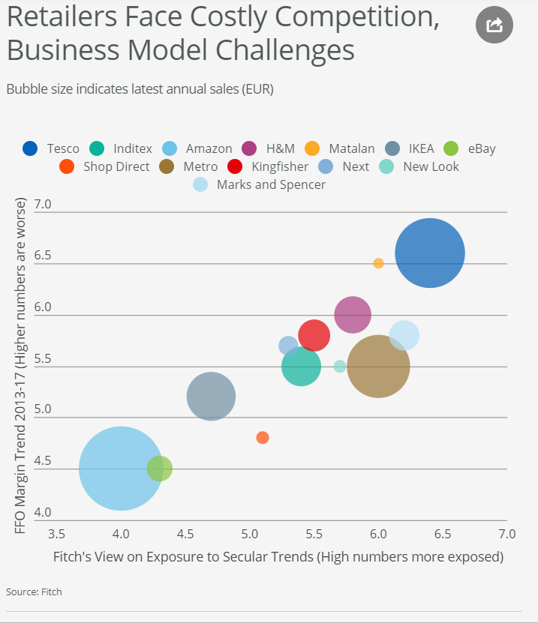
Perception, Area
Bubble plot
Notes:
This graph shows exposure and margin trends on the x and y axes. Larger values are worse on both axes. The size of the bubble is the size of the company (annual sales). There is some ambiguity here–is size measured in terms of diameter or in terms of area. Which is bigger, the brown circle (Metro) or the dark blue circle (Tesco)?

Slide 60
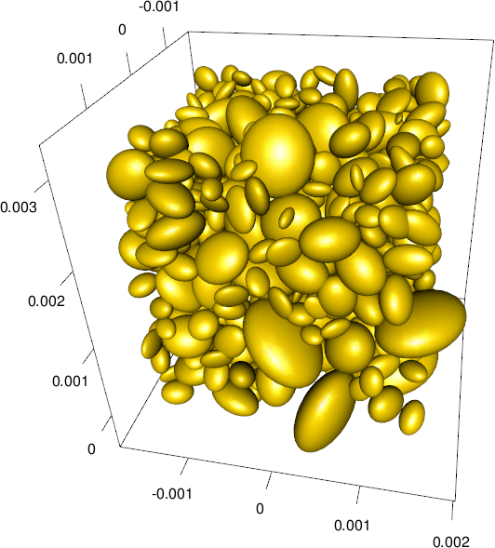
Perception, Volume
Ellipsoid plot
Notes:
Volume comparisons are especially difficult. This graphic image, busy beyond belief, shows three dimensional ellipsoids of various orientations. Picking out the biggest among these ellipsoids is not easy, even if you restricted it to ellipsoids that are fully visible.

Slide 61
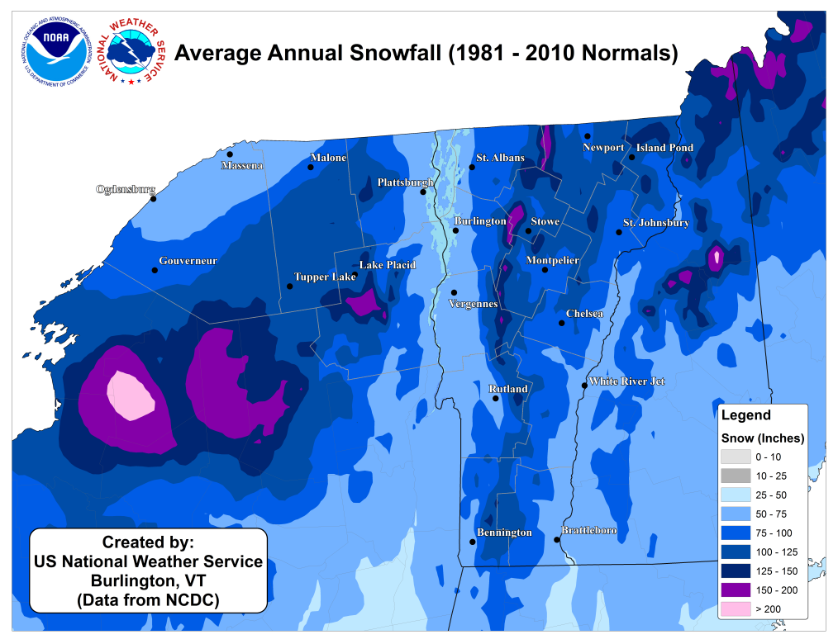
Perception, Color
Weather map of annual snowfall
Notes:
What city gets more snowfall, Remington, in the southwester corner of the state, or Newport, in the northeast corner of the state?

Slide 62
Barchart fundamentals
Fewer in numbers than points
Usually a summary statistic
Count
Percent
Average
Total
A bar chart is NOT a histogram
Notes:
Bar charts are different than point charts. There are usually only a few bars. These bars usually represent a summary statistic, like a count, percent, average, or total.
There is a technical distinction between a bar chart and a histogram. Histograms are a great diagnostic tool, but usually ends up on the cutting room floor. So I won’t be talking about it much, if at all, in this workshop.

Slide 63
Barchart fundamentals, Aesthetics for bars
Review
Location
Size
Color
NOT shape!!!
Notes:
Recall that aesthetics are visual attributes associated with a geometry/mark. You can map variables to the location, size, and/or color of bars, but you cannot assign a variable to the shape of a bar.

Slide 64
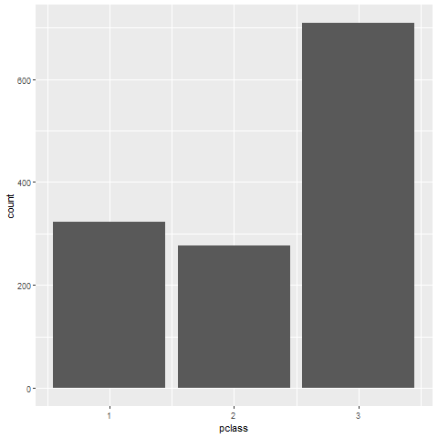
Barchart fundamentals, Location
Bar chart of passenger class count
Notes:
This is data from the Titanic, a ship that was as massive as its name. It was considered unsinkable, but on its maiden voyage in 1912, the ship hit an iceberg and sank. It sank during an era where people really believed in women and children first, and this shows quite clearly in the mortality statistics. There was a difference, though, between third class passengers like Leonardo diCaprio and first class passengers like Kate Winslet.
This shows a simple bar chart. The x-axis is passenger class and the y-axis is count. Note that there are about the same number of first and second class passengers, but the two combined does not come close to the number of third class passengers.

Slide 65
Exercise, Gender barchart
Draw a bar chart showing the number of people in each gender (use the Sex variable).

Slide 66
Exercise, Python code
Here’s the Python code
ch = alt.Chart(df).mark_bar().encode( x='sex', y='count()' )

Slide 67

Exercise, Python output

Slide 68
Exercise, R code
Here’s the R code
ggplot(titanic, aes(sex)) + geom_bar()

Slide 69
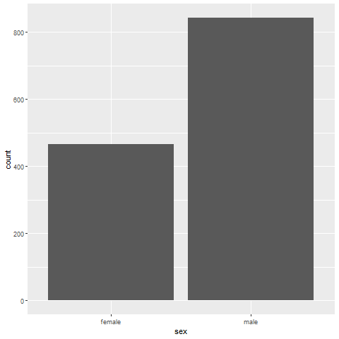
Exercise, R output

Slide 70
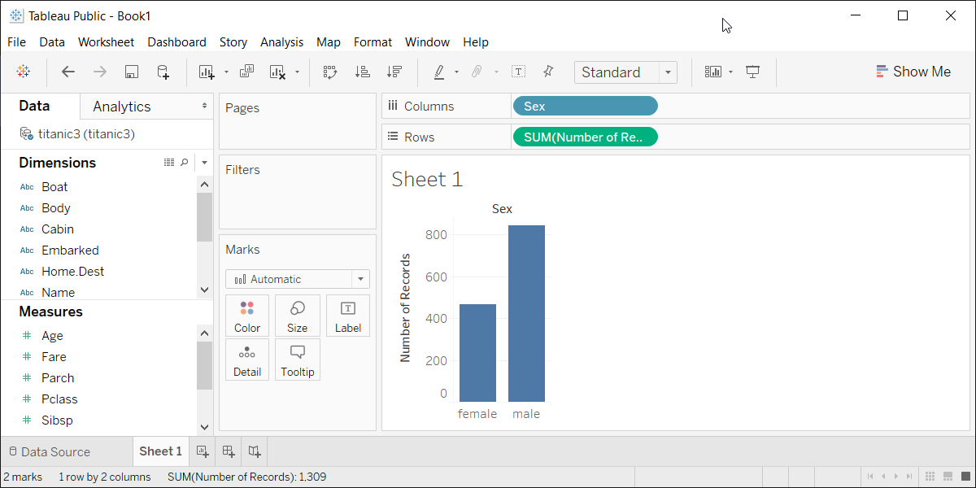
Exercise, Tableau output
Tableau barchart

Slide 71
Barchart fundamentals, Size
Length varies, width doesn’t
Exception, mosaic plots
Think about gaps between bars
Notes:
Normally bar charts have different lengths but a common width. That’s not always the case. There are some bar charts that vary the width, such as mosaic plots and spine plots. We will not cover those types of barcharts.
Barcharts are also typically rooted at the axis. There are a few exceptions, such as Gannt charts, but again, we will not cover those types of graphs.

Slide 72
Barchart fundamentals, Color
Use for emphasis in simple bar charts
Very important for stacked or side-by-side bar charts
Notes:
For simple bar charts like all the ones we’ve seen so far, color is not really needed. You already can distinguish between the passenger classes using the location. If you do use color in a simple bar chart, it is often to emphasize a point. In the previous bar chart, I used red for third class, because Kate Winslet, a rich first class passenger, found true love in third class, with the adorable Leonardo di Caprio.
Color becomes very important in just a minute when we add another layer of complexity.

Slide 73
Barchart fundamentals, Color
Barchart

Slide 74
Exercise, First class red
Make the first class bar red to show Leonardo di Caprio’s perspective on the Titanic.

Slide 75
Exercise, Python code
Here’s the Python code
((Python code))

Slide 76
Exercise, Python output
((Python results))

Slide 77
Exercise, R code
Here’s the R code
((R code))

Slide 78
Exercise, R output
((R results))

Slide 79
Exercise, Tableau output
((Tableau results))

Slide 80
Barchart fundamentals, Stack versus dodge
Summarize by two categories
Facet
Separate plots
Dodge
Side by side
Similar to facet
Stack
One on top, one on bottom
Notes:
Bar charts that represent a summary across a single categorical variable are fairly simple and easy to handle. But when you want to summarize by two categories simultaneously, things get interesting. Interesting in a good way.

Slide 81
Barchart fundamentals, Titanic passenger count by gender
Bar chart

Slide 82
Barchart fundamentals, Titanic passenger count by passenger class

Slide 83
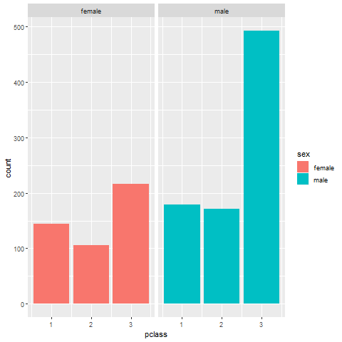
Barchart fundamentals, Titanic facet

Slide 84
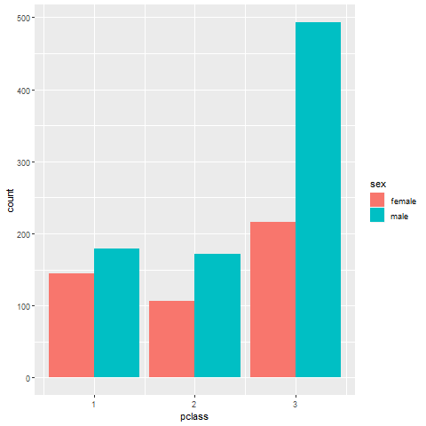
Barchart fundamentals, Titanic dodge

Slide 85
Barchart fundamentals, Titanic stack
`r display_images

Slide 86
Exercise, Mortality by gender
Draw a bar chart showing counts involving both mortality and gender. Use a panel, then stacking, then dodging. Which do you like best?
Notes:
Mortality on the Titanic reflects the fact that this was an era when people really did believe in the concept of “women and children first.” Someone like me, I’d be shoving the little kids aside so I could get on one of the lifeboats.
Anyway, examine how mortality is related to gender. It’s a spoiler alert, but on the Titanic, Kate survives, but Leonardo, I am so sad to say this, didn’t make it.

Slide 87
Exercise,Python code
Python code
((Python code))

Slide 88
Exercise, Python output
((Python results))

Slide 89
Exercise, R code
R code
titanic %>% ggplot(aes(x=sex, fill=survived)) + geom_bar() + facet_grid(cols=vars(survived))

Slide 90
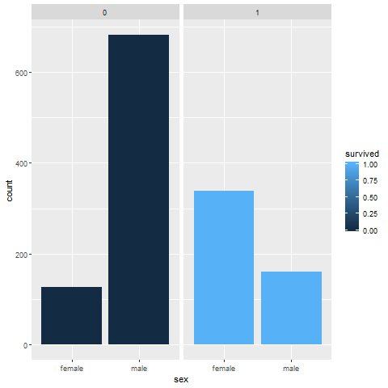
Exercise, R output

Slide 91
Exercise, Tableau output
((Tableau results))

Slide 92
Barchart fundamentals, Summarizations
One number summary (mean or percentage)
Two number summary (error bars)
Five number summary (boxplots)
All the data
Jittering
Opacity
Notes:
All of the examples, so far, have used counts in the bar chart. There are many other statistics that you can choose from, and
((note to myself: maybe this goes better in the talk about lines.))

Slide 93
Barchart fundamentals, Switching from count to percent
((Show the code in Python, R, and Tableau. Explain why you might want counts versus percents.))

Slide 94
Barchart fundamentals, Example with means
((Need to find the right data set to illustrate this. Maybe the Saratoga house prices?))

Slide 95
Barchart fundamentals, Example with totals
((Same data. What means tell you versus totals.))

Slide 96
Barchart fundamentals, Boxplots example
((Include an explanation of what a boxplot is))

Slide 97
Barchart fundamentals, Jittering example
((Include an explanation on when it doesn’t work.))

Slide 98
Barchart fundamentals, Opacity example
((Note the computational expense.))

Slide 99
Barchart fundamentals, Summary
“A mapping of data to the visual aesthetics of geometries/marks”
Bars are a type of geometry/mark
Aesthetics for bars include location, size, color
Stack versus dodge
Basic tips
Place comparators close
Use axis ticks, light grid lines

Slide 100
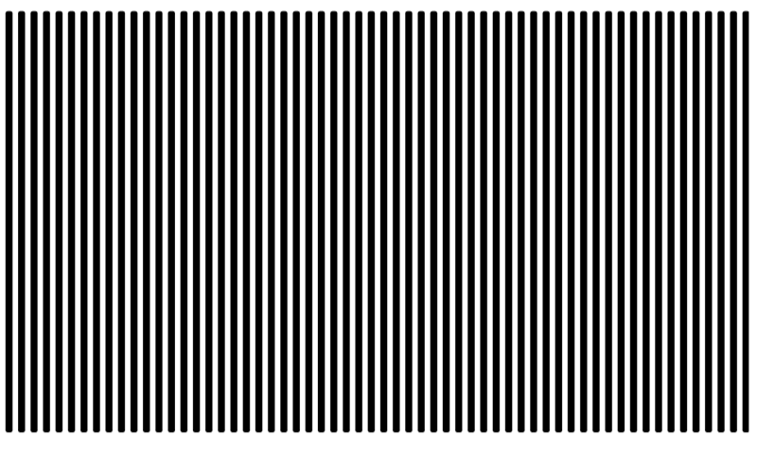
Barchart recommendations, Don’t make gaps equal to widths (1/2)
Alternate white and black lines showing a Moire effect
Notes:
If the space between the bars is equal to the width of the bars themselves, you get an unsettling vibratory effect. This is because your eye is constantly shifting perspective. Sometimes it perceives the black as the foreground and the white as the background. Sometimes it perceives the white as the foreground and the black as the background.
“I’m ten years old, my life’s half over. And I don’t even know if I’m black with white stripes or white with black stripes.” Marty the Zebra in the movie Madagascar.

Slide 101
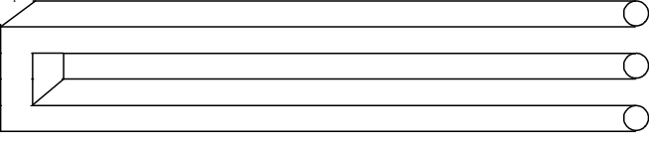
Barchart recommendations, Don’t make gaps equal to widths (2/2)
Optical illusion showing two bars becoming three
Notes:
If the widths are the same and the bars are empty, then you can get a differnt problem. You might get confused as to what is the bar and what is the gap, as in this optical illusion.
As a general rule, the gap between bars should be about 10 to 20 percent of the width of the bars. Most visualization software has sensible defaults, but beware when you have a very large number of bars. There’s always a bit of rounding when you place pixels on a screen or on a page. Your software is trying to fill the available plotting area, so it may have to squeeze or stretch one gap or another. This unevenness can become noticeable when the gaps are only a few pixels wide.
((Show an example of this using the scotus data))

Slide 102
Barchart fundamentals, Thoughts on location
Axis labels often fit better on vertical location
Cannot vary both X and Y
Notes:
The default for most visualization software is vertical bars, but you should give thoughtful consideration to horizontal bars. The labels often fit better when the bars are horizontal. You also often have more room left to right than you do up and down in a graph, so the bars can stretch out more, allowing you to more easily discern small and subtle differences.
Remember the fault of default principle. Always try different ways of displaying your data. It costs nothing other than a few electrons to display a horizontal alternative to the typical vertical bar chart format, so why not indulge yourself?

Slide 103
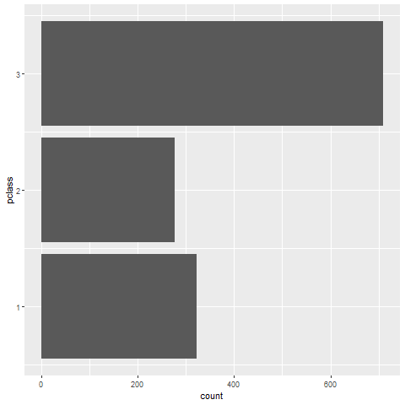
Barchart recommendations, Turn the chart sideways
Notes:
Labels often fit better on a vertical bar chart.

Slide 104
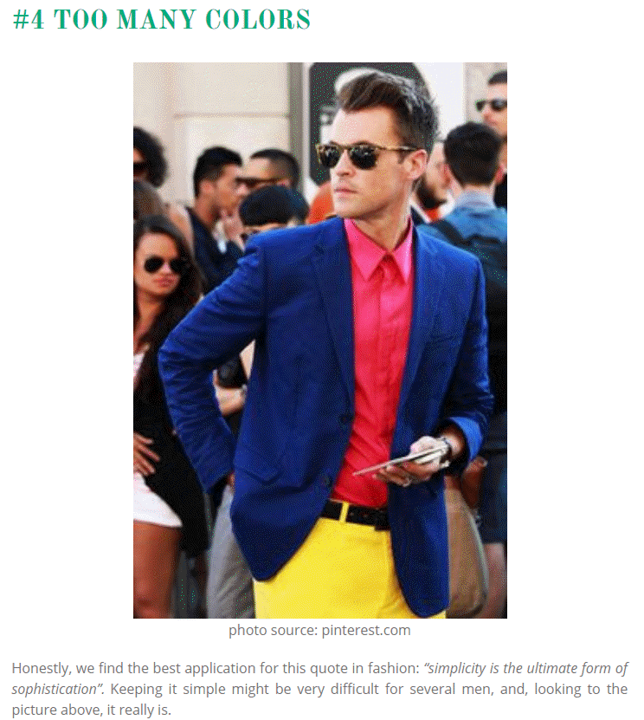
Barchart recommendations, similar to fashion
Image of man wearing three bold colors
Notes:
It’s a well known fasion mistake to wear too many colors at the same time. Maybe this guy could get away with it, but most of us would look like idiots if we tried to dress that way.
There’s a similar lesson for data visualization.

Slide 105
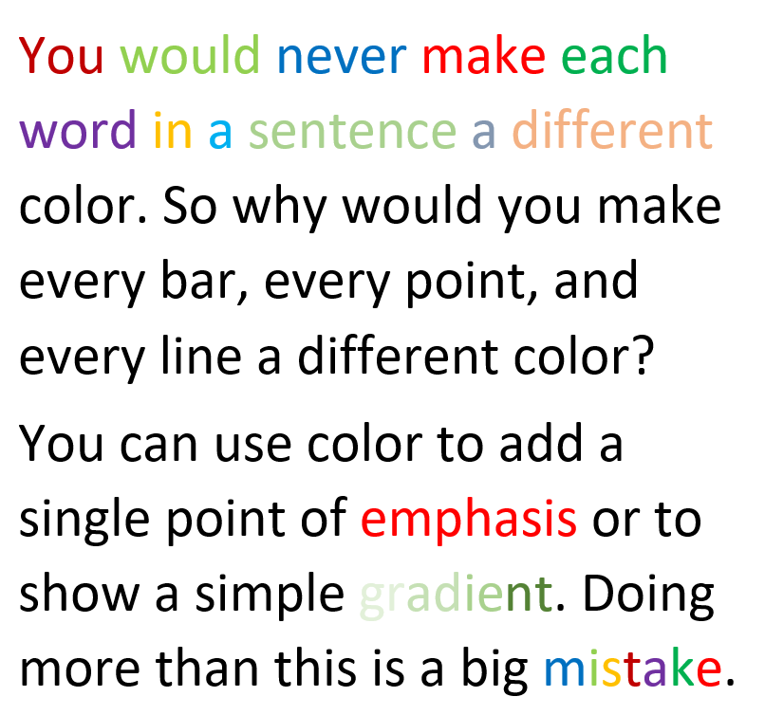
Barchart recommendations, Don’t overuse colors.
Text will a variety of colors
Notes:
Naomi Robbins, an expert on data visualization, made an interesting observation. You would never make each word in a sentence a different color. So why would you make every bar, every point, and every line a different color?
Too many colors dilutes the impact that color can have.
You can use a second color to add emphasis. Or maybe a gradient between two different colors could work. Doing more than this is usually a big mistake.

Slide 106
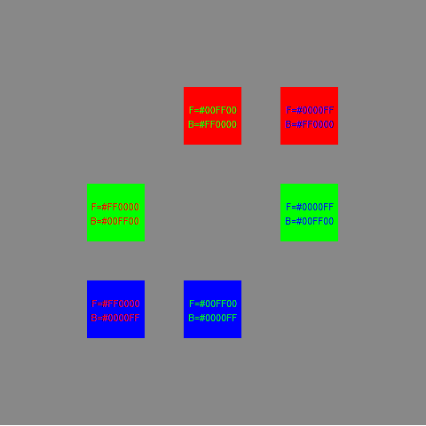
Colors, Contrasting pure colors often appear too intense

Slide 107
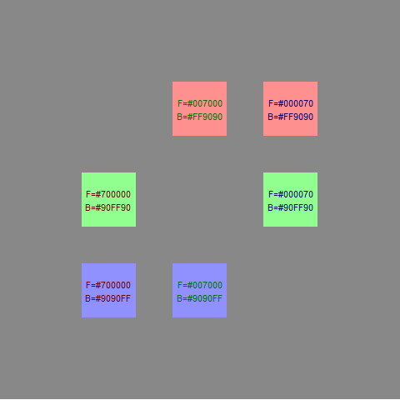
Colors, Lighter background, darker foreground

Slide 108
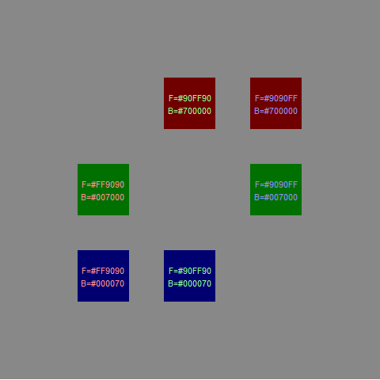
Colors, or the reverse

Slide 109
Avoid the rainbow gradient
(To be added)

Slide 110
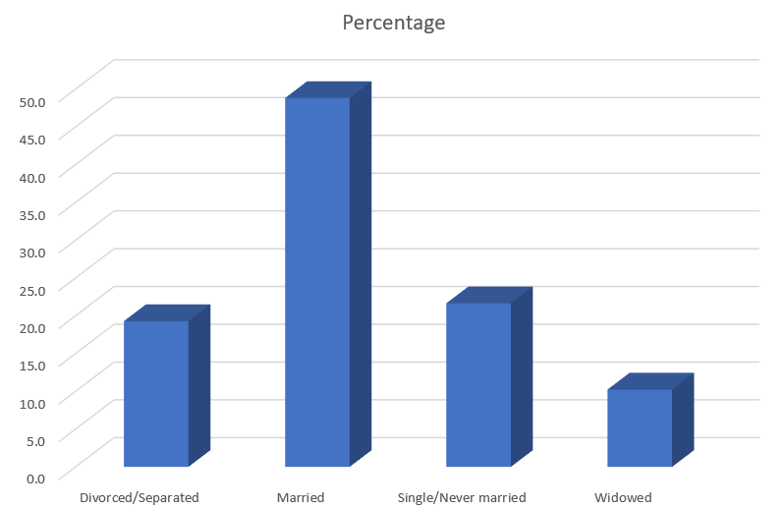
Perception, Adding depth (1/4)
Three dimensional bar chart
Notes:
Some sotware packages allow you to add some depth to your pie chart. This can catch your eye, at first, but almost all experts hate this approach. The most common complaint is that the three dimensional effects make a graph worse.
Worse means that it slows you down and it decreases the accuracy of your response. So here’s a question. What percentage of your sample is single/never married? THe three dimensional effects slow you down. So for this three dimensional bar chart, do you measure the height of the single/never married bar by projecting the front of the bar to the axis on the left or by projecting the back of the bar? Actually, you need to first project to the back “wall” because the bars are placed a small distance in front.

Slide 111

Perception, Adding depth (2/4)
Projection lines for a three dimensional bar chart
Notes:
Once you realize that you need to project to the back wall, you have to do this accurately. Notice that it is not a simple horizontal or vertical projection. Instead you have to do a couple of superimpositions, shifts at a 45 degree angle. You can do this, but it degrades your accuracy.

Slide 112
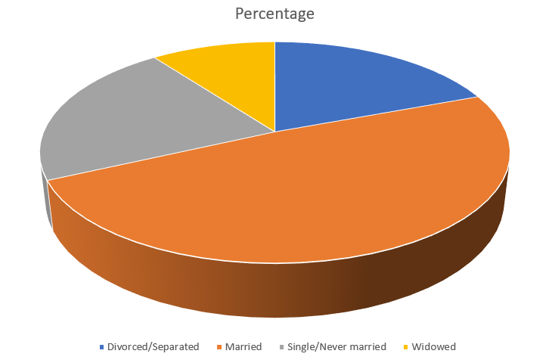
Perception, Adding depth (3/4)
Three dimensional pie chart

Slide 113
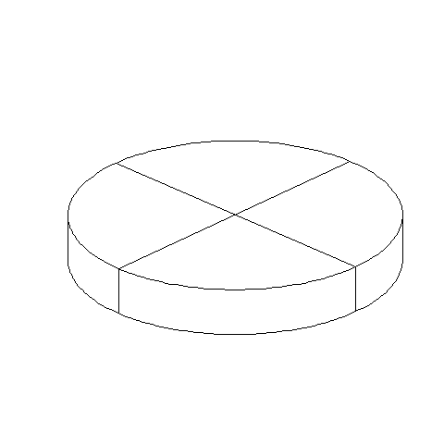
Perception, Adding depth (4/4)
Three dimensional pie chart split into four equal pieces
Notes:
There are several issues with the three dimensional pie chart, and you can see this best when you split this pie chart into four equal pieces. Notice that the angles are no longer 90 degrees because the perspective view distorts the angles. So you lose the big advantage (and possibly the only advantage) of the pie chart, the ability to divide it easily into four pieces.
Also notice that the wedge in the foreground looks bigger than the wedge in the background, because you can see the side of the foreground wedge, but you can’t see the side of the background wedge.

Slide 114
Perception, review
Visual tasks
Hierarchy of perception

Slide 115
Graphs in the news, what are the aesthetics?
What aesthetics (location, shape, size, color) are used?
What aesthetics are not used?
What variables are mapped to which aesthetics?
Notes:
Review the same newspaper article and graph that you used earlier. Identify the various aesthetics that are used or are not used in your graph. What variables are associated with which aesthetics?

Slide 116
Barcharts, On your own
((Describe some possible analyses using the scotus data set.))

