Slide 1
A tutorial on colors
Steve Simon

Slide 2
Colors, introductory tutorial
Kindergarten view of colors
Review hexadecimal codes
Color systems
RGB
HSV
CMYK
Notes:
There are three major color systems used on computers, RGB, HSV, and CYMK. I’ll discuss RGB in detail, and touch briefly on the other systems. But you need to realize that how colors work on a computer was not the way you learned in Kindergarten. A solid understanding of the RGB color system also requires you to work comfortably with hexadecimal codes, so I have a brief review of that as well.

Slide 3
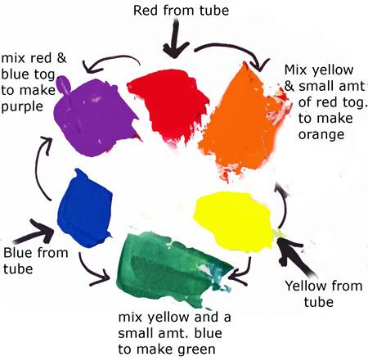
Colors, Everything I know about colors, I learned in Kindergarten.
Notes:
It was probably in Kindergarten where you learned the basic way to combine primary colors. Yellow plus red equals orange, Yellow plus blue equals green. Red plus blue equals purple/violoet.
It doesn’t work that way on a computer screen because screens use light to create colors and lights blend in different ways than paints or crayons.
Before you tackle ths computer system for colors, you need to review binary and hexadecimal number systems.

Slide 4
Colors, Binary codes
“There are 10 types of programmers in the world, those who undestand binary and those who don’t.”
1001 1100 (base 2)
= $1*2^{7}+0*2^{6}+0*2^{5}+1*2^{4}+1*2^{3}+1*2^{2}+0*2^{1}+0*2^{0}$
= 128+16+8+4 = 156
Eight binary digits represent the numbers 0-255
Notes:
Let me share a bad joke about binary numbers. Actually, you need to read it because the digits “1”-“0” represent something entirely different in the world of binary numbers.
Here’s an example of how to decode the binary number 1001 1100.
Binary numbers use powers of two: 1, 2, 4, 8, 16, etc. Eight binary digits can represent any number from 0 to 255.

Slide 5
Colors, Hexadecimal codes
Hexadecimal digits (base 16)
0-9, A=10, B=11, C=12, D=13, E=14, F=15
1001 1100 (base 2)
= 9C (base 16)
= $9*{16}^{1}+12*{16}^{0}$
Two hexadecimal digits represent the numbers 0-255.
00 (base 16) = 0, FF (base 16) = 255
A # prefix implies hexadecimal in most computer languages.
Notes:
Binary representations get unwieldy very quickly, and the hexadecimal format provides a much tighter representation that still has the spirit of binary. It is fairly easy to switch back and forth between binary and hexadecimal.
Hexadecimal means powers of 16 and you can represent numbers up to (but not including) 16 using four binary digits. The ehxadecimal digits start out like normal digits, 0, 1, 2, etc. but once you get up to nine you run out of single digits. So the value of 10 is represented by the letter A, the value of 11 by B, etc. through the letter F which represents 15. At sixten, you roll over to the next place.
So you count in hexadecimal like 0, 1, 2, 3, 4, 5, 6, 7, 8, 9, A, B, C, D, E, F, 10, 11, …
Split the eight digit binary number 1001 1100 into groups of four binary digits. The binary 1001 is equal to 9 and the binary 1100 is equal to 12 or C. So the hexadecimal equivalent is 9C. You can represent this using powers of 16, 9 times 16 to the first power plus twelve times 16 to the zeroth power. That works out to 156.
Tow hexadecimal digits just like eight binary digits can represent the numbers 0 to 255, with 00 hexadecimal equaling 0 and FF hexadecimal equaling 255 (15*16+15).
Use the prefix of a pound sign (hash tag) to tell the computer that you are speaking to it in hexadecimal.

Slide 6
Colors, Codes for colors
#rrggbb format
#000000 is pure black
#FFFFFF is pure white
#FF0000 is pure red
#00FF00 is pure green
#0000FF is pure blue
You can mix and match to get 16,777,216 colors
#800080 is purple, #FF69B4 is pink, #40e0d0 is turquoise
Notes:
The RGB format uses six hexadecimal digits to represent colors. A hexidecimal of all zeros is pure black and at the other extreme, a hexidecimal of all F’s is pure white.
The first two hexidecimal digits represent the red channel. The highest value FF for the red channel combined with zeros for the other two channels (#FF0000) equals pure red.
The next two digits represent the green channel. #00FF00, giving the maximum to the green channel and the minimum to the other two channels produces a pure green.
The last two digits represent the blue channel, and #0000FF represents pure blue.
You can combine these in a variety of ways. You end up with an almost unlimited number of colors. Six hexadecimal digits allow you to produce 16^6 or 16,777,216 different colors.

Slide 7
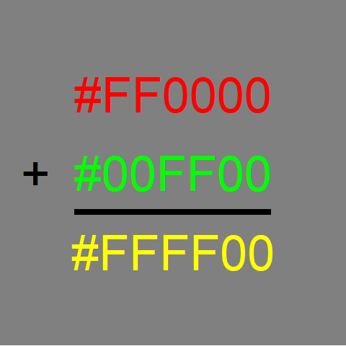
Colors, Red plus green equals yellow
Notes:
Whne you combine colors in the RGB system, they become lighter in color. So if you add red light (FF in the red channel) to green light (FF in the green chanel), you get yellow, which is FF in both the red and green channels.

Slide 8
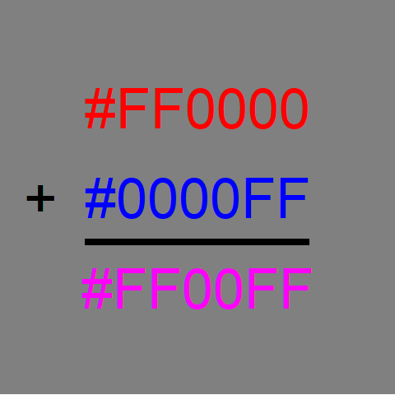
Colors, Red plus blue equals magenta
Notes:
Red plus blue gives you #FF00FF, which is magenta, a light purplish red.

Slide 9
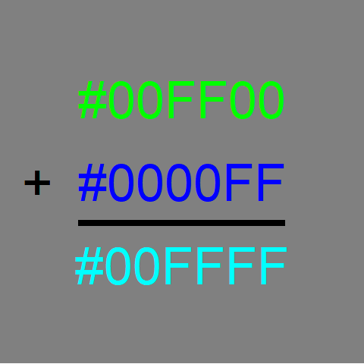
Colors, Green plus blue equals cyan
Notes:
Green plus blue gives you #00FFFF, which is cyan, a greenish blue color.

Slide 10
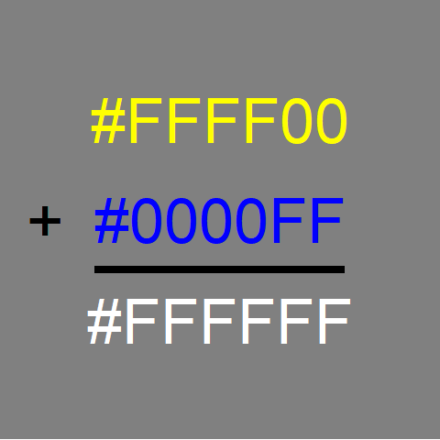
Colors, Yellow plus blue equals white
Notes:
Yellow has FF in the red and green channels and 00 in the blue chanel. If you combine yellow with blue, you fill up all three channels and produce white.
Notice that this is not at all what happens with crayons or paints. In those settings, yellow plus blue gives you green.

Slide 11
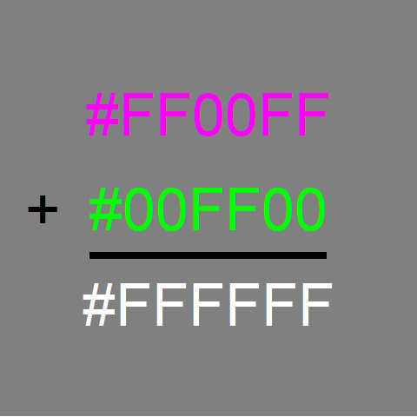
Colors, Magenta plus green equals white
Notes:
Similarly, magenta has FF in the red and blue channles. Add green to fill in the last channel and you get white.

Slide 12
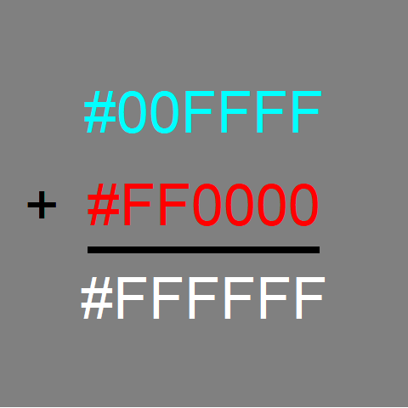
Colors, Cyan plus red equals white
Notes:
Finally, cyan has FF in the green and blue channels. Adding red to fill the last channel produces white.

Slide 13
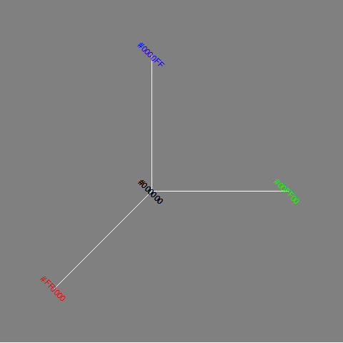
Colors, The color cube (1/2)
The three axes of the color cube
Notes:
The color cube shows the three dimensions (red, green, and blue) of the RGB color system as axes in a three dimensional space.

Slide 14
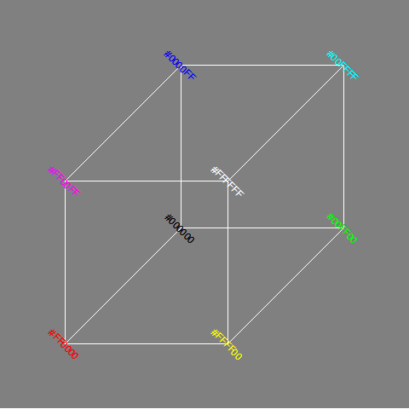
Colors, The color cube (2/2)
The full color cube with a front white vertex
Notes:
The combination colors of yellow, magenta, cyan, and white represent different vertices of the color cube.

Slide 15
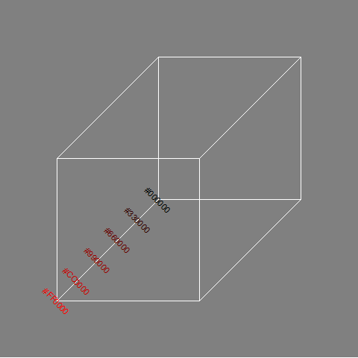
Colors, Gradients of black to red
Notes:
You can develop gradients, gradual and continuous changes in color, by varying the channels from lowest to highest. If you let the red channel range from 00 to FF and keep the other channels at zero, you get a gradient from black through dark shades of red to pure red.
The figure only shows six values for the gradient (red channels ranging from 00 to 33, to 66 to 99 to CC), but you can produce 255 different shades between black and red.

Slide 16
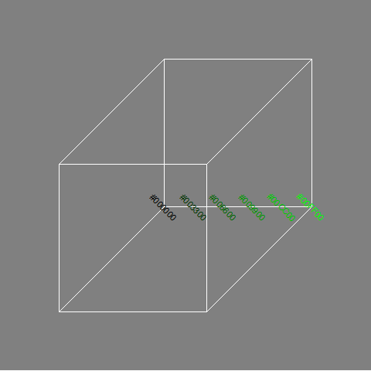
Colors, Gradients of black to green
Notes:
Similarly, if you let the green channel vary from 00 to FF and hold the red and blue channels at zero, you get a gradient that goes from black through dark shades of green to pure green.

Slide 17
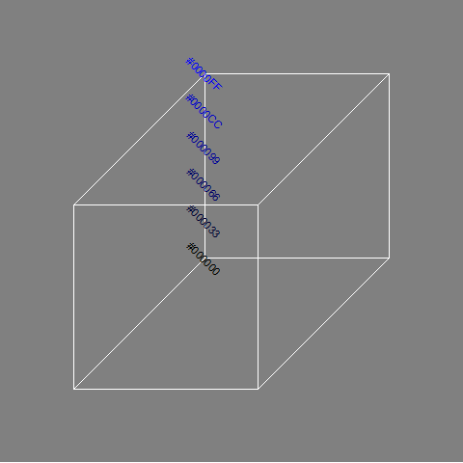
Colors, Gradients of black to blue
Notes:
Varying the blue channel from 00 to FF while keeping the red and green channels at zero will produce a gradient of black through dark shades of blue to pure blue.

Slide 18
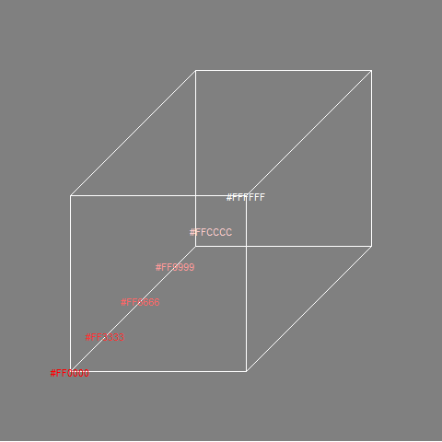
Colors, Gradients of red to white
Notes:
To create a gradient from red through the lighter shades of red (pinkish, actually) to white, keep the red channel at full strength (FF) and vary the green and blue channels from 00 to FF.

Slide 19
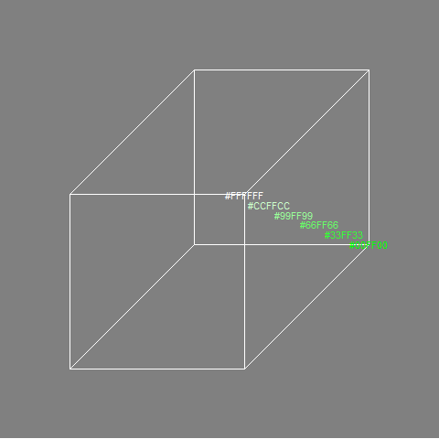
Colors, Gradient of green to white
Notes:
Similary, you can create a gradient from pure green through the lighter shades of green to white.

Slide 20
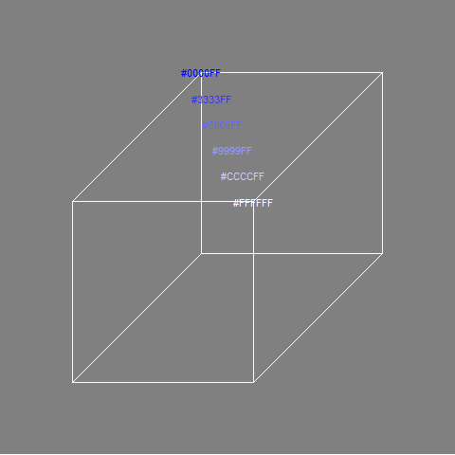
Colors, Gradient of blue to white
Notes:
And just as easily you can develop a gradient that goes from pure blue through the lighter shades of blue to white.

Slide 21
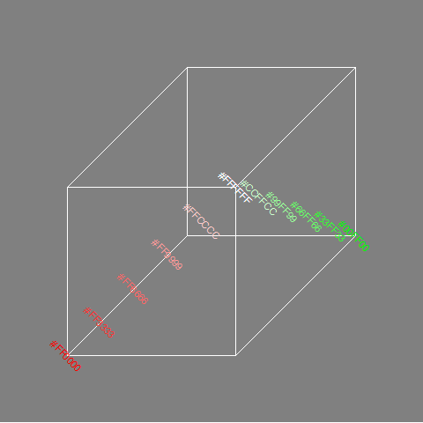
Colors, Gradients of red to green via white
Notes:
If you want to go from one pure color to another, there is more than one route that works. You can run red to white and then white to green.

Slide 22
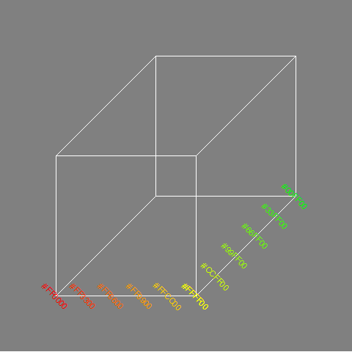
Colors, Gradients of red to green via yellow
Notes:
A common gradient for red to green relies on the fact that yellow is a combination of red and green. So start with red at full blast (FF), green at zero (and blue at zero). Move towards yellow by mixing in a bit more green. Once you get to pure yellow (FF in the green and red channels), reverse this process by keeping the green channel at full blast (FF) and gradually reduce the red channel to zero.

Slide 23
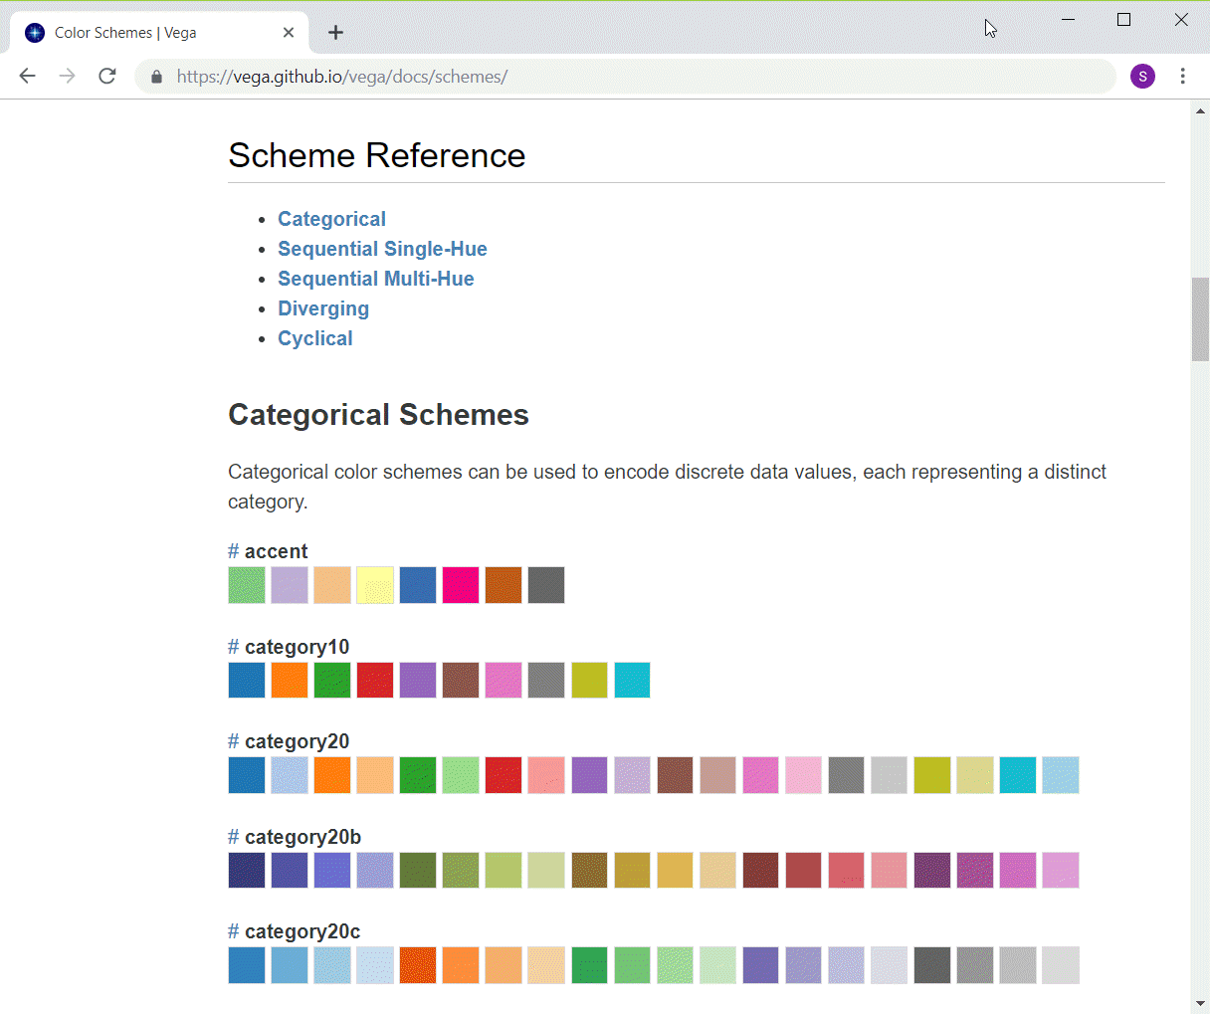
Colors, Python categorical schemes
Listing of first few Altair color schemes
Notes:
If you want to use colors to represent categories, you want every color value to be readily distinguishable from every other color value. Python/Altair offers some pretty good choices if you have 10 or less levels for your categories. If you have more than 10 categories, you have to live with some colors being only slightly different than the others.

Slide 24
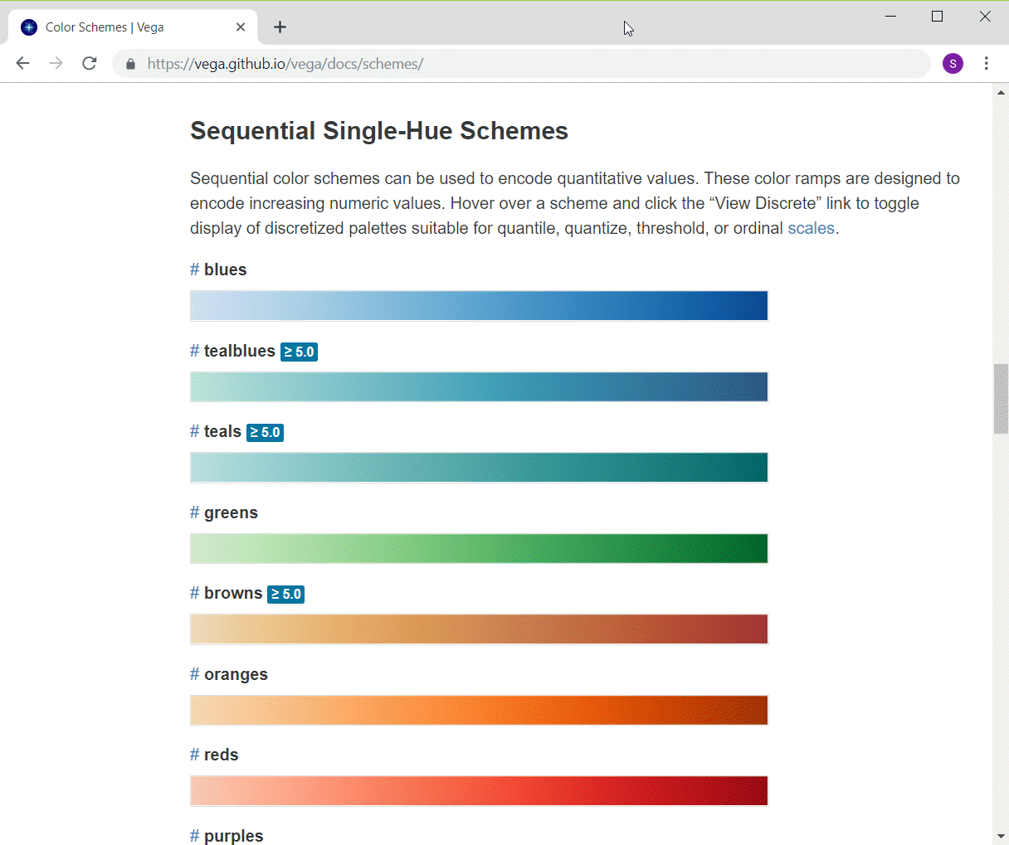
Colors, Python single hue schemes
Listing of first few Altair color schemes
Notes:
Python/Altair has several single hue gradients that go from a very light to very dark in a variety of hues.

Slide 25
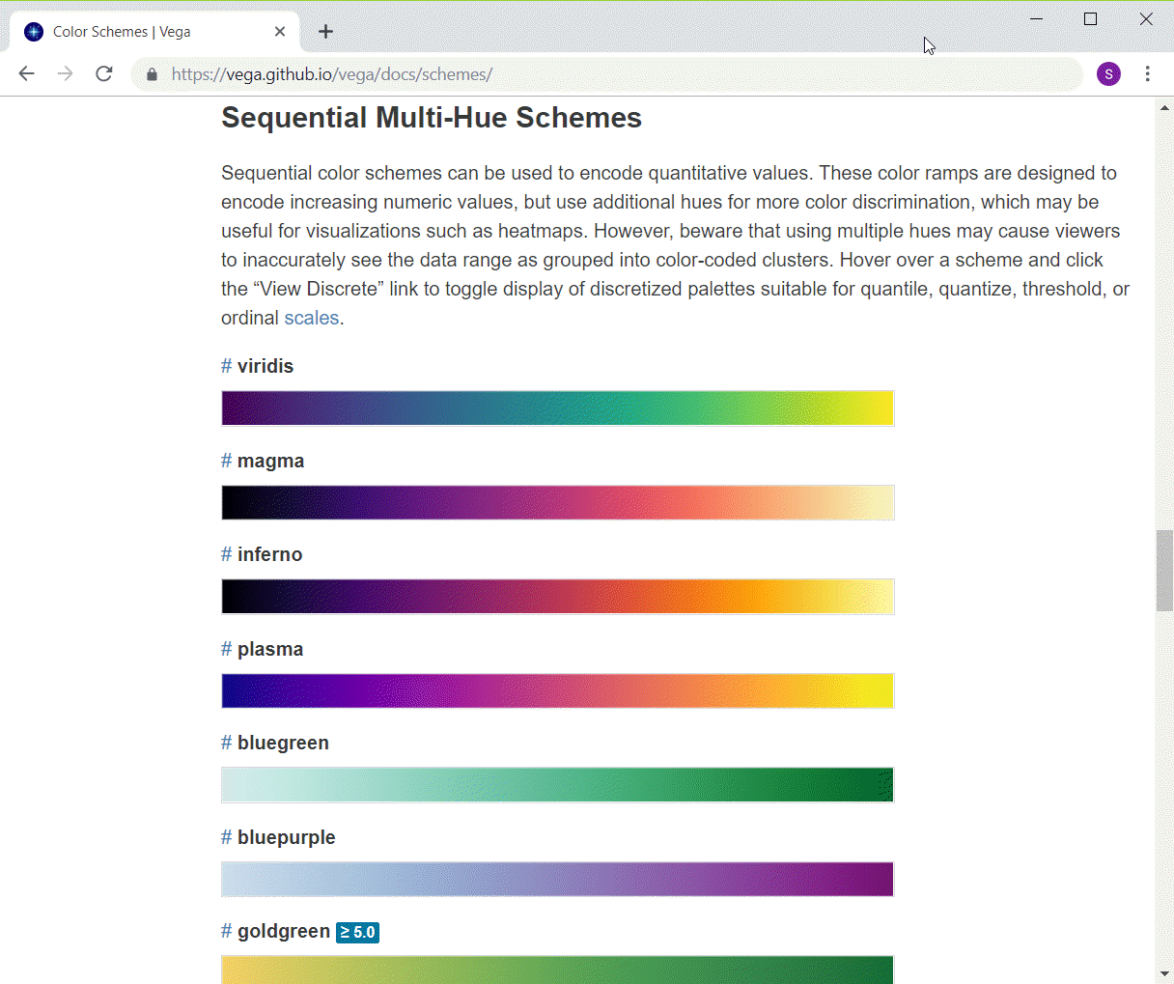
Colors, Python multi-hue schemes
Listing of first few Altair color schemes
Notes:
The multi-hue color schemes in Python/Altair transition from one hue to another hue. The colors are more or less equally intense throughout the entire range.

Slide 26
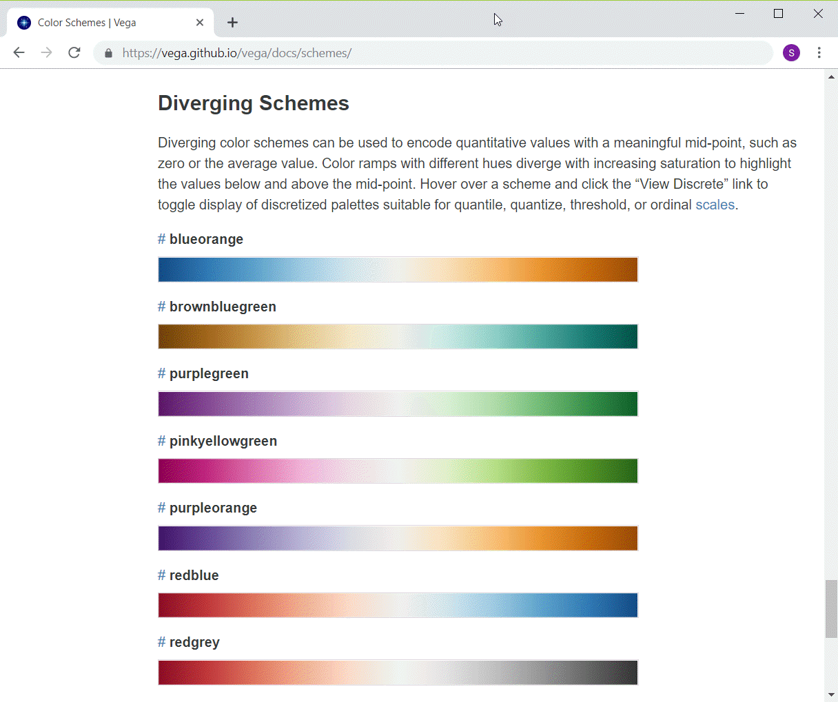
Colors, Python diverging schemes
Listing of first few Altair color schemes
Notes:
The diverging schemes also transition from one hue to another but in the middle the colors lose all their intensity, fading away to white or gray.

Slide 27
Colors, Python code to change color schemes
ch = alt.Chart(df).mark_point().encode( alt.Color('Bathrooms', scale=alt.Scale(scheme='reds')), x='Age', y='Price' )

Slide 28
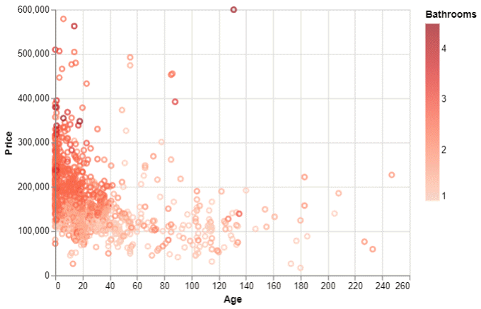
Colors, Python output
Python scatterplot using red gradient

Slide 29
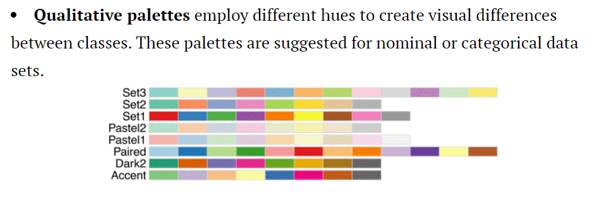
Colors, R qualitative schemes
Display of various discrete color schemes
Notes:
You can get color schemes from various sources in R. One of the best and most popular is called Color Brewer. It has color schemes in three areas: qualitative, sequential, and diverging. Here are the qualitative color schemes.
Notice that R does not try to present a categorical color scheme with more than 12 values. These schemes do a fairly good job of keeping each of the colors reasonably different from the others.

Slide 30
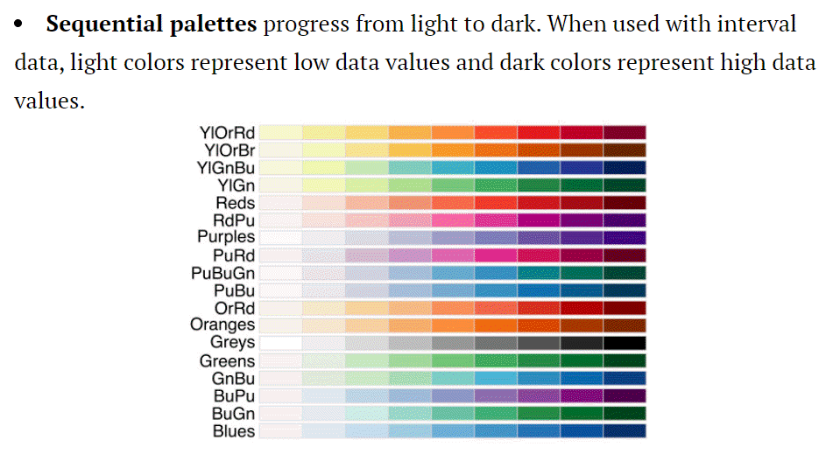
Colors, R sequential schemes
Display of various sequential color schemes

Slide 31
Colors, R code for changing color schemes
ggplot(saratoga_houses, aes(Age, Price)) + geom_point(aes(color=Bathrooms)) + scale_color_gradient(low="#FFFFFF", high="#FF0000")

Slide 32
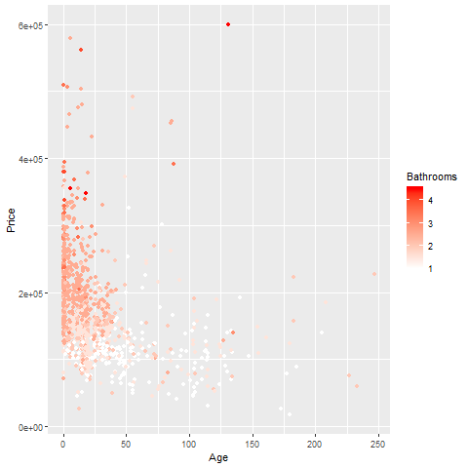
Colors, R output

Slide 33
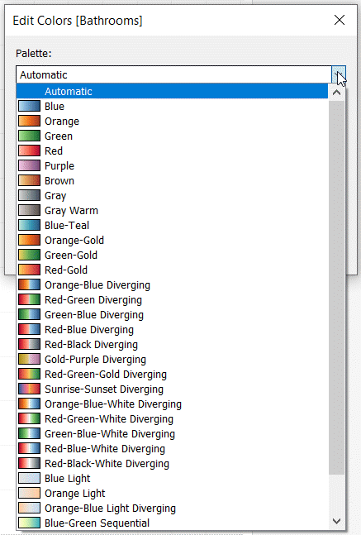
Colors, Tableau gradient schemes
Gradient drop-down menu in Tableau
Notes:
Tableau has quite a few choices for a continuous color gradient, but they are not as neatly categorized as the ones in Python/Altair and R.
https://help.tableau.com/current/pro/desktop/en-us/viewparts_marks_markproperties_color.htm

Slide 34
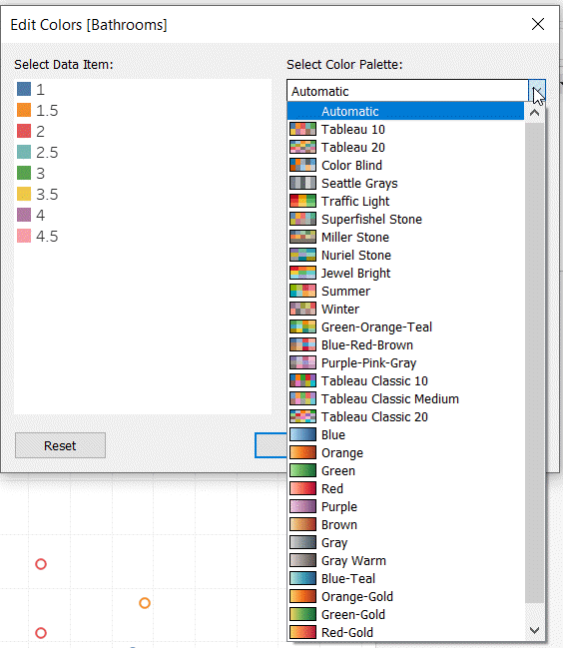
Discrete color options in Tableau
Discrete color drop-down menu in Tableau
Notes:
The discrete choices (for representing categories using color) are also quite diverse, but they seem hard to group into any pattern.

Slide 35
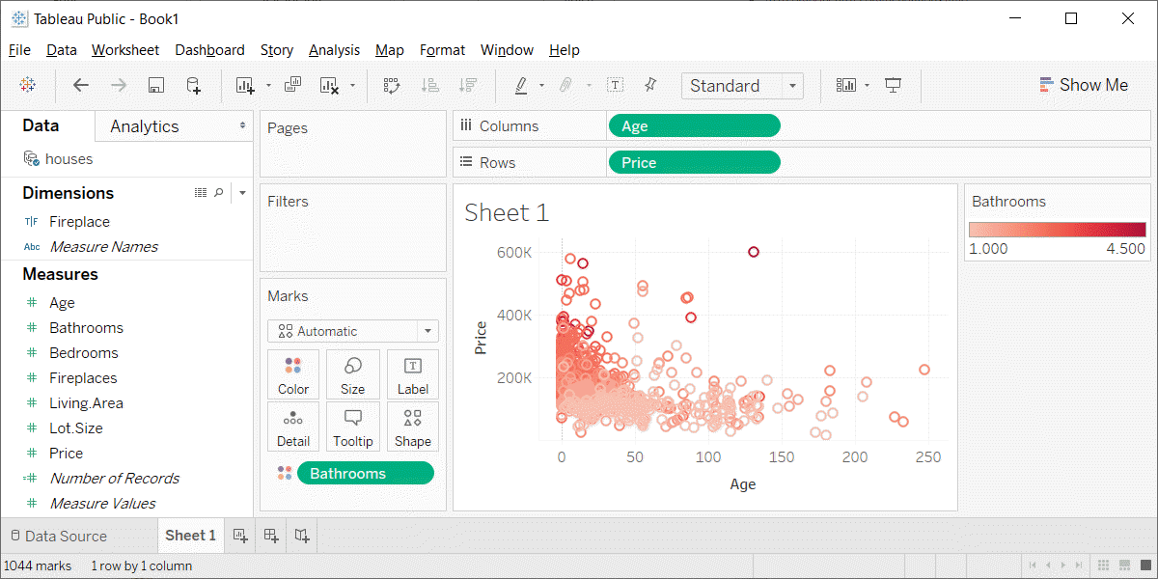
Colors, Tableau output
Tableau scatterplot with red gradient
Notes:
Here’s what the Tableau output looks like.

Slide 36
Colors, HSV system
H = Hue
Color wheel
Red, yellow, green, cyan, blue, and magenta
Saturation
How colorful
Low saturation produces white or various shades of gray
Value
How dark
Low values produce dark color
0 produces black
Notes:
The HSV system has three parameters, hue, saturation, and value. Hue is a color wheel including red, yellow, green, cyan, blue, and magenta, or some mixture of these colors. Saturation is a measure of intensity or colorfulness. Unsaturated colors produce white or various shades of gray. Value is a measure of darkness and a value of zero is totally black.

Slide 37
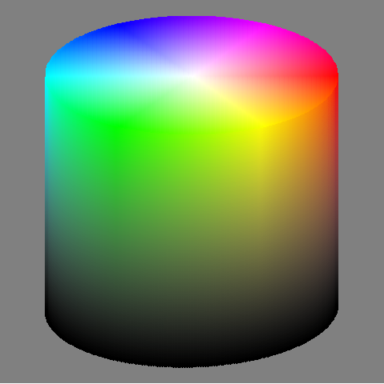
Colors, HSV system

Slide 38
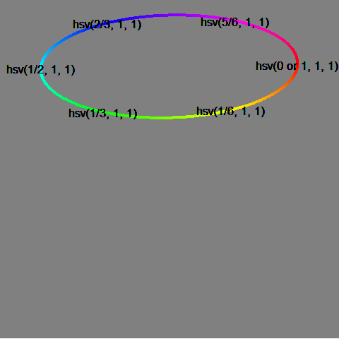
Colors, HSV system, hue only

Slide 39
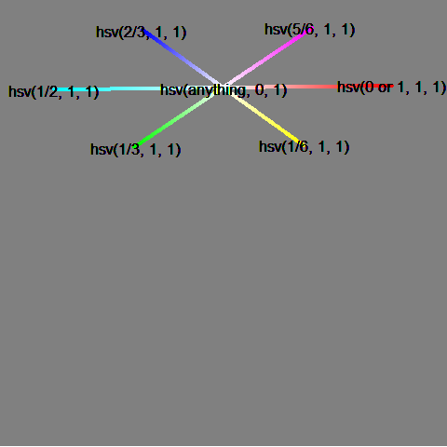
Colors, HSV system, saturation only

Slide 40
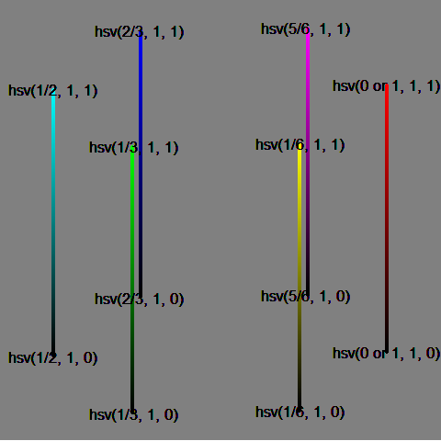
Colors, HSV system, value only

Slide 41
Colors, HCL system
H = hue
arranged on a wheel 0-360 degrees
0 = red, 120 = green, 240 = blue
60 = yellow, 180 = cyan, 240 = magenta
C = chroma
colorfulness relative to a gray of equal luminance
not quite same as saturation
L = luminance
brightness, lightness
Not all combinations of HCL work
Very similar systems are CIE-LUV, CIE-LAB
Notes:
Another color system is the HCL system. It is very similar to standards CIE-LUV and CIE-LAB.
It has a hue value, just like the hsl system.
Chroma is a measure of how intense the color is. It is like saturation, but represents a relative amount of saturation, relative to a grey value of the same luminance.
Luminance is a meausre of brightness or lightness. The luminance is similar to the V (value) in the hsv system. It does a better job of matching brightness, because certain colors, such as yellow and green have a naturally higher level of brightness.
For a given value of luminance, there may be restrictions in how far you can move towards the pure colors. For high values of luminance, you can’t get near the pure red or pure blue colors, as they don’t have enough brightness, especially compared to the yellows and greens. For values of low luminance, the opposite occurs. Pure yellow and pure green are just too bright, but you can get reasonable values for something close to pure red and pure blue.

Slide 42
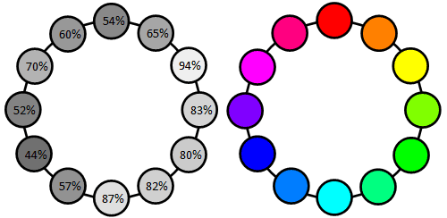
Colors, Luminance of pure colors
Luminance of the color wheel
Notes:
This image, borrowed from the excellent website, workwithcolor.com, shows that the pure colors are not equally bright. Yellow is the brigthest color. At 94% luminance, it is almost white. Cyan, at 87% luminance, and green, at 80% luminance, are almost as bright. The remaining colors have much less luminance. Magenta has 70% luminance, red has 54% luminance, and blue, at 44% luminance, is closer to black than it is to white.

Slide 43
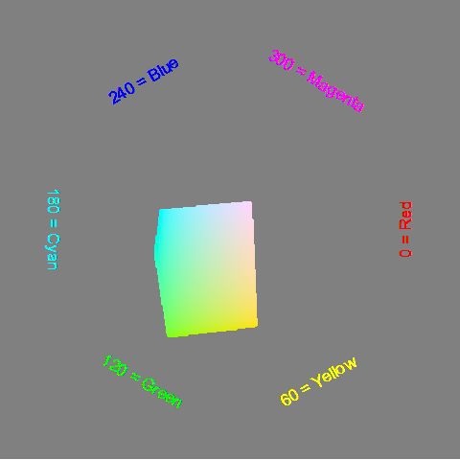
Colors, Luminance = 90%
Notes:
These are the color values with a luminance of 90%. It favors the green and yellow side of the color wheel.

Slide 44
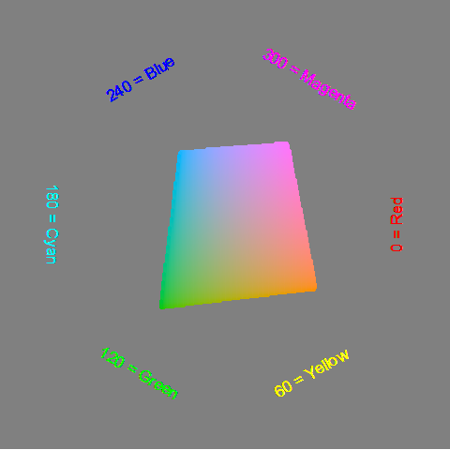
Colors, Luminance=70%

Slide 45
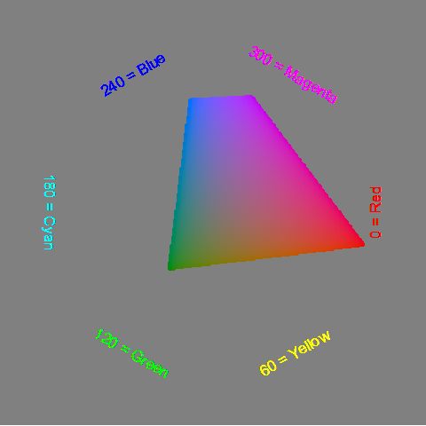
Colors, Luminance=50%

Slide 46
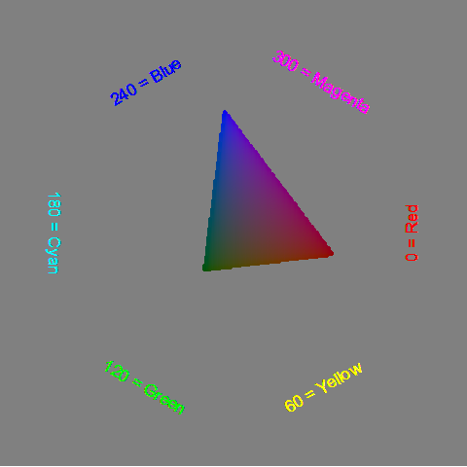
Colors, Luminance=30%

Slide 47
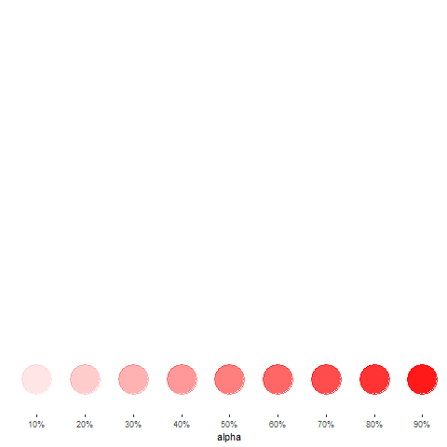
Colors, Opacity (1/3)
Notes:
There is one more feature of color that is important, opacity. Opacity is the extent to which you can peek through a color to see the background beheath.

Slide 48
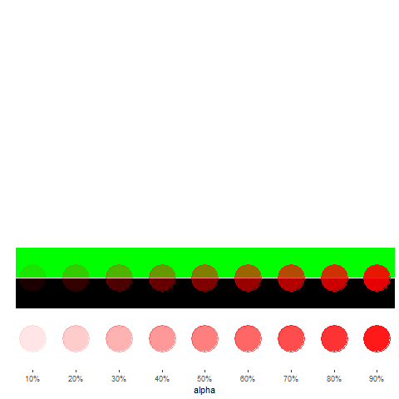
Colors, opacity (2/3)
Notes:
A low degree of opacity does not impy a lighter color. It’s only lighter when the background is white, because more of the white is showing through. When the background is black, a low degree of opacity means a dar red. When the background is green, a low degree of opacity produces a darker green with a tint of red.

Slide 49
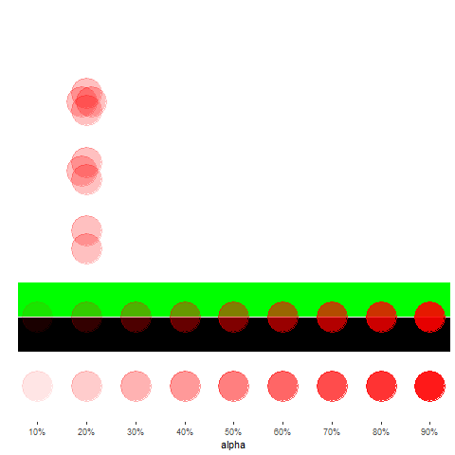
Colors, Opacity (3/3)
Notes:
If two points with high opacity overlap, then the overlap is more opaque. It becomes even more so when three or four points overlap.

Slide 50
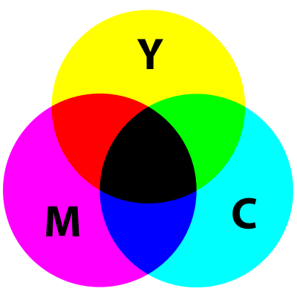
Colors, CMYK system
Illustration of subtractive color scheme
Notes:
When you are printing, more of something makes things darker. This is the exact opposite of a computer monitor, where more of something makes things lighter. Also, printing is typically done on a sheet of white paper, so you don’t need to put any ink down in areas that are pure white and you put very little ink down in areas that are nearly white.

Slide 51
Colors, CMYK system, combinations
Building blocks Cyan (C), Magenta (M), Yellow (Y), Black (K).
Subtractive system
Cyan plus Magenta equals Blue
Cyan plus Yellow equals Green
Magenta plus Yellow equals Red
All three combined equals Black
Notes:
The building blocks of the CMYK are the colors cyan, magenta, yellow and K=black. You don’t want the letter B for black because it might get confused with the B for blue in an RGB system.
The combination of colors in a CMYK system works in a complementary way to RGB. The combinations of cyan and magenta produces blue, cyan plus yellow produces green, and magenta plus yellow produces red.

Slide 52
Colors, CMYK system, Why you need black
Only in theory does, C+M+Y = Black
Too much ink
Dull muddy color
On screen versus print
Notes:
The CYMK color system adds a fourth color, black, to the mix. In theory, you don’t need black, because you can get it with cyan plus magenta plus yellow. But that wastes a lot of expensive ink, and you can also run into trouble by putting some much in a single spot, especially when the image is very dark.
Also, in practice, the combination of cyan, magenta, and yeloow produces a dull muddy color that is not close enough to black. So adding a black ink helps. It also helps to mix in a bit of black ink for some of the other colors close to black on the color spectrum.
The translation of colors from an additive system like RGB to a subtractive system like CMYK is complicated and it is difficult to get something on the computer screen to match perfectly with what gets printed. If you work with printed color materials, you have to do a lot of extra work to get things to look right.

Slide 53
Colors, review
Kindergarten view of colors
RGB color system
Gradients
HSV color system
Discrete color palettes
HCL color system
Equal luminance
CYMK system
Notes:
The kindergarten view of colors (red plus yellow equals orange) doesn’t work on a computer screen because the screen uses mixtures of light to combine colors. We covered the RGB system including how to create gradients. The HSV system provides a more intuitive description of colors, while CMYK is used when printing, where a subtractive rather than additive color system is needed.

