Slide 1
Recommendations for line graphs
Steve Simon

Slide 2
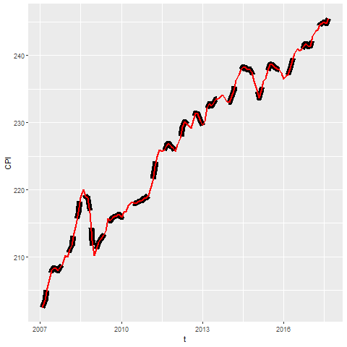
Recommendation, Avoid dashed lines for high frequency data
Notes:
High frequency events are sudden surges and dips in a line over a narrow range. If your data has high frequency events (think stock market prices), then avoid thick lines or long dashes. These can hide some of the high frequency events.

Slide 3
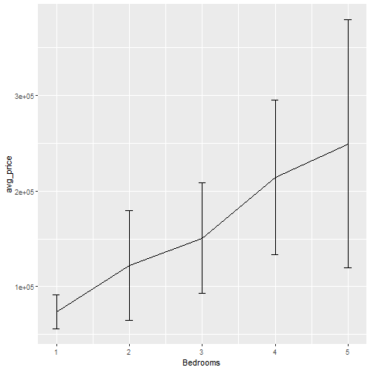
Recommendations, Avoid error bars (1/3)
Average price shown with error bar equal to one standard deviaiton
Notes:
This graph shows error bars for the average price of a house given a fixed number of bedrooms. There is indeed an upward trend in prices. The more bedrooms you have, the higher the average price. But these error bars, equal to plus or minus one standard deviation, emphasize that there is a lot of overlap in individual prices.

Slide 4
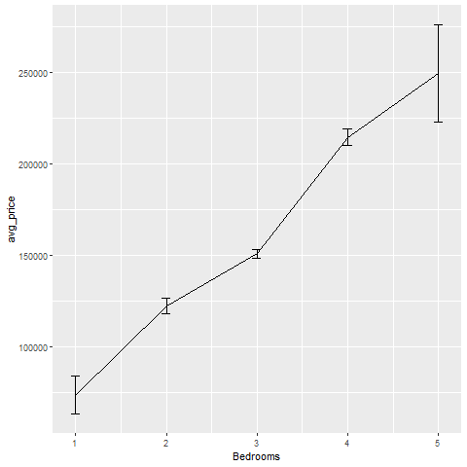
Recommendations, Avoid error bars (2/3)
Average price shown with error bar equal to one standard error
Notes:
Here is the same graph, but with the error bar representing plus or minus one standard error. The standard error is the standard deviation divided by the square root of the sample size. It shows how variable the mean is rather than how variable an individual observation is. This picture is quite different, and implies a much stronger trend. Which graph is better? Well, neither in my opinion.

Slide 5
Recommendations, Avoid error bars (3/3)
No agreed upon definition for error bars
One standard deviation?
One standard error?
Confidence interval?
Range?
Error bars may hide asymmetric distributions
What does an overlap, non-overlap mean?
Notes:
The first problem with error bars is that they do not have a commonly agreed upon definition. Is it plus or minus one standard deviation or plus or minus one standard error?
The general rule is that you use a standard deviation or a range when you want to place the emphasis on individual values and a standard error or confidence interval when you want to place the emphasis on the average.
A big problem with error bars is that they may falsely imply a symmetry to your data. If your data is skewed, then try to avoid error bars.
The other problem with error bars is that people make up rules, such as if two sets of error bars overlap, there is not a statistically significant difference between the two means. That only works for a confidence interval and it doesn’t quite work then even. Standard errors and confidence intervals are not additive, and a small amount of overlap between two confidence intervals proves nothing.

Slide 6
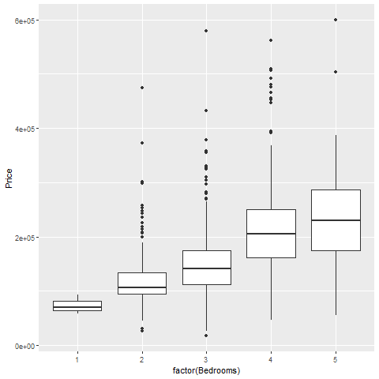
Recommendations, Alternatives to error bars (1/3)
Boxplot of house prices by number of bedrooms
Notes:
The box plot provides a more useful summary because, among other reasons, it shows whether your data is skewed in one direction or another.

Slide 7
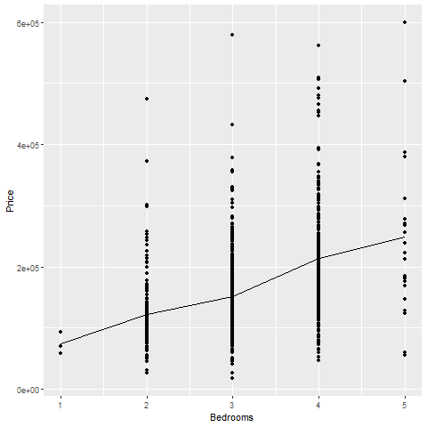
Recommendations, Alternatives to error bars (2/3)
Scatterplot with line connecting means
Notes:
There is often no substitute, however, for showing every individual data point.

Slide 8
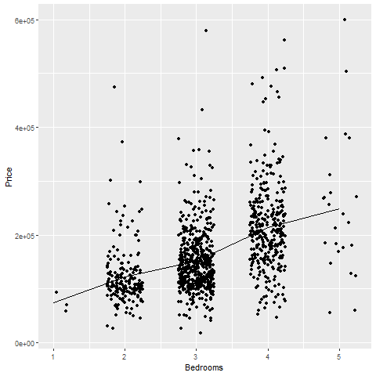
Recommendations, Alternatives to error bars (3/3)
Jittered scatterplot with line connecting means
Notes:
There is a fair amount of overprinting in this graph, so jittering (randomly shifting data points around) can help you see where there are just a few points and where there are many points.

Slide 9
Recommendations, when to start at zero
Bargraphs almost always start at zero, linegraphs have more latitude.
Not relevant when data has negative values
Is there a “natural zero”?
Counterexamples: temperature, IQ
Start at zero allows relative comparisons
Twice as big, half as big
Start at minimum Y improves resolution
Notes:
There is a controversy that never seems to end about whether your y-axis should include the value of zero. It doesn’t seem to be as much of a controversy about the X axis, for what it’s worth. It is also not much of a controversy for bargraphs, as the strong consensus is that bargraphs should always start at zero.
You should resign yourself to the fact that if you come down on one side of this controversy, your boss is probably going to be on the other side. So get in the habit of knowing how to change from one type of graph to another.
First of all, recognize that if you have negative values in your data set, the controversy is moot. You include zero and keep on going down to include all of the negative values.
You also need to ask yourself whether your data contains a natural zero, a value that is well accepted as meaning “nothing”. Two counterexamples are temperature and IQ. Unless you are talking about the Kelvin scale where zero represents the physical concept of absolute zero, temperature does not have a natural zero. It doesn’t matter whether you are talking 0 Fahrenheit or ) Celsius. Neither temperature represents the absence of all heat.
IQ also does not have a natural zero. There is no IQ rather represents the absence of all intelligence.
Starting at zero allows you to make relative comparisons. You can see when one Y value is twice as big or half as big as another value. Do relative comparisons make sense for your data. They certainly don’t for IQ, because you can’t say that a person with an IQ of 150 is twice as intelligent as a person with an IQ of 75.
You lose something though, when you start at zero rather than the starting at the minimum possible Y value. The extra space required by including zero forces your entire linegraph into a narrow range, making it harder for you to make absolute comparisons.
I think that debates about whether to include zero or not are often silly, but the safe thing to do is to include a zero whenever you think the reader might be interested in relative comparisons.

Slide 10
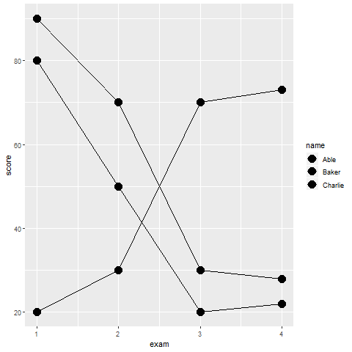
Recommendations, differentiating lines
Fictional data on exam scores for three subjects
Notes:
How do you best differentiate among lines. In this graph, you can’t tell which line represents which subject.

Slide 11
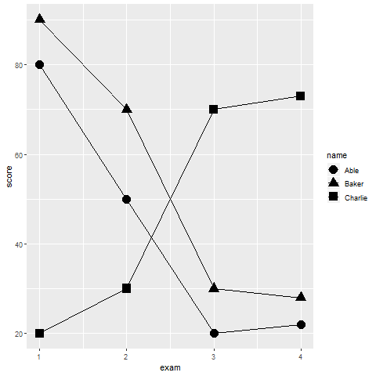
Recommendations, differentiating by shape
Linegraph distinguished by point shape
Notes:
I deliberately added points to the lines because it gives you an extra chance to differentiate the lines. In this graph, the square, circle, and triangle allow you to tell which subject is which.
you’d be a bit better off if you compared an open symbol with a closed symbol versus an “X” or a “+” that is neither open nor closed. Even so, the use of symbols, by itself, is not very helpful in allowing you to distinguish which line is associated with which subject.

Slide 12
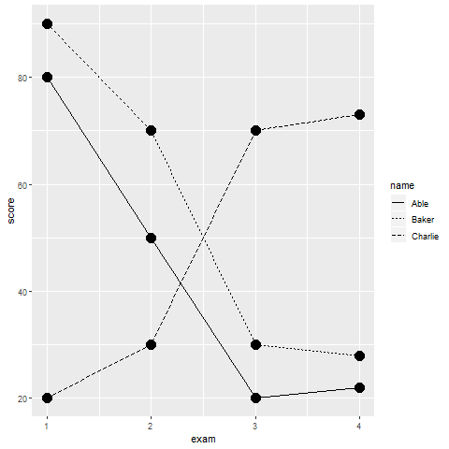
Recommendations, differentiating by linetype
Linegraph distinguished by linetype
Notes:
You can also differentiate by linetype. This works fine for two groups, perhaps because a solid line looks quite different than any dotted or dashed line. The problem with three or more groups is that the various dotted and dashed lines look very similar. Even this simple graph, it is a bit difficult to distinguish the short dashed line of Baker from the long dashed line of Charlie.

Slide 13
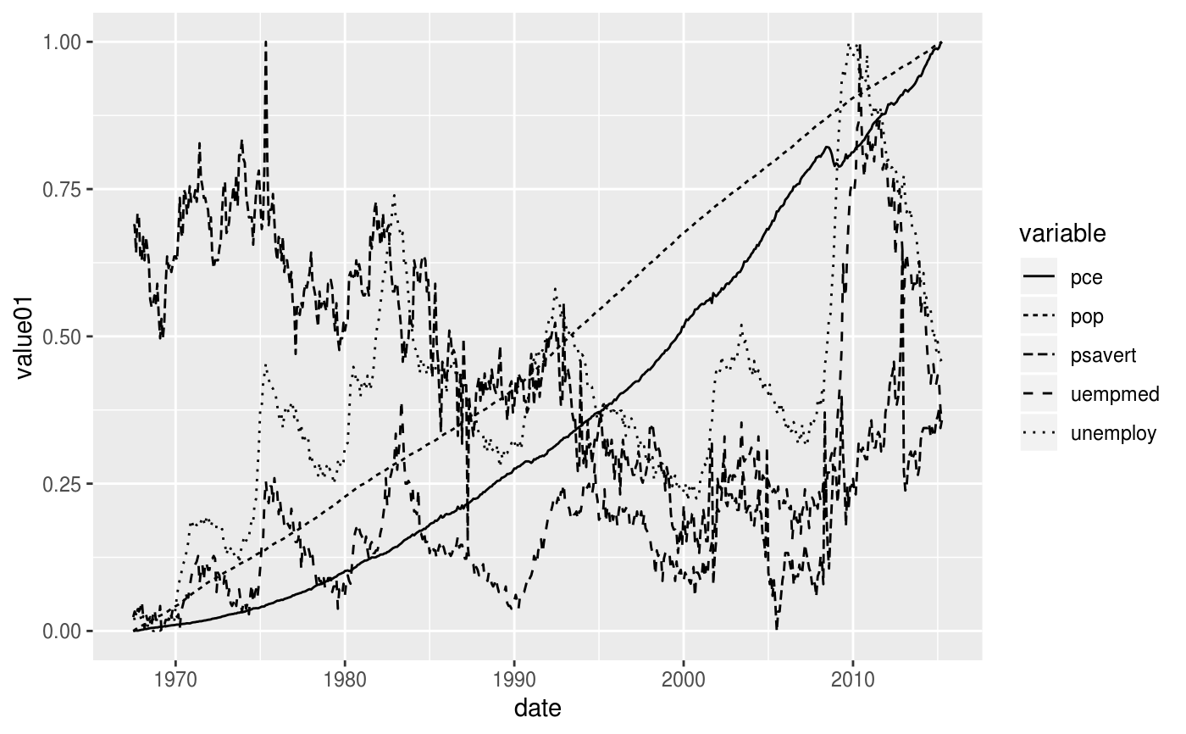
Recommendations, a graph with five different linetypes
A linegraph with five lines, each with a different dash/dot pattern
Notes:
I hesitate to show this graph, because it was drawn mostly just to illustrate the variety of linetypes that R has. But it does illustrate how confusing a graph can be when the only thing you have to distinguish among five different lines is the linetype.

Slide 14
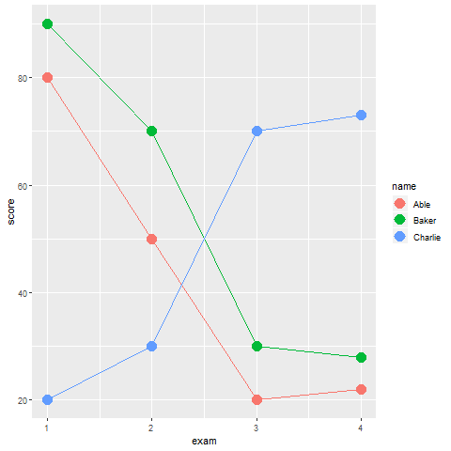
Recommendations, differentiating by color
Linegraph distinguished by color
Notes:
Color works a little bit better and it is not hard to find four or five colors that are fairly easy to distinguish from one another.

Slide 15
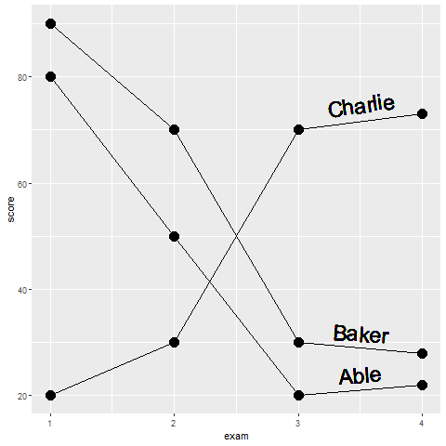
Recommendations, differentiating by labels
Linegraphs with labels directly on the graph
Notes:
Labels take advantage of the Gestalt principle of proximity. They often require a bit of hand tweaking, so they are tedious. But labels are the best approach by themselves to distinguishing among different lines.
Of course, you can and should consider doubling up and combining two elements like color and linetype, if you want to make the lines readily distinguishable from one another.

Slide 16
Recommendations, lines imply continuity, bars don’t
Boxplot of house prices by number of bedrooms
Notes:
The line connecting the one bedroom house mean to the two bedroom house mean to the three bedrood house mean, etc. is thought by some people to imply that intermediate values are possible. But you can’t have 2.2 bedrooms. It has to be a whole number. This does not bother me, but if it bothers you, then convert this graph to a bar chart or use discontinuous line segments.

Slide 17
Recommendations, Aspect ratio
Aspect ratio = width to height ratio
Square has 1:1 aspect ratio
Older televisions have 4:3 aspect ratio
Newer televisions have 16:9 ratio
You can vary the aspect ratio of your graphs as well

Slide 18
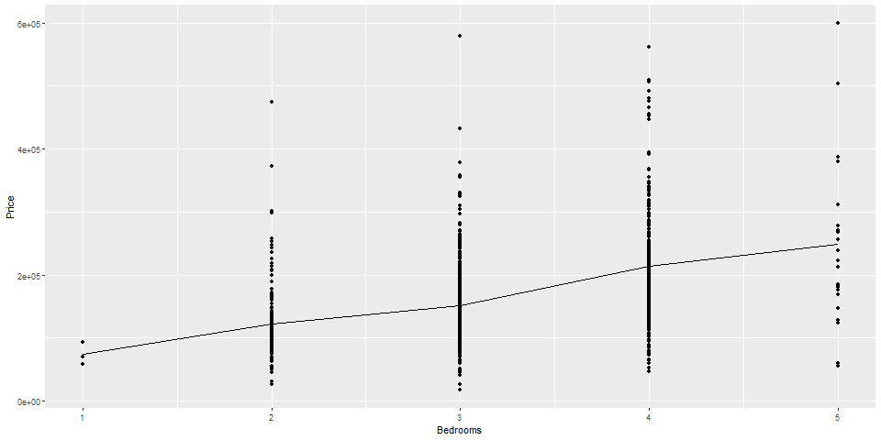
Recommendations, Which is better?
Scatterplot with a 2:1 aspect ratio
Notes:
This is a graph which is (roughly) twice as wide as it is tall. Sometimes this is called landscape orientation. Compare this to the next graph.

Slide 19
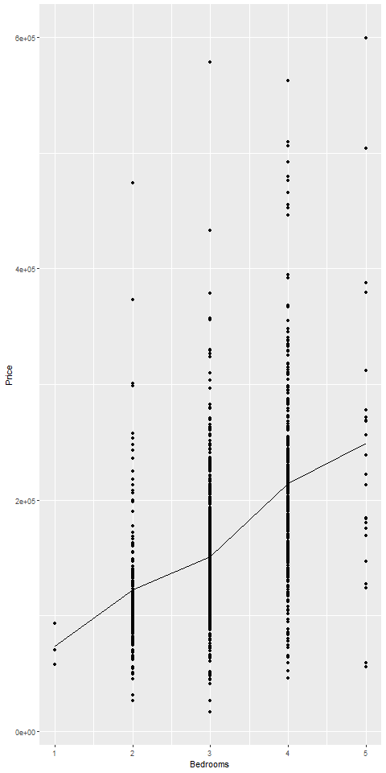
Recommendations, Which is better?
Scatterplot with a 1:2 aspect ratio
Notes:
This graph has an aspect ratio of 1 to 2. It is twice as tall as it is wide. Which one is better?

Slide 20
Recommendations for aspect ratio
When changes in slope are important
Very flat lines (angle close to zero) are difficult to compare
Very steep lines (angle close to plus or minus 90 degrees) are also difficult to compare
Size your graph so that most lines have angles of plus or minus 45 degrees.
Use square graph when comparing measurements of the same thing
Predicted versus actual
New lab method versus gold standard method

Slide 21
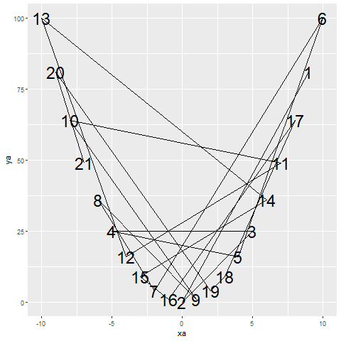
Recommendations, sort your data or hope that your software does

