Slide 1
v01 Basic exercise - shape
Steve Simon

Slide 2
Basic exercise - shape
Use the Saratoga housing data set.
Draw a plot of all of the data where the location is x=Age and y=Price and the symbol represents the number of bedrooms.

Slide 3
Here’s the Python code.
ch5 = alt.Chart(df).mark_point().encode( x='Age',y='Price', shape='Bedrooms:N')

Slide 4
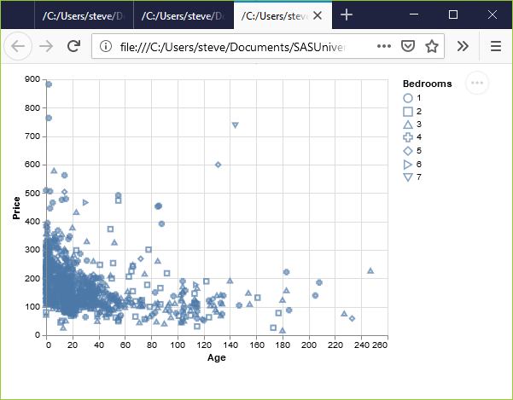
Here’s the results in Python.
Python scatterplot mapping bedrooms to shape

Slide 5
Here’s the R code.
ggplot(saratoga_houses, aes(x=Age, y=Price)) + geom_point(aes(shape=factor(Bedrooms)))

Slide 6
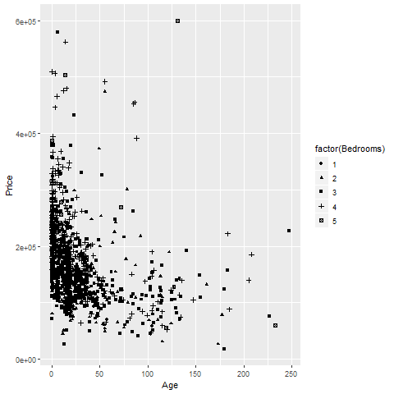
Here’s the results in R
R scatterplot mapping bedrooms to shape
Notes:
Here is what the R graph looks like. I don’t particularly like this graph. It is confusing, especially with all the overprinting.

Slide 7
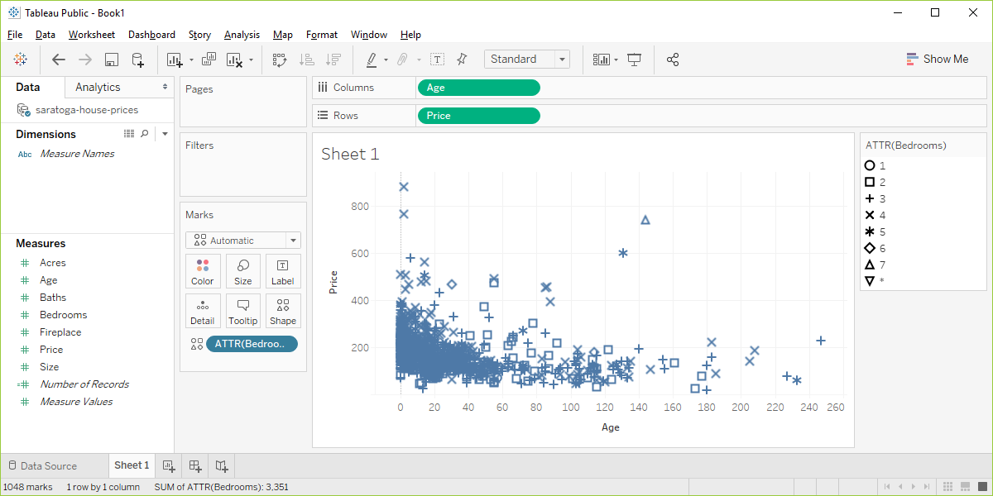
Here ’s the result in Tableau.
Tableau scatterplot using shapes to represent Bedrooms
Notes:
Here are the steps in Tableau. First revert to the earlier scatterplot where Age is in the Column fields and Price is in the Rows field. Then drag and drop Bedrooms on top of the Shape icon. Change from SUM(Bedrooms) to ATTR(Bedrooms).

