Slide 1
Exercise, modify line colors
Steve Simon

Slide 2
Exercise, change defaults
Draw a line graph with the cpi-food data
x=t
y=cpi
color=index
Change the default line colors
food-home=darkgreen
food-away=red
food-pets=blue
Make the Y-axis start at 100 and end at 200
Notes:
Take the cpi-food linegraph and modify some of the default options. Highlight the food-home in darkgreen, food-away in red, and food-pets in blue. Modify the y-axis to start at 100 and end at 200.

Slide 3
Exercise, Python code
Here’s the Python code
ch = alt.Chart(df).mark_line().encode( alt.Color('index', scale=alt.Scale( range=['#FF0000', '#00CC00', '#0000FF'] ) ), alt.X('t'), alt.Y('cpi', scale=alt.Scale(domain=(100, 200))), )
Notes:
HEre is the Python code. Notice that the color and width are changed inside the mark_line function.

Slide 4
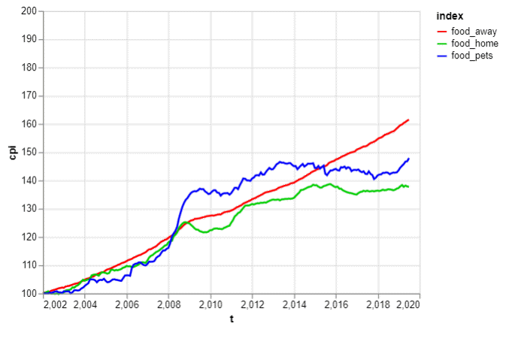
Exercise, Python output
Line graph with thick green line

Slide 5
Exercise, R code
Here’s the R code
ggplot(cpi-food, aes(x=t, y=CPI)) + geom_line(aes(color=index)) + scale_color_manual(values=c("#FF0000", "#00CC00", "#0000FF")) + ylim(100, 200)
Notes:
Here is the R code. Notice that you change the size and color inside the geom_line function.

Slide 6
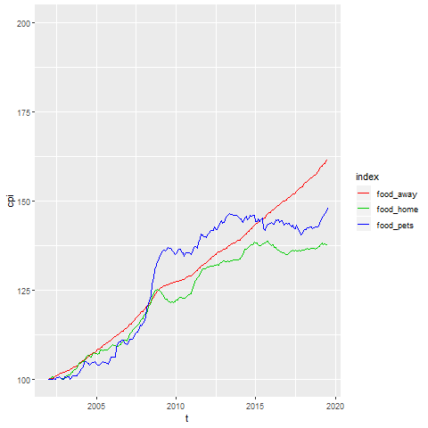
Exercise, R output
Notes:
Here is the R output.

Slide 7
Exercise, Tableau steps
Drag T to coumns, CPI to rows
Set both as Dimension, Continuous (Green pill)
Change Marks pull-down to Line
Drag index to colors button
Click on boxes in legend
Click on size button, move slider to the right
Double click on Y axis
Select Range, Fixed
Enter 100, 200 as fixed start, fixed end
Notes:
Here are the Tableau steps.

Slide 8
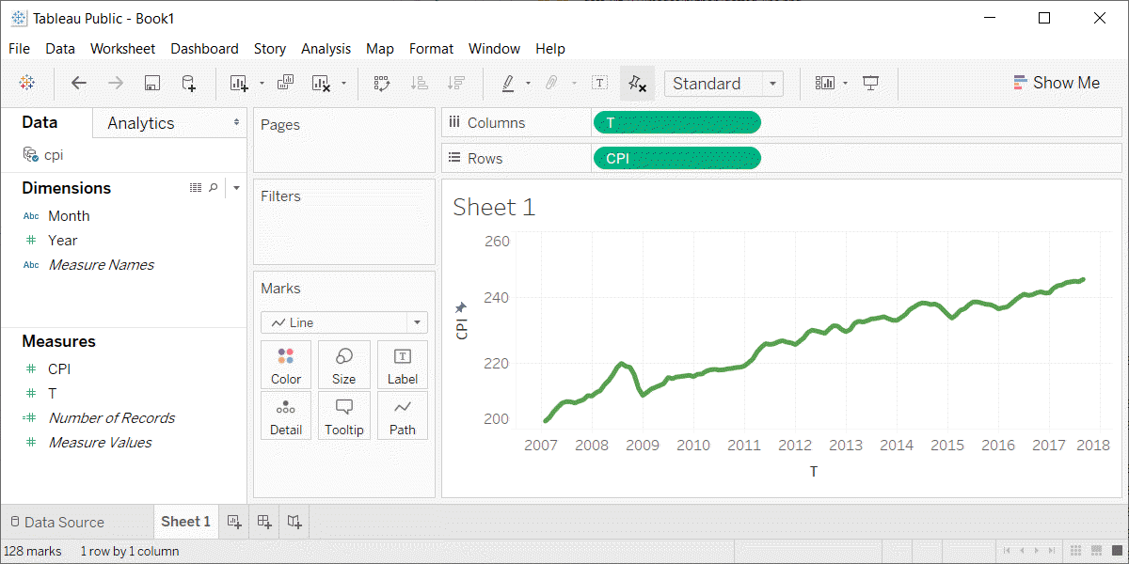
Exercise, Tableau output
Line graph with thick green line
Notes:
Here is the Tableau output.

