Slide 1
Barchart fundamentals, draw gender
Steve Simon

Slide 2
Barchart fundamentals, Gender barchart
Draw a bar chart showing the number of people in each gender (use the Sex variable).

Slide 3
Barchart fundamentals, Gender barchart, Python code
((Python code))

Slide 4
Barchart fundamentals, Gender barchart, Python results
## Hello world
## 5
((Python results))

Slide 5
Barchart fundamentals, Gender barchart, R code
ggplot(titanic, aes(Pclass)) + geom_bar()

Slide 6
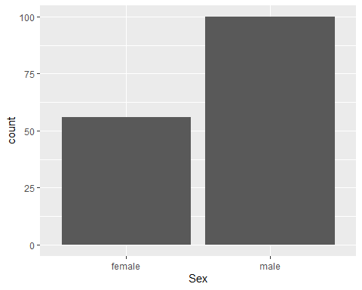
Barchart fundamentals, Gender barchart, R results

Slide 7
Barchart fundamentals, Gender barchart, Tableau steps
((Tableau steps))

Slide 8
Barchart fundamentals, Gender barchart, Tableau results
((Tableau results))

Slide 9
Barchart fundamentals, On your own
Make the first class bar red to show Leonardo di Caprio’s perspective on the Titanic.

Slide 10
Barchart fundamentals, Wait before showing
((Python code))
((R code))
((Tableau steps))

Slide 11
Barchart fundamentals, What your visualization might look like
((Show visualization))

Slide 12
Barchart fundamentals, Color
Use for emphasis in simple bar charts
Very important for stacked or side-by-side bar charts
Notes:
For simple bar charts like all the ones we’ve seen so far, color is not really needed. You already can distinguish between the passenger classes using the location. If you do use color in a simple bar chart, it is often to emphasize a point. In the previous bar chart, I used red for third class, because Kate Winslet, a rich first class passenger, found true love in third class, with the adorable Leonardo di Caprio.
Color becomes very important in just a minute when we add another layer of complexity.

Slide 13
Barchart fundamentals, On your own
Revise this visualization so the first class bar is red.

Slide 14
Barchart fundamentals, Wait before showing
((Python code))
((R code))
((Tableau steps))

Slide 15
Barchart fundamentals, What your visualization might look like
((Show visualization))

Slide 16
Barchart fundamentals, On your own
Draw a bar chart showing counts involving both mortality and gender. Use a panel, then stacking, then dodging. Which do you like best?
Notes:
Mortality on the Titanic reflects the fact that this was an era when people really did believe in the concept of “women and children first.” Someone like me, I’d be shoving the little kids aside so I could get on one of the lifeboats.
Anyway, examine how mortality is related to gender. It’s a spoiler alert, but on the Titanic, Kate survives, but Leonardo, I am so sad to say this, didn’t make it.

Slide 17
Barchart fundamentals, Wait a bit before showing the code
Did you make the panel/stack/dodge Survived or did you make it Sex? Here’s some code, but yours might be different.
((Show Python code))
R code
fn <- initiate_image() titanic %>% ggplot(aes(x=Sex, fill=Survived)) + geom_bar() + facet_grid(cols=vars(Survived)) finalize_image()
((Show Tableau))

Slide 18
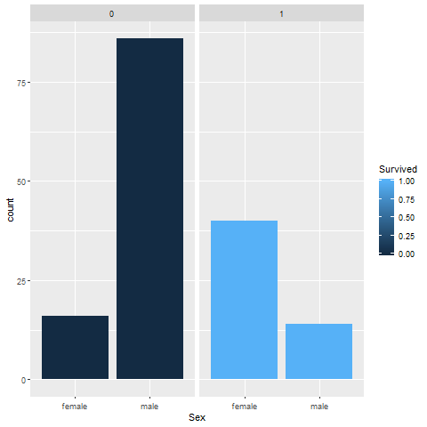
Barchart fundamentals, Panel, one approach
Bar chart

Slide 19
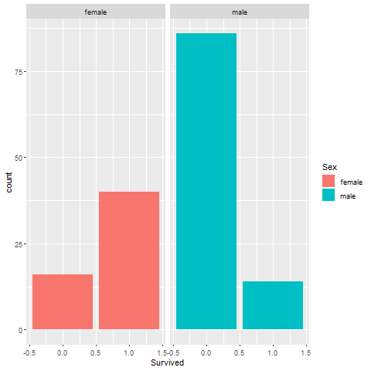
Barchart fundamentals, Panel, alternate approach
Bar chart

Slide 20
Barchart fundamentals, Stack, one approach

Slide 21
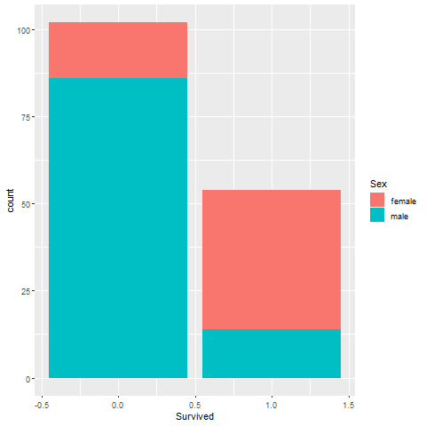
Barchart fundamentals, Stack, alternate approach
Bar chart

Slide 22
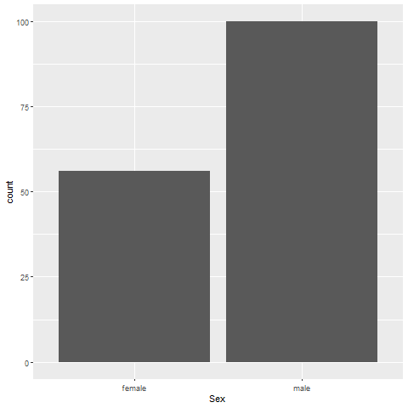
Barchart fundamentals, Dodge, one approach
Bar chart

Slide 23
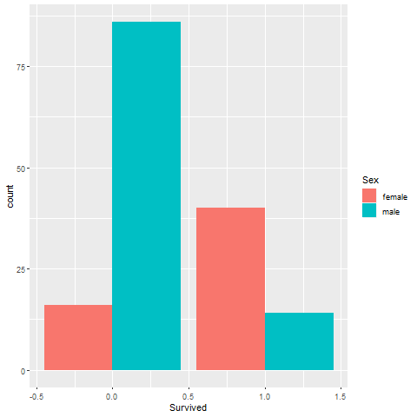
Barchart fundamentals, Dodge, alternate approach
Bar chart

