Slide 1
Data-viz-02, Exercise, What is the message in this graph?
Steve Simon

Slide 2
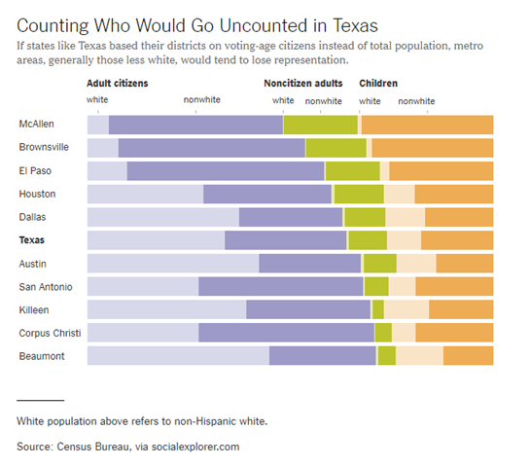
Group exercise (1 of 4)
Bar chart of demographics of selected Texas counties
Notes:
This is one of two graphs. It was published in
Badger, E. (2019). People Who Can’t Vote Still Count Politically in America. What if That Changes?. Retrieved June 24, 2019, from The New York Times website: https://www.nytimes.com/2019/06/22/upshot/america-who-deserves-representation.html

Slide 3
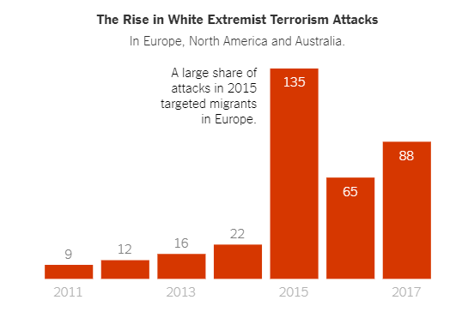
Group exercise (2 of 4)
Bar chart counting white extremist terrorism attacks over time
Notes:
Weiyi Cai, Simone Landon. Attacks by White Extremists Are Growing. So Are Their Connections. The New York Times, April 3, 2019. Retrieved August 8, 2019 from https://www.nytimes.com/interactive/2019/04/03/world/white-extremist-terrorism-christchurch.html

Slide 4
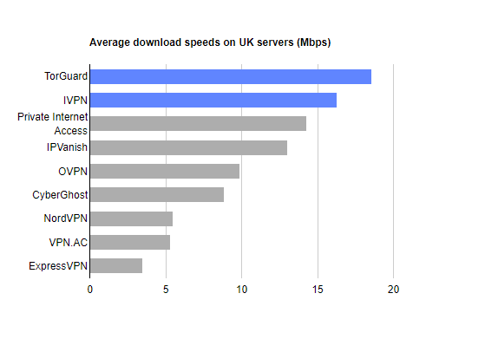
Group exercise (3 of 4)
Bar chart showing speeds of various VPN providers
Notes:
Mark Smirniotis. The Best VPN Service. Wirecutter, February 8, 2019. Retrieved August 14, 2019 from https://thewirecutter.com/reviews/best-vpn-service/.

Slide 5
Group exercise (4 of 4)
These bar charts come from recent newspaper articles.
People Who Can’t Vote Still Count Politically in America. What if That Changes?
Attacks by White Extremists Are Growing. So Are Their Connections.
The Best VPN Service.
Read the newspaper article for context and then look at the graph again.
Explain to your partner what the graph is trying to show. Your partner will do the same to you with his/her graph.

