Slide 1
Exercise, first-class-red
Steve Simon

Slide 2
Exercise, First class red
Make the first class bar red to show Leonardo di Caprio’s perspective on the Titanic.

Slide 3
Exercise, Python code
Here’s the Python code
ch = alt.Chart(df).mark_bar().encode( alt.Color( 'pclass:N', scale=alt.Scale( range=['gray', 'gray', 'red'] ) ), x='pclass:N', y='count()' )

Slide 4
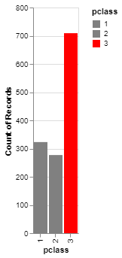
Exercise, Python output
Bar chart with red accent color

Slide 5
Exercise, R code
Here’s the R code
ggplot(titanic, aes(x=pclass, fill=pclass)) + geom_bar() + scale_fill_manual(values=c("darkgrey", "darkgrey", "red"))

Slide 6
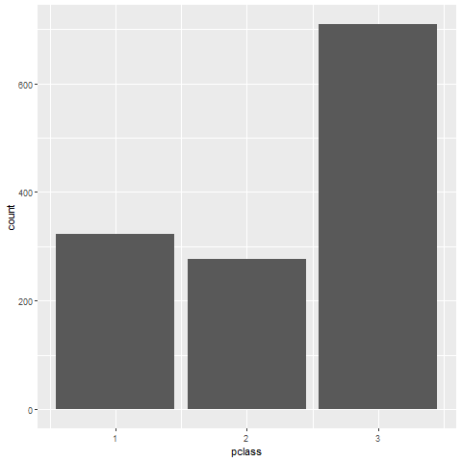
Exercise, R output
Barchart

Slide 7
Exercise, Tableau output
((Tableau results))

