Slide 1
Barchart fundamentals
Steve Simon

Slide 2
Barchart fundamentals
Fewer in numbers than points
Usually a summary statistic
Count
Percent
Average
Total
A bar chart is NOT a histogram
Notes:
Bar charts are different than point charts. There are usually only a few bars. These bars usually represent a summary statistic, like a count, percent, average, or total.
There is a technical distinction between a bar chart and a histogram. Histograms are a great diagnostic tool, but usually ends up on the cutting room floor. So I won’t be talking about it much, if at all, in this workshop.

Slide 3
Barchart fundamentals, Aesthetics for bars
Review
Location
Size
Color
NOT shape!!!
Notes:
Recall that aesthetics are visual attributes associated with a geometry/mark. You can map variables to the location, size, and/or color of bars, but you cannot assign a variable to the shape of a bar.
There is a bit of potential ambiguity on bar charts. If you are looking at a vertical bar chart (the bar chart shown earlier is a vertical bar chart), then the location on the x-axis represents which category. For the vast majority of bar charts, the bars are anchored on the x-axis, though there are a few exceptions.
The location of the Y-axis, then, is the measure of the bar’s height. You could, if you wanted to, call this the bar’s size, but most people think of the bar’s size as the width of the bar. For the vast majority of cases, the width of a bar is constant, but there are a few exceptions.
The color of a bar can refer to the interior of the bar or the border of the bar. Usually these two colors are the same, but there are some exceptions.
We won’t talk about the exceptions in this lecture, but you are welcome to ask about them, if you are curious.
You cannot vary the shape of a bar. A bar is a bar.

Slide 4
Barchart fundamentals, Basic barchart
Python code
ch = alt.Chart(df).mark_bar().encode( x='pclass:N', y='count()'
R code
ggplot(ti, aes(x=pclass)) + geom_bar()
Tableau
Drag and drop
Notes:
The Python/Altair code uses the mark_bar function instead of mark_point. You encode the passenger class on the x axis, but you have to remind Python/Altair that the values of 1, 2, and 3 represent categories of first class, second class, and third class. The y axis represents the count.
The code in R uses the geom_bar function. You can get away with specifying only a single location, the x-axis, because the default in geom_bar is to use the count as the location on the y-axis.

Slide 5
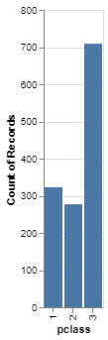
Barchart fundamentals, Python output
Barchart in Python
Notes:
This is the Python version of the barchart.

Slide 6
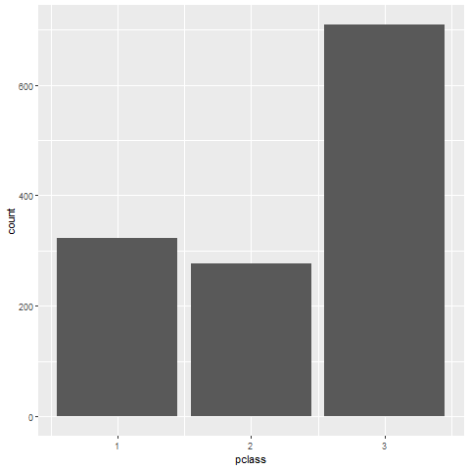
Barchart fundamentals, R output
Notes:
This is the R version of the barchart.

Slide 7
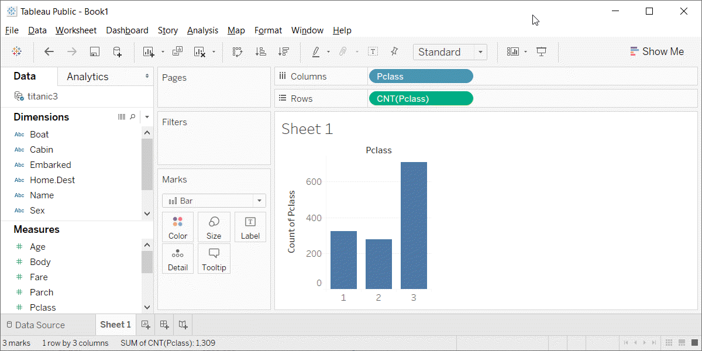
Barchart fundamentals, Tableau output
Barchart in Tableau
Notes:
Here is the Tableau output. Notice the columns (the x-axis) is a blue pill. That tells Tableau that passenger class is a discrete dimenion (or categorical). The rows (y-axis) is the count summary function.

Slide 8
Barchart fundamentals, changing the default
Python code
ch = alt.Chart(df).mark_bar( color='red', size=5 ).encode( x='pclass:N', y='count()' )
R code
ggplot(titanic, aes(pclass)) + geom_bar(fill="red", width=0.5)
Tableau
Point and click
Notes:
Here is the code to change the color and the size of all the bars. In Altair/Python, you place color and size arguments inside the mark_bar function. The size represents the number of pixels (not counting a one pixel border), so a value of 5 will produce a 7 pixel barrather narrow bar. The default in Python is to leave a 3 pixel gap between each bar.
In R, the arguments are different. You specify the color of a bar with the fill argument. If you tried to use the color argument, it would change the color of the border, and leave the interior of the bar as the default color.
R also uses the width argument rather than size. This might not be the best choice, but width is less ambiguous than size, which could just as easily refer to the height as the width of the bar.
In R, width is a relative measure, and a value of 1 would mean that the bars fill up the entire space without any gaps. The value of 0.5 shown here will make the bars fill 50% of the space, making the bar widths equal to the width of the gaps. The default in R is 0.8.
In Tableau, you click on the color button to change the color for every bar. You click on the size button to change the width of the bars. Slide all the way to the right to have the bars touching and all the way to the left to get a single pixel width bar.

Slide 9
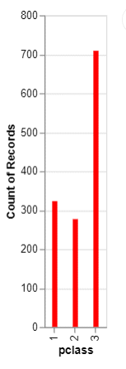
Barchart fundamentals, Python output
Bar chart with red bars

Slide 10
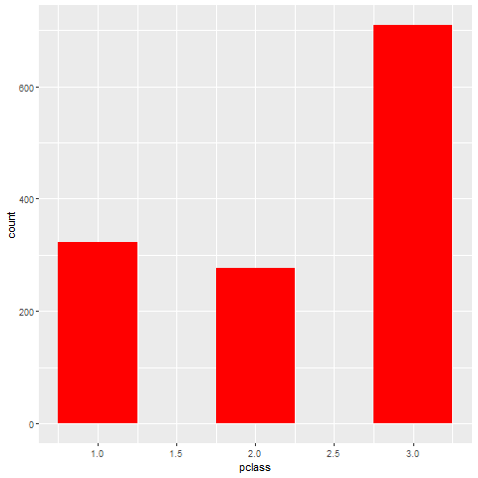
Barchart fundamentals, R output
Bar chart of passenger class count
Notes:
Here is the output in R. Notice that the gaps between the bars are equal to the widths of the bars themselves.

Slide 11
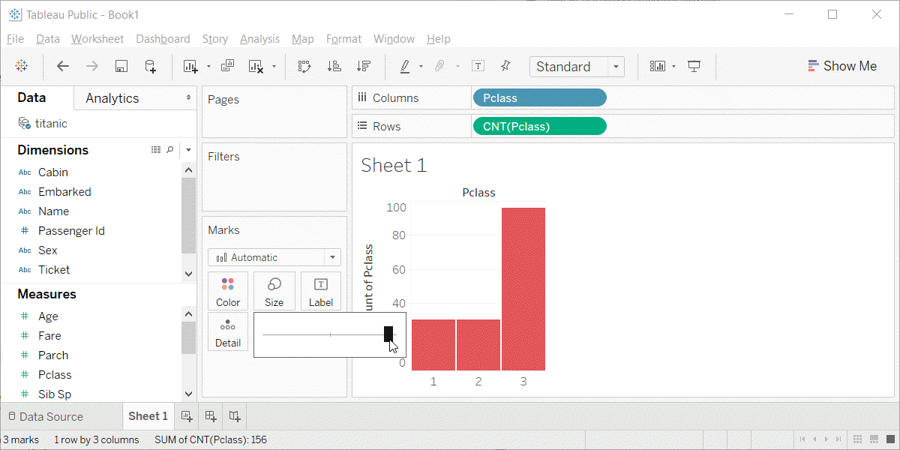
Barchart fundamentals, Tableau output
Barchart with red bars
Notes:
This is what Tableau produces. I am showing the slider bar that appears when you click on the size button. It is almost all the way to the right, so the bars are very fat and there is only a very tiny gap between the bars.

Slide 12
Barchart fundamentals, Location
Bar chart of passenger class count
Notes:
This is data from the Titanic, a ship that was as massive as its name. It was considered unsinkable, but on its maiden voyage in 1912, the ship hit an iceberg and sank. It sank during an era where people really believed in women and children first, and this shows quite clearly in the mortality statistics. There was a difference, though, between third class passengers like Leonardo diCaprio and first class passengers like Kate Winslet.
This shows a simple bar chart. The x-axis is passenger class and the y-axis is count. Note that there are about the same number of first and second class passengers, but the two combined does not come close to the number of third class passengers.

Slide 13
Exercise, Gender barchart
Draw a bar chart showing the number of people in each gender (use the Sex variable).

Slide 14
Exercise, Python code
Here’s the Python code
ch = alt.Chart(df).mark_bar().encode( x='sex', y='count()' )

Slide 15

Exercise, Python output

Slide 16
Exercise, R code
Here’s the R code
ggplot(titanic, aes(sex)) + geom_bar()

Slide 17
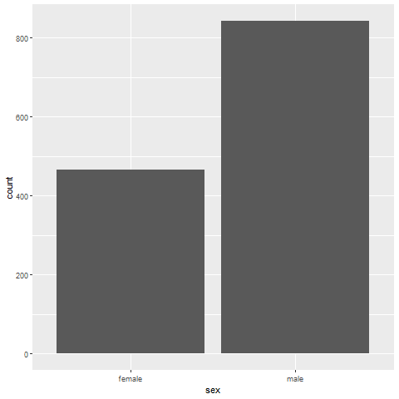
Exercise, R output

Slide 18
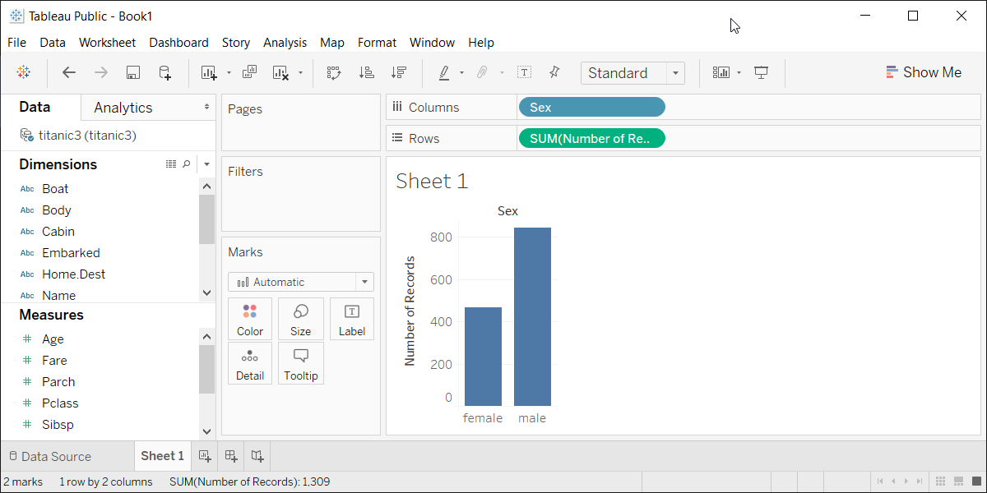
Exercise, Tableau output
Tableau barchart

Slide 19
Barchart fundamentals, Color
Use for emphasis in simple bar charts
Very important for stacked or side-by-side bar charts
Notes:
For simple bar charts like all the ones we’ve seen so far, color is not really needed. You already can distinguish between the passenger classes using the location. If you do use color in a simple bar chart, it is often to emphasize a point. In the previous bar chart, I used red for third class, because Kate Winslet, a rich first class passenger, found true love in third class, with the adorable Leonardo di Caprio.
Color becomes very important in just a minute when we add another layer of complexity.

Slide 20
Barchart fundamentals, Color
Barchart

Slide 21
Exercise, First class red
Make the first class bar red to show Leonardo di Caprio’s perspective on the Titanic.

Slide 22
Exercise, Python code
Here’s the Python code
ch = alt.Chart(df).mark_bar().encode( alt.Color( 'pclass:N', scale=alt.Scale( range=['gray', 'gray', 'red'] ) ), x='pclass:N', y='count()' )

Slide 23
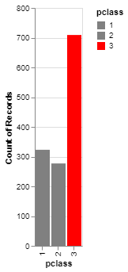
Exercise, Python output
Bar chart with red accent color

Slide 24
Exercise, R code
Here’s the R code
ggplot(titanic, aes(x=pclass, fill=pclass)) + geom_bar() + scale_fill_manual(values=c("darkgrey", "darkgrey", "red"))

Slide 25
Exercise, R output
Barchart

Slide 26
Exercise, Tableau output
((Tableau results))

Slide 27
Barchart fundamentals, Stack versus dodge
Summarize by two categories
Facet
Separate plots
Dodge
Side by side
Similar to facet
Stack
One on top, one on bottom
Notes:
Bar charts that represent a summary across a single categorical variable are fairly simple and easy to handle. But when you want to summarize by two categories simultaneously, things get interesting. Interesting in a good way.

Slide 28
Barchart fundamentals, Titanic passenger count by gender
Bar chart

Slide 29
Barchart fundamentals, Titanic passenger count by passenger class

Slide 30
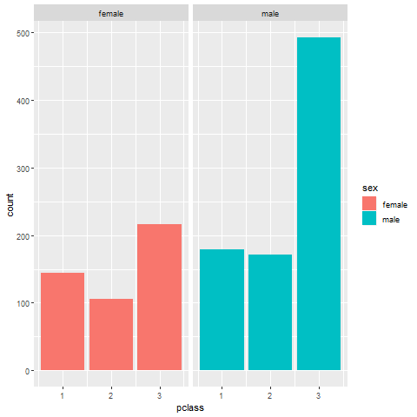
Barchart fundamentals, Titanic facet

Slide 31
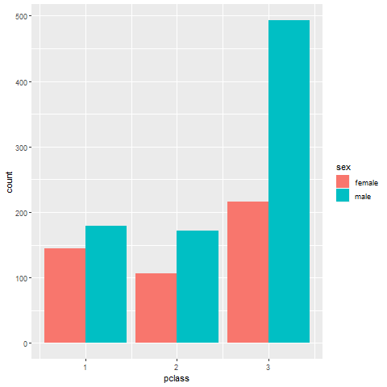
Barchart fundamentals, Titanic dodge

Slide 32
Barchart fundamentals, Titanic stack
`r display_images

Slide 33
Exercise, Mortality by gender
Draw a bar chart showing counts involving both mortality and gender. Use a panel, then stacking, then dodging. Which do you like best?
Notes:
Mortality on the Titanic reflects the fact that this was an era when people really did believe in the concept of “women and children first.” Someone like me, I’d be shoving the little kids aside so I could get on one of the lifeboats.
Anyway, examine how mortality is related to gender. It’s a spoiler alert, but on the Titanic, Kate survives, but Leonardo, I am so sad to say this, didn’t make it.

Slide 34
Exercise,Python code
Python code
((Python code))

Slide 35
Exercise, Python output
((Python results))

Slide 36
Exercise, R code
R code
titanic %>% ggplot(aes(x=sex, fill=survived)) + geom_bar() + facet_grid(cols=vars(survived))

Slide 37
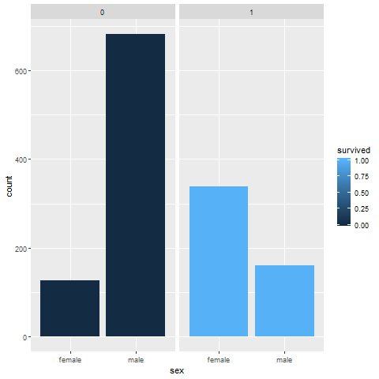
Exercise, R output

Slide 38
Exercise, Tableau output
((Tableau results))

Slide 39
Barchart fundamentals, Summarizations
One number summary (mean or percentage)
Two number summary (error bars)
Five number summary (boxplots)
All the data
Jittering
Opacity
Notes:
All of the examples, so far, have used counts in the bar chart. There are many other statistics that you can choose from, and
((note to myself: maybe this goes better in the talk about lines.))

Slide 40
Barchart fundamentals, Switching from count to percent
((Show the code in Python, R, and Tableau. Explain why you might want counts versus percents.))

Slide 41
Barchart fundamentals, Example with means
((Need to find the right data set to illustrate this. Maybe the Saratoga house prices?))

Slide 42
Barchart fundamentals, Example with totals
((Same data. What means tell you versus totals.))

Slide 43
Barchart fundamentals, Boxplots example
((Include an explanation of what a boxplot is))

Slide 44
Barchart fundamentals, Jittering example
((Include an explanation on when it doesn’t work.))

Slide 45
Barchart fundamentals, Opacity example
((Note the computational expense.))

Slide 46
Barchart fundamentals, Summary
“A mapping of data to the visual aesthetics of geometries/marks”
Bars are a type of geometry/mark
Aesthetics for bars include location, size, color
Stack versus dodge
Basic tips
Place comparators close
Use axis ticks, light grid lines

