Slide 1
Data visualization, scatterplots
Steve Simon

Slide 2
Introduction, Modules
Scatterplots
Bar charts
Line plots
Surface plots (optional)
Maps (optional)
Notes:
This workshop is split up into three to five modules. The basic modules cover scatterplats, bar charts, and line plots. There are optional advanced modules on surface plots and maps.

Slide 3
Introduction, Module components
Preparation
Exercise, what is the message?
Tutorial
Fundamentals
Basic exercises
Recommendations
Exercise, identify features
Short quiz
On your own
Notes:
Each module will start with some basic preparations that you should do before the class starts or at the very beginning of the class..
Then you will review some data visualizations that appeats in newpspaper or web articles. Your goal is to identify (in 25 words or less) the message is that the visualization is trying to convey. The
Each module will include a tutorial on perceptual issues that you need to understand in order to design effective data visulalizations.
Then you will review some fundamental commands that you need to know to draw basic data visualizations. Warning: some of the visualizations you will be asked to produce will look terribly ugly. That’s okay. You’re just learning the basic programming steps for now. Later, you will see how to apply these steps to make better looking and more effective visualizations.
Then you will learn some general recommendations on how to produce effective visualizations.
You will return to the newspaper articles and and relate features of the data visualizations to concepts discussed in the previous lecture.
You will have to answer a short quiz, not for a grade, but to reinforce some of the important points in the module.
Finally, you will work on your own with a different data set, trying to create effective data visualizations similar to the ones presented in each module.

Slide 4
Introduction, Software agnosticism
This course will show examples using
Python,
R, and
Tableau
I do not play favorites
Notes:
I am a big believer in software agnosticism. That means that when I teach something, I teach it with the expectation that the software used to do the assignments is software of YOUR choosing. I have my own preferences, but those should not be your preferences.
It’s a lot more work to teach a course that is not dependent on a particular software system, but I do not know what the best software choice would be for you. In this class, I will try to show examples using Python, R, and Tableau. I realize that there are other good choice, but I’m hoping that most of you will be happy with one of these three choices. Within Python, I will use the altair package. In R, I will use ggplot2. I realize that there are other graphics packages in these two languages, but altair and ggplot2 rely on modern graphics principles, so I will restrict my attention to these packages.
Tableau is a commercial product. If you don’t currently have access to Tableau, the company offers a free version, Tableau Public. It has all the features of Tableau, but you have to store any data visualizations on a public server. That’s just fine for someone like me who uses teaching examples with publicly available data sets. If you are using private or proprietary data, you need to pay the money for the commercial version.

Slide 5
Introduction, What software should you use?
Use the software you like best
What does your boss use?
What do your co-workers use?
What software are you most comfortable with?
Notes:
If you are not sure what software package to use in this class, let me offer a few suggestions. First, your boss may have a strong opinion about what software that you should use. You can go to your boss and say “My teacher is a really smart guy says that the _____ package in _____ is the best choice for data visualization.” Try it and see what happens. Nothing, I suspect. One of the great tragedies in life is that the wise advice you get in this class carries very little weight in the real world.
If your boss doesn’t care, see what most of your co-workers are using. They may not be as smart as I am (put on a false air of pride here) but they are a lot closer to your cubicle when this workshop ends and you have to find a quick answer.
There’s also a comfort level here. Tableau develops its visualizations using a graphical user interface. Python and R are programming languages. A graphical interface is great for getting work done quickly. A programming language is great for reproducibility and reusability. What fits your working style better? I don’t know and it would be arrogant of me to make the presumption that I do know.
One more consideration. Some of you in this class are “ringers.” You already know visualization better than I do because you’ve been doing it for longer, with bigger and more complex data sets. You’re just here to see if I know one or two things that you don’t already know. If you’re a ringer, take the challenge of learning a new software system. It will keep you from getting too bored when I talk about all these things that you already know better than I do.

Slide 6

Preparation, DASL https://dasl.datadescription.com/
Main page of DASL website
Notes:
DASL is an acronym for Data And Story Library. It used to sit on a website, Statlib, at Carnegie Mellon, but the company, Data Description, which makes a data analysis program, DataDesk, took over when the Statlib site went dark. It’s a very nice site for small data sets useful for teaching.
I want to use a file on housing prices in Saratoga, New York, and you can find it through the search function on the main page. Look for housing or Saratoga, and you’ll find it pretty quickly.

Slide 7
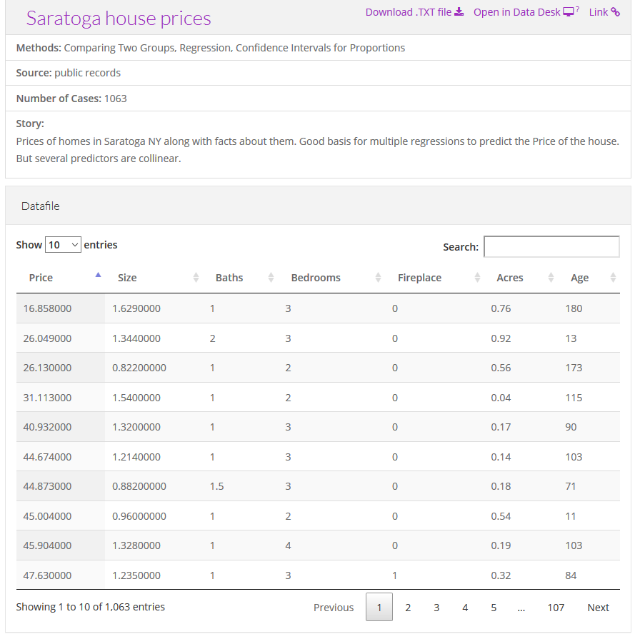
Preparation, Saratoga House Prices
Description of the Saratoga house prices dataset
Notes:
There are two files actually, that look very similar. You want the “Saratoga House Prices” file and not the one called “Saratoga Houses”. The Saratoga House Prices file has 1063 records and the variables are Price, Living.Area, Bathrooms, Bedrooms, Fireplaces, Lot.Size, Age, Fireplace.
This is the file that you want to download and run a scatterplot.

Slide 8
Preparation, Advice if things don’t work
Download the file
Tweak the file
Remove variable names in first line
Change missing value codes
Change the delimiter
Look for inconsistencies
Convert the format
Notes:
These things never work right the first time. If computers worked the first time and every time, we’d all be getting paid the minimum wage. I’m glad to help if you have any problems importing this or any other files, but here is some general advice that you might want to try first.
Some software systems allow you to download directly from the web. This is fast and easy and convenient, but if it doesn’t work download the file and see if you can import it directly.
If this doesn’t work, open the file in a text editing program like notepad and see if you can make some minor changes that allow you to import the file.
If the first line of code has variable names, see if you can import the file without the variable names.
Look at the code for missing values. Some systems use a single dot for a missing value, and others use the letters “NA”. Sometimes converting the missing value code to a different code will help.
Most files have a delimiter, a character that separates one variable from the next. This could be a space, a comma, or a tab character. You may have better luck if you do a careful search and replace, changing from one delimiter to another.
Look for inconsistencies, such as some invalid lines at the bottom of the file or a line with one too few variables or an unmatched quote mark. Fix these and try again.
See if you can read the file into a different program like a spreadsheet and export it in a different format.

Slide 9
Preparation, Python code
import pandas as pd import altair as alt df = pd.read_csv("data/houses.csv") ch = alt.Chart(df).mark_point().encode( x='Age', y='Price' ) ch.save("/images/python-scatterplot.html")
Notes:
Here is the Python code that will download the data and create a simple scatterplot. You may need to adapt the names of the files or the directories where they are stored.

Slide 10
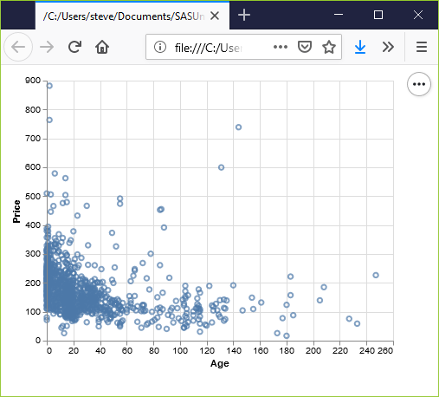
Preparation, Python output
Basic scatterplot using Python
Notes:
See if you can get a graph that looks something like this. If your graph uses different colors, scaling, etc. don’t worry. I just want to know at this point that you can produce any sort of reasonable graph.

Slide 11
Preparation, R code
Here is the R code that will download the data and create a simple scatterplot.
library(ggplot2) saratoga_houses <- read.csv("data/houses.csv") ggplot(saratoga_houses, aes(x=Age, y=Price)) + geom_point()
Notes:
Here’s a brief bit of R code that should work. You may need to adapt the names of the files or the directories where they are stored.

Slide 12
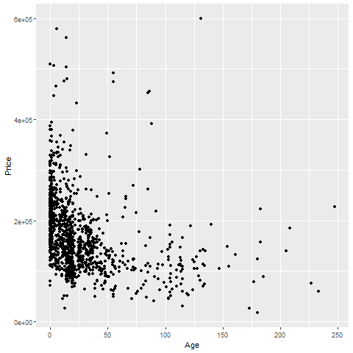
Preparation, R output
Notes:
Again, see if you can get a graph that looks something like this. If your graph uses different colors, scaling, etc. don’t worry. I just want to know at this point that you can produce any sort of reasonable graph.

Slide 13
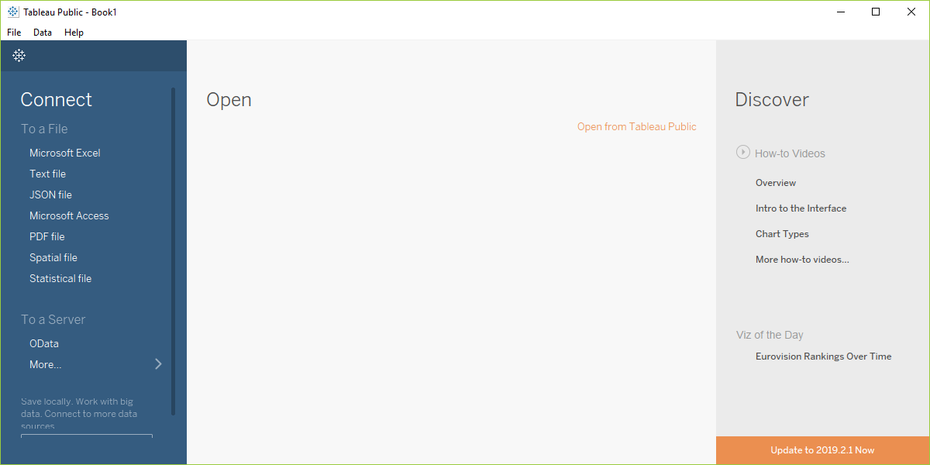
Preparation, Tableau Open dialog box
Screenshot of Tableau software, main screen
Notes:
Before you start with Tableau, download the Saratoga Housing Prices file to your local computer.
Tableau uses a graphical user interface, so there is no “program” to run. Here are the steps you need to take to get the data in and produce a simple scatterplot.
This is what Tableau looks like when you open it up. It may appear slightly differently on your computer system.
Select “Text file” from the left side menu bar or “File | Open” from the main menu.

Slide 14
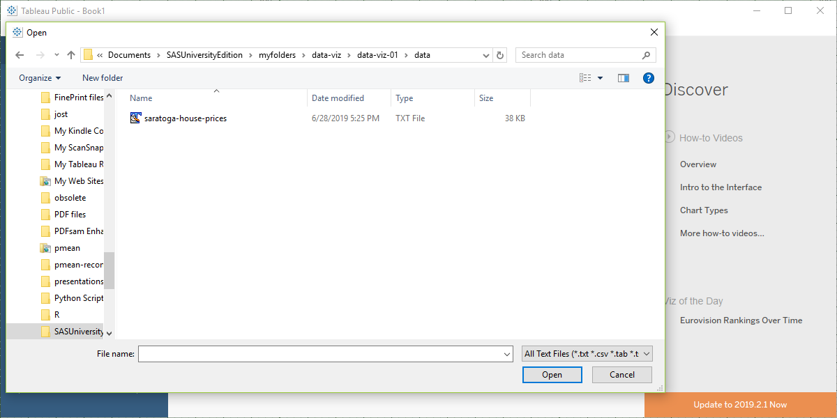
Preparation, Tableau, Select your file
Screenshot of Tableau software, file open dialog box
Notes:
Find the proper location on your computer where you stored the downloaded file and open it.

Slide 15
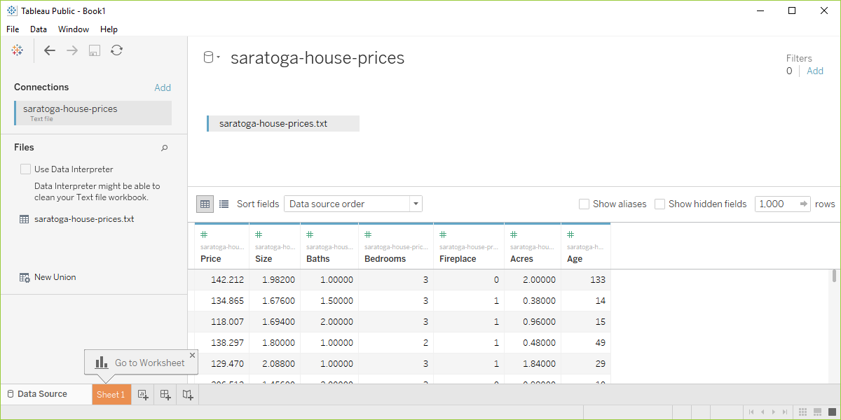
Preparation, Tabelau data preview
Screenshot of Tableau software with data imported
Notes:
Your screen should look something like this if you imported the data correctly. Click on the sheet1 tab in the lower left corner to open up a blank visualization page.

Slide 16
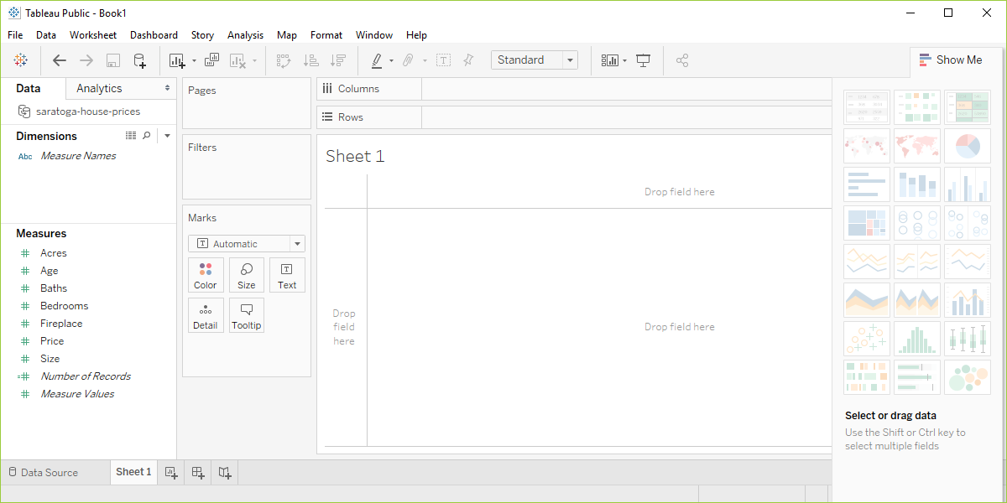
Preparation, Tableau, start visualization
Screenshot of Tableau software, blank visualization page
Notes:
Tableau will try to classify your data as measures or dimensions and will also try to decide whether they are categorical (designated by blue tags) or continuous (designated by green tags). Don’t worry too much about this now, other than to note that changing the designations that Tableau makes will change how you visualize things.
Drag the variable Age into the Columns field and drag Price into the Rows field

Slide 17
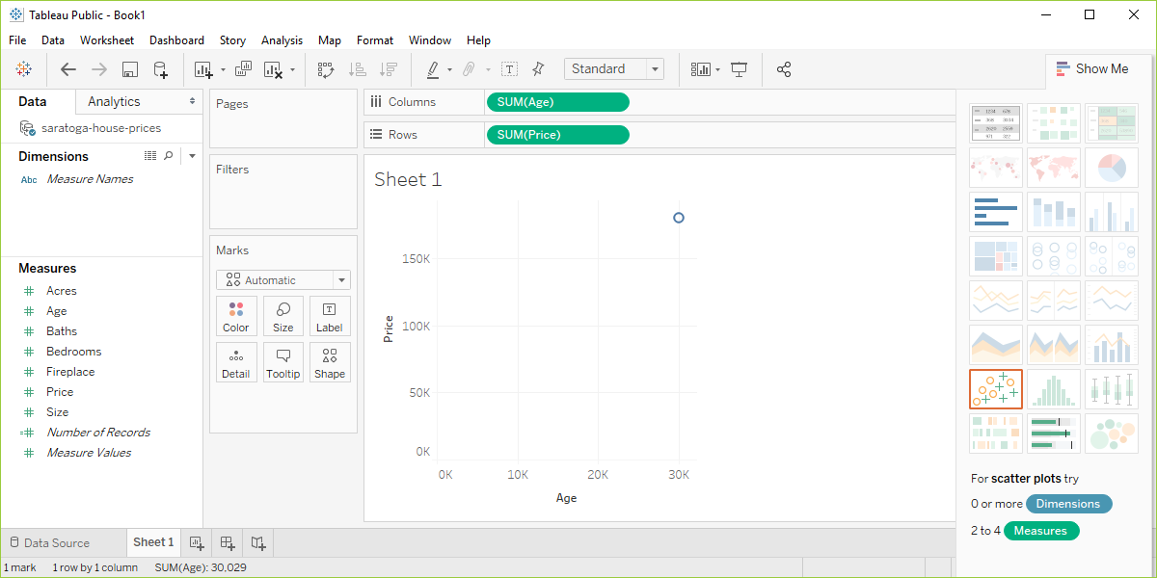
Preparation, Tableau, Identify columns and rows
Screenshot of Tableau software after initial drag and drop
Notes:
Tableau makes some educated guesses about what you want. It thinks that you are interested in aggregating age and price and plots a single data point with the sum of all the ages of the houses on the X axis and the sum of all the prices on the Y axis.
This is not what you want, but that’s okay. Better a wrong guess that you can correct than no guess at all.

Slide 18
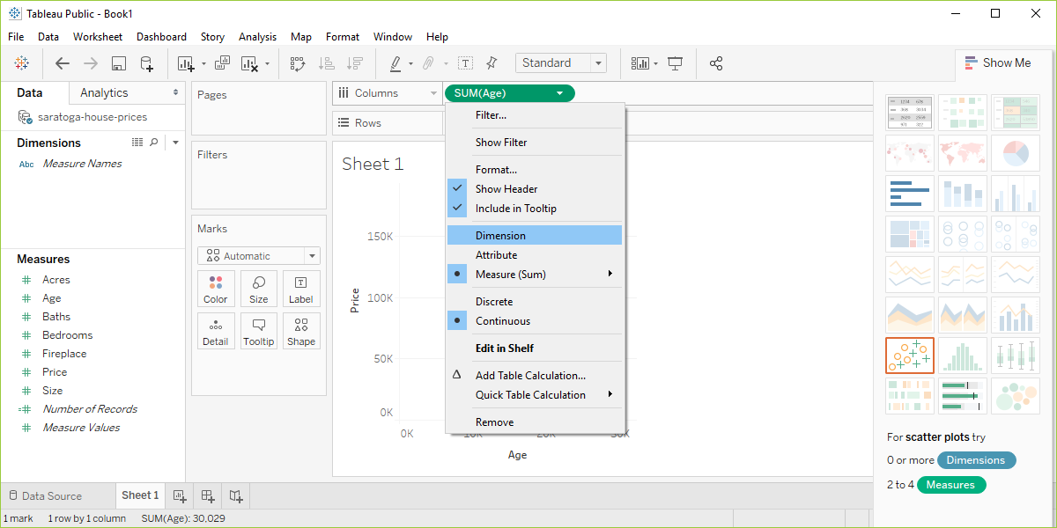
Preparation, Tableau, change columns
Screenshot of Tableau software changing from measure to dimension
Notes:
Click on the green Sum(Age) and change it from Measure(Sum) to Dimension. Don’t freak out when the graph goes all bonkers on you. Click on the green Sum(Price) and do the same thing. Then you’ll get a nice basic scatterplot.

Slide 19
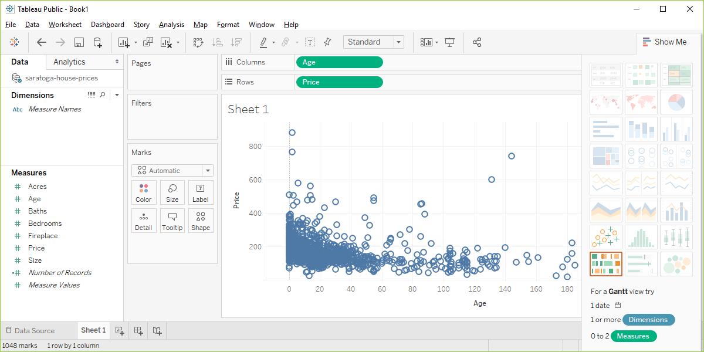
Preparation, Tableau output
Screenshot of Tableau software changing from measure to dimension
Notes:
Did you get something that looks roughly like this? Pat yourself on the back for a job well done.

Slide 20
Graphs in the news, group exercise
Review one of these graphs/newspaper articles
We Charted Arctic Sea Ice for Nearly Every Day Since 1979. You’ll See a Trend.
We Read 150 Privacy Policies. They Were an Incomprehensible Disaster.
How Medicine Became the Stealth Family Friendly Profession.
Notes:
The following images are taken from various newspaper articles. Look at the graph and read/skim the article.

Slide 21
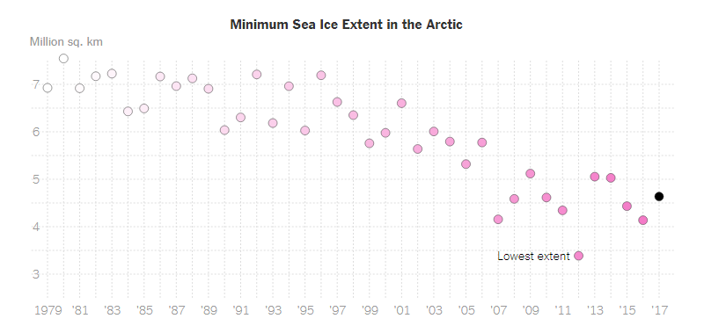
Graphs in the news, Arctic ice levels
Scatterplot of Arctic ice levels
Notes:
This image was found in a newpaper article,
Popvich, N., Fountain, H., & Pearce, A. (2017, September 22). We Charted Arctic Sea Ice for Nearly Every Day Since 1979. You’ll See a Trend. - The New York Times. The New York Times. Retrieved from https://www.nytimes.com/interactive/2017/09/22/climate/arctic-sea-ice-shrinking-trend-watch.html

Slide 22
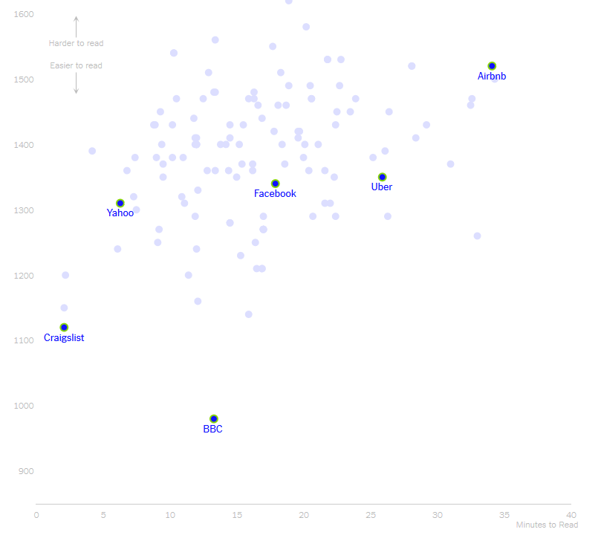
Graphs in the news, Privacy policies
Scatterplot of length versus reader difficulty
Notes:
This image was found in a newpaper article,
Kevin Litman-Navarro. We Read 150 Privacy Policies. They Were an Incomprehensible Disaster. The New York Times. Retrieved from https://www.nytimes.com/interactive/2019/06/12/opinion/facebook-google-privacy-policies.html

Slide 23
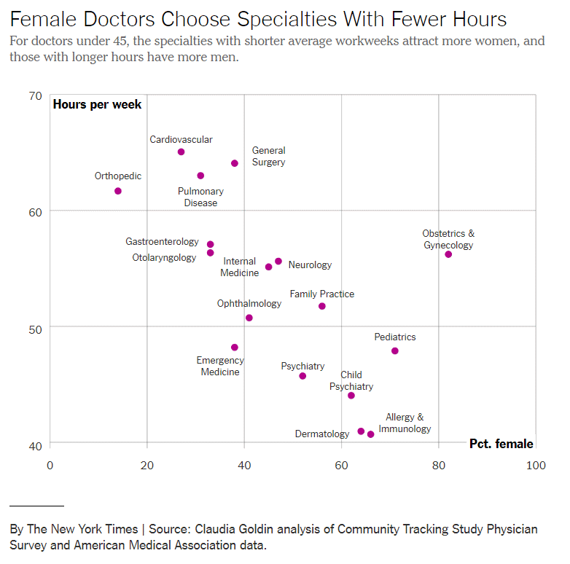
Graphs in the news, Family friendly profession
Notes:
This image was found in a newpaper article,
Claire Cain Miller (2019, August 21). How Medicine Became the Stealth Family Friendly Profession. The New York Times. Retrieved from https://nytimes.com/2019/08/21/upshot/medicine-family-friendly-profession-women.html

Slide 24
Graphs in the news, what is the message?
Your group will be assigned one particular graph and newspaper article
Read/skim the article and examine the graph
What is the message?
Summarize in 25 words or less.
Notes:
The following images are taken from various newspaper articles or press releases. Look at the graph and read/skim the article.
What message do you think the journalist is trying to convey with this graph. Summarize this message in 25 words or less.

Slide 25
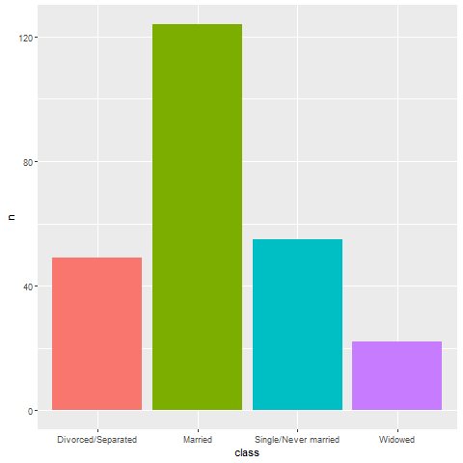
Evaluation, Which is better? A bar chart…
Bar chart, with four bars side by side
Notes:
Here’s a bar chart dispaying the counts for people in four categories for marital status, divorced, married, single, widowed.

Slide 26
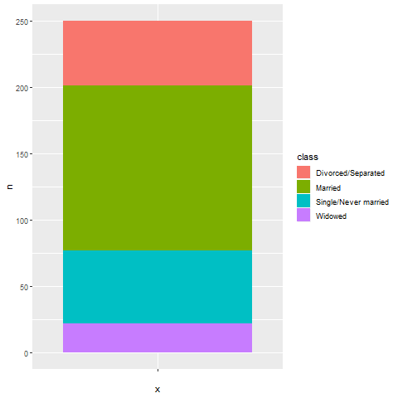
Evaluation, … a stacked bar chart, …
Notes:
Here’s the same data, but the bars are now stacked in a single column.

Slide 27
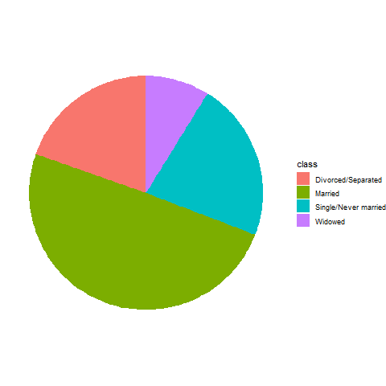
Evaluation, … or a pie chart
Pie chart
Notes:
There’s one more obvious choice. You can display the counts in a pie chart.

Slide 28
Evaluation, Better in what way?
Two most important criteria
Speed
Accuracy
Notes:
The answer really depends on what question you are asking. There are a variety of questions that you might ask.
You can run an experiment (people have done this) where randomize and show half of them a bar chart and half of them a pie chart. Then you ask a question. Then you note the speed and accuracy of the response. Depending on the question, sometimes pie charts give faster and more accurate answers. Sometimes bar charts give faster and more accurate answers. It turns out that the results match up nicely with what we know about the psychology of perception.

Slide 29

Evaluation, Which percentage is larger? Bar chart is best!
Bar chart, projecting one bar to another
Notes:
If you ask the question, which percentage is larger, the percentage for single or the percentage for divorced/separated, the bar chart is the winner, hands-down. The comparison involves a simple horizontal projection. You can do this quickly and accurately.

Slide 30
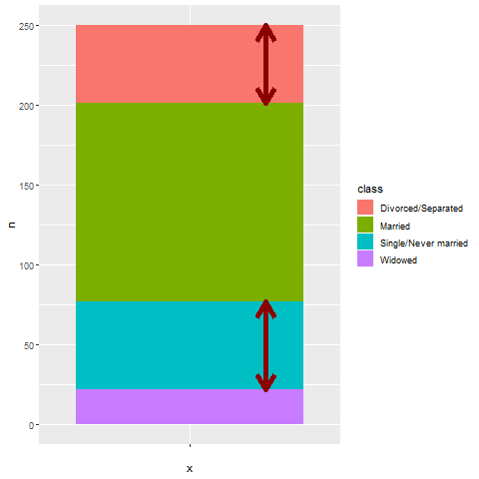
Evaluation, Second best, stacked bar chart
Stacked bar chart, comparing lengths
Notes:
The second best choice for answering this question is the stacked bar chart. You have to compare the lengths of two bars which are not aligned. It takes a bit longer to make this judgement, and it is harder to provide an accurate answer when the bars are very similar in length. But it is still not too difficult.

Slide 31
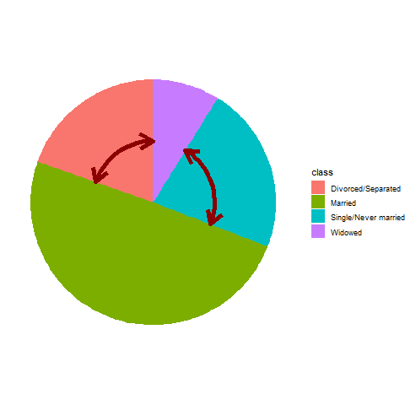
Evaluation, Worst, pie chart
Pie chart, comparing two angles
Notes:
For the pie chart, you have to judge which wedge of the pie is bigger by looking at the area of the wedges, but actually most people make assessments in a pie chart by looking at the interior angle. You can see that the interior angle is bigger for the single group, but it is a harder judgement to make quickly and it is a harder judgement to make accurately.
Now I need to note that this is not my opinion. It is a fact established by empirical study. The first bar chart, which allows you to make comparisons using relative position, produces faster and more accurate answers.

Slide 32
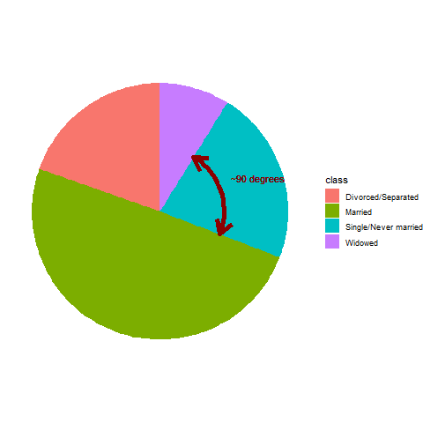
Evaluation, What fraction of people are single? Best is pie chart
Pie chart, estimating a percentage for one wedge
Notes:
But wait! If you ask a different question, what percentage of people in your sample are single, the pie chart does the best. The interior angle for the single wedge is just a bit under 90 degrees, and that tells you quickly, and fairly accurately, that the percentage is a bit under 25%.

Slide 33
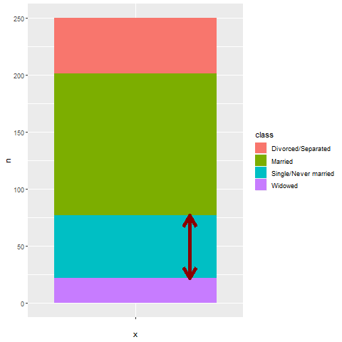
Evaluation, The stacked bar chart is second best
Stacked bar chart, estimating percentage
Notes:
You can ask the same question for the stacked bar chart, but it will take longer and be less accurate. It’s easy to split a bar in half, but you will have much harder perceptual task to split it into quarters. So deciding whether that single bar is a bit less than 25% or a bit more than 25% can’t be done as well.

Slide 34
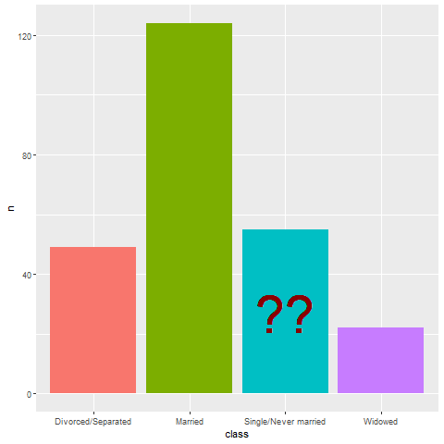
Evaluation, The side-by-side bar chart is hopeless.
Bar chart, trying to assess percentage questions
Notes:
Trying to answer a percentage question for a side by side bar chart is pretty much hopeless. What you have to do is visually stack the bars and then divide the bars into quarters.
When you ask percentage questions, all methods do pretty well for percentages near 0% and 100%. All methods also do well for percentages around half, or 50%. The pie chart also does well for percentages close to 25% and 75%. It is easy visually to split a pie into four equal pieces. Just look for the 90 degree angles. The empirical research supports this. Speed and accuracy of percentage judgements are about the same for bar charts and pie charts, except around 25% and 75% where the pie chart is markedly superior.

Slide 35
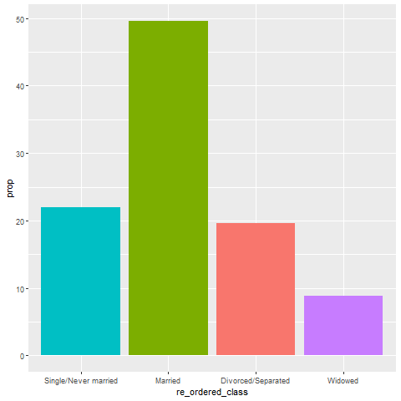
Evaluation, Maybe the “hopeless” bar chart isn’t so hopeless
Bar chart, with bars re-ordered and a percentage value on the Y axis
Notes:
Things are never totally hopeless, however. If your goal is to simplify the estimation of the percentage of your sample in the single/never married category, change your y axis from counts to percentages. Also, place the most important bar closest to the Y axis. Horizontal projections are easiest when the distances you have to project are very short.
There’s lots of other little things you can do. We’ll talk a lot more about bars in the second part of this workshop.

Slide 36
Evaluation, Summary
Judging effectiveness of a graph
Speed
Accuracy
Pie chart better for estimating percentages
Any graph can be improved
Notes:
The way that you judge the effectiveness of a graph is by speed and accuracy. How quickly you answer a question about the graph, and how accurate your answer is.
The bar chart is best for comparing one bar to another, but if you want to estimate the percentage of a whole, then a pie chart is better, particularly for percentages around 25% and 75%.
Even a bad graph can often be improved with some minor changes.

Slide 37
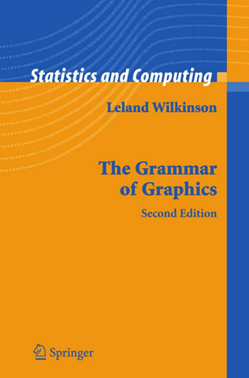
Grammar, Theoretical foundation of data visualization
Front cover of the book, The Grammar of Graphics
Notes:
Most of the current designers of data visualization software have based their work on the theoretical foundations of Leland Wilkinson. This includes ggplot2 in r, altair in Python, and Tableau, among others. Dr. Wilkinson wrote a book, The Grammar of Graphics, in 1999 (second edition in 2006) that laid out the principles for the development of pretty much any data visualizaton that you could imagine. The work is mathematically rigorous, and I do not recommend that you read this book unless you enjoy that sort of thing. I do want to highlight a few of the fundamental ideas in the book

Slide 38
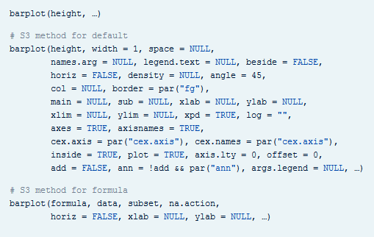
Grammar, Visualization before Wilkinson (1 of 3)
Excerpt from the R help file for the barplot function
Notes:
I’m going to do one of those bad things that a presenter should never do. I’m going to show you a series of three slides that is intended to create a sense of confusion. I’m doing this because I want you to appreciate how bad things were before Leland Wilkinson came along.
There’s a saying that a camel is a horse designed by a committee. Well, this slide and the next two slides represent some very ugly looking camels.
Here’s the help function from the program R for the barplot function. This function and the following were developed before Wilkinson’s work and show the problem without using his framework.
I don’t want you to study this help file closely. I just want to emphasize two points.
First, there are a dizzying number of options, 30 for the barplot. Maybe this is unavoidable. But what follows when you look at the next help function is the real problem.
When you switch from one function to another, from one visualization method to another, the options change. This is bad because it makes it harder for you to learn new graphical display methods. Even after you learn them, you will have a difficult time remembering which options and which defaults go with which graphical displays.

Slide 39
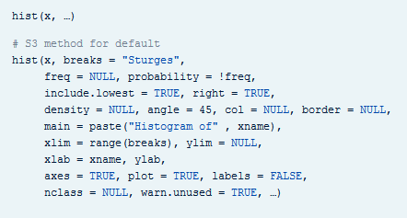
Grammar, Visualization before Wilkinson (2 of 3)
Excerpt from the R help file for the hist function
Notes:
Here’s the help function from the program R for the hist function. The default option for the borders of the bars of a barplot differ from the option for the borders of the bars of a histogram. This makes no sense. A histogram is different than a bar chart, but not that much different.
The way that you determine the limits for the x-axis and the y-axis differ. Again, how is a histogram so much different from a barplot that you need different methods for deciding something like this?

Slide 40
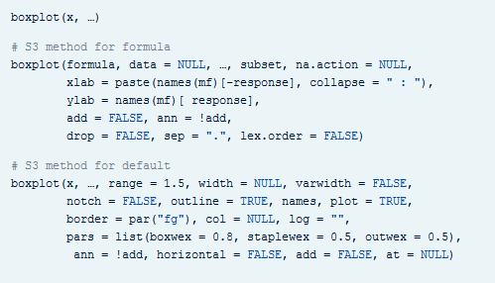
Grammar, Visualization before Wilkinson (3 of 3)
Excerpt from the R help file for the boxplot function
Notes:
If that isn’t confusing enough, look at the help file for the boxplot.
It’s pure chaos. Each function has a different set of arguments, listed in a different order and with different default options. This continues when you look at help for the pie function for pie charts, the contour function for contour plots, the persp3d function for three dimensional surfaces, the stem function for stem and leaf diagrams, and many others.
Adopting the framework developed in The Grammar of Graphics provides you with one stop shopping. It is a bit daunting at first, because it includes everything and the kitchen sink. But once you get comfortable with it, you will find that each new visualization that you try uses the same syntax, more or less.

Slide 41
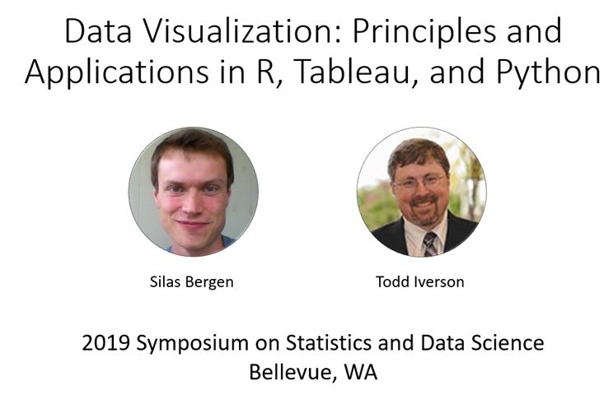
Grammar, Helpful resource
Title slide from the Bergen-Iverson presentation
Notes:
In this section, I am going to borrow heavily from a short course presented at the 2019 Symposium on Statistics and Data Science. The presenters are nice enough to share their materials on their github site. You can find it easily with a google search of bergen iverson sdss2019 data visualization.

Slide 42
Grammar, Definition of data visualization
“A mapping of data to the visual aesthetics of geometries/marks”
Bergen and Iverson 2019
Notes:
A definition of visualization, based on the Grammar of Graphics framework is provided in the Bergan and Iverson presentation that I mentioned on the previous slide.
There are four nouns in this definition.
Data. I hope I don’t have to define data other than to say that it is an interesting set of numbers. I won’t talk about non-numeric data like text in this workshop. Ideally these numbers have enough structure that you can put them into a rectangular grid like a spreadsheet or database table.
Aesthetics is a work that Dr. Wilkinson likes, but I’m not so sure that I care for it. An aesthetic is a visual feature.
The compound noun geometries/marks is a deliberate choice of Bergen and Iverson. If you use ggplot2 in R, you will be more comfortable with the noun geometries. If you use altair in Python, or if you use Tableau, you will be more comfortable with the noun marks.
Mapping means a transformation. You are taking data and converting it into various visual features.
It will help to see some examples.

Slide 43
Grammar, Examples
Geometries/marks
Points
Lines
Bars
Aesthetics
Position
Shape
Size
Color
Notes:
Think of geometries/marks are ink placed on a sheet of paper. They could represent points, lines, bars, or text, among other things.
There are four (more or less) major visual properties of points, lines, bars, and text.
The aesthetics fall into five major classes: position, shape, size, and color.
Not every geometry/mark will have every possible aesthetic. Some of these aesthetics can be combined to great effect, but sometimes they work antagonistically. Do consider every possible aesthetic in your graph, but intentionally ignoring an aesthetic can sometimes work to your advantage. Some aesthetics map very nicely to continuous data, but others only work well with categorical data.

Slide 44
Grammar, Geometries/marks in Python
mark_point
mark_line
mark_bar
Notes:
You specify the type of geometry/mark in Python using a range of mark functions.

Slide 45
Grammar, Geometries/marks in R
geom_point
geom_line
geom_bar, geom_col
Notes:
You specify the type of geometry/marks in R using a range of geom functions.

Slide 46
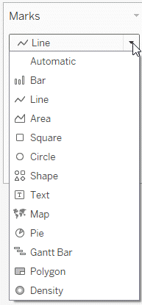
Grammar, Geometries/marks in Tableau
Screenshot of the Marks pulldown menu
Notes:
Tableau will try to guess what type of marks to use, but if it guesses wrong, you can correct things with the Marks pull down menu. This menu gives you options for (among other things) Bar, Line, Shape (scatterplot), and Text.

Slide 47
Grammar, Mapping to aesthetics in Python
encode function
x=
y=
shape=
size=
color=
Example
alt.Chart(data).mark_point().encode( x=‘var1’, y=‘var2’, size=‘var3’, shape=‘var4’, color=‘var5’)
Notes:
In Python, the mapping is done with the encode function. The location is represented by x= and y= arguments. Size, shape, and color are mapped using the size=, shape=, and color= arguments.
Here’s an example. The age and price of the home are mapped to the x and y locations. The acreage of the land maps to the size. The number of bedrooms maps to the shape, and the number of bathrooms maps to the color.

Slide 48
Grammar, Mapping to aesthetics in R
aes function
x=
y=
size=
shape=
color=
Example
ggplot(data, aes(x=var1, y=var2)) +
geom_point(aes(size=var3, shape=var4, color=var5))
Notes:
In R, the mapping is done with the aes (short for aesthetics) function. The location is represented by x= and y= arguments. Size, shape, and color are mapped using the size=, shape=, and color= arguments.
Here’s an example. The age and price of the home are mapped to the x and y locations. The acreage of the land maps to the size. The number of bedrooms maps to the shape, and the number of bathrooms maps to the color.

Slide 49
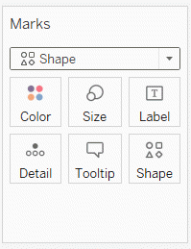
Grammar, Mapping to aesthetics in Tableau
Tableau buttons below Marks
Notes:
Tableau accomplishes mapping through a drag and drop interface. Drag a variable to the Columns field and a second variable to the Rows field to specify the x and y locations. Drag a variable on top of the size, shape, and color icons to map those variables appropriately.

Slide 50
Grammar, changing variable types in Python
Q: Quantitative
Use for continuous variables
O: Ordinal
Use for ordered categories
N: nominal
Use for unordered categories
T: Temporal
Use for time variables
Notes:
All of these graphic packages will make assumptions about what the data represents, and set certain default graphic types on the basis of these guesses. Those choices are usally good, but when they are not, then you can override these guesses.
In Altair/Python, you use letter codes.
The letter Q (quantitative) will tell the system that you want to treat this variable as continuous.
The letter O (Ordinal) will tell the system that you want to treat this variable as ordered categories.
The letter N (Nomina) will tell the system that you want to treat this variable as unordered categories.
The letter T (Temporal) will tell the system that you want to treat this variable as a measure of time.

Slide 51
Grammar, Changing variable types in R
as.numeric()
Use for continuous variables
as.character(), as.factor()
Use for categorical variables
as.Date()
Use for date variables
Notes:
There are lots of conversion functions in R, and it beyond the scope of the class to cover them. But sometimes you will find in R that you need to convert the variable type before you do certain analyses. If you want to represent a variable as continuous, the as.numeric function will often do the trick. If you want to represent a variable as categorical, then try the as.character or as.factor functions. For temporal data, try the as.Date function.

Slide 52
Grammar, Changing variable types in Tableau
Dimension Discrete (blue pill)
Use for categorical variables
Dimension Continuous (green pill)
Use for continuous variables
Measure
Use for summary measures (average, count, etc.)
Notes:
In Tableau, use Dimension Discrete to designate catergorical data. The color of the “pill” for your variable will change to blue when you make this choice. Use Dimension Continuous for continuous data. The color of the “pill” for your variable will change to green when you make this choice.
Use Measure when you want to display not the invidual values within a group but rather an aggregate or summary statistic, such as a mean or a count.

Slide 53
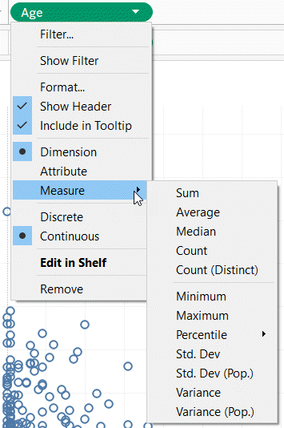
Grammar, Changing variable types in Tableau
Variable pull down menu in Tableau
Notes:
This image shows the pull down menu for a variable with the choices you get.

Slide 54
Grammar, Summary
“A mapping of data to the visual aesthetics of geometries/marks”
Geometries/marks
Point
Bar
Line
Aesthetics
Location
Size
Shape
Color
Notes:
Data visualization is a mapping of data.
Geometries/marks include points, bars, and lines. Aesthetics include location, size, shape, and color.
These ideas are implemented in R (ggplot2), Python (Altair), and Tableau.

Slide 55
Fundamentals, Review basic scatterplot
Python code
ch = alt.Chart(df).mark_point().encode( x='Age', y='Price' )
R code
ggplot(saratoga_houses, aes(x=Age, y=Price)) + geom_point()
Tableau
(Drag and drop)
Notes:
You’ve already drawn a basic scatterplot in Python, R, or Tableau. All three systems choose a slightly different visualization, but, for the most part, the graphs look fairly nice. You can change some of those default options.

Slide 56
Fundamentals, Changing default options
Python code
.mark_point(shape="square", color="green").
R code
geom_point(shape="square", color="green")
Tableau
Click on the shape and color buttons
Notes:
In Python, you can change the default for every data point inside the mark_point function. In R, you do this inside the geom_point function. In Tableau, you have to click on the color and shape buttons to change the defaults.
Note that you may want to change the color or shape only for some of the data points. This is done inside the encode function in Altair/Python. In R, this is done inside the aes function. In Tableau, you drag and drop certain variables on top of buttons for color and shape.

Slide 57
Exercise, change the color and shape
Use the Saratoga housing data set.
Change the default color to any color you like
Change the default shape to any shape you like
Notes:
Take the scatterplot that you have already drawn and change the color of the points. Any color is fine as long as it is different from the default color. Change the shape of the points as well to any shape you want.

Slide 58
Exercise, Python code
Here’s the Python code.
ch = alt.Chart(df).mark_point( shape="square", color="green" ).encode( x='Age', y='Price' )
Notes:
In Python, you change defaults inside the mark_point function.

Slide 59
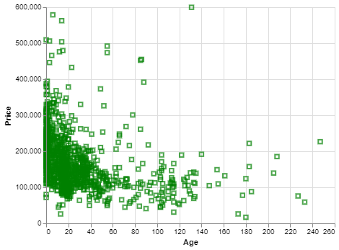
Exercise, Python output
Python scatterplot with green squares
Notes:
Here’s what my output looks like. You are welcome to experiment with different colors and different shapes.

Slide 60
Exercise, R code
Here’s the R code
ggplot(saratoga_houses, aes(x=Age, y=Price)) + geom_point(shape="square", color="green")
Notes:
The change in default shape and color are found in the geom_point function.

Slide 61
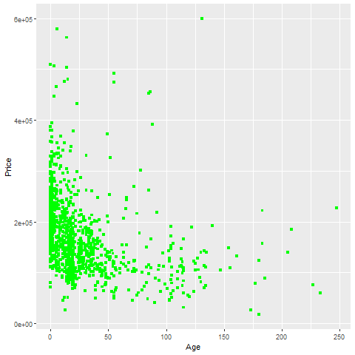
Exercise, R output
Notes:
This is the R output. Try other options if you have time.

Slide 62
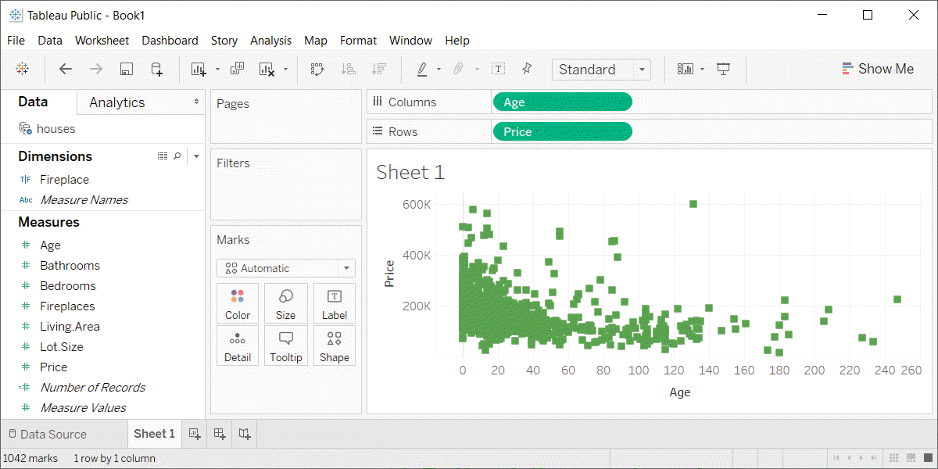
Exercise, Tableau output
Tableau scatterplot with green squares

Slide 63
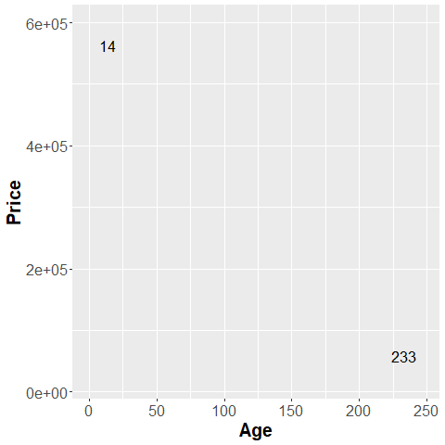
Fundamentals, Aesthetics for points - location (1 of 2)
Illustration of location aesthetics
Notes:
This plot show only two data points, and is labeled with the variable age, corresponding to the X location.
The point on the left is a young house, only 14 years old. The point on the right is an old house, 233 years old.

Slide 64
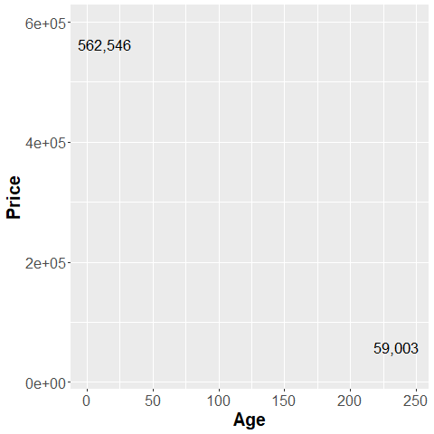
Fundamentals, Aesthetics for points - location (2 of 2)
Illustration of location aesthetics
Notes:
This plot is labeled with the variable Price, corresponding to the Y location.
The point in the up high is an expensive house, over a half million dollars. The point down low a cheap house, about one-tenth of the price.

Slide 65
Exercise, change the location
Use the Saratoga housing data set.
Revise the plot so that the location of the points represents X=Bedrooms and Y=Price.
Notes:
Go back to the plot you just drew. Modify it so that the x location is Bedrooms and not Age.

Slide 66
Exercise, Python code
Here’s the Python code.
ch = alt.Chart(df).mark_point().encode( x='Bedrooms',y='Price')
Notes:
You specify the x and y locations inside the encode function.

Slide 67
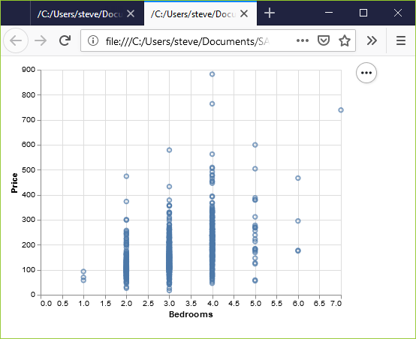
Exercise, Python output
Python scatterplot of bedrooms and price
Notes:
This is what the Python graph should look like. There is a general upward trend. Houses with more bedrooms tend to cost more.

Slide 68
Exercise, R code
Here’s the R code
ggplot( saratoga_houses, aes(x=Bedrooms, y=Price)) + geom_point())
Notes:
In R, the X and Y locations go inside the aes function. Normally the aes function sits insider the ggplot function.

Slide 69
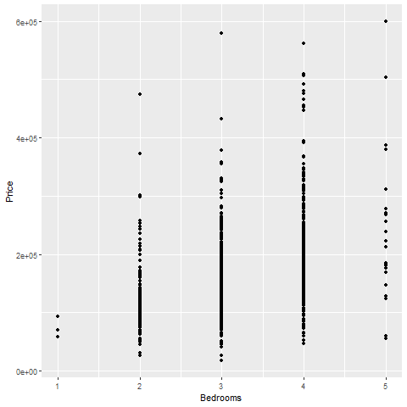
Exercise, R output
Scatterplot of bedrooms and price
Notes:
This is the plot in R. It shows a general upward trend.

Slide 70
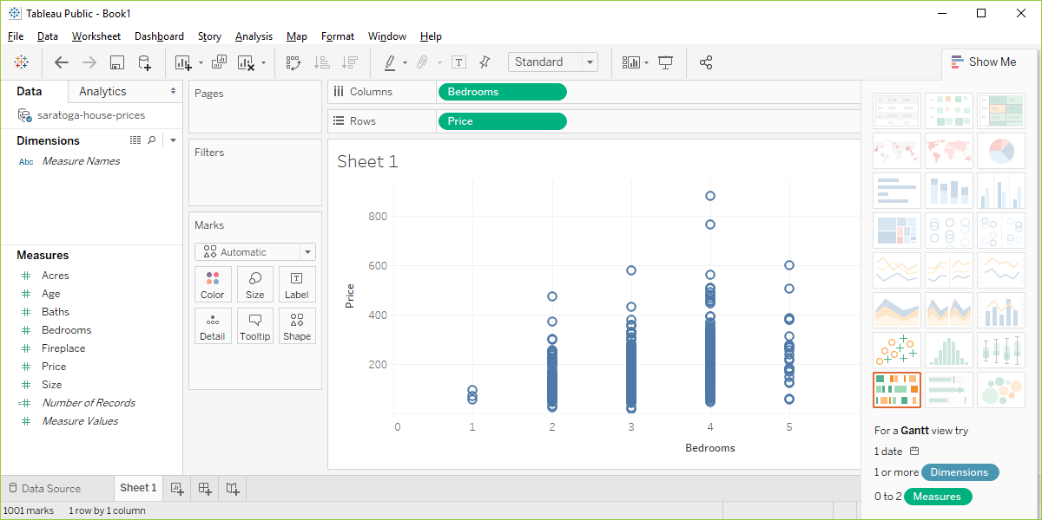
Exercise, Tableau output
Tableau scatterplot of Bedrooms and Price
Notes:
In Tableau, click on Age in the Columns field and choose the remove option. The graph looks a bit weird with no columns, but ignore it. Drag Bedrooms over to the Columns field. Tableau wants to use a sum, but you want individual data points. So click on SUM(Bedrooms) and change it to a Dimension.

Slide 71
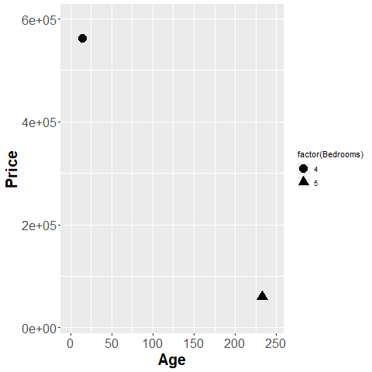
Fundamentals, Aesthetics for points - shape
Illustration of shape aesthetics
Notes:
The house in the upper left corner has four bedrooms, and the house in the lower right corner has five bedrooms. You use circles and triangles to designate this and the legend on the right hand side tells you how to decipher the symbols.
I want to note here that this plot is effectively showing three dimensions, Age, Price, and Bedrooms, even though it is restricted to a two dimensional screen.
I also want to point out that this may not be the best way to visualize the relationship among these three variables.

Slide 72
Exercise, change the shape
Use the Saratoga housing data set.
Draw a plot of all of the data where
X=Age,
Y=Price,
Symbol=number of bedrooms.
Notes:
Revisit your scatterplot. Draw a plot with x representing the age of the house, y representing the price, and the symbol representing the number of bedrooms.

Slide 73
Exercise, Python code
Here’s the Python code.
ch = alt.Chart(df).mark_point().encode( x='Age',y='Price', shape='Bedrooms:N')
Notes:
In Python, when you want the shape to vary by the levels of a particular variable, you specify this in the encode function. This Python program has three variables that are mapped. Age is mapped to the X location, Price is mapped to the Y location, and Bedrooms is mapped to various shapes.
Bedrooms is on a continuous scale, and you have to tell Python that you want to treat it as if it were nominal.

Slide 74
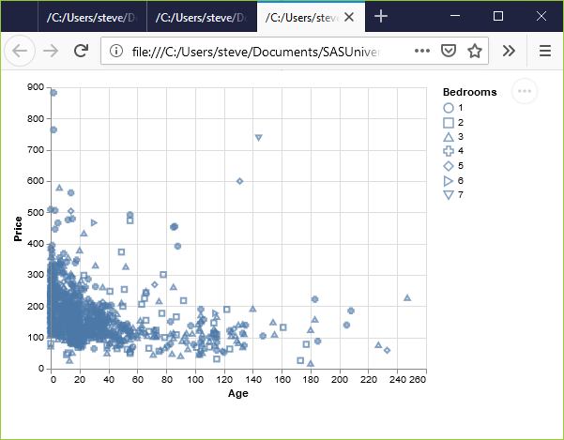
Exercise, Python output
Python scatterplot mapping bedrooms to shape
Notes:
This is what the plot looks like. There is a terrible mix of shapes with no obvious pattern.

Slide 75
Exercise, R code
Here’s the R code.
ggplot(saratoga_houses, aes(x=Age, y=Price)) + geom_point(aes(shape=factor(Bedrooms)))
Notes:
Here is the R code. When the shape of a point is dependent on a variable, you need to specify that variable inside the aes function. You could have defined it inside the existing aes function in the first line of code, but you can also add an aes function to the geom_point function.
I like the second option because it makes the code a bit easier to read.
Bedrooms is numeric, and by default in R is treated as a continuous variable. You can convert it to a nominal variable with the factor function.

Slide 76
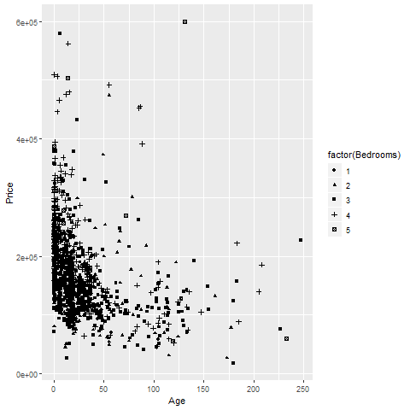
Exercise, R output
R scatterplot mapping bedrooms to shape
Notes:
Here is what the R graph looks like. I don’t particularly like this graph. It is confusing, especially with all the overprinting.

Slide 77
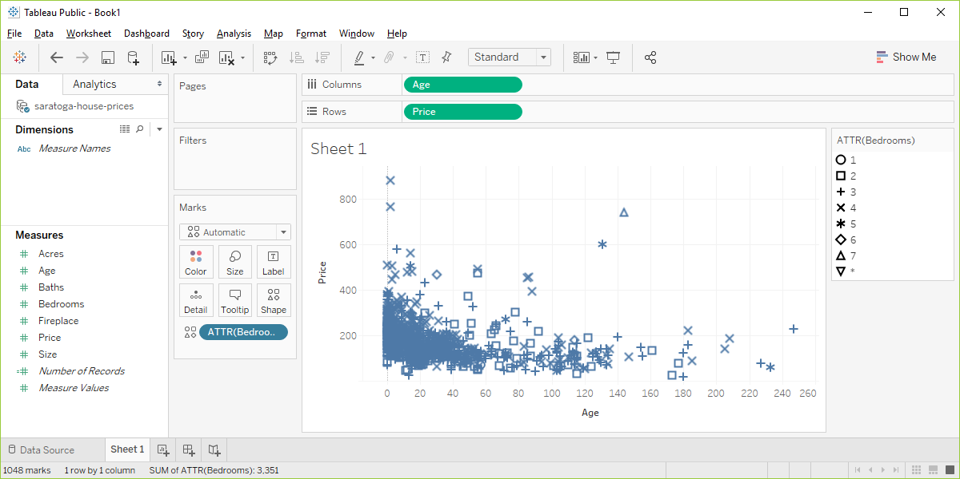
Exercise, Tableau output
Tableau scatterplot using shapes to represent Bedrooms
Notes:
Here are the steps in Tableau. First revert to the earlier scatterplot where Age is in the Column fields and Price is in the Rows field. Then drag and drop Bedrooms on top of the Shape icon. Change from SUM(Bedrooms) to Dimension Categorical.

Slide 78
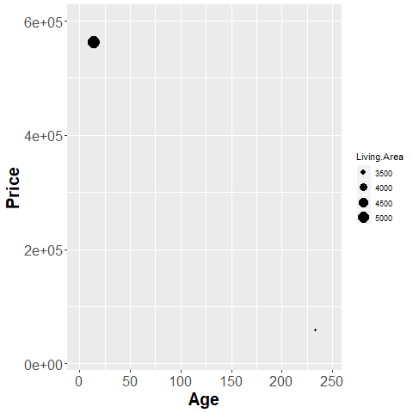
Fundamentals, Aesthetics for points - size
Illustration of size aesthetics
Notes:
You can also use the size of a point to represent a third dimension. Here is a plot where the larger house, the house with more living area has a big circle and the house with less living area has a small circle.

Slide 79
Exercise, change the size
Use the Saratoga housing data set.
Draw a plot of all of the data where
X=Age,
Y=Price,
Size=Living.Area.
Notes:
Revisit your scatterplot. Draw a plot with x representing the age of the house, y representing the price, and the size representing the living area.

Slide 80
Erercise, Python code
Here’s the Python code
ch = alt.Chart(df).mark_point().encode( x='Age',y='Price', size='Living.Area')
Notes:
For Altair/Python, you define the variable associated with size in the encode function.

Slide 81
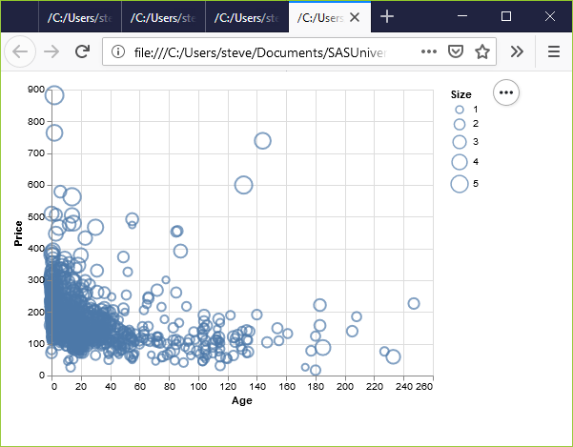
Exercise, Python output
Python scatterplot mapping living area to size
Notes:
This plot is a bit of a jumble, but you do notice that the very very high prices are all large circles, meaning spacious houses.

Slide 82
Exercise, R code
Here’s the R code.
ggplot(saratoga_houses, aes(x=Age, y=Price)) + geom_point(aes(size=Living.Area))
Notes:
With R, you put the variable associated with size in the aes function. Here, I placed this particular aes function in the geom_point function, but it would be okay to specify it as part of the earlier aes function inside the ggplot function.

Slide 83
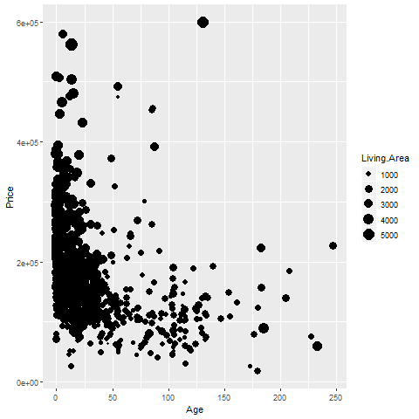
Exercise, R output
R graph using size to represent Living Area
Notes:
This plot shows the same pattern as earlier. The spacious houses tend to be clustered near the top of the graph, the expensive part of the graph.

Slide 84
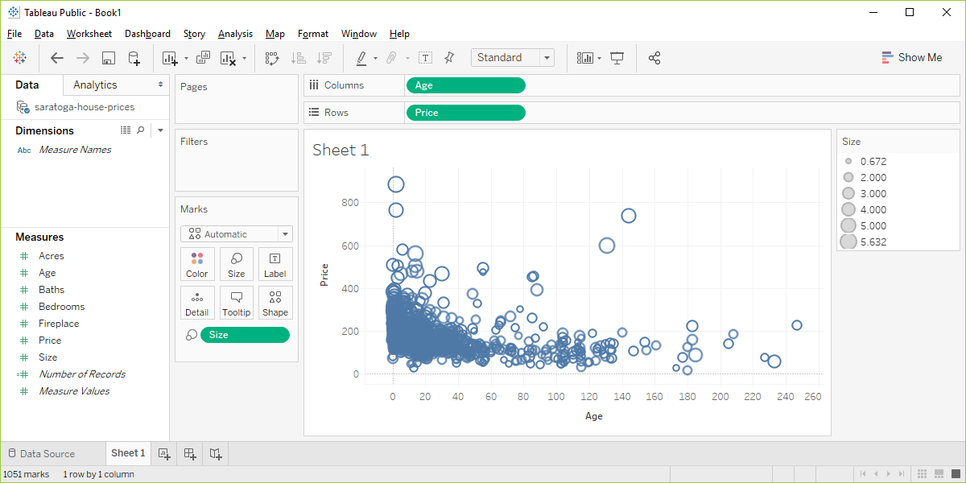
Exercise, Tableau output
Visualizaion using Living.Area as the size
Notes:
In Tableau, you drag and drop the Living.Area variable on the Size icon. The results are pretty much the same.

Slide 85
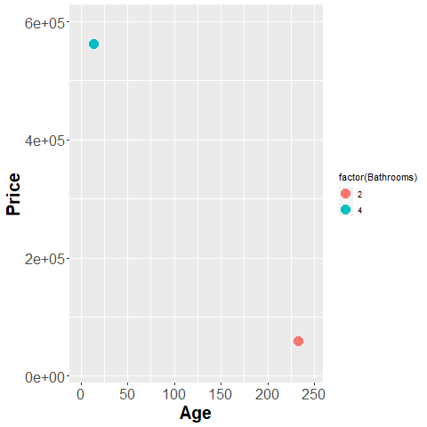
Fundamentals, Aesthetics for points - color (1 of 2)
Illustration of color aesthetics
Notes:
This plot shows a blue point representing a four bathroom house in the upper left corner and an orange point representing a two bathroom house in the lower right corner.

Slide 86
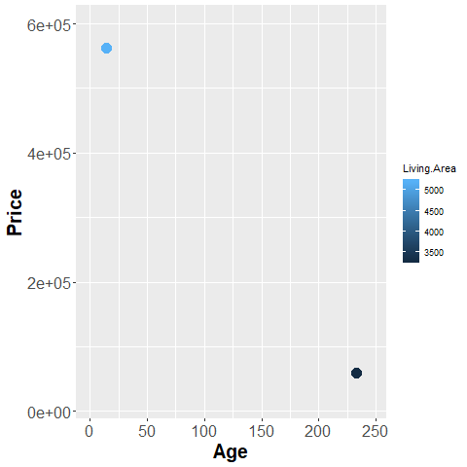
Fundamentals, Aesthetics for points - color (2 of 2)
R graph using color to represent Living.Area
Notes:
Notice how the legend has changed. All of the graphic packages use a set of discrete, easily distinguishable colors for categorical data. For continuous data, these graphic packages use a gradient.

Slide 87
Exercise, change the color
Use the Saratoga housing data set.
Draw a plot of all of the data where
X=Age,
Y=Price,
Color=Bathrooms.
Notes:
Revisit your scatterplot. Draw a plot with x representing the age of the house, y representing the price, and the color representing the number of bathrooms.

Slide 88
Exercise, Python code
Here’s the Python code.
ch2 = alt.Chart(df).mark_point().encode( x="Age", y="Price", color="Baths")
Notes:
In Altair/Python, the variable associated with different colors goes inside the encode function.

Slide 89
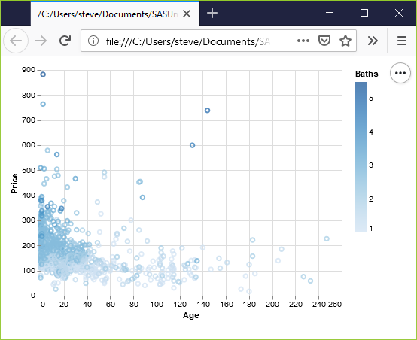
Exercise, Python output
Python scatterplot mapping bathrooms to color
Notes:
Notice that Altair/Python used a gradient of colors. This is a good choice.
The darker colors, associated with a larger number of bathrooms cluster to the left. Newer houses tend to have more bathrooms.

Slide 90
Exercise, R code
Here’s the R code.
ggplot(saratoga_houses, aes(x=Age, y=Price)) + geom_point(aes(color=factor(Bathrooms)))
Notes:
The color variable is defined inside the aes function.

Slide 91
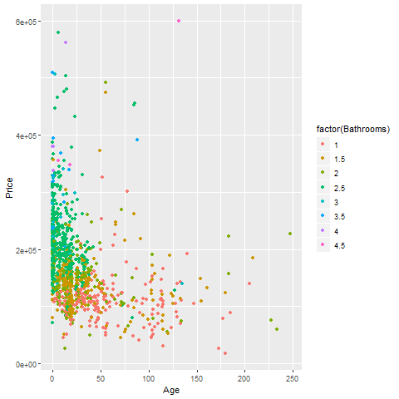
Exercise, R output
R scatterplot mapping bathrooms to color
Notes:
I deliberately defined Baths as categorical with the factor function, and notice the use of discrete colors again rather than a gradient.

Slide 92

Exercise, Tableau output
Tableau scatterplot mapping Bathrooms to color
Notes:
I deliberately defined Baths as Dimension Categorical (blue pill) to show the contrast. Notice that the colors are discrete well separated values.

Slide 93
Fundamentals, summary
In this section, you learned how to use Python, R, and/or Tableau to
Assign variables to the x and y position of a graph
Change the defaults for aesthetics like shape and color
Assign a third variable to shape, size, or color
Notes:
Pat yourself on the back because you’ve alredy learned a lot. You know how to assign variables to the x and y positions of a graph. You can change the appears of the points on that graph. You can include a third variable in your graph, represented by shape, size, or color.
(Note to myself) The use of panels is an important aspect of visualization, and it is unclear to me where best to introduce it. Possibly it could be another dimension of location. You have your x position and your y position, but you also have a position within one of several panels.

Slide 94
Recommendations, outline of topics
Solving problems with overprinting
Don’t mix shape and size
Double up for emphasis
Shape is only good for categories
Size is only good for continuous variables.
Notes:
Here are some general recommendations for scatterplots.
First, if you have a lot of data, your scatterplot may look like a large black blob in one corner of your graph with a few stgray points in the other corners. Or it may look like a large elliptical blob in the center of the graph. Either way, there are several strategies to help you see patterns that might otherwise be lost with overprinting.
Another important lesson is to not let both the size and the shape aesthetic to vary within the same graph. At the same time, you can sometimes double up aesthetics, letting both the shape and the color, for example, to both represent the same variable.
The other important issue is that shape is a useful aesthetic only for categorical data, while size is only good for continuous variables.

Slide 95
Recommendations, Solutions to excessive overprinting
Open symbols
Small points
Opacity
Log scale
Notes:
The plots that you have drawn tend to have difficulty with overprinting. Too many data points crammed into a small area produces a large solid blob that is hard to interpret. There are four possible solutions: open symbols, small points, opacity, and a log scale.

Slide 96

Recommendations, Overprinting - open symbols
R graph using open circles
Notes:
Open symbols have less trouble with overprinting. They use less ink and it is easier to disentanlge two or three partially overlapping symbols.

Slide 97

Recommendations, Overprinting - small points
Graph using small points
Notes:
Smaller data points have less trouble with overprinting.

Slide 98

Recommendations, Overprinting - opacity
Graph using opacity
Notes:
If you make the data points somewhat translucent, so that you can see what it behind it, this prevents a massive black blob from forming. You have to experiement a bit with the level of translucence.

Slide 99

Recommendations, Overprinting - log scale
Graph using log scales
Notes:
The log function stretches the small values and squeeze the large values. Here the log scale is used on the x-axis only and the points that are all piled on top of one another on the left side of the graph are stretched apart. The outlying points on the right, the very, very old houses are fairly rare and waste some of the space that you might need for the far more numerous new houses. The log squeezes these few old houses together. The points are more evenly distributed across the x-axis when you use a log scale, so you can see more details and have less overprinting.
It doesn’t work perfectly, and sometimes the log scale is like jumping from the frying pan into the fire. But it is easy enough to try, so what the heck!

Slide 100
Recommendations, Some tips
Don’t try to squeeze in too much
Double up to emphasize
Shape is only good for categories
Size is only good for continuous variables
Shape and size don’t mix

Slide 101

Recommendations, Don’t try to squeeze in too much.
Graph using only two colors
Notes:
Sometimes less is more, and that is especially true for colors. Rather than assign eight different colors to the eight different number of bathrooms, why not just have two colors. Red for a small number of bathrooms (1.5 or less) and blue for a large number of bathrooms (2 or more).
Sure you are losing some information, but the increasing clarity of the pattern more than compensates. Note that I deliberately included redundant values in the legend to better emphasize the choice I made. I would not recommend this for a final graph.

Slide 102

Recommendations, Double up to emphasize
Graph using colors and shapes
Notes:
It’s okay to map a single variable to more than one aesthetic. In fact, this often helps emphasize that variable. Here, both the shape and the color are associated with the number of bathrooms. It makes things a bit easier to pick out.

Slide 103

Recommendations, Use shape only for categorical variables
Notes:
First, shape makes sense only for categorical data. If you have a large number of values, as is typical for a continuous variable, you run out of symbols before you run out of categories.

Slide 104

Recommendations, Shape and size don’t mix
Notes:
Also size and shape don’t mix. You can really compare two diffent shapes, such as an X and an O on size. Is the size related to the diameter, the area, or the perimeter? There’s no really good answer, so it’s asking to much of a graph that asks you to decide which is larger among points represent different shapes. Either vary the shape or vary the size, but not both.

Slide 105
Recommendations, summary
Overprinting
Open symbols
Small points
Opacity
Log transformation
Don’t try to squeeze in too much
Double up to emphasize
Shape is for categorical variables
Size is for continuous variables

Slide 106
Quick quiz (1 of 4)
Data visualization is a mapping of data to the visual aesthetics of geometries/marks. Some examples of visual aesthetics include (choose all that apply)
Size
Points
Shapes
Notes:
Answer: 1 and 3 (size and shapes)

Slide 107
Quick quiz (2 of 4)
The log transformation works by (choose the best answer)
Stretching all data values equally.
Stretching the small values and squeezing the large values.
Stretching the large values and squeezing the small values.
Notes:
Answer: 2 (strethcing the small values and squeezing the large values)

Slide 108
Quick quiz (3 of 4)
Strategies that can sometimes help when you have a lot of problems with overprinting include (choose all that apply)
Using open circles
Using large size points
Using translucent points
Notes:
Answer: 1 and 3 (using open circles and translucent points)

Slide 109
Quick quiz (4 of 4)
The two visual aesthetics that doen’t work well together are (choose the best answer)
color and size
color and shape
size and shape
Notes:
Answer: 3 (size and shape)

Slide 110
Graphs in the news, what are the aesthetics?
What aesthetics (location, shape, size, color) are used?
What aesthetics are not used?
What variables are mapped to which aesthetics?
Notes:
Review the same newspaper article and graph that you used earlier. Identify the various aesthetics that are used or are not used in your graph. What variables are associated with which aesthetics?

Slide 111
Advanced exercise
There is a second data set on sleep in mammals. You can find a brief description of this data set at
http://www.statsci.org/data/general/sleep.html
You can download the actual data at
http://www.statsci.org/data/general/sleep.txt
Notes:
This is an interesting data set. You can download from the web, or I can provide a comma separated value format for you to use.

Slide 112

Data dictionary
Data dictionary for sleep file
Notes:
This is the data dictionary for this file, from the website listed above.

Slide 113
Advanced exercise
There are some interesting relationships among the variables. Explore whatever strikes you as interesting. Some possibiilities include
bodywt and predation
gestation and lifespan
exposure and totalsleep
Draw a visualization
illustrates an intersting interrelationships
use a third variable for shape, size, or color

Slide 114

Correlations
Correlation matrix among sleep variables
Notes:
You might find this table of correlations helpful when deciding what relationships to explore.

Slide 115
Summary
“A mapping of data to the visual aesthetics of geometries/marks”
Points are a type of geometry/mark
Aesthetics for points include location, shape, size, color
Basic tips
Don’t try to squeeze in too much
Double up to emphasize
Shape is only good for categories
Shape and size don’t mix

