Slide 1
Line graphs, Fundamentals
Steve Simon

Slide 2
Fundamentals, how to produce a line graph
+The key step in Python
mark_line()
The key step in R
geom_line()
The key step in Tableau
Choose Line from the Marks pulldown list
Notes:
The basic steps to producing a line graph are fairly easy in each of the systems. In Tableau, you use the mark_line function. In R, you use the geom_line function. In Tableau, if you are lucky, the default graph choice will be a line graph. If not, select Line from the Marks list.

Slide 3
Fundamentals, Changing axis range
Python
alt.Y(scale=alt.Scale(zero=False))
or
alt.Y(scale=alt.Scale(domain=(100, 200)))
R code
expand_limits(y=0)
or
ylim(100, 200)
Tableau steps
Double click on axis
Notes:
This example is the first one where you can see a big difference between the default options. Python wants to include zero on the y-axis, no matter what. It may make sense for a barchart to always include zero, but it is less obvious for a line graph.
To override the default Python option of showing zero on the Y axis, include the zero=False statement in the Scale function. Or you can specify a particular set of limits using the domain option in the Scale function.
R does not always include zero, but if you want, you can force R to include zero with the expand_limits function. Or you can specify a lower and upper limit with the ylim function.
Tableau also does not always include zero. To modify the limits of an axis in Tableau, you double click on it to get a dialog box.

Slide 4
Fundamentals, Aesthetics for lines
Location
Size
Shape (not what you think it is!)
Color
Notes:
A line could mean a straight line or a curved line, a single line segment, a connected series of line segments or a polygon. It’s a pretty complex thing, but generally a line represents a two dimensional relationship.
You can vary the size, shape, and color of a line. Shape is not what you think it is.

Slide 5
Fundamentals, Location
Sequence of x,y pairs
sorted by x
Connected in order (cannot double back)
Alternatives to lines
Paths
Polygons
Notes:
A line could mean a straight line or a curved line. You get a curve by connecting small straight line segments. If the segments are small enough, you don’t even notice. One requirement of a line is that the X values are sorted from low to high and are connected in order. This means that the line cannot double back on itself.
An alternative to a line is a path, which is allowed to meander in any direction including reversing course in the X direction one or more times. A polygon is a path that does not intersect itself and which returns at the end to the point at which it started. Paths and polygons will not be a major focus in this presentation, but the principles that apply to lines generally apply equally well to paths and polygons.

Slide 6
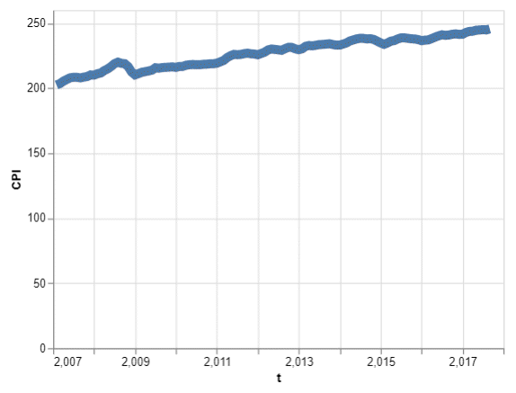
Fundamentals, Size
Line graph with thick line

Slide 7
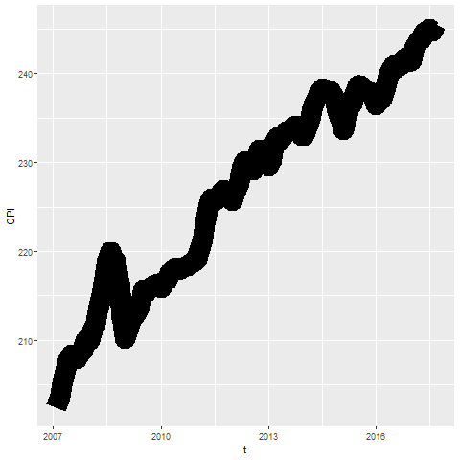
Fundamentals, Size
Notes:
Lines can change size, but some systems refer to this as line width rather than size. You might use a thick line at times to create a greater emphasis, but it does tend to obscure small sudden changes in this current graph.

Slide 8
Fundamentals, Size
Python code
mark_line(size=8)
R code
geom_line(size=8)
Tableau
Click on size button
Notes:
To change the line thickeness in R, use the size= option inside the geom_line function.

Slide 9
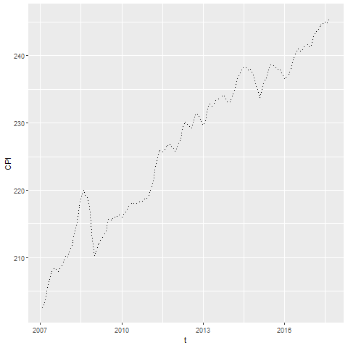
Fundamentals, Shape
Notes:
The shape of a line is not whether it is curved or straight. The shape of a line is whether it is represented using solid, dashed, or dotted lines. Most visualizations call this a line type rather than a line shape.

Slide 10
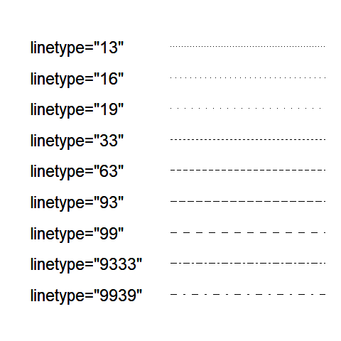
Fundamentals, Shape
Notes:
There is a code for dotted and dashed line patterns that works pretty much the same way for both Python and R. You specify a sequence of two (sometimes four) numbers. The odd numbered values (first, third, etc.) represent an “on” number of pixels which specifies the length of the dash. The even numbered values (second, fourth, etc.) represent an “off” number of pixels. This is the gap or space between the marks.
The code “13” is a tight dotted line. One pixel on represents the dot and three pixels off represents the tight space between the dots. Note that anything tighter that 3 for a space is hard to distinguish from a solid line.
The code “16” puts a moderate amount of space between the dots and “19” puts a large space between the dots.
The codes “33” and “63” and “93” create short medium and long dashes with just a small space between the dashes. The code “99” creates long dashes with large spaces between them.
A set of four numbers usually produces an alternating pattern. The pattern “9333” produces a dash-dot pattern. The “9” produces a long dash. The first “3” produces a small space. The second “3” produces a short dash and the last “3” produces a short space. The pattern “9939” produces a similar dash-dot pattern, but the “9”’s in the second a fourth position widens the spaces between the dashes and dots quite a bit.
There are an infinite number of possibilities here.

Slide 11
Fundamentals, Shape
Tableau code
mark_line(strokeDash=[5, 2, 2, 2])
R code
geom_line(linetype="5222")
Tableau
NO easy solution
Notes:
In Python, set the strokeDash argument to create various dotted and dashed lines. In R, use the linetype argument.
Tableau allows you a lot of freedom in choosing between dotted and dashed lines when you have two or more lines on a single graph, but it is surprisingly hard to deviate from the formal default of a solid line when you only have a single line on your graph. This is annoying, but quite honestly, there is little reason to deviate from a solid line when you only have one line on your graph.

Slide 12
Fundamentals, Color
Tableau code
mark_line(color="red")
R code
geom_line(color="red")
Tableau
Click on color button

Slide 13
Exercise, change defaults
Draw a line graph with the cpi data
x=t
y=CPI
Change the defaults for the line
Make the width equal to 3
Make the color green
Make the Y-axis start at 200 and end at 260
Notes:
Take the CPI line graph and modify some of the default options. Make the line green and increase the thickness to three pixels.

Slide 14
Exercise, Python code
Here’s the Python code
ch = alt.Chart(df).mark_line( color='green', size=3 ).encode( alt.X('t'), alt.Y('CPI', scale=alt.Scale(domain=(200, 260))) )
Notes:
HEre is the Python code. Notice that the color and width are changed inside the mark_line function.

Slide 15
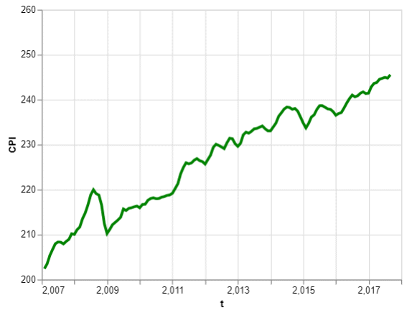
Exercise, Python output
Line graph with green dashed line

Slide 16
Exercise, R code
Here’s the R code
ggplot(cpi, aes(x=t, y=CPI)) + geom_line(size=3, color="green")
Notes:
Here is the R code. Notice that you change the size and color inside the geom_line function.

Slide 17
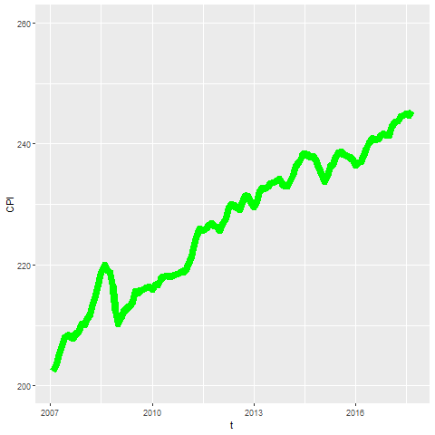
Exercise, R output
Notes:
Here is the R output.

Slide 18
Exercise, Tableau steps
Drag T to coumns, CPI to rows
Set both as Dimension, Continuous (Green pill)
Change Marks pull-down to Line
Click on the color button, select green
Click on size button, move slider to the right
Double click on Y axis
Select Range, Fixed
Enter 200, 260 as fixed start, fixed end
Notes:
Here are the Tableau steps.

Slide 19
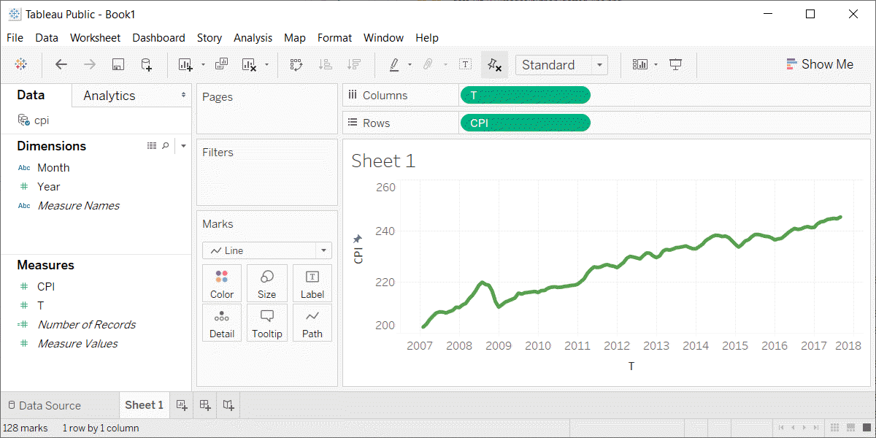
Exercise, Tableau output
Line graph with thick green line
Notes:
Here is the Tableau output.

Slide 20
Fundamentals, Multiple lines
New data set, consumer price index for food
Food consumed at home
Food consumed away from home
Pet food
Set January 2002 as 100.
Notes:
There is a similar data set that I want to switch to. It provides the consumer price index for food. It has a separate series for food consumed at home. That includes things you buy at the store like Pop Tarts for eating at home. There is a second series for food consumed away from home, such as the 1300 calorie Monster Thickburger that you got at Hardee’s. There is a third series for pet food.
There’s a bad joke about this. I took my dog shopping and he was unhappy with the price of Alpo. It was 99 cents, but you have to realize that this is almost seven dollars in dog money.
The index variable distinguishes which index is which.

Slide 21
Fundamentals, Coding for multiple lines
Python code
ch = alt.Chart(df).mark_line().encode( x='t', y='cpi', color='index' )
R code
ggplot(cpi, aes(x=t, y=cpi)) + geom_line(aes(color=index))
Tableau
Drag index onto the color button
Notes:
When you want to have a different line for each consumer price index series, you specify a different color for each line. Notice how this goes inside the encode function in Python and inside the aes function in R because you are encoding a third variable, index, to an aesthetic.

Slide 22
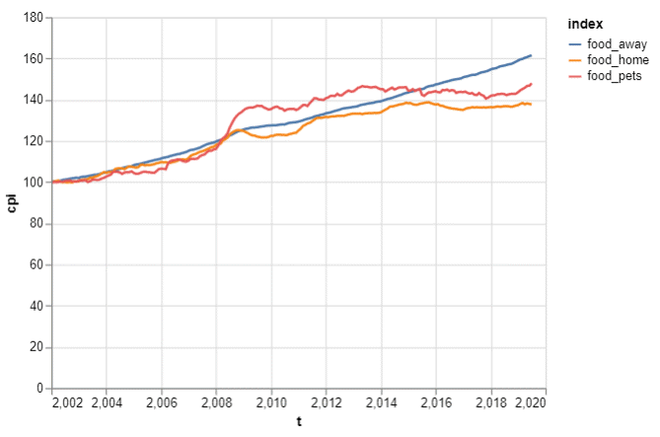
Fundamentals, Python output
Line graph of three price indices
Notes:
This is what the Python output looks like.

Slide 23
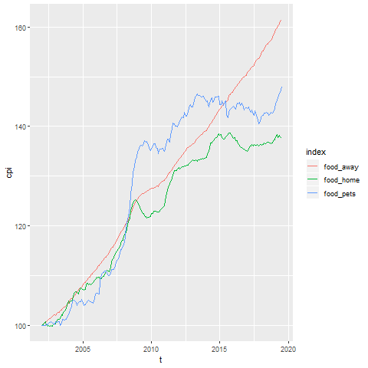
Fundamentals, R output
Line graph showing increase over time of the consumer price index
Notes:
Here is what the graph looks like in R.

Slide 24
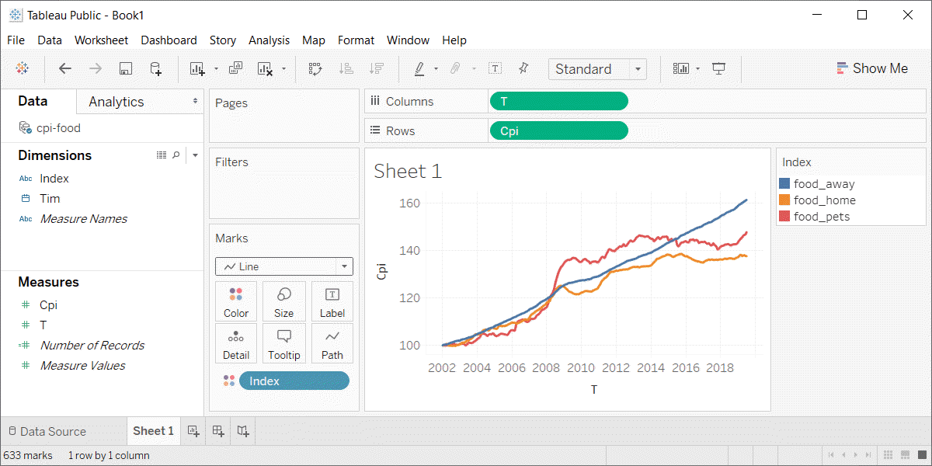
Fundamentals, Python output
Line graph in Tableau
Notes:
This is what the Tableau graph looks like.

Slide 25
Exercise, change defaults
Draw a line graph with the cpi-food data
x=t
y=cpi
color=index
Change the default line colors
food-home=darkgreen
food-away=red
food-pets=blue
Make the Y-axis start at 100 and end at 200
Notes:
Take the cpi-food linegraph and modify some of the default options. Highlight the food-home in darkgreen, food-away in red, and food-pets in blue. Modify the y-axis to start at 100 and end at 200.

Slide 26
Exercise, Python code
Here’s the Python code
ch = alt.Chart(df).mark_line().encode( alt.Color('index', scale=alt.Scale( range=['#FF0000', '#00CC00', '#0000FF'] ) ), alt.X('t'), alt.Y('cpi', scale=alt.Scale(domain=(100, 200))), )
Notes:
HEre is the Python code. Notice that the color and width are changed inside the mark_line function.

Slide 27
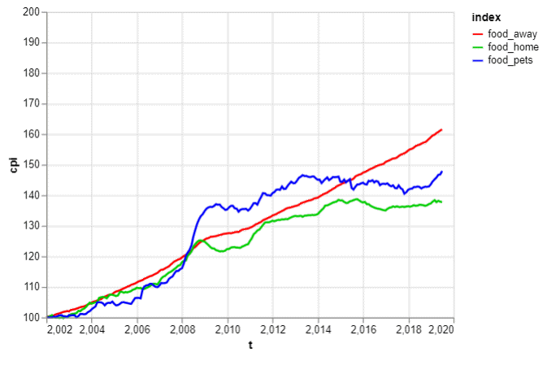
Exercise, Python output
Line graph with thick green line

Slide 28
Exercise, R code
Here’s the R code
ggplot(cpi-food, aes(x=t, y=CPI)) + geom_line(aes(color=index)) + scale_color_manual(values=c("#FF0000", "#00CC00", "#0000FF")) + ylim(100, 200)
Notes:
Here is the R code. Notice that you change the size and color inside the geom_line function.

Slide 29
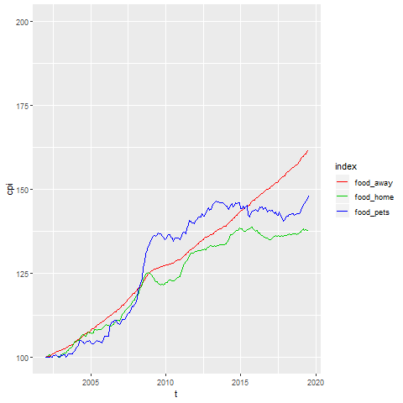
Exercise, R output
Notes:
Here is the R output.

Slide 30
Exercise, Tableau steps
Drag T to coumns, CPI to rows
Set both as Dimension, Continuous (Green pill)
Change Marks pull-down to Line
Drag index to colors button
Click on boxes in legend
Click on size button, move slider to the right
Double click on Y axis
Select Range, Fixed
Enter 100, 200 as fixed start, fixed end
Notes:
Here are the Tableau steps.

Slide 31
Exercise, Tableau output
Line graph with thick green line
Notes:
Here is the Tableau output.

Slide 32
Fundamentals, Adding lines to a scatterplot
Lines can emphasize patterns in a scatterplot
Connect means
Linear regression (not covered)
Moving average (not covered)
Smoothing splines (not covered)
Notes:
If you have a lot of data, a line can sometimes emphasize patterns or trends that you might miss with just a scatterplot.
You can do this by connecting lines between individual point means, a linear regression trend line, moving averages, or smoothing splines.
We will only cover the first approach connecting means. The other approaches are quite good and definitely worth talking about. Unfortunately, these alternative approaches are implemented inconsistently across the different programs.

Slide 33
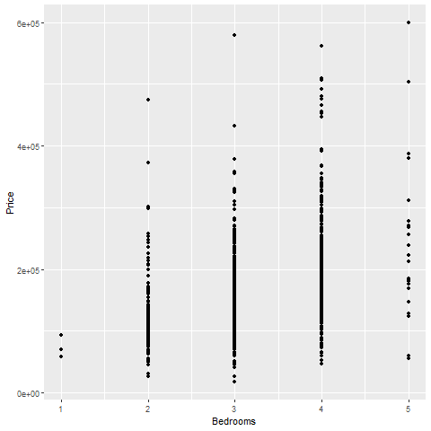
Fundamentals, Review an earlier scatterplot
Notes:
Here’s the housing data set that we looked at earlier. This scatterplot shows the relationship between number of bedrooms and price.

Slide 34
Fundamentals, Lines at individual averages, Python
Here’s the Python code
pts = alt.Chart(df).mark_point().encode( x='Bedrooms', y='Price' ) avg = alt.Chart(df).mark_line().encode( x='Bedrooms', y='mean(Price)' ) ch = pts + avg

Slide 35
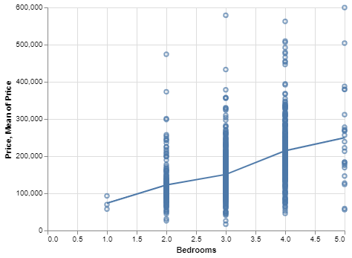
Python graph
Python graph with average summary line

Slide 36
Fundamentals, Lines at individual averages, R
Here’s the code in R
ggplot(saratoga_houses, aes(Bedrooms, Price)) + geom_point() + stat_summary(fun.y=mean, geom="line")
Notes:
Here is the R code. You need the stat_summary function to create averages for y at each discrete value of X.

Slide 37
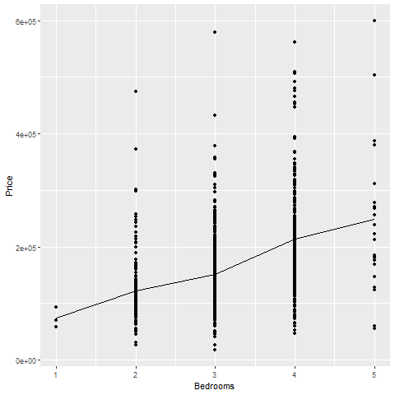
R output
Notes:
There is a clear and consistnet trend in the average price. As the number of bedrooms increase, the average price increases.

Slide 38
Fundamentals, Lines at individual averages, Tableau steps
Draw your normal scatterplot
Drag Price to opposite Y axis
Change to Measure(Average)
Change Marks for first plot to Shape
Right click on either Y axis
Select Synchronize Axis

Slide 39
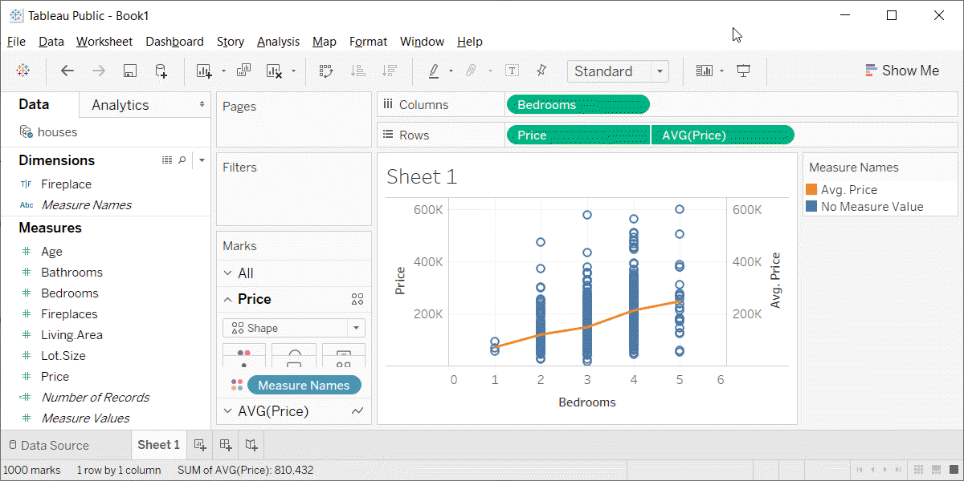
Fundamentals, Lines at individual averages, Tableau plot
Tableau plot with lines at individual averages

Slide 40
Exercise, Connect individual averages
Draw a scatterplot showing
X = Bathrooms
Y = Age
Add a line connect the individual averages
Notes:
On your own, draw a scatterplot. Put the number of bathrooms on the X axis and the age of the house on the Y-axis. Add a line conencting the individual averages.

Slide 41
Exercise, Python code
pts = alt.Chart(df).mark_point().encode( x='Bathrooms', y='Age' ) avg =alt.Chart(df).mark_line().encode( x='Bathrooms', y='mean(Age)' ) ch = pts+avg

Slide 42
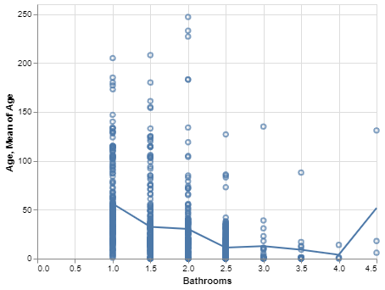
Exercise, Pyhton output
Python plot showing trend of age versus bathrooms

Slide 43
Exercise, R code
Here’s the R code
ggplot(saratoga_houses, aes(Bathrooms, Age)) + geom_point() + stat_summary(fun.y=mean, geom="line")
Notes:
The geom_point function creates the scatterplot and the stat_summary function adds the line.

Slide 44
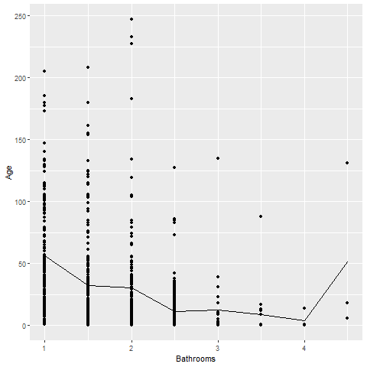
Exercise, R output
Notes:
There is a clear and consistent trend in the average age. The average age declines as the number of bathrooms increase. There is a blip at the end, but this is probably just an artefact due to the small sample size.

Slide 45
Exercise, Tableau steps

Slide 46
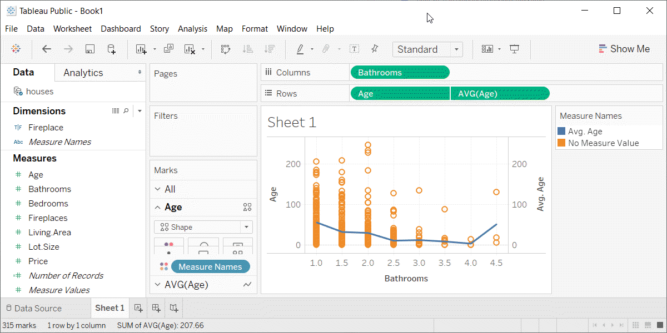
Exercise, Tabeleau output
Tableau plot showing trend in average age versus number of bathrooms
Notes:
Here is the Tableau graph.

Slide 47
Summary
Lines have the same aesthetics as points and bars
Location
Size (width)
Shape (solid, dashed, dotted)
Color
Use mark_line (Python), geom_line (R) or a drop down menu (Tableau)
Lines added to a scatterplot can emphasize trends and patterns
Notes:
The same aesthetics that you learned about for points and bars also apply to lines. The have an s and y location, a size (meaning width of the line), a shape (solid, dashed, dotted, and various combinations), and color.
In Python, use the mark_line function to draw a line graph. In R, use the geom_line function. In Tableau, there is a pull-down menu.
Linegraphs can show a single relationship or compare multiple relationships. You can add a line to a scatterplot to emphasize a trend or pattern.

