Slide 1
Data-viz-03, Preparation
Steve Simon

Slide 2
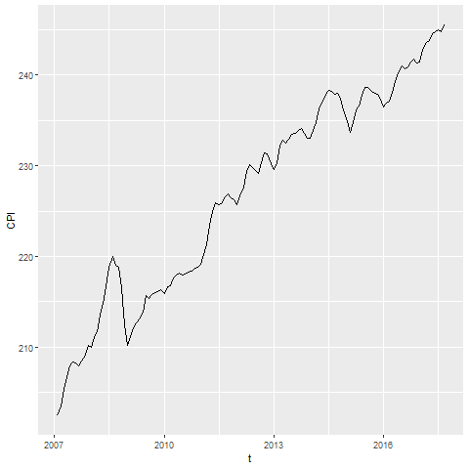
CPI line graph
Line graph showing increase over time of the consumer price index

Slide 3
To prepare for this section
((Download the Titanic data set))

Slide 4
Python code

Slide 5
R code

Slide 6
Tableau steps

