Slide 1
Data visualization - 03 - lines
Steve Simon

Slide 2
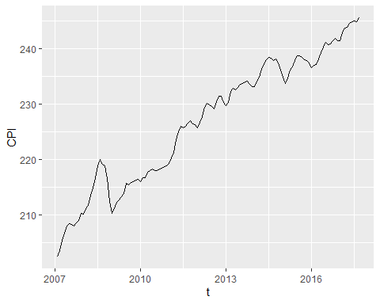

Slide 3
Notes about this talk
This slide should not to be included in the final presentation
01-points MUST come before
02-bars could come before or after

Slide 4
To prepare for this section
((Download the Titanic data set))

Slide 5
Python code

Slide 6
R code

Slide 7
Tableau steps

Slide 8
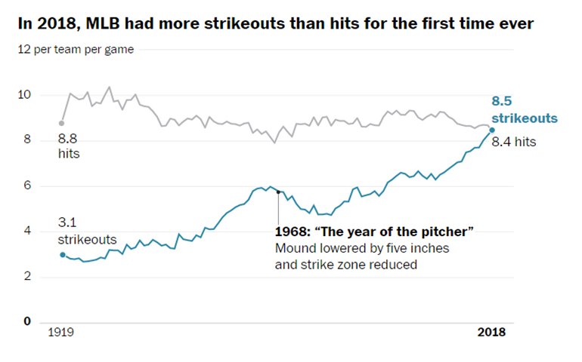
Group exercise (1 of 2)
Line graph of strikeouts and hits over time
Notes:
This is one of two graphs. It was published in
Popvich, N., Fountain, H., & Pearce, A. (2017, September 22). We Charted Arctic Sea Ice for Nearly Every Day Since 1979. You’ll See a Trend. - The New York Times. The New York Times. Retrieved from https://www.nytimes.com/interactive/2017/09/22/climate/arctic-sea-ice-shrinking-trend-watch.html
Split into pairs. Review the article briefly (about 5 minutes) and look at the graph. Explain to your partner what the graph is trying to show. Your partner will get a different graph and do the same thing with you listening this time.

Slide 9
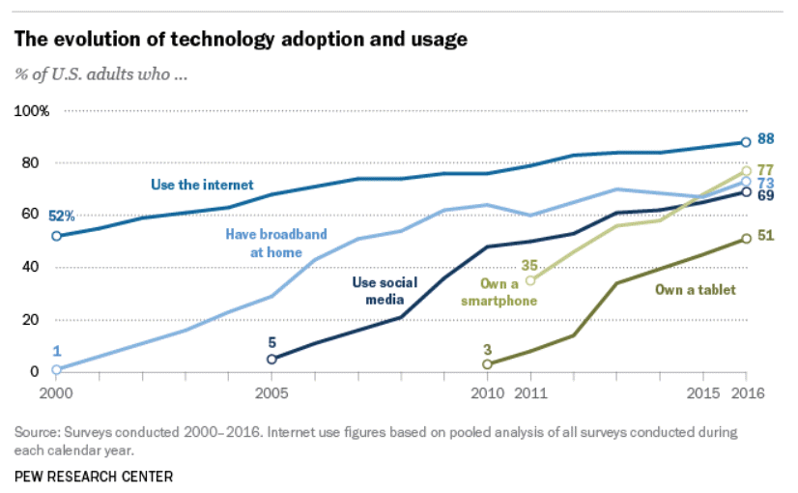
Group exercise (2 of 2)
Line graph of technology trends
Notes:
Aaron Smith, Record shares of Americans now own smartphones, have home broadband. Pew Research Center, January 12, 2017. Retrived August 14, 2019 from https://www.pewresearch.org/fact-tank/2017/01/12/evolution-of-technology/.

Slide 10
More theory – The gestalt of graphics
How do you draw someone’s eye to quickly make certain associations?
These ideas drawn from the Bergen and Iverson workshop.

Slide 11

A block of points - no emphasis

Slide 12
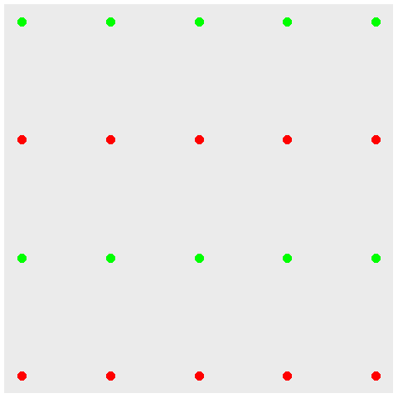
Color emphasizes rows

Slide 13
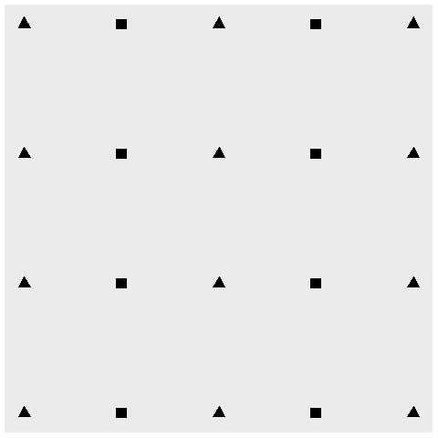
Shape emphasizes columns

Slide 14
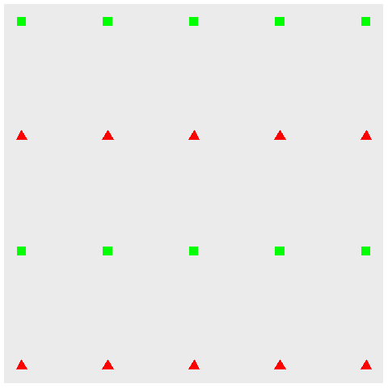
Double up for stronger emphasis

Slide 15
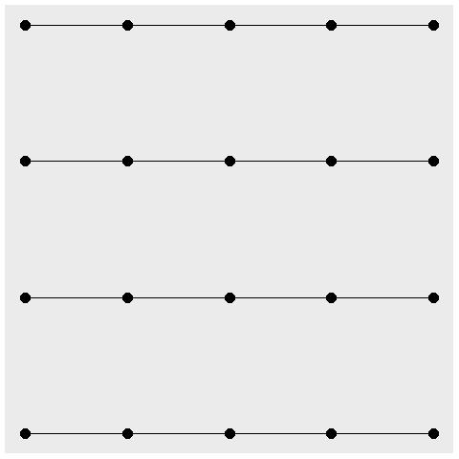
Connectedness emphasizes rows

Slide 16

Proximity emphasize columns

Slide 17
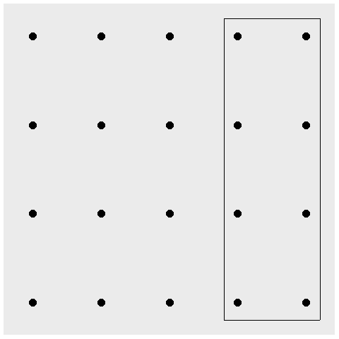
Enclosure for emphasis, eight special points

Slide 18
Continuity
((Show example of sloping text))

Slide 19
Changing your emphasis
((Recreate example from slides 47-50 of Bergen and Iverson))

Slide 20
Aesthetics for lines
Location
Size
Shape (not what you think it is!)
Color
Notes:
A line could mean a straight line or a curved line, a single line segment, a connected series of line segments or a polygon. It’s a pretty complex thing, but generally a line represents a two dimensional relationship.
You can vary the size, shape, and color of a line. Shape is not what you think it is.

Slide 21
Show different types and locations of lines
((Show a curved line, a straight line, a line segment, a series of line segments, and a polygon.))

Slide 22
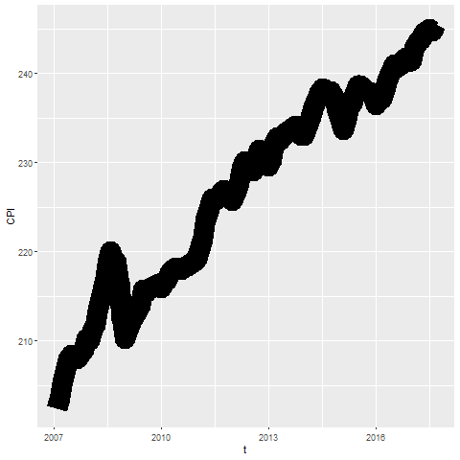
Size

Slide 23
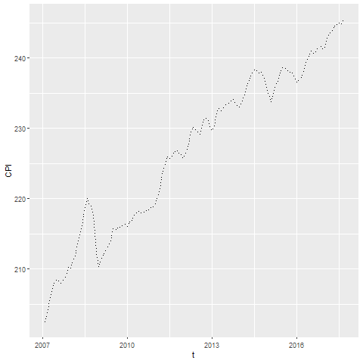
Shape

Slide 24
On your own
change the line to a dashed line.
Make the width equal to 3
Make the color green

Slide 25
Wait before showing
((Python code))
# R code ggplot(cpi, aes(x=t, y=CPI)) + geom_line(size=3, linetype="dashed", color="green")
((Tableau steps))

Slide 26
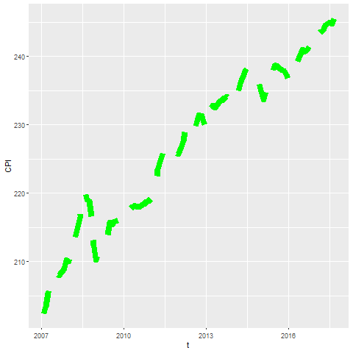
What your visualization might look like

Slide 27
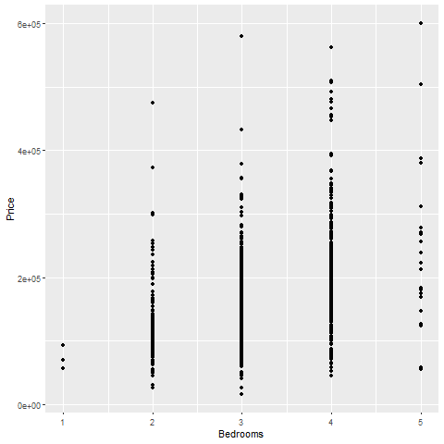
Lines as summary statistics

Slide 28
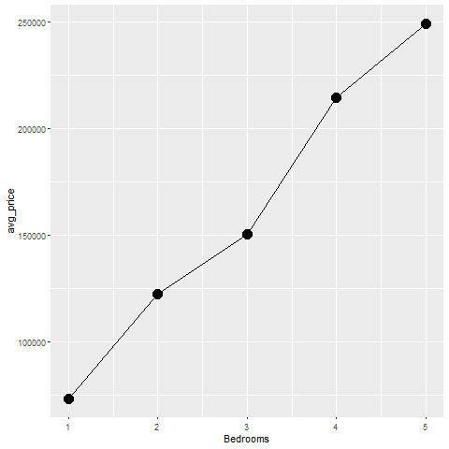
Lines as averages

Slide 29
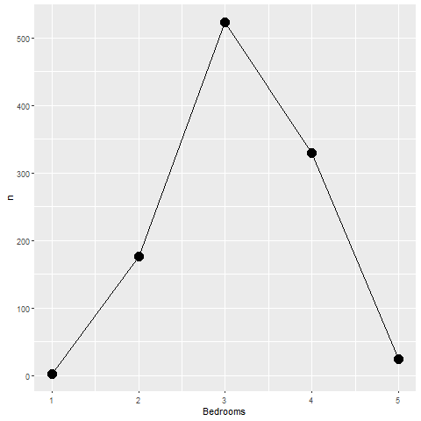
Lines as counts

Slide 30
On your own
Draw a line graph showing the relationship between the number of bathrooms and price.

Slide 31
Wait before showing
((Add code here))

Slide 32
What your visualization might look like
((Add visualization here))

Slide 33
Boxplots
((Draw example and ask students to do a similar example))

Slide 34
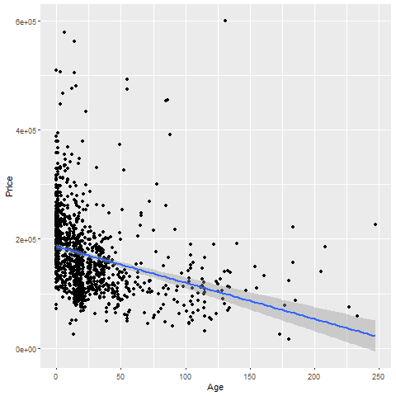
Trend lines (linear)

Slide 35
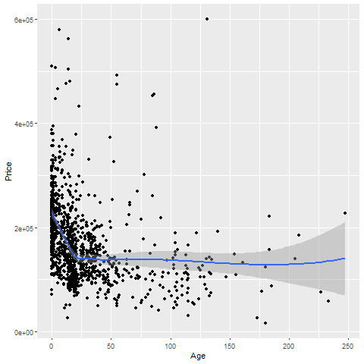
Trend lines (spline)

Slide 36
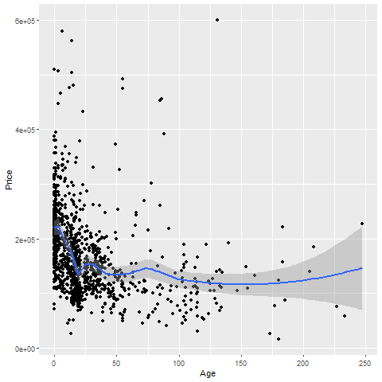
Trend lines (spline), not so smooth

Slide 37
On your own
Fit a linear trend line looking at Living.Area versus Price.
Fit a smooth curve

Slide 38
Wait before showing

Slide 39
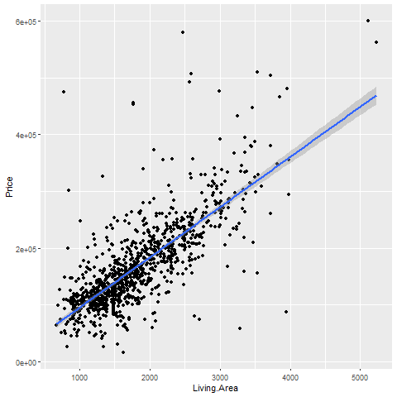
What your visualization might look like

Slide 40
What your visualization might look like

Slide 41
Trend lines (logistic)
((Need a different data set here. Titanic???))

Slide 42
Helpful tips
((Add three or four slides here. Maybe talk about opacity.))

Slide 43
Group exercise
Review the following visualization in your group.
Summarize what aesthetics (location, size, shape, color) appear in the graph
What variables map to each aesthetic?
((Find new images or use the ones from earlier))

Slide 44
Summary (1 of 2)
Gestalt principles
((List here))
Aesthetics for lines
Size, Shape, Color
Lines as summary statistics
One number summary (mean, total, count, percent)
Two number summary (error bars)
Five number summary (boxplots)

Slide 45
Summary (2 of 2)
Trend lines (linear, logistic, spline)
Helpful tips
((List here))

