Slide 1
Bar charts, Preparation
Steve Simon

Slide 2
Preparation, overview
Follow these steps to get ready for lecture #2 in data visualization.
Download and import Titanic data
Download and import scotus data

Slide 3
Preparation, Titanic data set
R code
read.csv("../../common-files/data/titanic3.csv")
Python code
(To be added)
Notes:
Make sure you can import the file titanic3.csv to Python, R or Tableau.

Slide 4
Preparation, Scotus data set
Python code
(To be added)
R code
(To be added)
Notes:
Also import the scotus (Supreme Court of the United States) data.

Slide 5
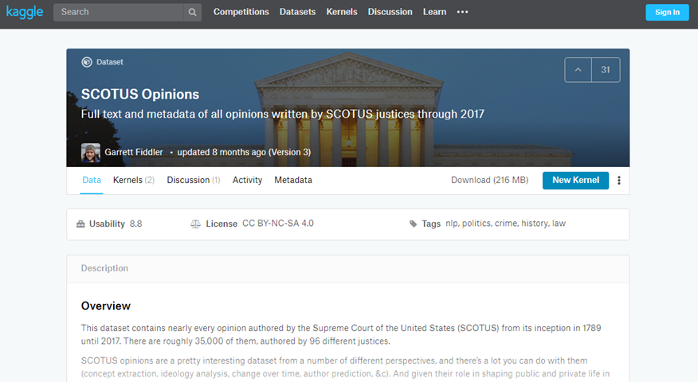
Preparation, kaggle website
Kaggle datasets webpage
Notes:
The scotus file comes originally from the Kaggle datasets webpages. I fixed a few small typos, but you can get pretty much the same results by downloading the original file and keeping the typos in there.

Slide 6
Preparation, Draw a simple bar chart
Import the data and create a bar chart showing the frequency of opinions written by year_filed. Note that there are a few typos and a few rows that do not belong. You can remove these, but they will not affect any of the analyses we are considering.

Slide 7
Preparation, Code
Python code
(Add later)
R code
(Add later)

Slide 8
Preparation, Python output
(Add later)

Slide 9
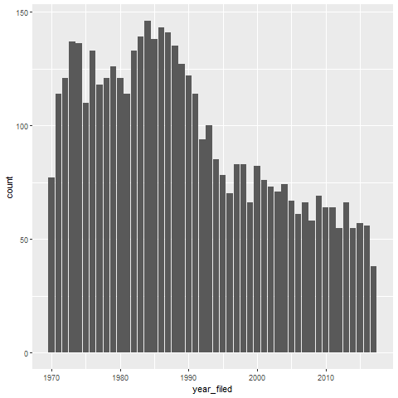
Preparation, R output

Slide 10
Preparation, Tableau output
(Add later)

