Slide 1
Scatterplot exercise, change the size
Steve Simon

Slide 2
Exercise, change the shape
Use the Saratoga housing data set.
Draw a plot of all of the data where
X=Age,
Y=Price,
Size=Living.Area.
Notes:
Revisit your scatterplot. Draw a plot with x representing the age of the house, y representing the price, and the size representing the living area.

Slide 3
Erercise, Python code
Here’s the Python code
ch6 = alt.Chart(df).mark_point().encode( x='Age',y='Price', size='Size')

Slide 4
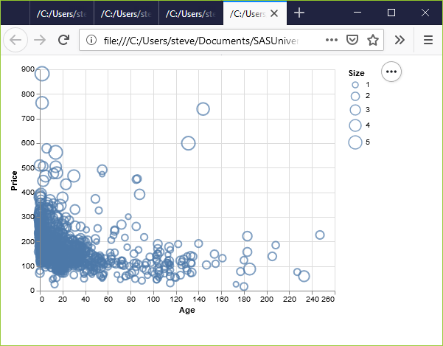
Exercise, Python output
Python scatterplot mapping living area to size

Slide 5
Exercise, R code
Here’s the R code.
ggplot(saratoga_houses, aes(x=Age, y=Price)) + geom_point(aes(size=Living.Area))

Slide 6
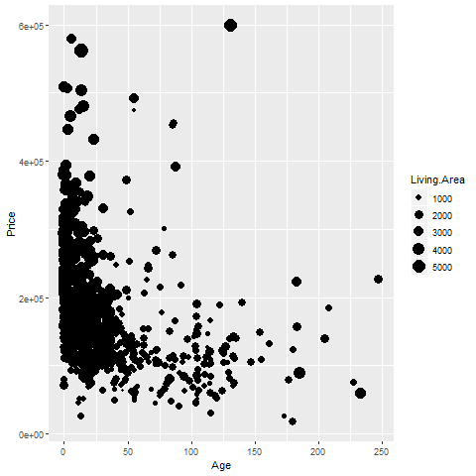
Exercise, R output
R graph using size to represent Living Area

Slide 7
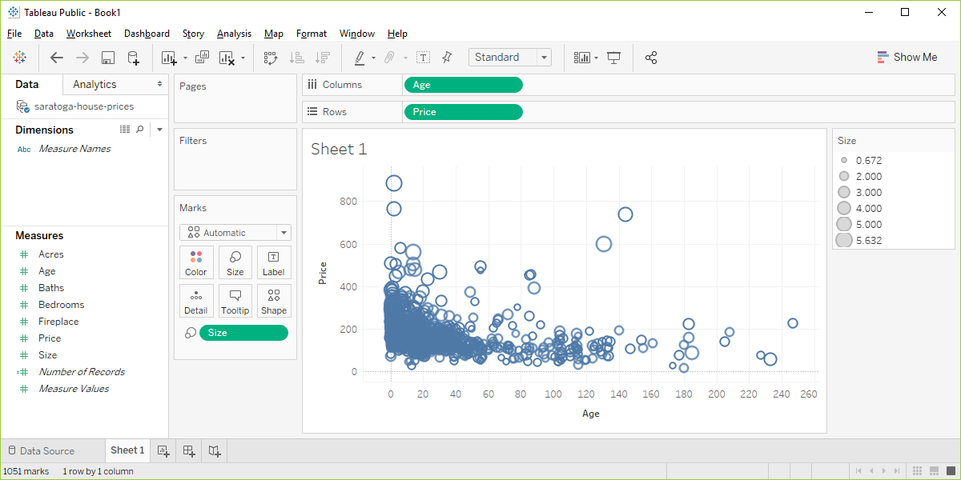
Exercise, Tableau output
Visualizaion using Living.Area as the size

