Slide 1
Data-viz-03, Preparation
Steve Simon

Slide 2
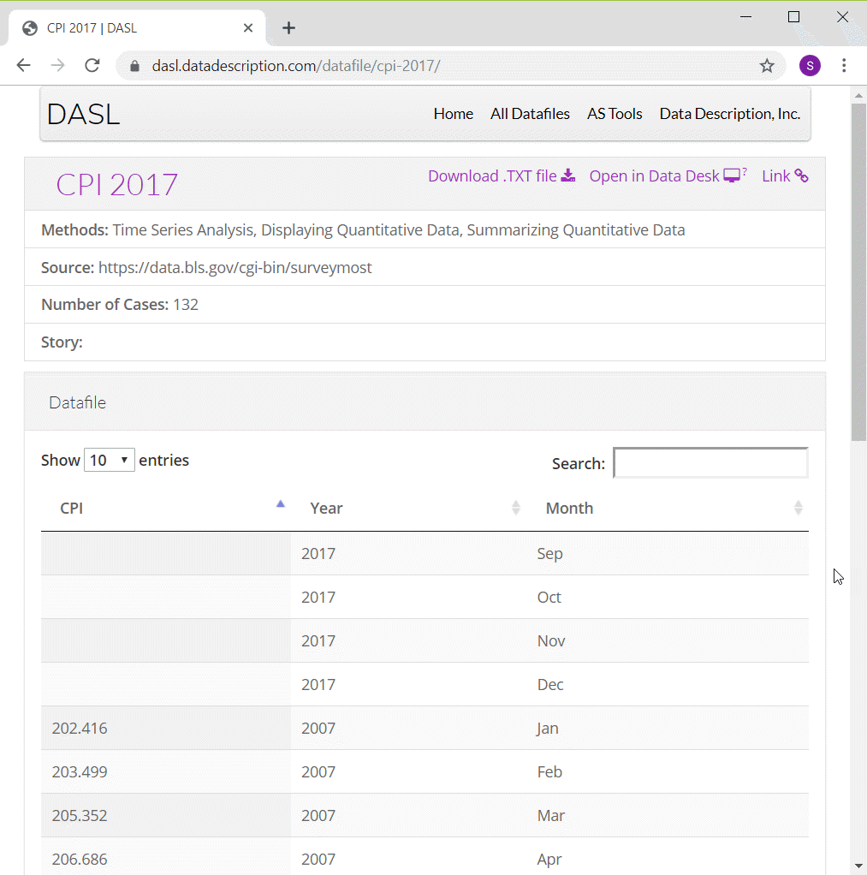
Preparation, DASL Consumer Price Index data
Screenshot of DASL website
Notes:
ONe of the data sets that I will use in this moldule on line graphs is monthly values of the Consumer Price Index from 2007 through 2016. I have to make some minor modifications to the data, adding a continuous variable for time and deleting four rows of data.
You can find information about this data set on the DASL website, but use the csv file that I created instead of the one from the DASL website.

Slide 3
Preparation, Pyhton and R code
Python code
(To be added)
R code
cpi <- read.csv("../data/cpi.csv) ggplot(cpi, aes(x=t, y=CPI)) + geom_line()
Notes:
Here is the Python code and the R code to read in the data and produce a simple line graph.

Slide 4
Preparation, Python graph
(To be added)

Slide 5
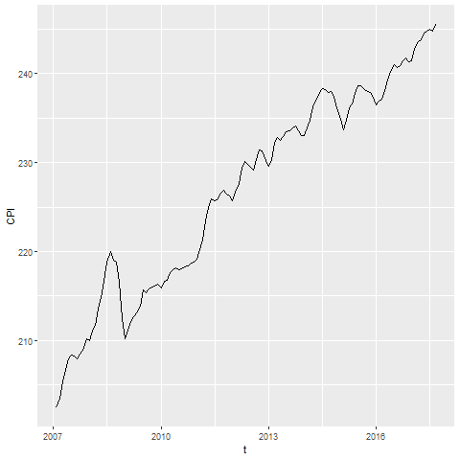
Preparation, R graph
Line graph showing increase over time of the consumer price index

Slide 6
Prepparation, Tableau graph
(To be added)

