Slide 1
Data visualization, line graphs
Steve Simon

Slide 2
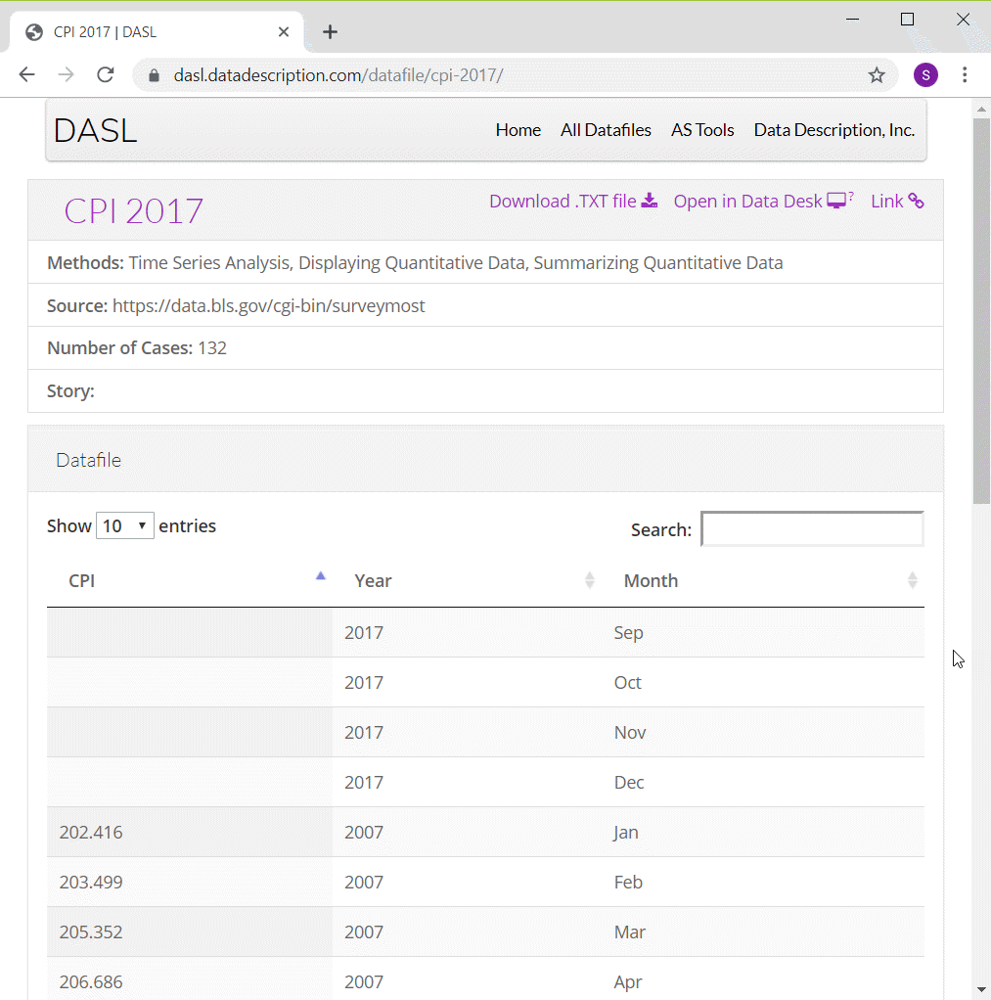
Preparation, DASL Consumer Price Index data
Screenshot of DASL website
Notes:
ONe of the data sets that I will use in this moldule on line graphs is monthly values of the Consumer Price Index from 2007 through 2016. I have to make some minor modifications to the data, adding a continuous variable for time and deleting four rows of data.
You can find information about this data set on the DASL website, but use the csv file that I created instead of the one from the DASL website.

Slide 3
Preparation, Pyhton and R code
Python code
(To be added)
R code
cpi <- read.csv("../data/cpi.csv) ggplot(cpi, aes(x=t, y=CPI)) + geom_line()
Notes:
Here is the Python code and the R code to read in the data and produce a simple line graph.

Slide 4
Preparation, Python graph
(To be added)

Slide 5
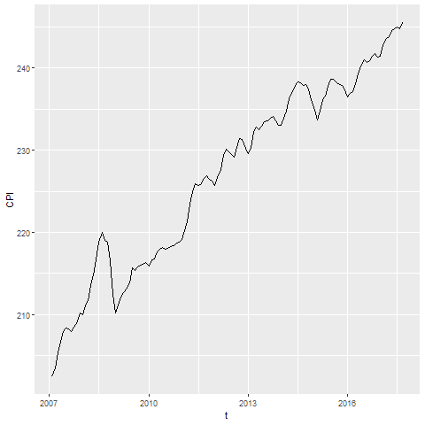
Preparation, R graph
Line graph showing increase over time of the consumer price index

Slide 6
Preparation, Tableau graph
(To be added)

Slide 7
Group exercise
Review one of these graphs/newspaper articles
More Strikeouts Than Hits? Welcome to Baseball’s Latest Crisis.
Record shares of Americans now own smartphones, have home broadband.
F.D.A. Seeks Restrictions on Teens’ Access to Flavored E-Cigarettes and a Ban on Menthol Cigarettes.
What is the message? Summarize in 25 words or less.
Notes:
The following images are taken from various newspaper articles or press releases. Look at the graph and read/skim the article.
What message do you think the journalist is trying to convey with this graph. Summarize this message in 25 words or less.

Slide 8
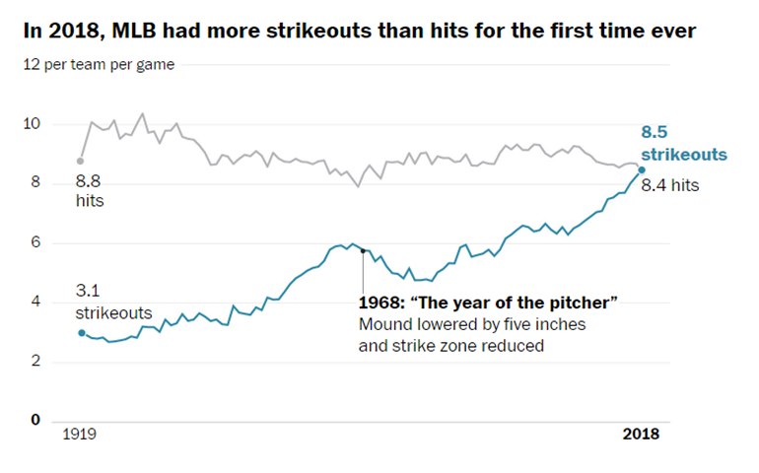
Graphs in the news, baseball strikeouts
Line graph of strikeouts and hits over time
Notes:
Tyler Kepner. More Strikeouts Than Hits? Welcome to Baseball’s Latest Crisis. The New York Times, Augst 16, 2018. Retrieved from https://www.nytimes.com/2018/08/16/sports/baseball-mlb-strikeouts.html.

Slide 9
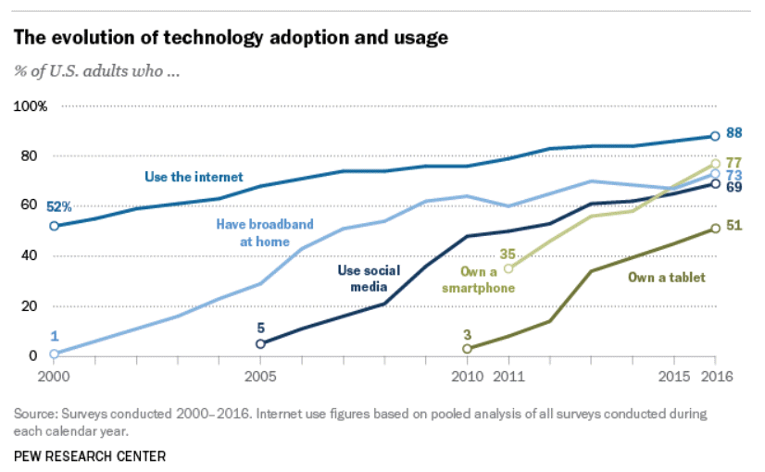
Graphs in the news, technology adaptation
Line graph of technology trends
Notes:
Aaron Smith, Record shares of Americans now own smartphones, have home broadband. Pew Research Center, January 12, 2017. Retrived August 14, 2019 from https://www.pewresearch.org/fact-tank/2017/01/12/evolution-of-technology/.

Slide 10
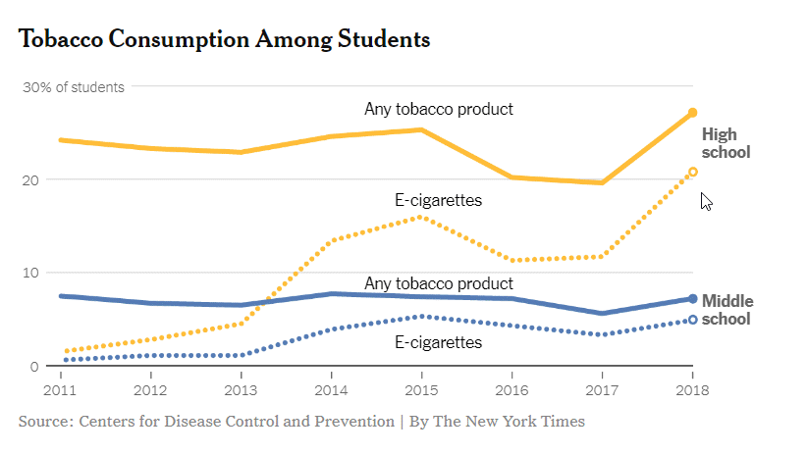
Graphs in the news, Tobacco and e-cigarette consumption
Line graph of tobacco and e-cigarette consumption
Notes:
Sheila Kaplan and Jan Hoffman, F.D.A. Seeks Restrictions on Teens’ Access to Flavored E-Cigarettes and a Ban on Menthol Cigarettes. The New York Times, November 15, 2018. Retrieved from http://nytimes.com/2018/11/15/health/ecigarettes-fda-flavors-ban.html

Slide 11
Graphs in the news, what is the message?
Your group will be assigned one particular graph and newspaper article
Read/skim the article and examine the graph
What is the message?
Summarize in 25 words or less.
Notes:
The following images are taken from various newspaper articles or press releases. Look at the graph and read/skim the article.
What message do you think the journalist is trying to convey with this graph. Summarize this message in 25 words or less.

Slide 12
The gestalt of graphics
These ideas drawn from the Bergen and Iverson workshop.
Gestalt definition
“The whole is greater than the sum of the parts”
How do you draw someone’s eye to quickly make certain associations?

Slide 13
Gestalt theory in artistic design
Many lesssons in effective artistic design
The Gestalt Principles Spokane Falls Community College.
Gestalt Theory Sophia.
Gestalt Principles Applied to Design The Graybox blog, January 19, 2015.
Gestalt Principles Interaction Design Foundation.
Notes:
The field of artistic design is more commonly called graphic design, but I use the former term to distinguish it from statistical graphics. Artistic design is the use of typography, photography, and illustration to effectively convey a message. Artistic designers work on commercial logos, magazines and brochure s, and product packaging.

Slide 14

A block of points - no emphasis
Notes:
What you see in this graph is 20 individual points. When you design a graph, you want people to group things in a way to reveal patterns.

Slide 15
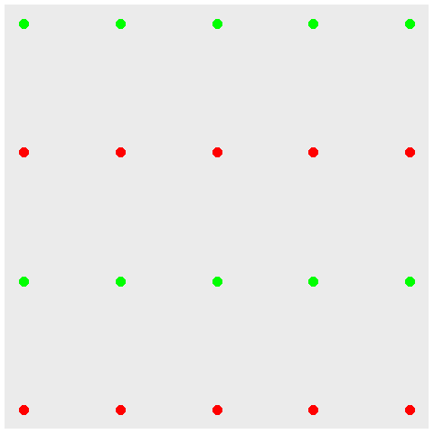
Color emphasizes rows

Slide 16
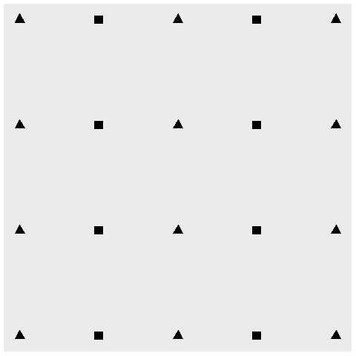
Shape emphasizes columns

Slide 17
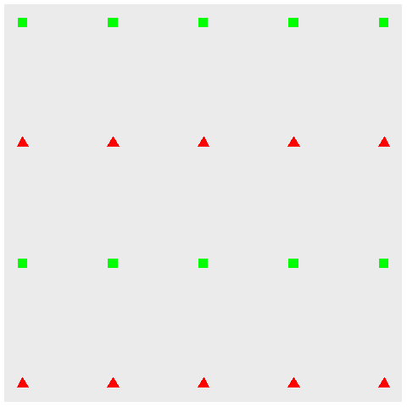
Double up for stronger emphasis

Slide 18
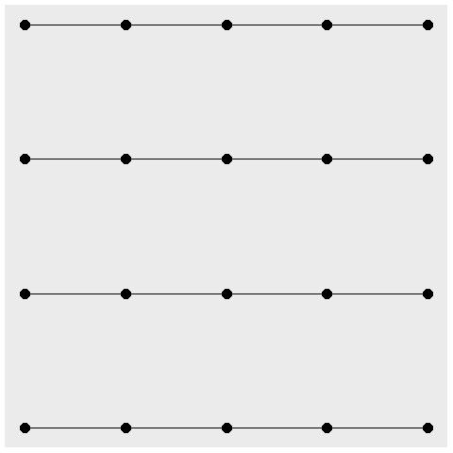
Connectedness emphasizes rows

Slide 19

Proximity emphasize columns

Slide 20
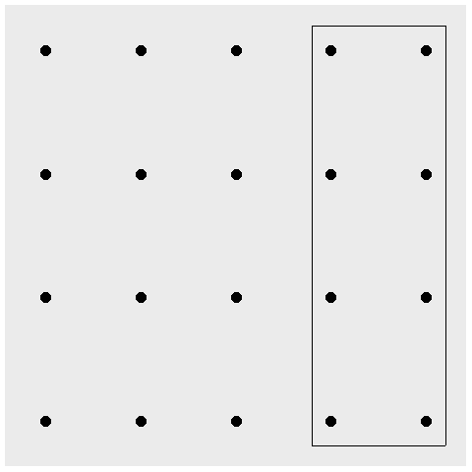
Enclosure for emphasis, eight special points

Slide 21
Continuity
((Show example of sloping text))

Slide 22
Changing your emphasis
((Recreate example from slides 47-50 of Bergen and Iverson))

Slide 23
Aesthetics for lines
Location
Size
Shape (not what you think it is!)
Color
Notes:
A line could mean a straight line or a curved line, a single line segment, a connected series of line segments or a polygon. It’s a pretty complex thing, but generally a line represents a two dimensional relationship.
You can vary the size, shape, and color of a line. Shape is not what you think it is.

Slide 24
Show different types and locations of lines
((Show a curved line, a straight line, a line segment, a series of line segments, and a polygon.))

Slide 25
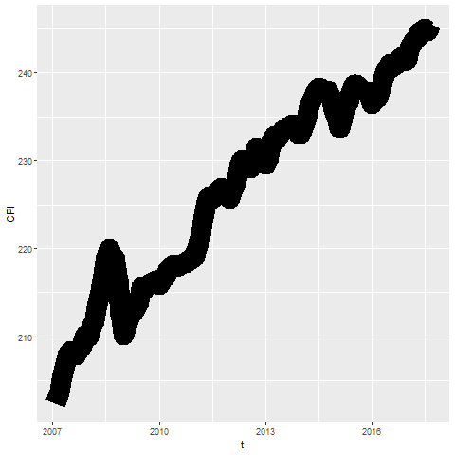
Size

Slide 26
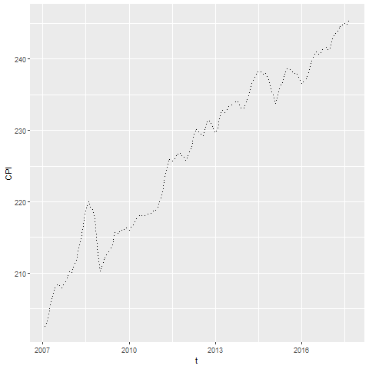
Shape

Slide 27
On your own
change the line to a dashed line.
Make the width equal to 3
Make the color green

Slide 28
Wait before showing
((Python code))
# R code ggplot(cpi, aes(x=t, y=CPI)) + geom_line(size=3, linetype="dashed", color="green")
((Tableau steps))

Slide 29
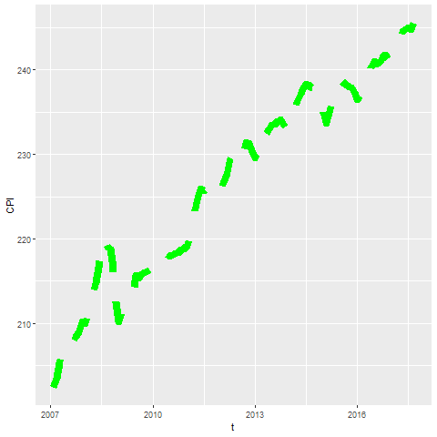
What your visualization might look like

Slide 30
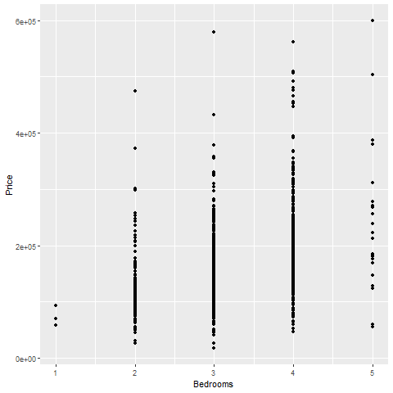
Lines as summary statistics

Slide 31
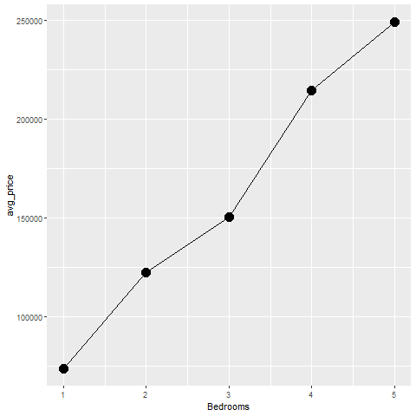
Lines as averages

Slide 32
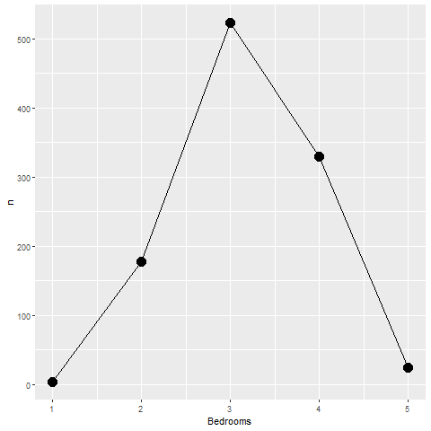
Lines as counts

Slide 33
On your own
Draw a line graph showing the relationship between the number of bathrooms and price.

Slide 34
Wait before showing
((Add code here))

Slide 35
What your visualization might look like
((Add visualization here))

Slide 36
Boxplots
((Draw example and ask students to do a similar example))

Slide 37
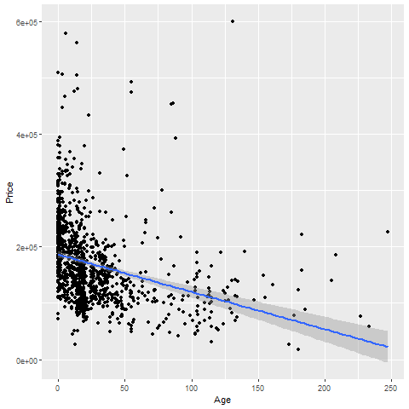
Trend lines (linear)

Slide 38
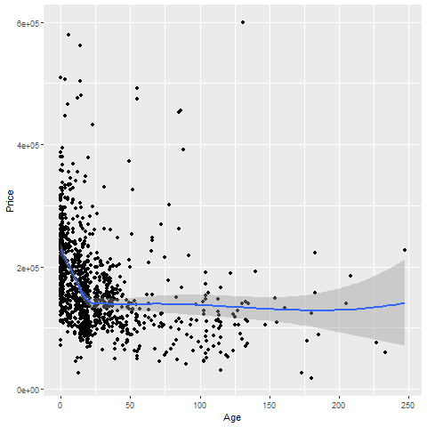
Trend lines (spline)

Slide 39
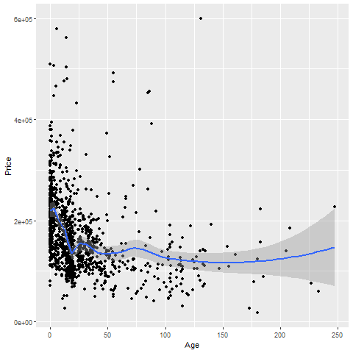
Trend lines (spline), not so smooth

Slide 40
On your own
Fit a linear trend line looking at Living.Area versus Price.
Fit a smooth curve

Slide 41
Wait before showing

Slide 42
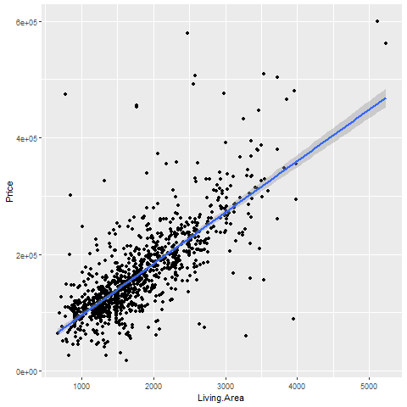
What your visualization might look like

Slide 43
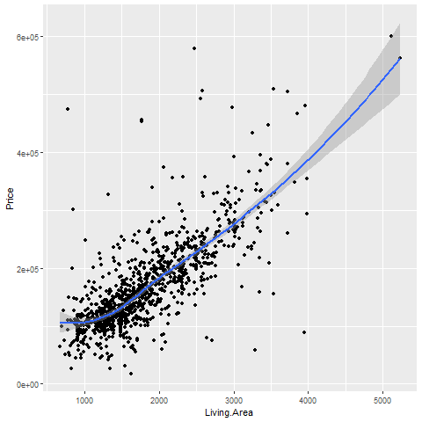
What your visualization might look like

Slide 44
Trend lines (logistic)
((Need a different data set here. Titanic???))

Slide 45
Helpful tips
((Add three or four slides here. Maybe talk about opacity.))

Slide 46
Helpful tips
((Add three or four slides here. Maybe talk about opacity.))

Slide 47
Group exercise
Review the following visualization in your group.
Summarize what aesthetics (location, size, shape, color) appear in the graph
What variables map to each aesthetic?
((Find new images or use the ones from earlier))

Slide 48
Summary (1 of 2)
Gestalt principles
((List here))
Aesthetics for lines
Size, Shape, Color
Lines as summary statistics
One number summary (mean, total, count, percent)
Two number summary (error bars)
Five number summary (boxplots)

Slide 49
Summary (2 of 2)
Trend lines (linear, logistic, spline)
Helpful tips
((List here))

