Slide 1
Scatterplot exercise, change the shape
Steve Simon

Slide 2
Exercise, change the shape
Use the Saratoga housing data set.
Draw a plot of all of the data where
X=Age,
Y=Price,
Symbol=number of bedrooms.
Notes:
Revisit your scatterplot. Draw a plot with x representing the age of the house, y representing the price, and the symbol representing the number of bedrooms.

Slide 3
Exercise, Python code
Here’s the Python code.
ch5 = alt.Chart(df).mark_point().encode( x='Age',y='Price', shape='Bedrooms:N')
Notes:
In Python, when you want the shape to vary by the levels of a particular variable, you specify this in the encode function. This Python program has three variables that are mapped. Age is mapped to the X location, Price is mapped to the Y location, and Bedrooms is mapped to various shapes.
Bedrooms is on a continuous scale, and you have to tell Python that you want to treat it as if it were nominal.

Slide 4
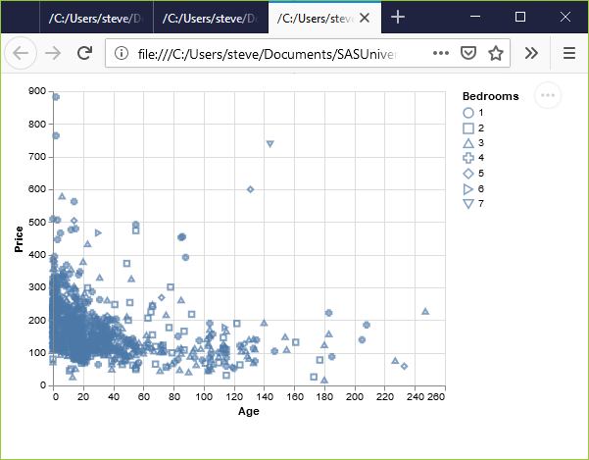
Exercise, Python output
Python scatterplot mapping bedrooms to shape
Notes:
This is what the plot looks like. There is a terrible mix of shapes with no obvious pattern.

Slide 5
Exercise, R code
Here’s the R code.
ggplot(saratoga_houses, aes(x=Age, y=Price)) + geom_point(aes(shape=factor(Bedrooms)))
Notes:
Here is the R code. When the shape of a point is dependent on a variable, you need to specify that variable inside the aes function. You could have defined it inside the existing aes function in the first line of code, but you can also add an aes function to the geom_point function.
I like the second option because it makes the code a bit easier to read.
Bedrooms is numeric, and by default in R is treated as a continuous variable. You can convert it to a nominal variable with the factor function.

Slide 6
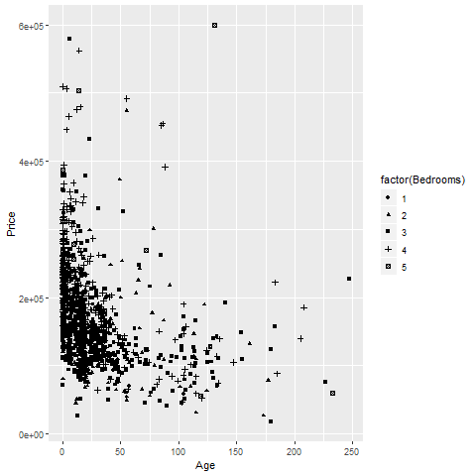
Exercise, R output
R scatterplot mapping bedrooms to shape
Notes:
Here is what the R graph looks like. I don’t particularly like this graph. It is confusing, especially with all the overprinting.

Slide 7
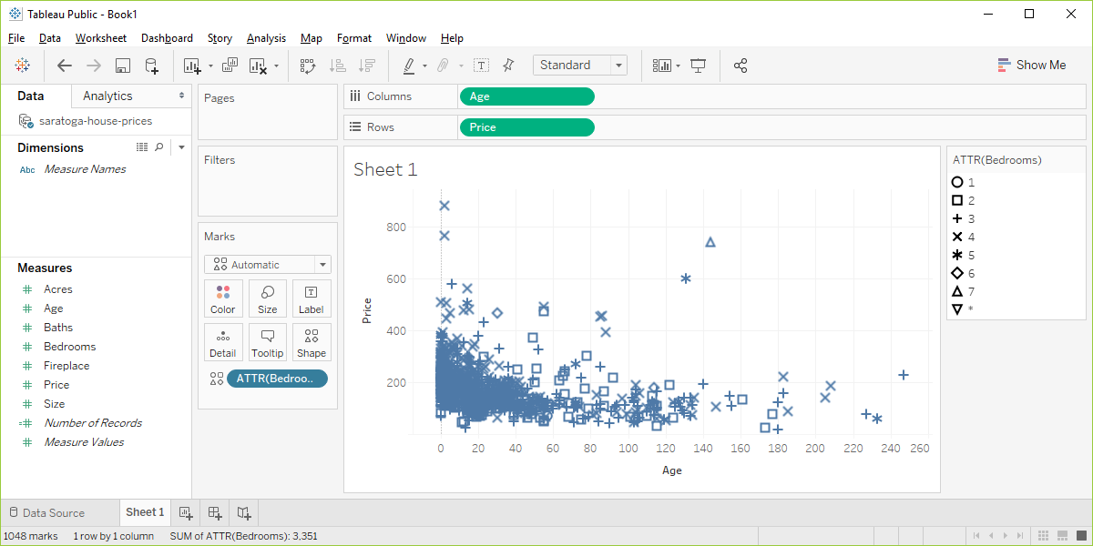
Exercise, Tableau output
Tableau scatterplot using shapes to represent Bedrooms
Notes:
Here are the steps in Tableau. First revert to the earlier scatterplot where Age is in the Column fields and Price is in the Rows field. Then drag and drop Bedrooms on top of the Shape icon. Change from SUM(Bedrooms) to ATTR(Bedrooms).

