Slide 1
Bar charts, Preparation
Steve Simon

Slide 2
Preparation, overview
Follow these steps to get ready for lecture #2 in data visualization.
Download and import Titanic data
Draw a barchart
Count for pclass
Notes:
The titanic data set shows mortality results (lived or died) for the 1,313 passengers onboard the Titanic. The data includes information about passenger class (third class fared poorly relative to first or second class), sex (men fared poorly compared to women), and age (children fared better than adults).
Draw a simple bar chart showing the count of the number of passengers in first, second, and third class.

Slide 3
Preparation, Pyhton Code
Python code
import pandas as pd import altair as alt df = pd.read_csv("data/titanic3.csv") ch = alt.Chart(df).mark_bar().encode( x='pclass:N', y='count()' ) ch.save("images/python/basic-barchart.html")

Slide 4
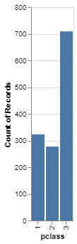
Preparation, Python output
Barchart in Python

Slide 5
Preparation, R code
R code
ti <- read.csv(file="data/titanic3/csv") ggplot(ti, aes(pclass)) + geom_bar()

Slide 6
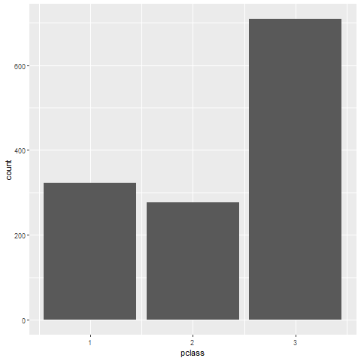
Preparation, R output

Slide 7
Preparation, Tableau steps
Import titanic3.csv
Drag pclass to columns
Change to Discete Dimension
Drag pclass to rows
Change to Measure(Count)
If needed, change Marks to Bar

Slide 8
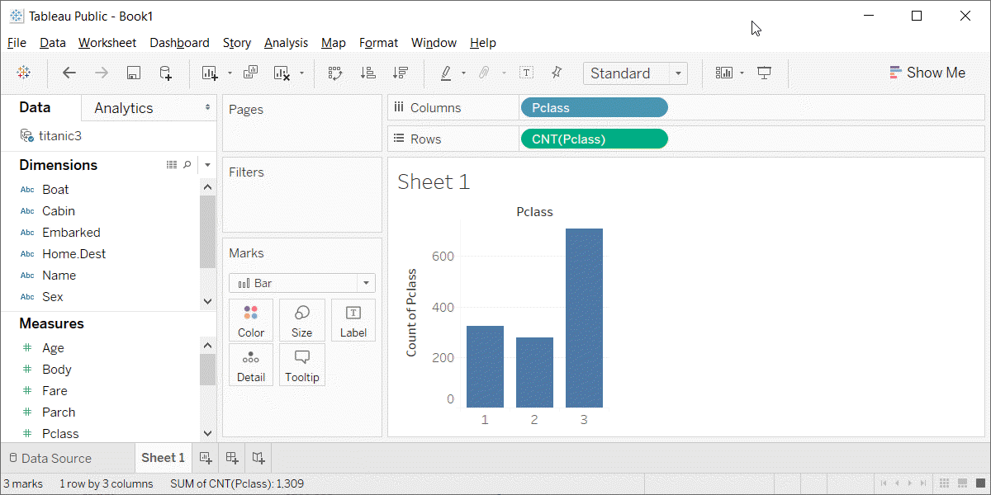
Preparation, Tableau output
Barchart in Tableau

