Slide 1
Data visualization – surfaces
Steve Simon

Slide 2
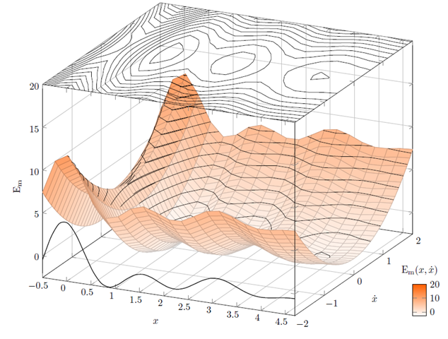
Contour plot
Illustration of a contour plot above a three dimensional surface
Notes:
Here’s an example of how you might convert a three dimensional surface into a contour plot.
Note to myself: This may not be the best image to use. I have some alternatives on different slides. Or I might draw an image from scratch.

Slide 3
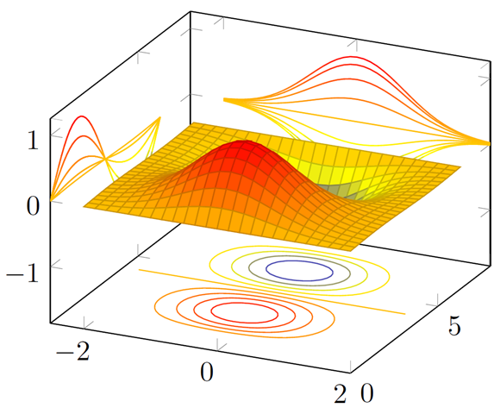
Contour plot
Illustration of a contour plots surrounding a three dimensional surface

Slide 4
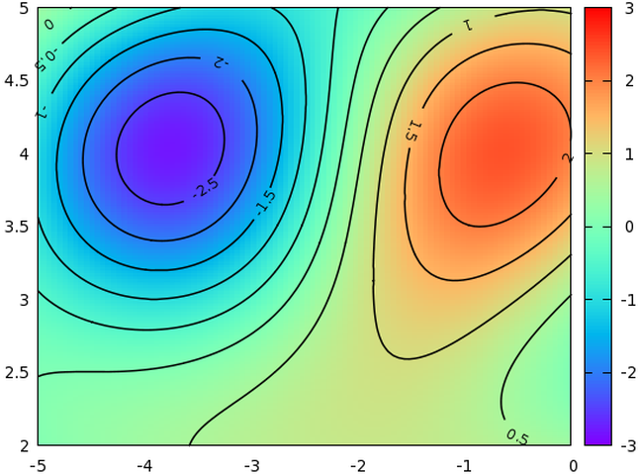
Contour plot
Illustration of a contour plot above a three dimensional surface

Slide 5
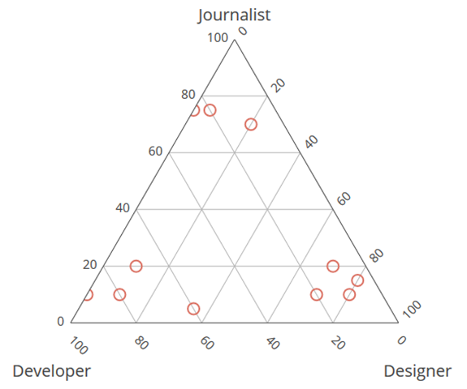
Ternary plot
Ternary plot of proportions (developer, designer, journalist)
Notes:
Note to myself: It might be nice to place a simple example of a ternary plot here. It might also fit in better later on.

Slide 6
Interactivity
Examples
Sliders
Hover
Excellent for exploratory graphics
Not within the scope of this talk
Notes:
Note to myself: I might try to find a website or two that has interactivity, just to show what you can accomplish with sliders and hovering. But it is not something that I plan to cover in this course. Potentially, it could be a separate two hour module, but I suspect that a lot of this will be covered in the workshop on dashboards.

Slide 7
Drawing contour plots
((Like before. Find a simple data set, show them how to draw something basic and then ask them to modify things slightly.))

