Slide 1
Exercise, draw gender
Steve Simon

Slide 2
Exercise, Gender barchart
Draw a bar chart showing the number of people in each gender (use the Sex variable).

Slide 3
Exercise, Gender barchart, Python (1/2)
Python code
ch = alt.Chart(df).mark_bar().encode( x='Sex', y='count()' )

Slide 4

Exercise, Gender barchart, Python results

Slide 5
Exercise, Gender barchart, R code
R code
ggplot(titanic, aes(Pclass)) + geom_bar()

Slide 6
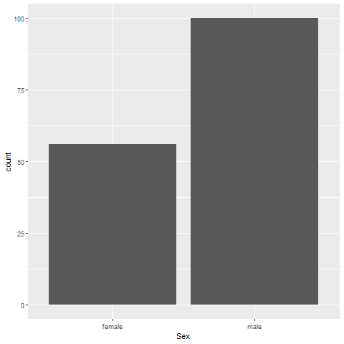
Exercise, Gender barchart, R results
r gender barchart

Slide 7
Exercise, Gender barchart, Tableau steps
((Tableau steps))

Slide 8
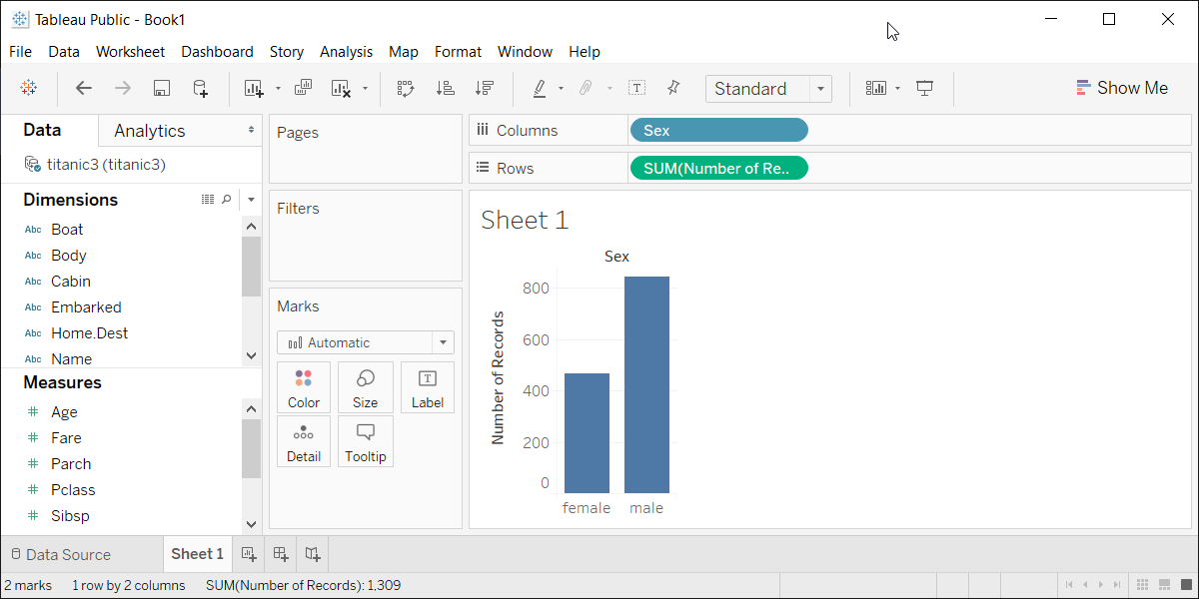
Exercise, Gender barchart, Tableau results
Tableau barchart

