Slide 1
Barchart fundamentals
Steve Simon

Slide 2
Barchart fundamentals, Bars
Fewer in numbers than points
Usually a summary statistic
Count
Percent
Average
Total
A bar chart is NOT a histogram
Notes:
Bar charts are different than point charts. There are usually only a few bars. These bars usually represent a summary statistic, like a count, percent, average, or total.
There is a technical distinction between a bar chart and a histogram. Histograms are a great diagnostic tool, but usually ends up on the cutting room floor. So I won’t be talking about it much, if at all, in this workshop.

Slide 3
Barchart fundamentals, Aesthetics for bars
Review
Location
Size
Color
NOT shape!!!
Notes:
Recall that aesthetics are visual attributes associated with a geometry/mark. You can map variables to the location, size, and/or color of bars, but you cannot assign a variable to the shape of a bar.

Slide 4
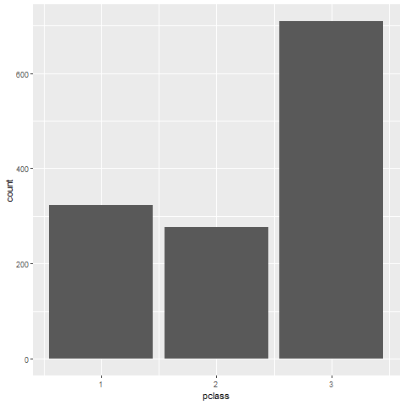
Barchart fundamentals, Location
Horizontal bar chart
Notes:
This is data from the Titanic, a ship that was as massive as its name. It was considered unsinkable, but on its maiden voyage in 1912, the ship hit an iceberg and sank. It sank during an era where people really believed in women and children first, and this shows quite clearly in the mortality statistics. There was a difference, though, between third class passengers like Leonardo diCaprio and first class passengers like Kate Winslet.
This shows a simple bar chart. The x-axis is passenger class and the y-axis is count. Note that there are about the same number of first and second class passengers, but the two combined does not come close to the number of third class passengers.

Slide 5
Exercise, Gender barchart
Draw a bar chart showing the number of people in each gender (use the Sex variable).

Slide 6
Exercise, Gender barchart, Python (1/2)
Python code
ch = alt.Chart(df).mark_bar().encode( x='sex', y='count()' )

Slide 7

Exercise, Gender barchart, Python (2/2)

Slide 8
Exercise, Gender barchart, R (1/2)
R code
ggplot(titanic, aes(sex)) + geom_bar()

Slide 9
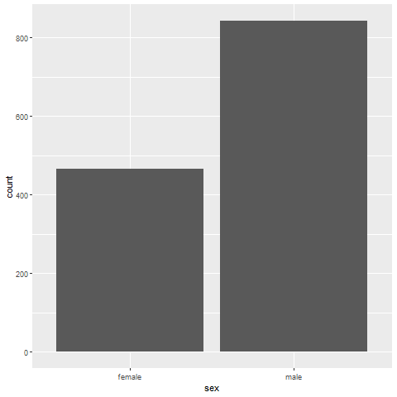
Exercise, Gender barchart, R (2/2)
r gender barchart

Slide 10
Exercise, Gender barchart, Tableau (1/2)
((Tableau steps))

Slide 11
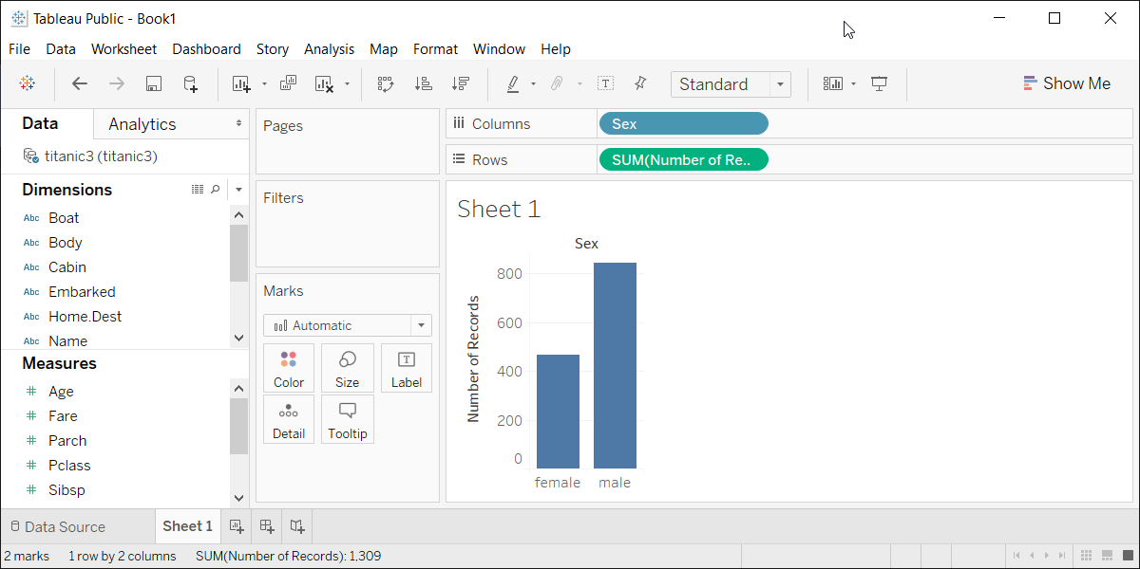
Exercise, Gender barchart, Tableau (2/2)
Tableau barchart

Slide 12
Barchart fundamentals, Size
Length varies, width doesn’t
Exception, mosaic plots
Think about gaps between bars

Slide 13
Barchart fundamentals, Color
Use for emphasis in simple bar charts
Very important for stacked or side-by-side bar charts
Notes:
For simple bar charts like all the ones we’ve seen so far, color is not really needed. You already can distinguish between the passenger classes using the location. If you do use color in a simple bar chart, it is often to emphasize a point. In the previous bar chart, I used red for third class, because Kate Winslet, a rich first class passenger, found true love in third class, with the adorable Leonardo di Caprio.
Color becomes very important in just a minute when we add another layer of complexity.

Slide 14
Barchart fundamentals, Color
Bar chart with emphasis color

Slide 15
Exercise, First class red
Make the first class bar red to show Leonardo di Caprio’s perspective on the Titanic.

Slide 16
Exercise, First class red, Python (1/2)
Python code
((Python code))

Slide 17
Exercise, First class red, Python (2/2)
((Python results))

Slide 18
Exercise, First class red, R (1/2)
R code
((R code))

Slide 19
Exercise, First class red, R (2/2)
((R results))

Slide 20
Exercise, First class red, Tableau (1/2)
((Tableau steps))

Slide 21
Exercise, First class red, Tableau (2/2)
((Tableau results))

Slide 22
Barchart fundamentals, Stack versus dodge
Summarize by two categories
Facet
Separate plots
Dodge
Side by side
Similar to facet
Stack
One on top, one on bottom
Notes:
Bar charts that represent a summary across a single categorical variable are fairly simple and easy to handle. But when you want to summarize by two categories simultaneously, things get interesting. Interesting in a good way.

Slide 23
Barchart fundamentals, Titanic passenger count by gender
Bar chart

Slide 24
Barchart fundamentals, Titanic passenger count by passenger class
Bar chart

Slide 25
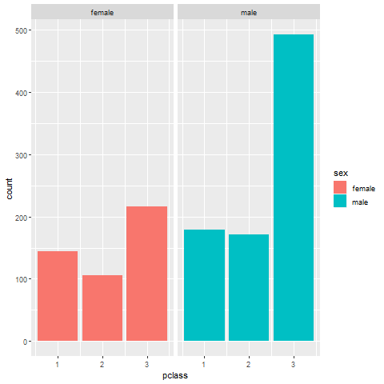
Barchart fundamentals, Titanic facet
Bar chart

Slide 26
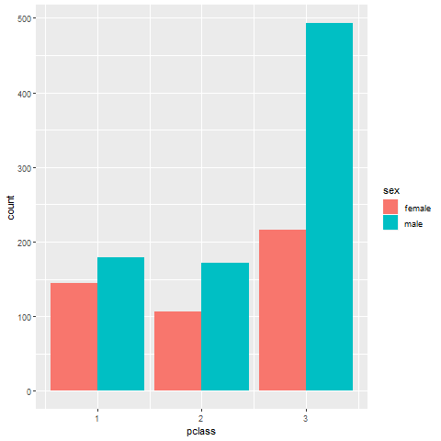
Barchart fundamentals, Titanic dodge
Bar chart

Slide 27
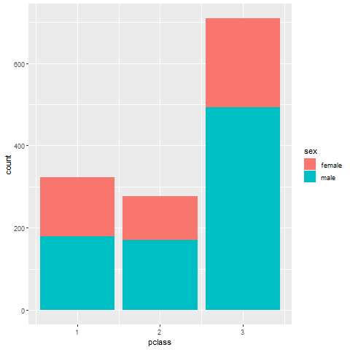
Barchart fundamentals, Titanic stack
Bar chart

Slide 28
Exercise, Mortality by gender
Draw a bar chart showing counts involving both mortality and gender. Use a panel, then stacking, then dodging. Which do you like best?
% ggplot(aes(x=sex, fill=survived)) + geom_bar() + facet_grid(cols=vars(survived)) ```
Notes:
Mortality on the Titanic reflects the fact that this was an era when people really did believe in the concept of “women and children first.” Someone like me, I’d be shoving the little kids aside so I could get on one of the lifeboats.
Anyway, examine how mortality is related to gender. It’s a spoiler alert, but on the Titanic, Kate survives, but Leonardo, I am so sad to say this, didn’t make it.

Slide 29
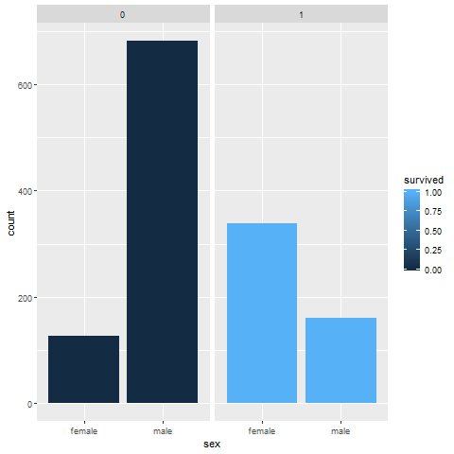
Exercise, Mortality by gender, R (2/2)

Slide 30
Exercise, Mortality by gender, Tableau (1/2)
((Tableau steps))

Slide 31
Exercise, Mortality by gender, Tableau (2/2)
((Tableau results))

Slide 32
Barchart fundamentals, Group exercise
Review the following visualization in your group
Summarize what aesthetics appear in the graph
What variables map to each aesthetic?
((Provide visualization. Maybe use the visualization from the earlier exercise?))

Slide 33
Barchart fundamentals, Summarizations
One number summary (mean or percentage)
Two number summary (error bars)
Five number summary (boxplots)
All the data
Jittering
Opacity
Notes:
((note to myself: maybe this goes better in the talk about lines.))

Slide 34
Barchart fundamentals, Switching from count to percent
((Show the code in Python, R, and Tableau. Explain why you might want counts versus percents.))

Slide 35
Barchart fundamentals, Example with means
((Need to find the right data set to illustrate this. Maybe the Saratoga house prices?))

Slide 36
Barchart fundamentals, Example with totals
((Same data. What means tell you versus totals.))

Slide 37
Barchart fundamentals, Boxplots example
((Include an explanation of what a boxplot is))

Slide 38
Barchart fundamentals, Jittering example
((Include an explanation on when it doesn’t work.))

Slide 39
Barchart fundamentals, Opacity example
((Note the computational expense.))

Slide 40
Barchart fundamentals, On your own
((Find a totally different data set and get the students to draw four different visualizations. Have them divide into groups that like the same visualization software and have each person do a different visualization.))

Slide 41
Barchart fundamentals, Summary
“A mapping of data to the visual aesthetics of geometries/marks”
Bars are a type of geometry/mark
Aesthetics for bars include location, size, color
Stack versus dodge
Basic tips
Place comparators close
Use axis ticks, light grid lines

Slide 42
Barchart fundamentals, On your own
((Find a totally different data set and get the students to draw four different visualizations. Have them divide into groups that like the same visualization software and have each person do a different visualization.))

