Slide 1
Perception tutorial
Steve Simon

Slide 2
Perception, introductory tutorial
Visual tasks
Hierarchy of perception

Slide 3
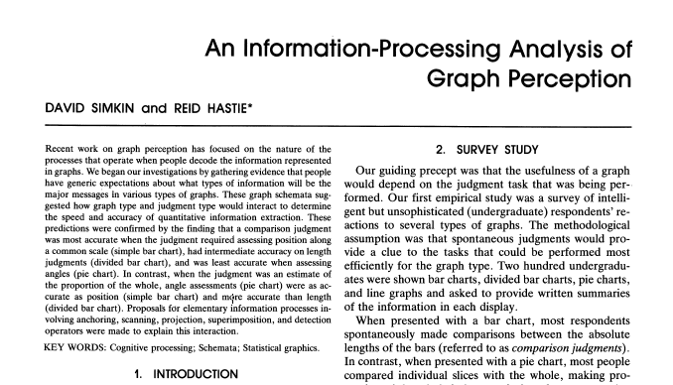
Perception, A framework for graph perception
Part of first page from Simkin and Hastie journal article
Notes:
Much of the work on the psychology of perception that I will be discussing next is drawn from this 1987 article by Simkin and Hastie.

Slide 4
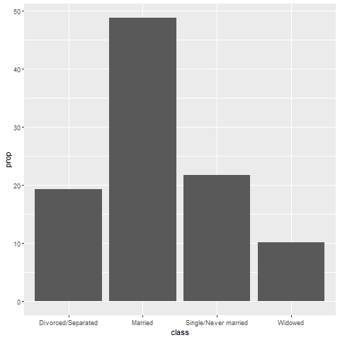
Perception, Which is better? A bar chart…
Bar chart

Slide 5
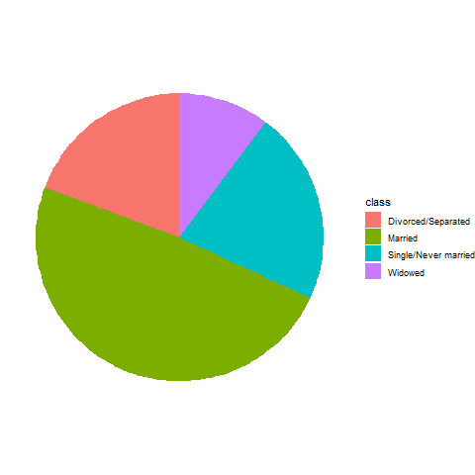
Perception, … or a pie chart
Pie chart

Slide 6
Perception, Answer. It depends.
What question are you trying to answer?
What proportion of the patients are single?
Are there more single or divorced patients?
Notes:
The answer really depends on what question you are asking. There are a variety of questions that you might ask. Two are illustrated above.
You can run an experiment (people have done this) where randomize and show half of them a bar chart and half of them a pie chart. Then you ask a question, like one of the questions above. Then you note the speed and accuracy of the response. Depending on the question, sometimes pie charts give faster and more accurate answers. Sometimes bar charts give faster and more accurate answers. It turns out that the results match up nicely with what we know about the psychology of perception.

Slide 7
Perception, Visual processing (1 of 3)
Projection
Shifting an object in a horizontal or vertical direction to make a comparison
Superimposition
Shifting in other directions (e.g., diagonal shifts, rotation) in order to make a comparison
Much harder than projection

Slide 8
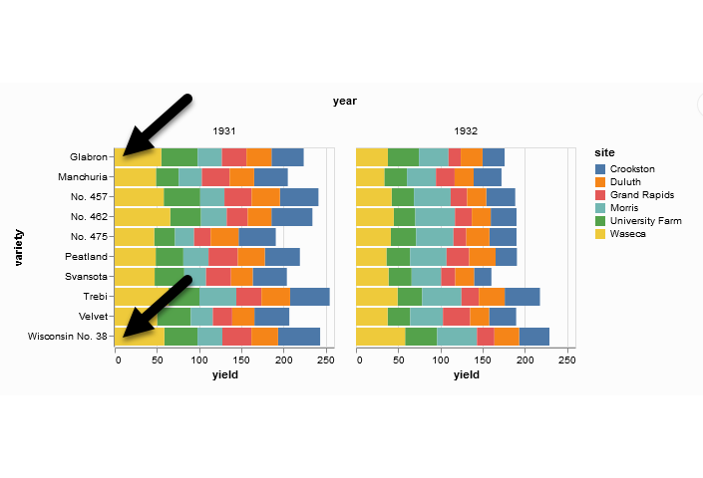
Perception, Projection (first yellow bar versus last yellow bar)
Stacked bar chart of crop yields
Notes:
The position means the vertical or horizontal location. Does the first yellow bar in 1931 (Glabron seeds planted in Wasica) extend further to the right than the last yellow bar (Wisconsin No. 38 seeds planted in Wasica)?

Slide 9
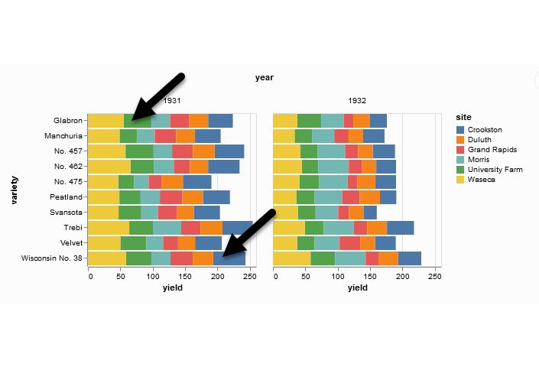
Perception, Superimposition (first green bar versus last blue bar)
Stacked bar chart of crop yields
Notes:
The length means either the width or the height. Does the first green bar in 1931 (Glabron seeds planted in University Farm) extend further to the right than the last yellow bar (Wisconsin No. 38 seeds planted in Crookston)?

Slide 10
Perception, Visual processing (2 of 3)
Scanning
Quantifying distance throug the use of a mental tape measure
Shorter distances are easier
Anchoring
Implicit or explicit development of reference points
Assists with scanning

Slide 11
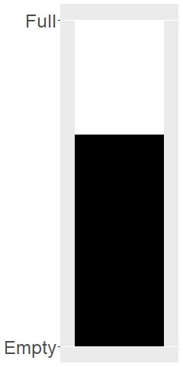
Perception, Scanning
Image of a fuel gauge, 65% full
Notes:
To understand scanning, think of a gas gauge. Usually it is a semicircular dial, but let’s set up the gas gauge as a rectangle. If the level is at the top, you have a full tank. If the level is at the bottom, you have an empty tank. This gauge shows a tank that is 65% full. Trust me, I drew the gauge. It is at 65%. Now how would you estimate the gas level?
You would take a mental tape measure, starting at the bottom and measure up to where the black box ends.
Now if you were smart, you’d start at the top and scan downwards. Less distance means that you can do this faster and more accurately.
Now if you were Albert Einstein, you’d split the gauge at the halfway point and measure from the halfway point to the top of the black box. Actually, there’s a little of Albert Einstein in all of us. That halfway point is something that all of us do subconciously. You did, because you recognized almost immediately that the tank was more than half full.

Slide 12
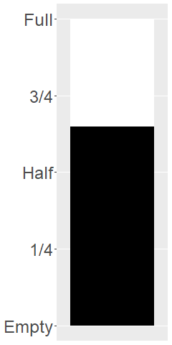
Perception, Assisting scanning with anchors
Image of a fuel gauge, anchors at 1/4, half, 3/4
Notes:
Here’s the same gas gauge, still at 65% full, but now we have added anchors at 1/4, half, and 3/4. You can read this gauge faster and more accurately, because you can scane from half up to 65% or from 3/4 down to 65%.

Slide 13
Perception, Visual processing (3 of 3)
Visually simple tasks
Position
Length
Angle/slope
Visually demanding tasks
Area
Volume
Density/Saturation/Hue
Notes:
There are a variety of perceptual tasks that you use when making comparisons within an image. These are arranged on this slide roughly in order of difficulty, with the easiest tasks at the top.

Slide 14
Perception, Position (first yellow bar versus last yellow bar)
Stacked bar chart of crop yields
Notes:
The comparison of the two yellow bars is a comparison of position. Which yellow bar extends further to the right?

Slide 15
Perception, Length (first green bar versus last blue bar)
Stacked bar chart of crop yields
Notes:
The comparison of the green and blue bars is a length comparison. The two bars start at different spots, so the position can’t help you.
Length is harder to judge than position, because it involves a superimposition rather than a projection.

Slide 16
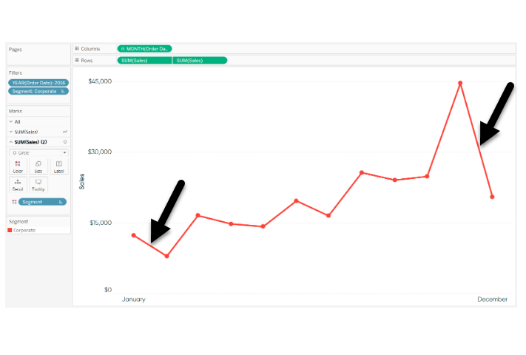
Perception, Angle/slope (first month decline versus last month decline)
Sales trend shown with a line graph
Notes:
This graph shows sales trends over a twelve month span. If you want to assess whether the first month decline (the dip in sales between January and February) was worse than the last month decline (the dip in sales between November and December), you would probably do this by judging the angle of the first line segment to the angle of the second line segment. This is not quite as easy as a position or length judgement, but it isn’t too bad either.

Slide 17
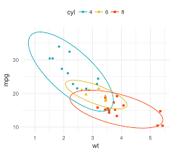
Perception, Area
Three ellipses

Slide 18
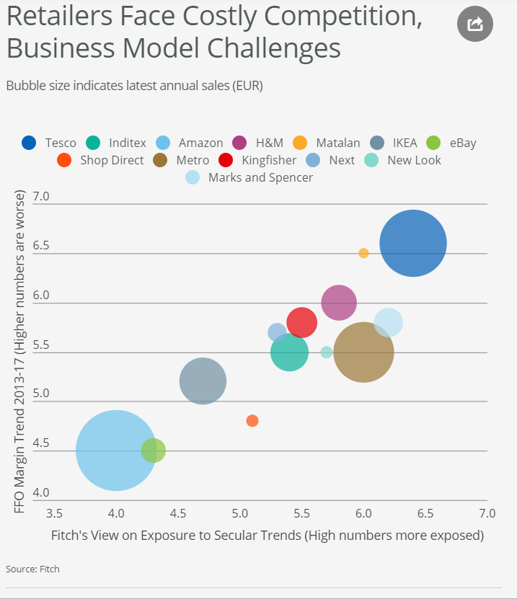
Perception, Area
Bubble plot
Notes:
This graph shows exposure and margin trends on the x and y axes. Larger values are worse on both axes. The size of the bubble is the size of the company (annual sales). There is some ambiguity here–is size measured in terms of diameter or in terms of area. Which is bigger, the brown circle (Metro) or the dark blue circle (Tesco)?

Slide 19
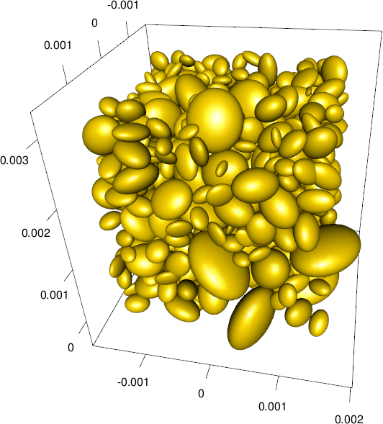
Perception, Volume
Ellipsoid plot

Slide 20
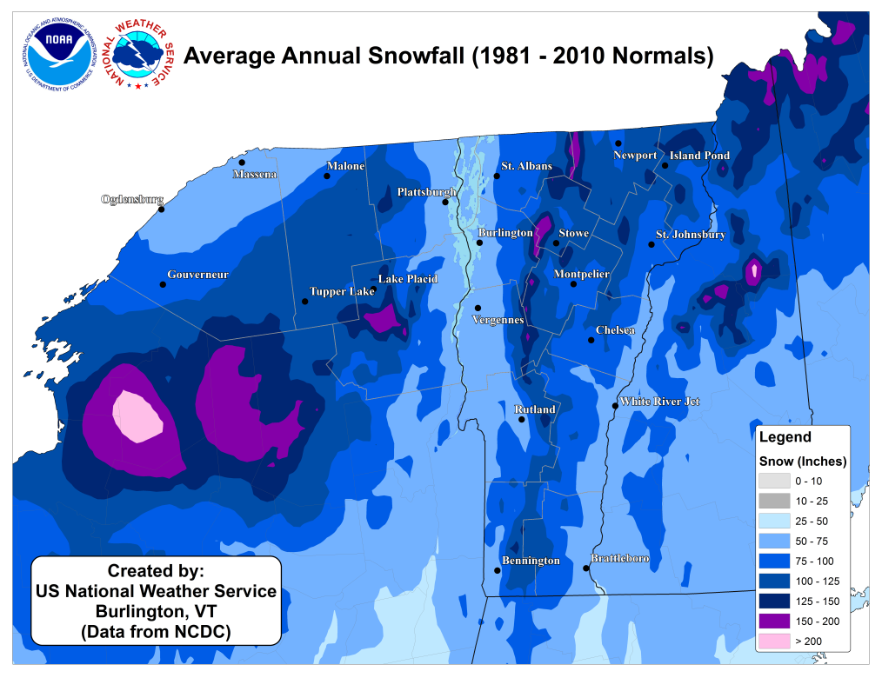
Perception, Color
Weather map of annual snowfall
Notes:
What city gets more snowfall, Remington, in the southwester corner of the state, or Newport, in the northeast corner of the state?

Slide 21
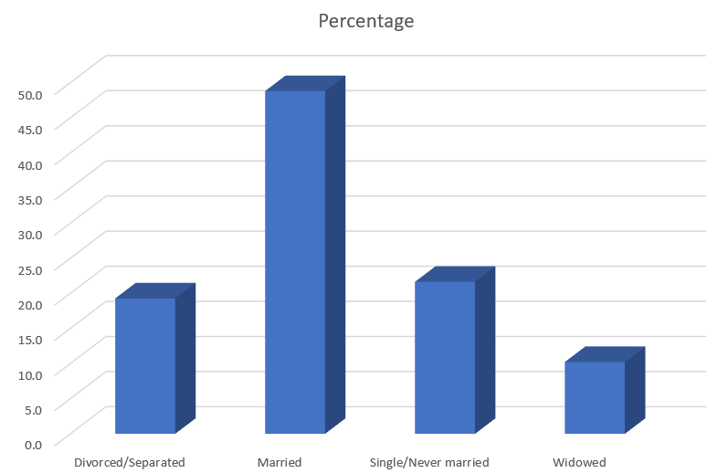
Perception, Adding depth (1/4)
THree dimensional bar chart
Notes:
Some sotware packages allow you to add some depth to your pie chart. This can catch your eye, at first, but almost all experts hate this approach. The most common complaint is that the three dimensional effects make a graph worse.
Worse means that it slows you down and it decreases the accuracy of your response. So here’s a question. What percentage of your sample is single/never married? THe three dimensional effects slow you down. So for this three dimensional bar chart, do you measure the height of the single/never married bar by projecting the front of the bar to the axis on the left or by projecting the back of the bar? Actually, you need to first project to the back “wall” because the bars are placed a small distance in front.

Slide 22

Perception, Adding depth (2/4)
Projection lines for a three dimensional bar chart
Notes:
Once you realize that you need to project to the back wall, you have to do this accurately. Notice that it is not a simple horizontal or vertical projection. Instead you have to do a couple of superimpositions, shifts at a 45 degree angle. You can do this, but it degrades your accuracy.

Slide 23
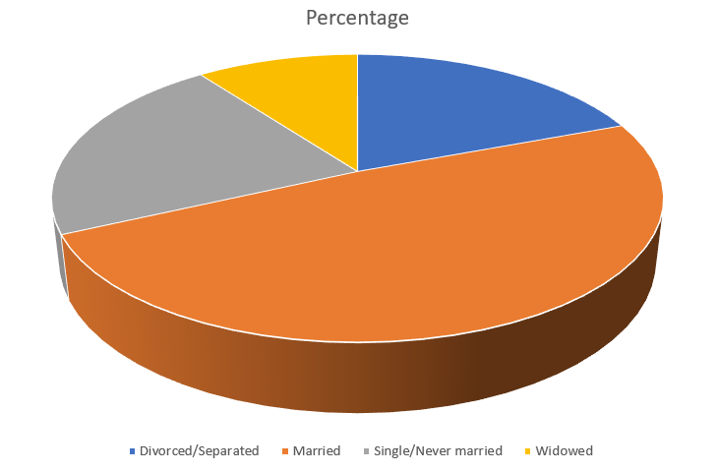
Perception, Adding depth (3/4)
Three dimensional pie chart

Slide 24
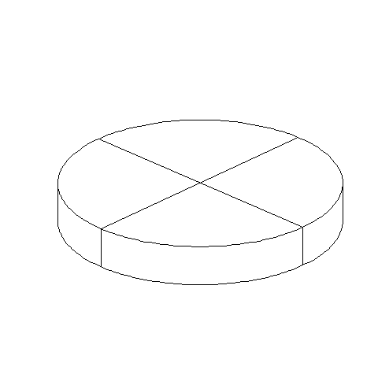
Perception, Adding depth (4/4)
Three dimensional pie chart split into four equal pieces
Notes:
There are several issues with the three dimensional pie chart, and you can see this best when you split this pie chart into four equal pieces. Notice that the angles are no longer 90 degrees because the perspective view distorts the angles. So you lose the big advantage (and possibly the only advantage) of the pie chart, the ability to divide it easily into four pieces.
Also notice that the wedge in the foreground looks bigger than the wedge in the background, because you can see the side of the foreground wedge, but you can’t see the side of the background wedge.

Slide 25
Perception, review
Visual tasks
Hierarchy of perception

