Slide 1
Finding customers
Steve Simon

Slide 2
Abstract
If you want to set up your own consulting business, you need to get the word out to potential customers. There are traditional ways to do this, but there are also new ways of improving your visibility using social media. This webinar will compare and contrast the traditional approaches (such as giving talks and volunteering) to “old school” Internet (such as websites and email newsletters) to social media (such as Facebook and Twitter).
Notes:
I won’t read this whole abstract, but to get customers, you have to get “known.” And getting known can be done with traditional approaches, old school internet, and social media.

Slide 3
Abstract (continued)
The key to all three approaches is that you give away small samples of what you know for free to establish your credibility and build up a network of contacts.
Notes:
The commonality of all these approaches is that they are free from a money standpoint, but do require an investment of time.

Slide 4
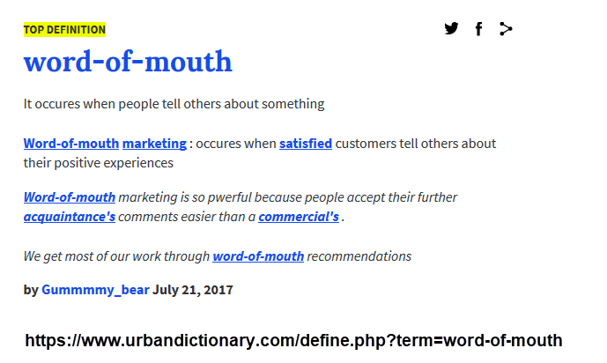
Word of mouth
Notes:
By far the best way to find new customers is the “word of mouth.” People want to hire someone that they know and trust. If they don’t have anyone, they will ask an acquaintance or colleague who they know and trust. You want be the first person that this acquaintance or colleague thinks of when they are asked this question.

Slide 5
Who is likely to recommend you?
Current customers
Your fellow statisticians
Casual acquaintances
You will find that people from all sorts of places will end up recommending you. Don’t miss a chance to let people know you are in the consulting business.

Slide 6
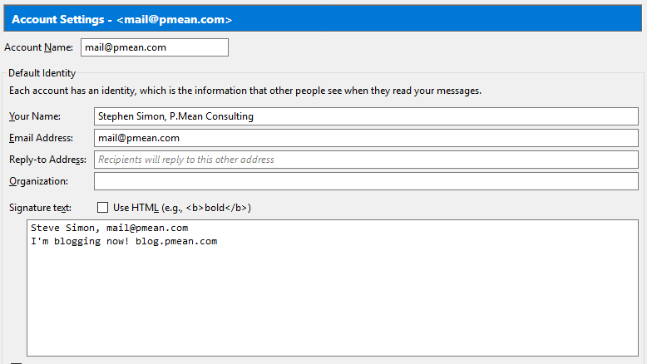
Spreading the word
Notes:
Getting the word out could be as simple as putting the name of your consulting company in your email name or in your signature file.

Slide 7
Current customers
One month after you complete your project
Ask if there are any other projects.
Ask if they know anyone else who might want a consulting statistician.
On a semi-regular basis
Find an excuse to stay in touch.
Notes:
When you’ve finished an assignment, you have a bit of good will (assuming that you did a good job). Take advantage and ask for new projects and recommendations. Then try to stay in touch regularly. Don’t spam them. You have to offer something that they find valuable. Be on the look out for interesting articles and websites. When you find something that you also think they might find interesting, pass it along with a note like “I really enjoyed this article (website), and I thought you might be interested also.”

