Slide 1

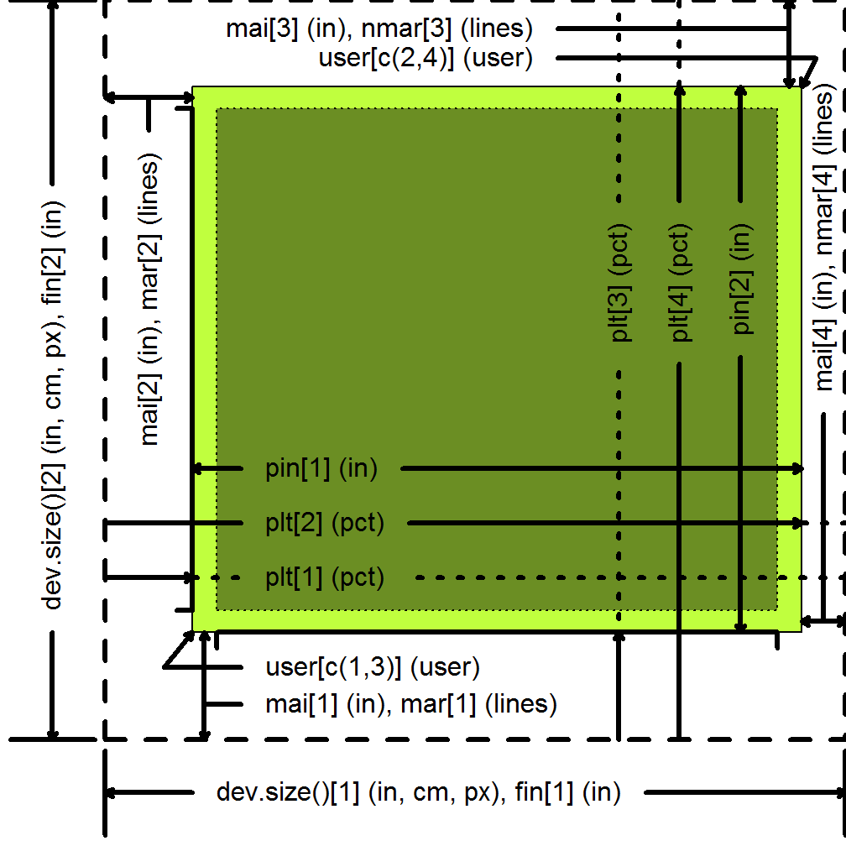
How Big is My Graph?
Cheat Sheet
Margins
Character and string sizes
par(“mai”) par(“mar”)
Margins provide you space for your axes, axis, labels, and titles.
Use par(“mai”) to display the size of the four margins (bottom, left, top, right) in inches while par(“mar”) displays the size in lines of text.
If your axis labels are getting clipped, you can designate wider margins to the mar or mai parameters.
If your graph has no axes or titles, you can remove the margins (and maximize the plotting region) with
par(mar=rep(0,4))
par(“cin”) par(“cra”) par(“csi”) par(“cxy”) strwidth(s, units, cex, font, vfont) strheight(s, units, cex, font, vfont)
The cin, cra, and cxy arguments to par give the approximate width and height of a single letter in inches, pixels, and user coordinates, respectively. The csi argument gives the height only in inches. These arguments are read only and you cannot use them to change the font size. Since letters like “I” and “M” have different widths, the values produced here are crude approximations at best.
The strwidth and strheight functions give the width and height of a string s in user coordinates (units=“user”), inches (units=“inches”) and as a percentage of the graphics window (units=“figure”).
The strwidth function will properly account for narrow and wide letters in a string. The strheight function gives the same value for each letter (the height of the letter “M”) and will understate the height of string that has both descending letters (g, p, etc.) and ascending letters (b, d, etc.). For strings that have one or more linefeeds, strheight will calculate size incorporating the line height value (par(“lheight”)).
P.Mean
Consulting
Basics
You can measure the size of your graph in inches (in), centimeters (cm), or pixels (px). For graphs on your screen and graphs in bmp, tiff, gif, or jpeg formats, measurements in inches or centimeters should not be taken literally.
All functions that open a device for graphics will have height and width arguments to control the size of the graph and a pointsize argument to control the relative font size. In knitr, you control the size of the graph with the chunk options, fig.width and fig.height.
Plotting region user coordinates
par(“usr”)
User coordinates are the values you use when plotting your data. Run par(“usr”) to get a vector of length 4 with the user coordinates with the minimum X value, the maximum X value, the minimum Y value, and the maximum Y value.
This normally is not the same as the values specified by the xlim and ylim arguments in plot. By default, R adds and extra 4% to the plotting range so that points right on the edge do not get partially clipped. You can override this using the xaxs=“i” and/or the yaxs=“i” arguments in par.
Device size
dev.size(units) par(“fin”)
Sometimes you will need to query the size of the graphics device within the R program itself. You might do this because you can’t remember the default values, because you may have changed the size of the graphics window on your screen, or because you need the size of the device in order to calculate other important aspects of the size of your graph.
Both the dev.size function or par(“fin”) will tell you the size of the graphics device in inches (including margins), but par(“fin”) will not be updated if you resize your graphics window.
Type dev.size(units=“px”) or dev.size(units=“cm”) to get the size in different units. The command
dev.size(units=“px”) / dev.size()
will tell you the number of pixels per inch in the horizontal and vertical directions.
Plotting region size
par(“pin”) par(“plt”)
Use par(“pin”) to get a vector of length 2 with the size of the plotting region in inches for the X and Y dimensions.
Run par(“plt”) to get the space needed to get to the various edges of the plotting regions from the left/bottom of the graphics device.
RStudio® is a trademark of RStudio, Inc. • CC BY Steve Simon • mail@pmean.com • 844-448-1212 • rstudio.com
Learn more at web page or vignette • package version • Updated: September 2016

Slide 2
To get a perfectly square graph
Number of pixels per user coordinates
A square graph is one where the range of the user coordinates is same in both the x and y directions and the size of the plotting region is the same in the x and y directions. You can insure a square graph by
1. Using the same value for height and width when you open your graphics device. You could instead call par(pty=“s”)
2. Setting the margins symmetrically, e.g., par(mar=c(4.6, 4.6, 0.6, 0.6)).
3. Using identical limits for xlim and ylim.
For many applications, you need to be able to translate user coordinates to pixels.
# Range in user coordinates x.range <- par(“usr”)[2] – par(“usr”)[1] y.range <- par(“usr”)[4] – par(“usr”)[3] # Percentage used by plotting region x.pct <- par(“plt”)[2] – par(“plt”)[1] y.pct <- par(“plt”)[4] – par(“plt”)[3] # Number of pixels in plotting region x.px <- x.pct*dev.size(units=“px”)[1] y.px <- y.pct*dev.size(units=“px”)[2] # Number of pixels per user coordinate x.px.per.usr <- x.px / x.range y.px.per.usr <- y.px / y.range
Run par(“pin”) to get a vector of length 2 with the size of the plotting region in inches in the X and Y direction.
Run par(“plt”)[1:2] to get the percentage of space from the left edge of the graphics device to the left edge of the plotting region and the percentage of space from the left edge of the graphics device to the right edge of the
Basics
You can measure the size of your graph in inches (in), centimeters (cm), or pixels (px). For graphs on your screen and graphs in bmp, tiff, gif, or jpeg formats, measurements in inches or centimeters should not be taken literally.
All functions that open a device for graphics will have height and width arguments to control the size of the graph and a pointsize argument to control the relative font size. In knitr, you control the size of the graph with the chunk options, fig.width and fig.height.
If your fonts are too big or too small
Sometimes your fonts will be so large that they overlap each other or crowd out th other information in your graph. Fixing this takes a bit of trial and error. Here are some ways you can revise your graph to get more appropriate font sizes.
1. Trying opening your graphics device with different values for height and width. While most aspects of your graph will scale proportionately, the fonts (and the margins) will remain the same. A larger graphics device size will end up shrinking your fonts relative to the size of the graph and a smaller graphics device size will end up expanding your fonts.
2. Modify the pointsize argument when you open your graphics device.
3. Use the cex argument to increase or decrease the relative size of your fonts.
4. If your axis labels won’t fit, try increasing the size of the margins with par(“mar”) or par(“mai”). Try a different rotation for the axis labels with par(“las”). Try using fewer tick marks.
Device size
dev.size() par(“fin”)
Sometimes you will need to query the size of the graphics device within the R program itself. You might do this because you can’t remember the default values, because you may have changed the size of the graphics window on your screen, or because you need the size of the device in order to calculate other important aspects of the size of your graph.
Both the dev.size function or par(“fin”) will tell you the size of the graphics device in inches (including margins), but par(“fin”) will not be updated if you resize your graphics window.
Type dev.size(units=“px”) or dev.size(units=“cm”) to get the size in different units. The command
dev.size(units=“px”) / dev.size()
will tell you the number of pixels per inch in the horizontal and vertical directions.
RStudio® is a trademark of RStudio, Inc. • CC BY Steve Simon • mail@pmean.com • 844-448-1212 • rstudio.com
Learn more at web page or vignette • package version • Updated: September 2016

Slide 3
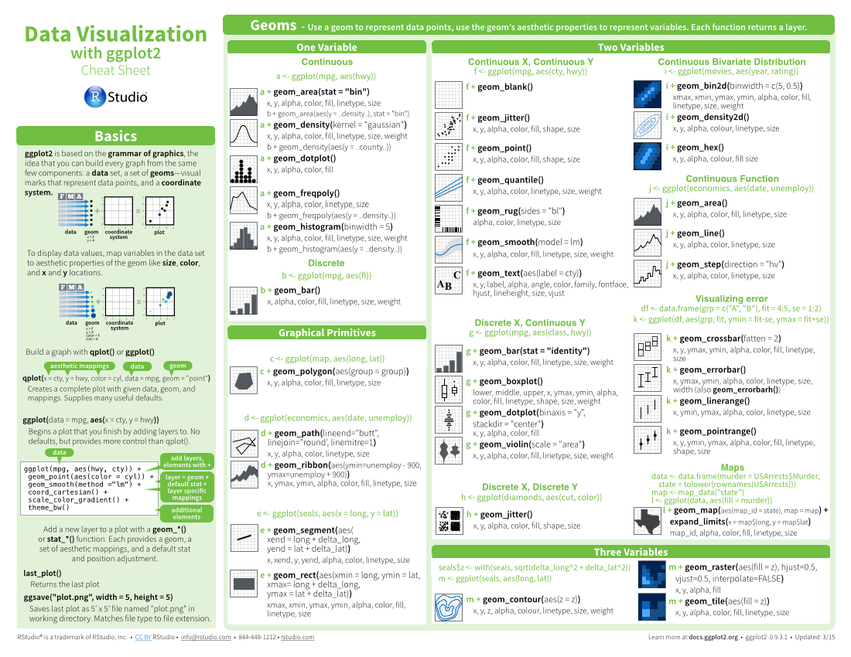
Four Column
layout
Cheat Sheet
Title - Group sections with titles, subtitles, and subsubtitles to create a visual hierarchy
Layout suggestions
Subtitle
Use headers, outlines, and/or backgrounds to separate or group together sections.
Use titles, subtitles, and subsubtitles to create a visual hierarchy that will help users navigate the page.
Fit sections to content. Try several different layouts.
Use numbers or arrows to link sections if the order/flow is confusing.
Example code
Color Scheme
Where possible, use code that works when run.
Please use the following color scheme when designing new cheatsheets to be distributed through http://www.rstudio.com/resources/cheatsheets/
Your
LOGO
Section 1
Section 2
Section 3
dplyr::lead
Copy with values shifted by 1.
dplyr::lag
Copy with values lagged by 1.
dplyr::dense_rank
Ranks with no gaps.
dplyr::min_rank
Ranks. Ties get min rank.
dplyr::percent_rank
Ranks rescaled to [0, 1].
dplyr::row_number
Ranks. Ties got to first value.
dplyr::ntile
Bin vector into n buckets.
dplyr::between
Are values between a and b?
dplyr::cume_dist
Cumulative distribution.
Basics
Greys - Programming topics
Thank you for making a new cheatsheet for R! These cheatsheets have an important job:
Cheatsheets make it easy for R users
to look up useful information.
Remember that the best cheatsheets are visual—not written—documents. Whenever possible use visual elements to make it easier for readers to find the information they need.
Use a layout that flows and makes it easy to zero in on specific topics.
Use visualizations to explain concepts quickly and concisely.
Use visual elements to make the sheet scannable.
Use visual emphasis (like color, size, and font weight) to make important information easy to find.
Purples - Reporting topics (knitr, R Markdown, etc.)
Title
Blues - Shiny or RStudio related
Subtitle
Greens - Data Visualization
Subsubtitle
Warm Colors - Data Manipulation and modeling topics
Useful elements
Keynote
icons
I make my cheatsheets in Apple Keynote, and not latex or R Markdown, because presentation software makes it much easier to tweak the visual appearance of a document
☞    
These are just font awesome characters
Mock tables
F | M | A
 | wind | wind
 | wwindind | wind
 | wwindind | wind
 | Allison | 1005
 | Allison | 1013
 | Arlene | 1010
 | Arthur | 1010
Keynote tips
Code snippets
Select multiple elements by holding down shift and then selecting each. Click on a selected element before letting go of shift to unselect it.
To group elements together. Select them all , then click Arrange > Group
To evenly space multiple objects, select them all then Right Click > Align objects or Right Click > Distribute objects
Click on a table, then visit Format >Table > Row and Column Size to make even width rows/columns.
summary
function
Mock graphs
ggplot(mpg, aes(hwy, cty)) +
geom_point(aes(color = cyl)) +
geom_smooth(method ="lm") +
coord_cartesian() +
scale_color_gradient() +
theme_bw()
j + geom_area()
x, y, alpha, color, fill, linetype, size
j + geom_line()
x, y, alpha, color, linetype, size
Tables
expect_equal() | is equal within small numerical tolerance?
expect_identical() | is exactly equal?
expect_match() | matches specified string or regular expression?
expect_output() | prints specified output?
Word balloons
can be
useful for
explaining code
Copyright
Each cheatsheet should be licensed under the creative commons license.
To license the sheet as creative commons, put CC'd by <your name> in the small print at the bottom of each page and link it to http://creativecommons.org/licenses/by/4.0/
Fonts
This template uses several fonts: Helvetica Neue, Menlo, Source Sans pro, which you can acquire for free here, http://www.fontsquirrel.com/fonts/source-sans-pro, and Font Awesome, which you can acquire here, http://fortawesome.github.io/Font-Awesome/get-started/
dplyr::bind_rows(y, z)
Append z to y as new rows.
To use a font awesome icon, copy and paste one from here http://fortawesome.github.io/Font-Awesome/cheatsheet/. Then set the text font to font awesome.
RStudio® is a trademark of RStudio, Inc. • CC BY Your Name • Your@email.com • 844-448-1212 • rstudio.com
Learn more at web page or vignette • package version • Updated: 3/15

Slide 4
Three Column
layout
Cheat Sheet
Layout Suggestions
Use headers, outlines, and/or backgrounds to separate or group together sections.
Create a visual hierarchy. Help users navigate the page with titles, subtitles, and subsubtitles
Fit sections to content. Try several different layouts.
Use numbers or arrows to link sections if the order/flow is confusing.
Section 1
Section 2
Section 3
Title
Your
LOGO
Subtitle
Subsubtitle
Basics
Code and Color
Example code
Thank you for making a new cheatsheet for R! These cheatsheets have an important job:
Cheatsheets make it easy for R users
to look up useful information.
Remember that the best cheatsheets are visual—not written—documents. Whenever possible use visual elements to make it easier for readers to find the information they need.
Use a layout that flows and makes it easy to zero in on specific topics.
Use visualizations to explain concepts quickly and concisely.
Use visual elements to make the sheet scannable.
Use visual emphasis (like color, size, and font weight) to make important information easy to find.
Where possible, use code that works when run.
Color Scheme
dplyr::lead
Copy with values shifted by 1.
dplyr::lag
Copy with values lagged by 1.
Please use the following color scheme when designing new cheatsheets to be distributed through http://www.rstudio.com/resources/cheatsheets/
Greys - Programming topics
Word balloons
Purples - Reporting topics (knitr, R Markdown, etc.)
ggplot(mpg, aes(hwy, cty)) +
geom_point(aes(color = cyl)) +
geom_smooth(method ="lm") +
coord_cartesian() +
scale_color_gradient() +
theme_bw()
Blues - Shiny or RStudio related
can be
useful for
Greens - Data Visualization
Warm Colors - Data Manipulation and modeling topics
explaining code
Useful Elements
Logistics
icons
Fonts
☞    
These are just font awesome characters
This template uses several fonts: Helvetica Neue, Menlo, Source Sans pro, which you can acquire for free here, http://www.fontsquirrel.com/fonts/source-sans-pro, and Font Awesome, which you can acquire here, http://fortawesome.github.io/Font-Awesome/get-started/
summary
function
Mock tables
F | M | A
 | wind | wind
 | wwindind | wind
 | wwindind | wind
 | Allison | 1005
 | Allison | 1013
 | Arlene | 1010
 | Arthur | 1010
To use a font awesome icon, copy and paste one from here http://fortawesome.github.io/Font-Awesome/cheatsheet/. Then set the text font to font awesome.
j + geom_area()
x, y, alpha, color, fill, linetype, size
j + geom_line()
x, y, alpha, color, linetype, size
Mock graphs
Keynote
I make my cheatsheets in Apple Keynote, and not latex or R Markdown, because presentation software makes it much easier to tweak the visual appearance of a document
Tables
Keynote tips
dplyr::bind_rows(y, z)
Append z to y as new rows.
expect_equal() | is equal within small numerical tolerance?
expect_identical() | is exactly equal?
expect_match() | matches specified string or regular expression?
expect_output() | prints specified output?
Select multiple elements by holding down shift and then selecting each. Click on a selected element before letting go of shift to unselect it.
To group elements together. Select them all , then click Arrange > Group
To evenly space multiple objects, select them all then Right Click > Align objects or Right Click > Distribute objects
Click on a table, then visit Format >Table > Row and Column Size to make even width rows/columns.
Copyright
Each cheatsheet should be licensed under the creative commons license.
To license the sheet as creative commons, put CC'd by <your name> in the small print at the bottom of each page and link it to http://creativecommons.org/licenses/by/4.0/
RStudio® is a trademark of RStudio, Inc. • CC BY Your Name • Your@email.com • 844-448-1212 • rstudio.com
Learn more at web page or vignette • package version • Updated: 3/15

Slide 5
Three Column
layout
Cheat Sheet
Layout Suggestions
Use headers, outlines, and/or backgrounds to separate or group together sections.
Create a visual hierarchy. Help users navigate the page with titles, subtitles, and subsubtitles
Fit sections to content. Try several different layouts.
Use numbers or arrows to link sections if the order/flow is confusing.
Section 1
Section 2
Section 3
Title
Your
LOGO
Subtitle
Subsubtitle
Basics
Code and Color
Example code
Thank you for making a new cheatsheet for R! These cheatsheets have an important job:
Cheatsheets make it easy for R users
to look up useful information.
Remember that the best cheatsheets are visual—not written—documents. Whenever possible use visual elements to make it easier for readers to find the information they need.
Use a layout that flows and makes it easy to zero in on specific topics.
Use visualizations to explain concepts quickly and concisely.
Use visual elements to make the sheet scannable.
Use visual emphasis (like color, size, and font weight) to make important information easy to find.
Where possible, use code that works when run.
Color Scheme
dplyr::lead
Copy with values shifted by 1.
dplyr::lag
Copy with values lagged by 1.
Please use the following color scheme when designing new cheatsheets to be distributed through http://www.rstudio.com/resources/cheatsheets/
Greys - Programming topics
Word balloons
Purples - Reporting topics (knitr, R Markdown, etc.)
ggplot(mpg, aes(hwy, cty)) +
geom_point(aes(color = cyl)) +
geom_smooth(method ="lm") +
coord_cartesian() +
scale_color_gradient() +
theme_bw()
Blues - Shiny or RStudio related
can be
useful for
Greens - Data Visualization
Warm Colors - Data Manipulation and modeling topics
explaining code
Useful Elements
Logistics
icons
Fonts
☞    
These are just font awesome characters
This template uses several fonts: Helvetica Neue, Menlo, Source Sans pro, which you can acquire for free here, http://www.fontsquirrel.com/fonts/source-sans-pro, and Font Awesome, which you can acquire here, http://fortawesome.github.io/Font-Awesome/get-started/
summary
function
Mock tables
F | M | A
 | wind | wind
 | wwindind | wind
 | wwindind | wind
 | Allison | 1005
 | Allison | 1013
 | Arlene | 1010
 | Arthur | 1010
To use a font awesome icon, copy and paste one from here http://fortawesome.github.io/Font-Awesome/cheatsheet/. Then set the text font to font awesome.
j + geom_area()
x, y, alpha, color, fill, linetype, size
j + geom_line()
x, y, alpha, color, linetype, size
Mock graphs
Keynote
I make my cheatsheets in Apple Keynote, and not latex or R Markdown, because presentation software makes it much easier to tweak the visual appearance of a document
Tables
Keynote tips
dplyr::bind_rows(y, z)
Append z to y as new rows.
expect_equal() | is equal within small numerical tolerance?
expect_identical() | is exactly equal?
expect_match() | matches specified string or regular expression?
expect_output() | prints specified output?
Select multiple elements by holding down shift and then selecting each. Click on a selected element before letting go of shift to unselect it.
To group elements together. Select them all , then click Arrange > Group
To evenly space multiple objects, select them all then Right Click > Align objects or Right Click > Distribute objects
Click on a table, then visit Format >Table > Row and Column Size to make even width rows/columns.
Copyright
Each cheatsheet should be licensed under the creative commons license.
To license the sheet as creative commons, put CC'd by <your name> in the small print at the bottom of each page and link it to http://creativecommons.org/licenses/by/4.0/
RStudio® is a trademark of RStudio, Inc. • CC BY Your Name • Your@email.com • 844-448-1212 • rstudio.com
Learn more at web page or vignette • package version • Updated: 3/15

