Slide 1

Retrieving data from multiple tables Displaying Data from Multiple Tables

Slide 2
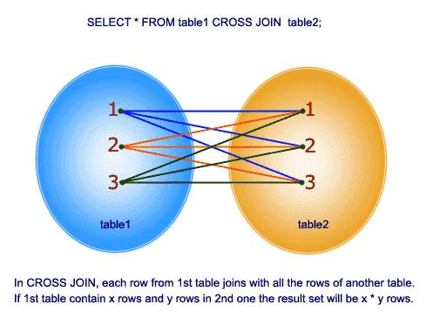
Cartesian product
In Mathematics, given two sets A and B, the Cartesian product of A x B is the set of all ordered pair (a,b), which a belongs to A and b belongs to B.
To create a Cartesian product of tables, you use the CROSS JOIN clause. The following illustrates the syntax of the CROSS JOIN clause:
SELECT * FROM P1 CROSS JOIN P2;
When you perform a cross join of two tables, which have no relationship, we will get a Cartesian product of rows and columns of both tables.

Slide 3
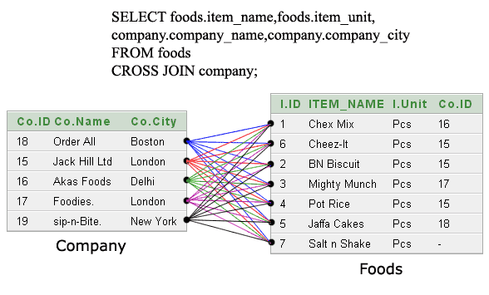
Cartesian product
A Cartesian product occurs when data is selected from two or more tables and no common relationship is specified in the WHERE clause.
If you do not specify a join condition for the tables listed in the FROM clause, database joins each row from the first table to every row in the second table.
If the first table has 3 rows and the second table has 4 rows, the result will have 12 rows.
If you add another table with 2 rows without specifying a join condition, the result will have 24 rows.
For the most part, Cartesian joins happen when there are many tables in the FROM clause and developers forget to include the join condition or they specify a wrong join condition.
You should, therefore, avoid them. To avoid a Cartesian join, there should be at least n–1 join conditions when joining n tables. Sometimes you intentionally use Cartesian joins to generate large amounts of data, especially when testing applications

Slide 4
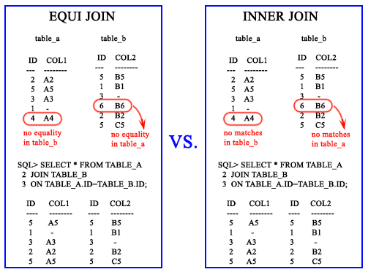
Matching using Equijoin
Equi join returns the matching column values of the associated tables. It uses a comparison operator in the WHERE clause to refer equality.
Equijoin also can be performed by using JOIN keyword followed by ON keyword and then specifying names of the columns along with their associated tables to check equality.
An equijoin returns only the rows that have equivalent values for the specified columns.
An inner join is a join of two or more tables that returns only those rows (compared using a comparison operator) that satisfy the join condition.
What is the difference between Equi Join and Inner Join in SQL?
An equijoin is a join with a join condition containing an equality operator. An equijoin returns only the rows that have equivalent values for the specified columns.
An inner join is a join of two or more tables that returns only those rows (compared using a comparison operator) that satisfy the join condition.

Slide 5
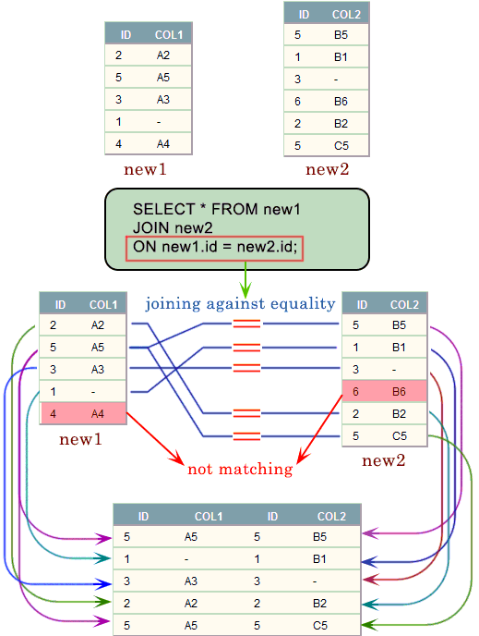
Matching using Equijoin

Slide 6
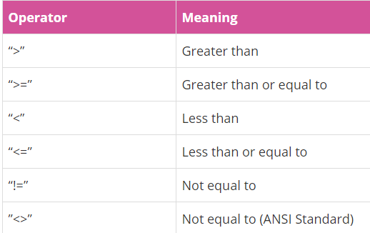
SQL JOINS – Non Equi JOIN
Non Equi Join is a join condition containing something other than equality operator.
For example: sometimes you would like to join two tables that do not have a shared column, and seemingly have no join condition
Non-equi joins don’t have a specific keyword
They are defined by the type of operator in the join condition:
Anything but an equals sign means a non-equi join.
Below, we have some non-equi join operators and their meanings:

Slide 7
Matching using the EXISTS criteria
EXISTS is only used to test if a subquery returns results. JOIN is used to extend a result set by combining it with additional fields from another table to which there is a relation.
EXISTS is used to return a boolean value, JOIN returns a whole other table.
use EXISTS when:
You don't need to return data from the related table
You have duplicate in the related table (JOIN can cause duplicate rows if values are repeated)
You want to check existence (use instead of LEFT OUTER JOIN)
-- EXISTS
SELECT *
FROM tableA
WHERE EXISTS (SELECT 1 FROM tableB WHERE title = 'Analyst' AND tableA.id = tableB.id);
-- JOIN (INNER is the default when only JOIN is specified)
SELECT *
FROM tableA
JOIN tableB
ON tableA.id = tableB.id
WHERE tableB.title = 'Analyst';

Slide 8
Retrieving data from multiple tables
Questions

