Slide 1
Simple SQL examples: NULL values
Suman Sahil, Steve Simon

Slide 2
Null values in SQL
Null is a special value in SQL
Typically intended to represent unknown or missing values
Always ask “why?”
Database designer may forbid use of null
Primary/foreign keys
Alternative, use special codes (-1 or 999)
Multiple codes for multiple reasons
Notes:
It is with a bit of trepidation that I talk about null values. You might think “much ado about nothing” but that’s not true.
The null value is a special value in SQL that is intended to represent unknown or missing values. You should always ask yourself why a value is missing because the reason it is missing will influence how you analyze the data. It is well beyond the scope of this course to discuss handling of missing values. I can make just one recommendation. Track missing values obsessively.
Database designers will often forbid the use of null values for some or all of the fields in a database. We will talk a bit more about this when we discuss primary and foreign keys.
An alternative commonly used by database designers is the use of special codes to stand in for unknown or missing values. This is especially common for settings where there may be more than one reason why a value is missing.

Slide 3
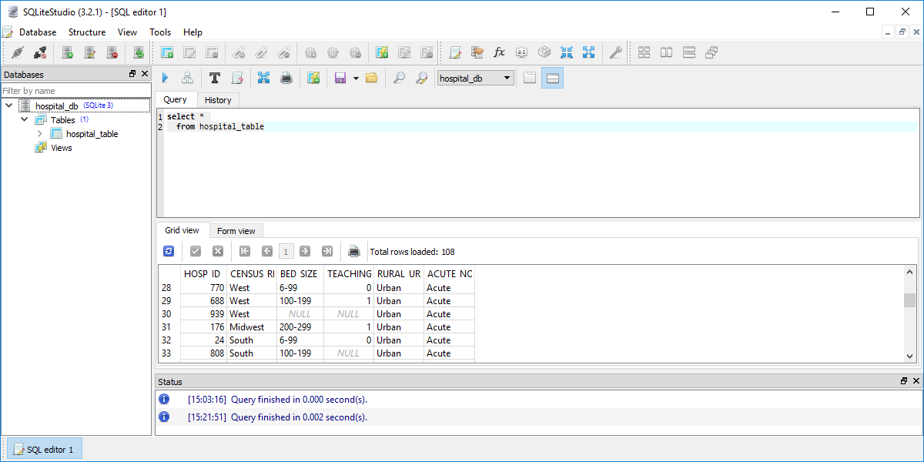
Example of null values in a database
List of selected rows of a database in SQLite Studio
Notes:
Here’s a peek at several rows of a database where there are some null values.

Slide 4
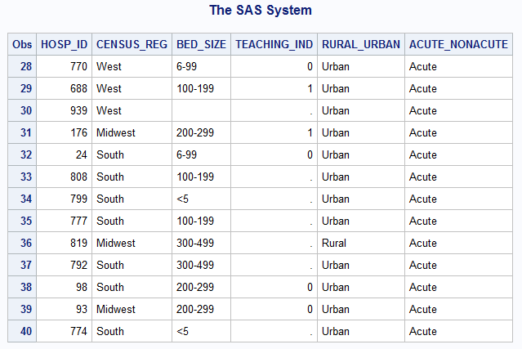
SAS translation of null
List of selected rows of a database after import into SAS
Notes:
When you import the data into SAS, SAS will convert numeric null values to a dot, which is the SAS code for missing values. For character values, SAS will convert null values to an empty string, a string of length zero. This may or may not be what you want.

Slide 5
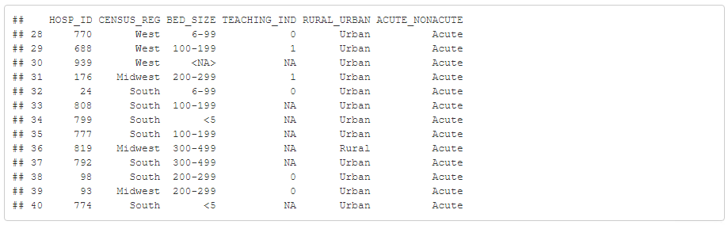
R translation of null
List of selected rows of a database after import into SAS
Notes:
R will convert null values to NA if the field is numeric. It will convert to if the field is character.

Slide 6
New data set with missing values
SQL code
select Name, Age from titanic_table where Name like 'Bar%'
Output
## Name Age ## 1 Barkworth, Mr Algernon H NA ## 2 Barber, Ms NA ## 3 Barbara, Mrs Catherine 45 ## 4 Barbara, Miss Saude 18 ## 5 Barry, Miss Julia 27 ## 6 Barton, Mr David 22
Notes:
Here’s a different database with null values. For this data set, the “Bar” names include two records with unknown ages.

Slide 7
Counting is very important
SQL code
select count(Name) as n_total from titanic_table
SQL output
## n_total ## 1 1313
Notes:
I can’t stress enough how important it is to get accurate counts when you have null values in your database. Here’s the code to get an overall count of the number of records.

Slide 8
Count of null values
SQL code
select count(Name) as n_missing from titanic_table where Age is null
SQL output
## n_missing ## 1 557
Notes:
You can (and should) get counts of all the null values.

Slide 9
Count of not null values
SQL code
select count(Name) as n_valid from titanic_table where Age is not null
SQL output
## n_valid ## 1 756
Notes:
You can exclude missing values using is not null.

Slide 10
Count that is independent of null values
My examples work
Only because Name is never missing.
You should not rely on this
Alternative code
count(*)
The wild card is never null
Notes:
One of my students from a previous semester noted a problem here. I am making an assumption that Name is never null. That’s a safe assumption, but only because I have some inside knowledge of the database. It is bad form to rely on this.
A better alternative is to use count(*).
This does not rely on inside knowledge about the database. count(*) will never ignore a row with null values because the widlcard symbol for everything is never missing.

Slide 11
Your homework
Use the hospital database
Verify that HOSP_ID has no missing vales
Count the number of missing values for TEACHING_IND
Find the id of the hospital where BED_SIZE is null.
Place your results in a single pdf file
Notes:
For your homework, use the hospital database that I mentioned briefly earlier in this lecture. Verify that the hospital id code (HOSP_ID) has no missing values. There are only two fields in the database that have null values. Get a count of the number of missing values for the indicator for teaching hospital (TEACHING_IND). There is only one hospital where the number of beds (BED_SIZE) is unknown. Find the id of that hospital.

Slide 12
End of Part 1
What have you learned
Null represents missing or unknown
Translated to . (SAS) or NA (R)
is null
is not null
What’s next (optional)
Statistical summaries for null values
Three valued logic
Notes:
Let’s take a break here. You’ve learned quite a bit in a few minutes. First, the null value in SQL is typically used to represent a missing or unknown value. When you import null values into SAS or R, these systems convert null values to the codes that they use for missing or unknown. You can’t find null values with the equal sign (we’ll explore this a bit more). Rather, you have to use the phrase “is null” or “is not null.”
The next section is optional, but it’s a lot of fun.

Slide 13
Statistical summary functions
In SQL, statistical summary functions will remove missing values and calculate based only on the non-missing values. This is similar to the default options in SAS and SPSS, which also exclude missing values by default in most summary statistics. In R, however, the default option is to return a missing value for a summary statistic anytime that one or more values are missing.

Slide 14
Statistical summary functions, avg
SQL code
select avg(age) as mean_age from titanic_table
SQL output
## mean_age ## 1 30.39799

Slide 15
Statistical summary functions, count
SQL code
select count(age) as n from titanic_table
SQL output
SQL output
## n ## 1 756
Notes:
The count function will toss out null values before counting.

Slide 16
Comparisons with null values
SQL code
select count(Name) from titanic_table where age<=18
SQL output
## count(Name) ## 1 126
Notes:
If you count the number of kids (age less than or equal to 18), you do not include the null values.

Slide 17
The “opposite” comparison
SQL code
select count(Name) from titanic_table where not age<=18
SQL output
## count(Name) ## 1 630
Notes:
If you count the number of kids (age less than or equal to 18), you do not include the null values.
The opposite condition also excludes null values. It seems odd that the number of cases with a statement plus all the cases with the negation of that statement should add up to less than the total. Think about that for a minute.
There is something unusual going on here. It is known as three valued logic.

Slide 18
Three valued logic
What happens with a logic statement involving a null value?
Is null <= 18?
Unknown is a third logic value
Neither true nor false
Notes:
A logic statement chokes when it encounters a null value. Is the value of null <= 18? Is it > 18? Well, it is neither. If age is null, that means that it is unknown, so maybe it is <= 18 and maybe it is not. Maybe doesn’t fit well in a world of logic where statements are either true or false.
The folks at SQL developed a third logical value, unknown.

Slide 19
Paradoxes of three valued logic (1/2)
Three valued logic system applied to the logic statement Age<=18
Age Age<=18? 12 TRUE 14 TRUE 24 FALSE NULL UNKNOWN
In a three valued logic system, comparisons to null are unknown
Notes:
The three valued logic assigns true to the logic statement age<=18 for the 12 and 14 year olds. It assigns false to that statement for the 24 year old. It assigns UNKNOWN to the null age.

Slide 20
Paradoxes of three valued logic (2/2)
Three valued logic system applied to the logic statement not Age<=18
Age Age<=18? not Age<=18 12 TRUE FALSE 14 TRUE FALSE 24 FALSE TRUE NULL UNKNOWN UNKWOWN
In a three valued logic system, not unknown is unknown
age<=18 or age>18?
Evaluates to unknown if age is null
Notes:
The three valued logic assigns true to the logic statement age<=18 for the 12 and 14 year olds. It assigns false to that statement for the 24 year old. It assigns UNKNOWN to the null age.
The negation of Age<=18 flips true to false and false to true, but it leaves unknown alone. In other words, not unknown is unknown. If you don’t know if a passenger is a child, you don’t know if a passenger is not a child.
The where clause includes true values and excludes false values and unknown values.
So the logic statement age<=18 or age>18 evaluates to true for almost everybody, but it evaluates to unknown if age is null. That seems wrong, doesn’t it?

Slide 21
Another paradox of three valued logic
Three valued logic system applied to the logic statement Age1=Age2
Age1 Age2 Age1=Age2? 12 18 FALSE 14 14 TRUE 26 39 FALSE 24 NULL UNKNOWN NULL 15 UNKNOWN NULL NULL UNKNOWN
Two null values could or could not be equal
Evaluates to unknown
Notes:
Another paradox involves comparison between two different fields. If you have two ages, such as the age of a person and the age of that person’s sibling, then it is pretty obvious what to do if you are asking the logical statement is the age of the patient and the age of his/her sibling the same. For 12 and 18, the answer if false. For 14 and 14, the answer is true. The 26 and 39, the answer is false. How about 24 and null? If you don’t know the age of the sibling, then the comparison has to evaluate to unknown. Similarly if you don’t know the age of the patient, and you do know the age of the sibling, you still have to evaluate to unknown.
What is interesting is when both ages are null. This also evaluates to unknown. The unknown ages might be 12 and 18, which would make the logic comparison false. Or they might both be 14. So it could just as easily be true. This should inform you that assigning either true or false won’t work. So you have to assign a value of unknown.

Slide 22
Logic table
X not X TRUE FALSE FALSE TRUE UNKNOWN UNKNOWN
Notes:
Here’s a logic table for the not operator.

Slide 23
Two valued logic table
X y x or y x and y TRUE TRUE TRUE TRUE TRUE FALSE TRUE FALSE FALSE TRUE TRUE FALSE FALSE FALSE FALSE FALSE
Notes:
Here’s a logic table for the “or” and “and” functions with just the two logic values of true and false. There are four combinations that work.

Slide 24
Three valued logic table
X y x or y x and y TRUE TRUE TRUE TRUE TRUE FALSE TRUE FALSE FALSE TRUE TRUE FALSE FALSE FALSE FALSE FALSE TRUE UNKNOWN TRUE UNKNOWN FALSE UNKNOWN UNKNOWN FALSE UNKNOWN TRUE TRUE UNKNOWN UNKNOWN FALSE UNKNOWN FALSE UNKNOWN UNKOWNN UNKONWN UNKNOWN
Notes:
If you have to add in the unknowns, that creates five more cases.

Slide 25
Special cases
FALSE and UNKNOWN
Both FALSE and FALSE, FALSE and TRUE evaluate to FALSE
TRUE or UKNOWN
Both TRUE or TRUE, TRUE or FALSE evaluate to TRUE
Arithmetic analogy 0*NULL
Notes:
You might think that any Boolean logic statement with one of the two conditions being UNKNOWN would end up helpless. But not always.
Consider the statement FALSE and UNKNOWN. It doesn’t really matter what the second condition is, because you already know based on the first condition that the entire Boolean statement has to evaluate to FALSE.
The other case is a statement TRUE or UNKNOWN. Once you know that one of the two conditions in an OR statement is TRUE, you don’t have to bother evaluating the second.
It’s kind of like multiplying an unknown number by zero. Any possible value for the unknown would end up being zeroed out.

Slide 26
Do you really want all this hassle?
Debate about whether you should use null values at all
Never use them for identification codes
Replace them with extreme values (-1, 999)
Whatever your choice, tread carefully
Notes:
There is a strong debate about whether you should use null values at all in databases. The potential for confusion is great. There is a general consensus that you should not use null values for identification codes. For other settings, you can use extreme codes like -1 and 999. Then you can track those codes explicitly because =-1 or =999 does not invoke the monster of three valued logic.
It is still tricky though. If the missing value code for age is -1 then you can’t say age <= 18, you have to say age <=18 and age >= 0.
Now as an end user, you don’t get to make this call. The lesson for you is that whenever you have missing or unknown values, you have to be alert to the troubles that they may cause.

Slide 27
Conclusion
What have you learned.
SQL uses null values
is null, is not null
How statistical summaries handle null values
Three valued logic systems

