Slide 1
Simple SQL examples within R: NULL values
Steve Simon

Slide 2
NULL values in SQL
NULL is a special value in SQL
Typically intended to represent unknown or missing values
Always ask “why?”
Database designer may forbid use of NULL

Slide 3
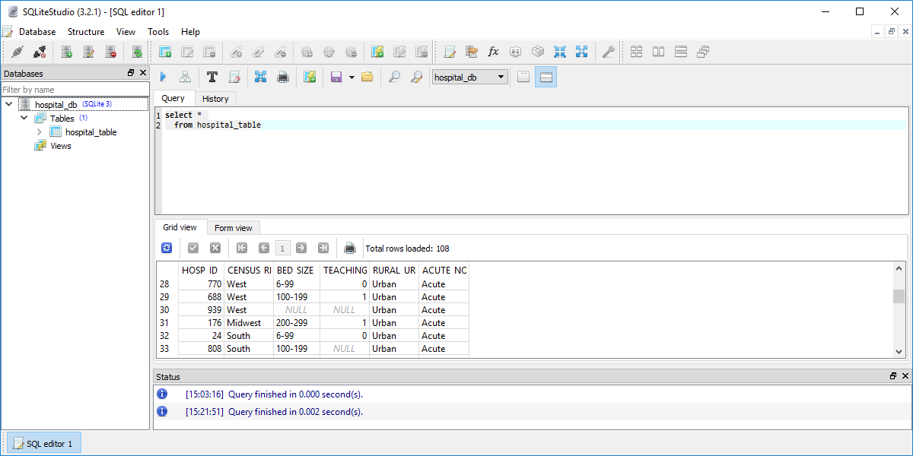
Example of NULL values in a database
List of selected rows of a database in SQLite Studio
Notes:
Here’s a peek at several rows of a database where there are some NULL values.

Slide 4
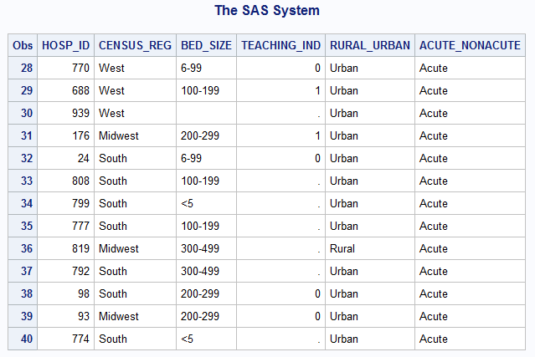
SAS translation of NULL
List of selected rows of a database after import into SAS
Notes:
SQL uses the term NULL to refer to missing values. In R, these NULL values are converted to NA, the R code for missing values. In SAS, these are converted to ., the SAS code for missing values.
You can select records with missing values by specifying IS NULL in the WHERE statement.

Slide 5
library(sqldf)
## Loading required package: gsubfn
## Loading required package: proto
## Loading required package: RSQLite
db <- dbConnect(SQLite(), dbname="../data/titanic.sqlite") dbGetQuery(conn=db, "select PClass, Age FROM ti where name like 'Bar%'")
## PClass Age ## 1 1st NA ## 2 1st NA ## 3 3rd 45 ## 4 3rd 18 ## 5 3rd 27 ## 6 3rd 22
dbGetQuery(conn=db, "SELECT COUNT(Name) AS n_missing FROM ti WHERE Age IS NULL")
## n_missing ## 1 557
You can exclude missing values using IS NOT NULL.
dbGetQuery(conn=db, "SELECT COUNT(Name) AS n_valid FROM ti WHERE Age IS NOT NULL")
## n_valid ## 1 756
In SQL, statistical summary functions will remove missing values and calculate based only on the non-missing values. This is similar to the default options in SAS and SPSS, which also exclude missing values by default in most summary statistics. In R, however, the default option is to return a missing value for a summary statistic anytime that one or more values are missing.
dbGetQuery(conn=db, "SELECT COUNT(Age) AS n_valid FROM ti")
## n_valid ## 1 756
dbGetQuery(conn=db, "SELECT AVG(Age) AS mean_age FROM ti")
## mean_age ## 1 30.39799
dbDisconnect(conn=db)
```

