Slide 1

Retrieving data from multiple tables Database Design

Slide 2
Database Design – Database Schema
At a high level, the process of database design involves defining entities to represent different sorts of data and designing relationships between those entities.
An entity represents a real world object, or a set of data that we want to model within our database
We can often identify these as the major nouns of the system we're modeling
We will draw a direct correlation between an entity and a single table of data. Knowing how foreign key constraints work allow us to understand how tables relate to one another.
What entities might we define for SQL Book application?
Well, we can have a users table, and we can think of a user as a specific entity within our app; a 'user' is someone who uses our app.
The purpose of our SQL Book app is to allow users to use books about SQL, so in this context we can think of books as an entity within our system.
One of the things our users can do is to checkout books, so we could have a third entity called checkouts that exists between users and books.
We also want users to be able to leave reviews of books they've read, so we might have another entity called reviews.
Finally, we want to store address information for each user. Since this address data will only be used occasionally and not for every user interaction, we decide to store it in a separate table.

Slide 3
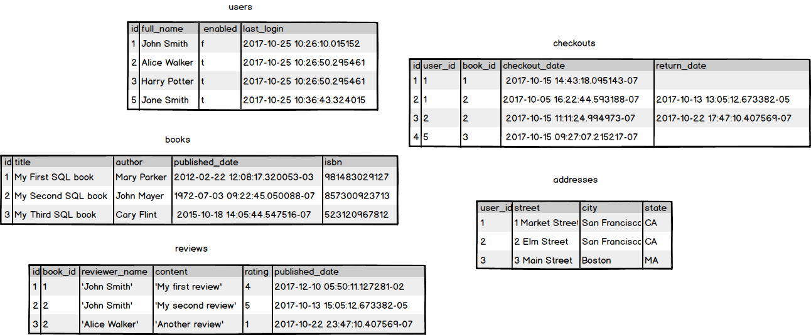
Database Design – Database Schema
We have defined the entities, we can plan tables to store the data for each entity.

Slide 4
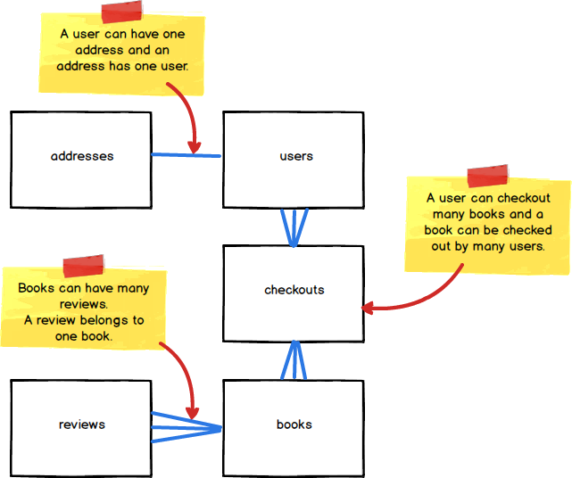
Database Design – Database Schema
Relationships
We've decided on the entities we want. There's something missing though, and that's the relationships between our entities.
If we look at the diagram of our five tables, the tables are all isolated and it's not obvious how these tables should relate to each other. Let's simplify our tables a bit and explicitly define some relationships between them.

Slide 5
Database Design – Database Schema
The diagram shows an abstract representation of our various entities and also the relationships between them
This is simple Entity Relationship Diagram, or ERD.
ERD as any diagram models relationships between entities.
We know the tables that we need and we've also defined the relationships that should exist between those tables in our ERD.
How do we actually implement those relationships in terms of our table schema?
The answer to that is to use keys.
Earlier we looked at an aspect of schema called constraints, and explored how constraints act on and work with the data.
Keys are a special type of constraint used to establish relationships and uniqueness.
They can be used to identify a specific row in the current table, or to refer to a specific row in another table.
Two types of keys that fulfil these particular roles: Primary Keys, and Foreign Keys.

Slide 6

Database Design – Database Schema
Referential Integrity
This is a concept used when discussing relational data which states that table relationships must always be consistent.
Different RDBMSes might enforce referential integrity rules differently, but the concept is the same.
The constraints we've defined for our addresses table enforce the one to one relationship we want between it and our users table, whereby a user can only have one address and an address must have one, and only one, user. This is an example of referential integrity.
What happens if we try to add another address for a user who already has one?
The error above occurs because we are trying to insert a value 1 into the user_id column when such a value already exists in that column. The UNIQUE constraint on the column prevents us from doing so.

Slide 7
Database Design – Database Schema
How about if we try to add an address for a user who doesn't exist?
Here we get a different error. The FOREIGN KEY constraint on the user_id column prevents us from adding the value 7 to that column because that value is not present in the id column of the users table.

Slide 8
Normalization : database design technique
Normalization reduces redundancy and dependency of data. It divides larger tables to smaller tables and links them using relationships.
Database Normal Forms
1NF Rules
What is a KEY?
What is Composite Key
2NF Rules
Database - Foreign Key
What are transitive functional dependencies?
3NF Rules
Boyce-Codd Normal Form (BCNF)

Slide 9
Retrieving data from multiple tables
Questions

