Slide 1
Gathering and spreading
Suman Sahil, Steve Simon

Slide 2
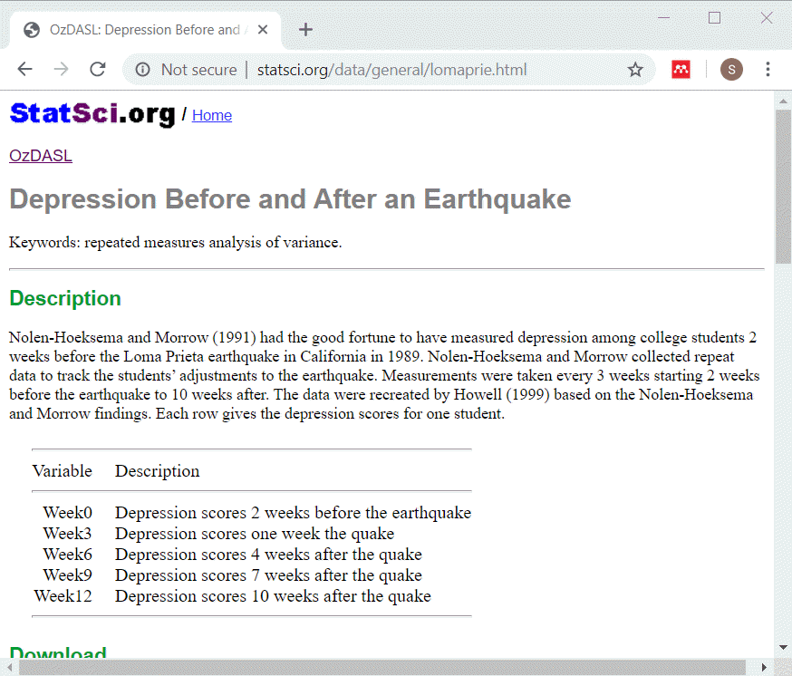
Description of lomaprie data set
Description of data
Notes:
Speaker notes:
This data set displays depression scores among college students in a study planned for other purposes but which ended up with the baseline measurements collected just before a major California earthquake. The researchers seized the opportunity to assess changes in depression immediately before and after the earchquake as well as the recovery process longer term.
The source for this data set is
http://www.statsci.org/data/general/lomaprie.html

Slide 3
lomaprie_db, listing of original table
SQL code
select * from lomaprie limit 5 select count(*) as n_records from lomaprie

Slide 4
lomaprie_db, listing of original table
Output
## id Week0 Week3 Week6 Week9 Week12 ## 1 1 6 10 8 4 6 ## 2 2 2 4 8 5 6 ## 3 3 2 4 8 5 6 ## 4 4 4 5 8 10 7 ## 5 5 4 7 9 7 12
## n_records ## 1 25
Notes:
Speaker notes:
This is what the original data looks like. Notice that there is no primary key in this table. Normally this is a major flaw in any reasonable database, but let’s ignore that for now.

Slide 5
Gathering into a single column
SQL code
select id, week0 as depression, 0 as time from lomaprie union select id, week3 as depression, 3 as time from lomaprie union select id, week6 as depression, 6 as time from lomaprie

Slide 6
Gathering
SQL code, continued
union select id, week9 as depression, 9 as time from lomaprie union select id, week12 as depression, 12 as time from lomaprie limit 13
Notes:
Speaker notes:

Slide 7
Gathering
Output
## id depression time ## 1 1 4 9 ## 2 1 6 0 ## 3 1 6 12 ## 4 1 8 6 ## 5 1 10 3 ## 6 2 2 0 ## 7 2 4 3 ## 8 2 5 9 ## 9 2 6 12 ## 10 2 8 6 ## 11 3 2 0 ## 12 3 4 3 ## 13 3 5 9
Notes:
Speaker notes:

Slide 8
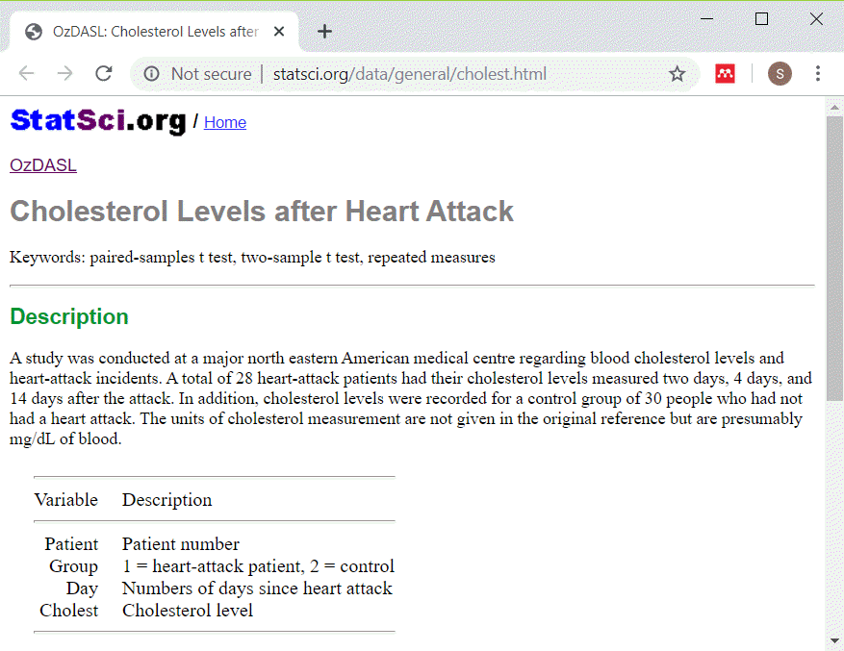
Description of cholestg data set
Description of data
Notes:
Speaker notes:
This data set shows cholesterol levels for patients after a heart attack. I simplified the data by removing the control patients.
The source for this data set is
STatSci.org

Slide 9
cholesterol, listing of original table
SQL code
select * from cholesterol order by patient, day limit 10 select count(*) as n_records from cholesterol

Slide 10
cholestg_1_db, listing of original table
Output
## patient day cholest ## 1 1 2 270 ## 2 1 4 218 ## 3 1 14 156 ## 4 2 2 236 ## 5 2 4 234 ## 6 3 2 210 ## 7 3 4 214 ## 8 3 14 242 ## 9 4 2 142 ## 10 4 4 116
## n_records ## 1 75
Notes:
Speaker notes:
This is what the original data looks like.

Slide 11
cholestg_1_db, count of days
SQL code
select day, count(day) as n_days from cholesterol group by day
Output
## day n_days ## 1 2 28 ## 2 4 28 ## 3 14 19

Slide 12
Spreading across multiple columns
SQL code
select d2.patient, d2.cholest as chol02, d14.cholest as chol14 from cholesterol as d2 left join cholesterol as d14 on d2.patient=d14.patient where d2.day=2 and d14.day=14 limit 10

Slide 13
Spreading across multiple columns
Output
## patient chol02 chol14 ## 1 1 270 156 ## 2 3 210 242 ## 3 6 272 256 ## 4 7 160 142 ## 5 8 220 216 ## 6 9 226 248 ## 7 11 186 168 ## 8 12 266 236 ## 9 14 318 200 ## 10 15 294 264

Slide 14
Spreading across multiple columns, Take 2
SQL code
select d2.patient, d2.cholest as chol02, d14.cholest as chol14 from cholesterol as d2 left join cholesterol as d14 on d2.patient=d14.patient and d2.day=2 and d14.day=14 limit 10

Slide 15
Spreading across multiple columns, Take 2
Output
## patient chol02 chol14 ## 1 1 270 156 ## 2 2 236 NA ## 3 3 210 242 ## 4 4 142 NA ## 5 5 280 NA ## 6 6 272 256 ## 7 7 160 142 ## 8 8 220 216 ## 9 9 226 248 ## 10 10 242 NA

Slide 16
Entity-Attribute-Value format
## entity attribute value ## 1 1 age 9.000 ## 2 1 fev 1.708 ## 3 1 ht 57.000 ## 4 1 sex 0.000 ## 5 1 smoke 0.000 ## 6 2 age 8.000 ## 7 2 fev 1.724 ## 8 2 ht 67.500 ## 9 2 sex 0.000 ## 10 2 smoke 0.000 ## 11 3 age 7.000 ## 12 3 fev 1.720

Slide 17
Advantages of Entity-Attribute-Value format
Universal format
Easy to add fields
Ideal for sparse matrices
Sparse: most entries are zero

Slide 18
Spreading the EAV format
SQL code
select d1.entity, d1.value as age, d2.value as fev, d3.value as ht, d4.value as sex, d5.value as smoke from eav as d1 inner join eav as d2 on d1.attribute='age' and d2.attribute='fev' and d1.entity=d2.entity

Slide 19
Spreading the EAV format
SQL code, continued
inner join eav as d3 on d3.attribute='ht' and d1.entity=d3.entity inner join eav as d4 on d4.attribute='sex' and d1.entity=d4.entity inner join eav as d5 on d5.attribute='sex' and d1.entity=d5.entity limit 10
Notes:
Speaker notes:

Slide 20
Spreading the EAV format
Output
## entity age fev ht sex smoke ## 1 1 9 1.708 57.0 0 0 ## 2 2 8 1.724 67.5 0 0 ## 3 3 7 1.720 54.5 0 0 ## 4 4 9 1.558 53.0 1 1 ## 5 5 9 1.895 57.0 1 1 ## 6 6 8 2.336 61.0 0 0 ## 7 7 6 1.919 58.0 0 0 ## 8 8 6 1.415 56.0 0 0 ## 9 9 8 1.987 58.5 0 0 ## 10 10 9 1.942 60.0 0 0
Notes:
Speaker notes:

Slide 21
Spreading the EAV format
SQL code
select entity, value as age from eav where entity in ( select entity from eav where attribute='smoke' and value=1 ) and attribute='age' limit 10

Slide 22
Spreading the EAV format
Output
## entity age ## 1 191 9 ## 2 332 14 ## 3 358 14 ## 4 366 13 ## 5 369 11 ## 6 370 14 ## 7 372 13 ## 8 381 12 ## 9 384 14 ## 10 388 10
Notes:
Speaker notes:

