Slide 1
Gathering into a single column
Suman Sahil, Steve Simon

Slide 2
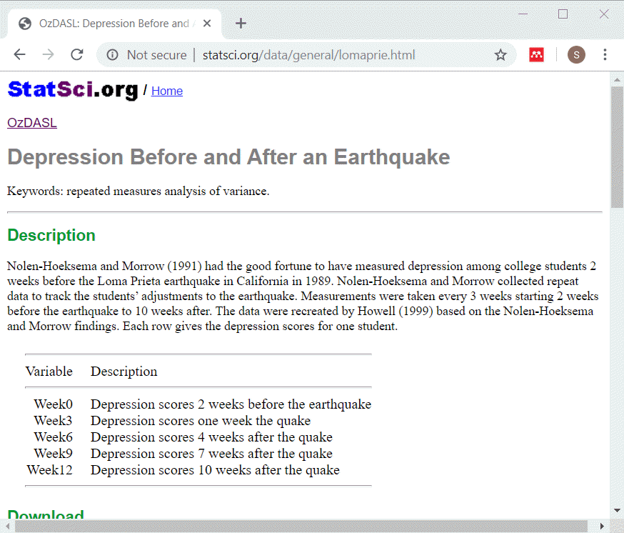
Description of lomaprie data set
Description of data
Notes:
This data set displays depression scores among college students in a study planned for other purposes but which ended up with the baseline measurements collected just before a major California earthquake. The researchers seized the opportunity to assess changes in depression immediately before and after the earchquake as well as the recovery process longer term.

Slide 3
lomaprie_db, listing of original table
SQL code
select * from earthquake_table limit 5
Output
## Week0 Week3 Week6 Week9 Week12 ## 1 6 10 8 4 6 ## 2 2 4 8 5 6 ## 3 2 4 8 5 6 ## 4 4 5 8 10 7 ## 5 4 7 9 7 12
Notes:
This is what the original data looks like. Notice that there is no primary key in this table. Normally this is a major flaw in any reasonable database, but let’s ignore that for now.

Slide 4
Adding a primary key
SQL code
select row_number() over (order by week0) as id, week0, week3, week6, week9, week12 from earthquake_table limit 5
Output
## id Week0 Week3 Week6 Week9 Week12 ## 1 1 2 4 8 5 6 ## 2 2 2 4 8 5 6 ## 3 3 2 9 11 8 8 ## 4 4 4 5 8 10 7 ## 5 5 4 7 9 7 12
Notes:
Here is the data table with a primary key added. You will need this before you try to restructure your data.

Slide 5
What is this row_number function
Windowing function
Not a single row function
Adds a sequence number
Require an over keyword.

Slide 6
Restructuring
SQL code
select row_number() over (order by week0) as id, week0 as depression_score, 0 as time from earthquake_table union select row_number() over (order by week0) as id, week3 as depression_score, 3 as time from earthquake_table limit 5

Slide 7
Restructuring
Output
## id depression_score time ## 1 1 2 0 ## 2 1 4 3 ## 3 2 2 0 ## 4 2 4 3 ## 5 3 2 0

