Slide 1
Retrieving data using the SQL SELECT statement
Suman Sahil, Steve Simon

Slide 2
Working with the airlines dataset
Database airlines_db
Single table, airlines_table.
Number of passengers bumped from their flights due to overbooking.
For years 2016, 2017
Also rate of bumping per ten thousand passengers.
More details at the Data Description website.
Notes:
The first data set is small. So small that you might wonder you would need a database for it.
The airlines_db database has a single table and that table only has five fields and twelve records. I wanted a database small enough that you could list the entire thing on a single slide.
You can check out the original source, though I did make a few minor modifications.

Slide 3
Select an entire table
SQL code
select * from airlines_table
Notes:
To select an entire table in SQL use the wild card symbol, asterisk. The asterisk is shorthand for “every field in the table.” If you are working directly with your database, you do not need any extra code, but in R and SAS there’s just a bit more to it.
For most of the lectures, I will not show the extra SAS and R code, but I wanted to illustrate it at least for the very first lecture.

Slide 4
Select an entire table in R (1/2)
R code
library(sqldf) db <- dbConnect(SQLite(), dbname="../../data/airlines_db.sqlite") airlines_data <- dbGetQuery(conn=db, "select * from airlines_table") airlines_data dbDisconnect(conn=db)
Notes:
In R, you need a third party extension. There are several that will work. I’ve had pretty good luck with the sqldf library. There is a generic library dbi and an extension to Oracle called ROracle.
You also need to connect to the database before you can extract any information. use the dbConnect function for this. For a password protected database, you would need extra arguments for the user name and password.
Finally, enclose your SQL code in quotes and pass it to the dbGetQuery function. This function produces a data frame which I have stored in airlines_data.
Always remember to disconnect when you are done. This doesn’t have to be right away, but you should disconnect somewhere rather than leaving the connection open when your program is done.

Slide 5
Select an entire table in R (2/2)
## Airline b2017 b2016 r2017 r2016 ## 1 DELTA 679 912 0.07 0.09 ## 2 VIRGIN 165 77 0.27 0.13 ## 3 JETBLUE 1475 2140 0.54 0.82 ## 4 UNITED 2067 2874 0.30 0.45 ## 5 HAWAIIAN 92 30 0.11 0.04 ## 6 EXPRESSJET 785 2541 0.67 1.58 ## 7 SKYWEST 917 2177 0.37 0.96 ## 8 AMERICAN 4517 6598 0.46 0.66 ## 9 ALASKA 658 734 0.35 0.41 ## 10 SOUTHWEST 6678 11907 0.58 1.06 ## 11 FRONTIER 540 688 0.45 0.63 ## 12 SPIRIT 1502 1418 0.88 0.93
Notes:
Here’s what the data frame looks like.

Slide 6
Select entire table in SAS (1/2)
SAS code
libname sql_lib odbc datasrc='sqlite3'; proc sql; create table full_table as select * from sql_lib.airlines_table; quit; proc print data=full_table; run;
Notes:
This program shows how to use the SELECT statement for SQL within a SAS program. This code shows all the steps that you need for a simple query that selects every record and all fields within a single table.
First you need to point to the database with a libname statement. Then you insert the code into proc sql.
By default, proc sql will just display the results of your query. To save a file for further work, use the create table as statement.
Notice that proc sql requires a quit statement rather than a run statement at the end.

Slide 7
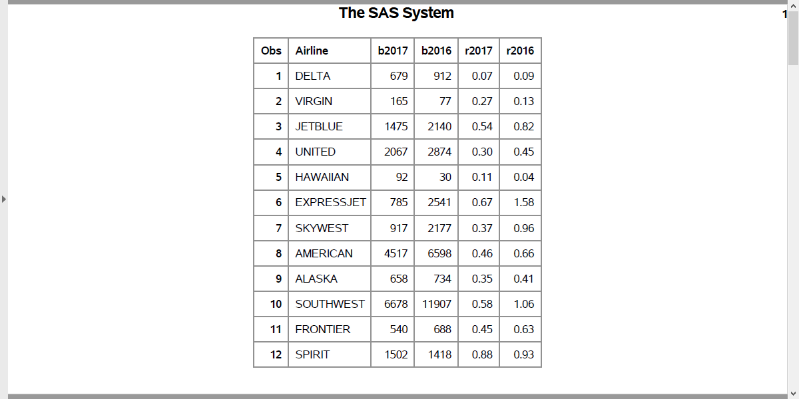
Select entire table in SAS (2/2)
SAS Output
Notes:
Here’s what the output looks like.

Slide 8
Selecting a single field
SQL code
select airline from airlines_table
Notes:
To select a single field, list that field’s name after the select statement.

Slide 9
Selecting a single field in R (1/2)
R code
db <- dbConnect(SQLite(), dbname="../../data/airlines_db.sqlite") airline_names <- dbGetQuery(conn=db, "select Airline from airlines_table") airline_names
Notes:
In R, you need to connect again (skip this step if you didn’t disconnect earlier). Then call the dbGetQuery function with the SQL code inserted. Keep the connection open for now to save time with the next couple of queries.

Slide 10
Selecting a single field in R (2/2)
## Airline ## 1 DELTA ## 2 VIRGIN ## 3 JETBLUE ## 4 UNITED ## 5 HAWAIIAN ## 6 EXPRESSJET ## 7 SKYWEST ## 8 AMERICAN ## 9 ALASKA ## 10 SOUTHWEST ## 11 FRONTIER ## 12 SPIRIT
Notes:
Here’s what the output looks like.

Slide 11
Select a single field in SAS (1/2)
SAS code
proc sql; create table single_column as select Airline from sql_lib.airlines_table; quit; proc print data=single_column; run;
Notes:
This is how you select a single field in SAS.
As before, place the SQL query inside proc sql and use the create table as statement to store the results in a SAS data set.
Watch your semicolons carefully in SAS!

Slide 12
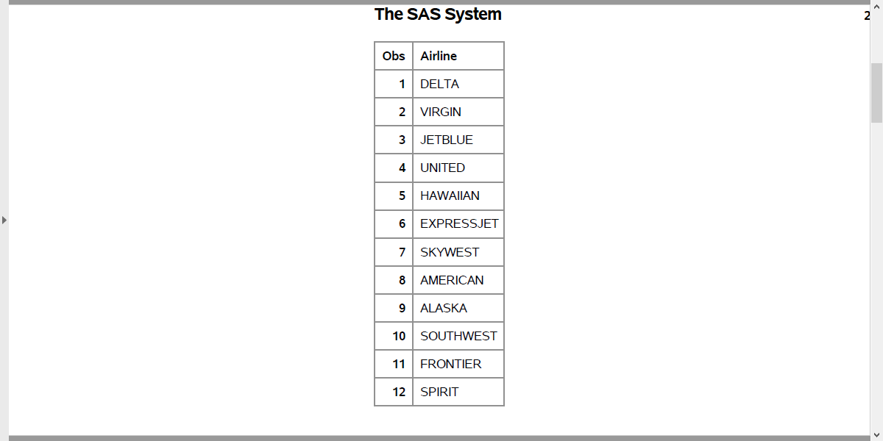
Select a single field in SAS (2/2)
SAS Output
Notes:
Here’s what the output looks like.

Slide 13
Selecting multiple fields
SQL code
select Airline, r2016, r2017 from airlines_table
Notes:
To select multiple fields, list them after the select statement separated by commas. Don’t leave out the commas. I usually do, and it inevitably leads to a cryptic error message.

Slide 14
Selecting multiple fields in R (1/2)
airline_bump_rates <- dbGetQuery(conn=db, "select Airline, r2016, r2017 from airlines_table") airline_bump_rates
Notes:
Here’s the code in R.

Slide 15
Selecting multiple fields in R (2/2)
## Airline r2016 r2017 ## 1 DELTA 0.09 0.07 ## 2 VIRGIN 0.13 0.27 ## 3 JETBLUE 0.82 0.54 ## 4 UNITED 0.45 0.30 ## 5 HAWAIIAN 0.04 0.11 ## 6 EXPRESSJET 1.58 0.67 ## 7 SKYWEST 0.96 0.37 ## 8 AMERICAN 0.66 0.46 ## 9 ALASKA 0.41 0.35 ## 10 SOUTHWEST 1.06 0.58 ## 11 FRONTIER 0.63 0.45 ## 12 SPIRIT 0.93 0.88
Notes:
Here’s what the output looks like.

Slide 16
Select a multiple fields in SAS (1/2)
SAS code
proc sql; create table multiple_columns as select Airline, r2017, r2016 from sql_lib.airlines_table; quit; proc print data=multiple_columns; run;
Notes:
This is how you select multiple fields in SAS.

Slide 17
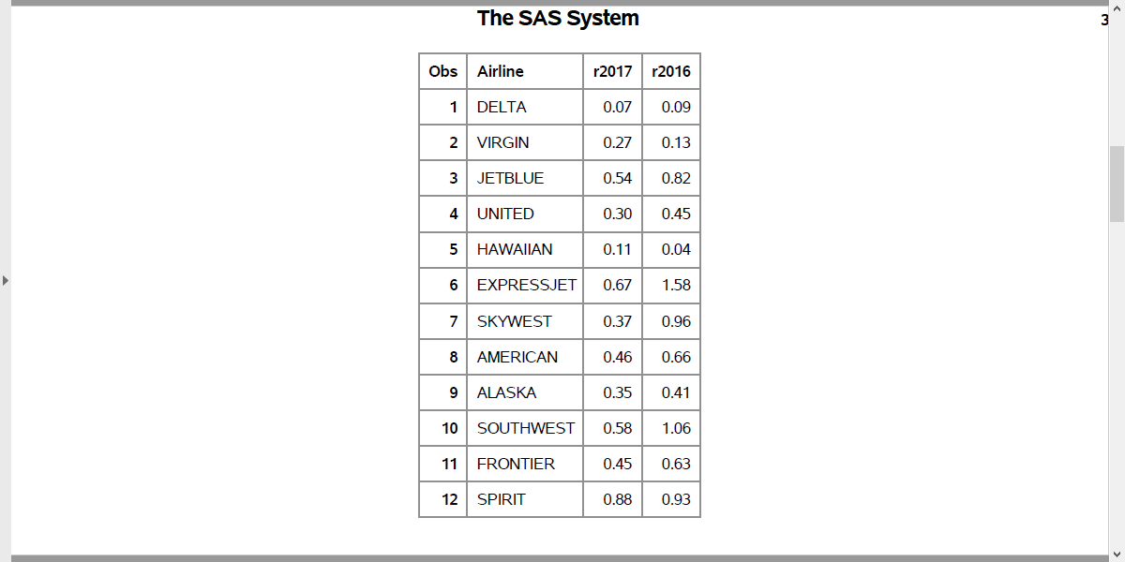
Select a multiple fields in SAS (2/2)
SAS Output
Notes:
Here’s what the output looks like.

Slide 18
Changing field names
SQL code
select Airline, r2017 as current_rate, r2016 as previous_rate from airlines_table
Notes:
Use the AS keyword to change the name of a field. Notice where the commas go. This code renames the fields in the output, but the names in the original database remain the same.

Slide 19
Changing field names in R (1/2)
changed_names <- dbGetQuery(conn=db, "select Airline, r2017 as current_rate, r2016 as previous_rate from airlines_table") changed_names dbDisconnect(conn=db)
Notes:
Here’s the R code. Since this is the last query in R, you need to disconnect here.

Slide 20
Changing field names in R (2/2)
## Airline current_rate previous_rate ## 1 DELTA 0.07 0.09 ## 2 VIRGIN 0.27 0.13 ## 3 JETBLUE 0.54 0.82 ## 4 UNITED 0.30 0.45 ## 5 HAWAIIAN 0.11 0.04 ## 6 EXPRESSJET 0.67 1.58 ## 7 SKYWEST 0.37 0.96 ## 8 AMERICAN 0.46 0.66 ## 9 ALASKA 0.35 0.41 ## 10 SOUTHWEST 0.58 1.06 ## 11 FRONTIER 0.45 0.63 ## 12 SPIRIT 0.88 0.93
Notes:
Here’s what the output looks like.

Slide 21
Renaming fields (1/2)
SAS code
proc sql; create table renamed_fields as select Airline, r2017 as current_rate, r2016 as previous_rate from sql_lib.airlines_table; quit; proc print data=renamed_fields; run;
Notes:
You can rename fields in proc sql, but be careful. Sometimes SAS retains the original name as the variable label. If you have trouble with renaming, you may want to do the renaming in SAS itself.

Slide 22
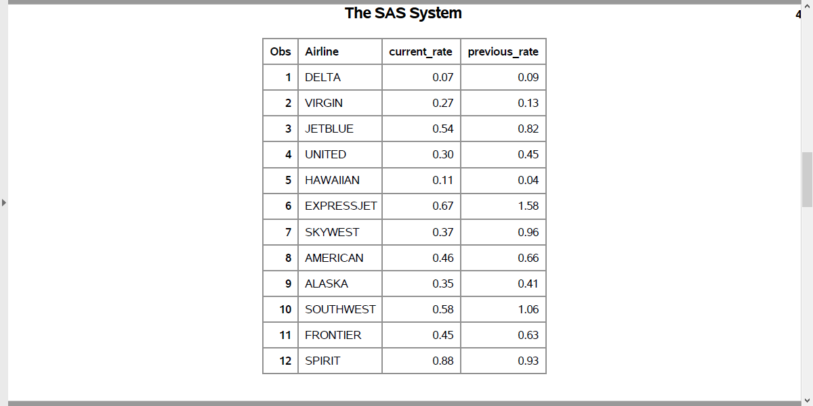
Renaming fields (2/2)
SAS Output
Notes:
Here’s what the output looks like.

Slide 23
Your homework
Database crawling_db
Single table, crawling_table.
Birth_month (self-explanatory)
Temperature (Average temperature (F) six months after birth)
avg_crawling_age (in weeks)
More details at the Data Description website.
Read all three fields and all records
Change Temperature to Temperature_F
Put your code and the output in a single PDF file
Notes:
The database for your first homework assignment is also very small. It has three fields and twelve records. This data came from a research publication in Infant Behavior and Development. The original data set included 414 infants, but the results were averaged by birth month. The hypothesis is that the colder temperature around the time when infants might start to crawl might adversely influence the age at which the infants started crawling because the bulky clothes needed in cold weather might restrict movement and interfere with their normal development.
You can check out the original source on the data description website.

