Slide 1
Gathering into a single column
Suman Sahil, Steve Simon

Slide 2
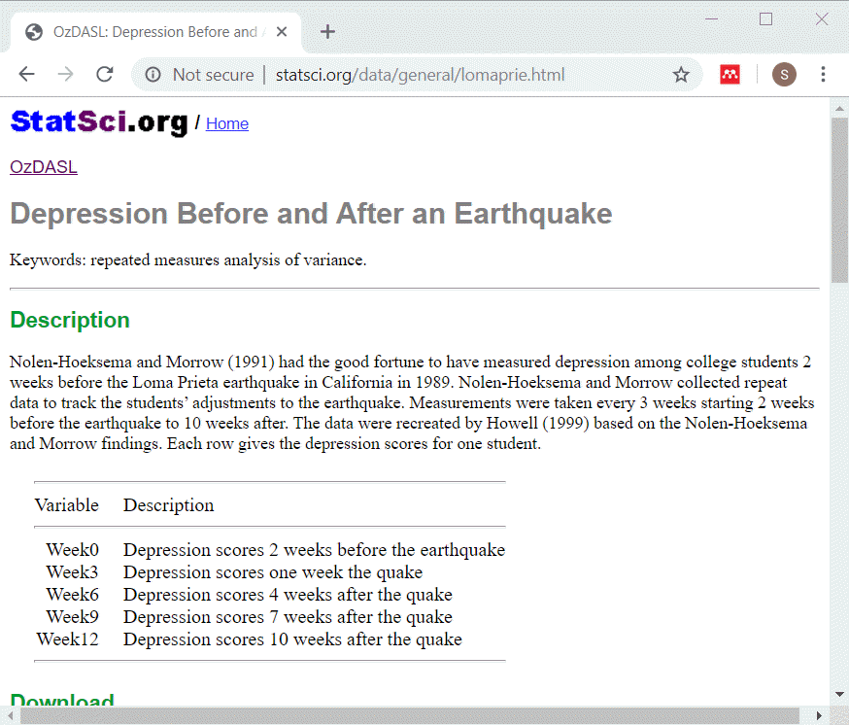
Description of lomaprie data set
Description of data
Notes:
This data set displays depression scores among college students in a study planned for other purposes but which ended up with the baseline measurements collected just before a major California earthquake. The researchers seized the opportunity to assess changes in depression immediately before and after the earchquake as well as the recovery process longer term.
The source for this data set is
http://www.statsci.org/data/general/lomaprie.html

Slide 3
lomaprie_db, listing of original table
SQL code
select * from earthquake_table limit 5 select count(*) as n_records from earthquake_table

Slide 4
lomaprie_db, listing of original table
Output
## id Week0 Week3 Week6 Week9 Week12 ## 1 1 6 10 8 4 6 ## 2 2 2 4 8 5 6 ## 3 3 2 4 8 5 6 ## 4 4 4 5 8 10 7 ## 5 5 4 7 9 7 12
## n_records ## 1 25
Notes:
This is what the original data looks like. Notice that there is no primary key in this table. Normally this is a major flaw in any reasonable database, but let’s ignore that for now.

Slide 5
Test slide
r01 1 1 2 2 3 3 4 4 4 r02 5 0 5 0 5 0 5 0 5 8 r03 r04 1 1 2 2 3 3 4 4 4 r05 5 0 5 0 5 0 5 0 5 8 r06 r07 1 1 2 2 3 3 4 4 4 r08 5 0 5 0 5 0 5 0 5 8 r09 r10 1 1 2 2 3 3 4 4 4 r11 5 0 5 0 5 0 5 0 5 8 r12 r13 1 1 2 2 3 3 4 4 4 r14 5 0 5 0 5 0 5 0 5 8 r15

Slide 6
Gathering
SQL code
select id, week0 as depression_score, 0 as time from earthquake_table union select id, week3 as depression_score, 3 as time from earthquake_table union select id, week6 as depression_score, 6 as time from earthquake_table

Slide 7
Gathering
SQL code, continued
union select id, week9 as depression_score, 9 as time from earthquake_table union select id, week12 as depression_score, 12 as time from earthquake_table limit 13

Slide 8
Gathering
Output
## id depression_score time ## 1 1 4 9 ## 2 1 6 0 ## 3 1 6 12 ## 4 1 8 6 ## 5 1 10 3 ## 6 2 2 0 ## 7 2 4 3 ## 8 2 5 9 ## 9 2 6 12 ## 10 2 8 6 ## 11 3 2 0 ## 12 3 4 3 ## 13 3 5 9

Slide 9
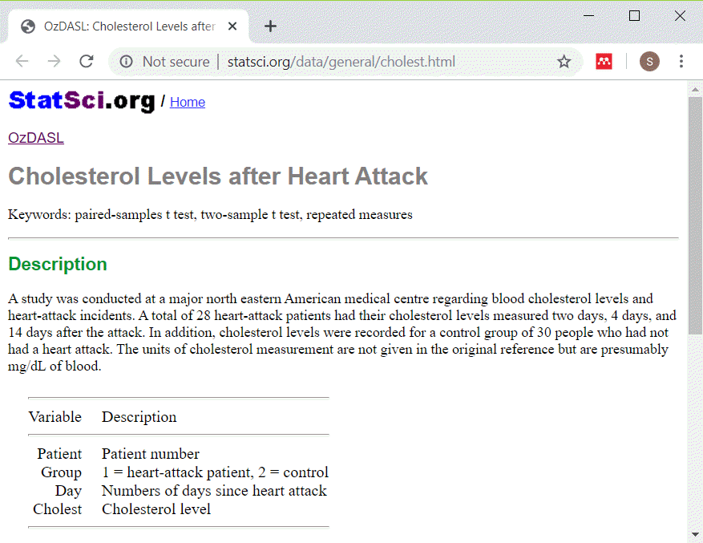
Description of cholestg data set
Description of data
Notes:
This data set shows cholesterol levels for patients after a heart attack. I simplified the data by removing the control patients.
The source for this data set is
STatSci.org

Slide 10
cholestg_1_db, listing of original table
SQL code
select * from ch_table order by patient, day limit 10 select count(*) as n_records from ch_table

Slide 11
cholestg_1_db, listing of original table
Output
## patient day cholest ## 1 1 2 270 ## 2 1 14 156 ## 3 2 2 236 ## 4 3 2 210 ## 5 3 14 242 ## 6 4 2 142 ## 7 5 2 280 ## 8 6 2 272 ## 9 6 14 256 ## 10 7 2 160
## n_records ## 1 47
Notes:
This is what the original data looks like.

Slide 12
cholestg_1_db, count of days
SQL code
select day, count(day) as n_days from ch_table group by day
Output
## day n_days ## 1 2 28 ## 2 14 19

Slide 13
Spreading
SQL code
select d2.patient, d2.cholest as chol02, d14.cholest as chol14 from ch_table as d2 left join ch_table as d14 on d2.patient=d14.patient where d2.day=2 and d14.day=14 limit 10

Slide 14
Spreading
Output
## patient chol02 chol14 ## 1 1 270 156 ## 2 3 210 242 ## 3 6 272 256 ## 4 7 160 142 ## 5 8 220 216 ## 6 9 226 248 ## 7 11 186 168 ## 8 12 266 236 ## 9 14 318 200 ## 10 15 294 264

