Slide 1
Gathering into a single column
Suman Sahil, Steve Simon

Slide 2
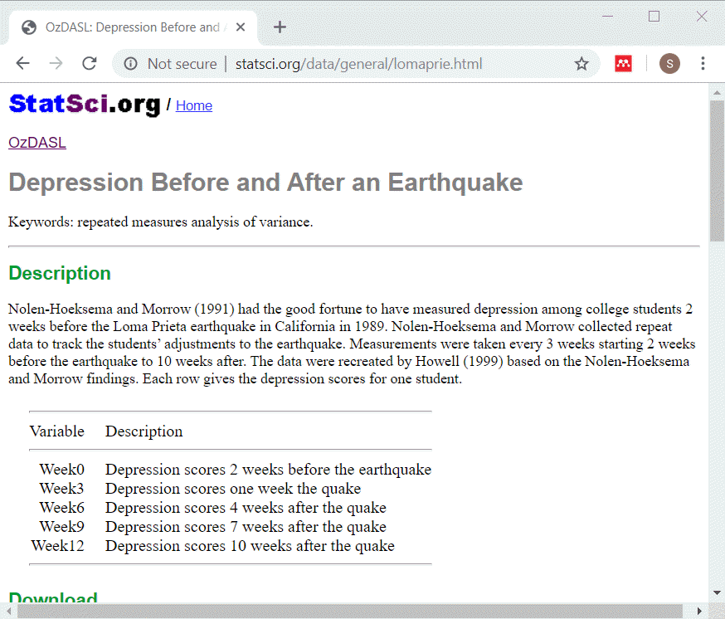
Description of lomaprie data set
Description of data
Notes:
This data set displays depression scores among college students in a study planned for other purposes but which ended up with the baseline measurements collected just before a major California earthquake. The researchers seized the opportunity to assess changes in depression immediately before and after the earchquake as well as the recovery process longer term.
The source for this data set is
STatSci.org

Slide 3
lomaprie_db, listing of original table
SQL code
select * from earthquake_table limit 5 select count(*) as n_records from earthquake_table

Slide 4
lomaprie_db, listing of original table
Output
## Week0 Week3 Week6 Week9 Week12 ## 1 6 10 8 4 6 ## 2 2 4 8 5 6 ## 3 2 4 8 5 6 ## 4 4 5 8 10 7 ## 5 4 7 9 7 12
## n_records ## 1 25
Notes:
This is what the original data looks like. Notice that there is no primary key in this table. Normally this is a major flaw in any reasonable database, but let’s ignore that for now.

Slide 5
Adding a primary key
SQL code
select row_number() over (order by week0) as id, week0, week3, week6, week9, week12 from earthquake_table limit 5
Output
## id Week0 Week3 Week6 Week9 Week12 ## 1 1 2 4 8 5 6 ## 2 2 2 4 8 5 6 ## 3 3 2 9 11 8 8 ## 4 4 4 5 8 10 7 ## 5 5 4 7 9 7 12
Notes:
Here is the data table with a primary key added. You will need this before you try to restructure your data.

Slide 6
What is this row_number function
Windowing function
Not a single row function
Adds a sequence number
Require an over keyword.

Slide 7
Restructuring
SQL code
select row_number() over (order by week0) as id, week0 as depression_score, 0 as time from earthquake_table union select row_number() over (order by week0) as id, week3 as depression_score, 3 as time from earthquake_table union select row_number() over (order by week0) as id, week6 as depression_score, 6 as time from earthquake_table

Slide 8
Restructuring, part 2
SQL code, continued
union select row_number() over (order by week0) as id, week9 as depression_score, 9 as time from earthquake_table union select row_number() over (order by week0) as id, week12 as depression_score, 12 as time from earthquake_table limit 13

Slide 9
Restructuring
Output
## id depression_score time ## 1 1 2 0 ## 2 1 4 3 ## 3 1 5 9 ## 4 1 6 12 ## 5 1 8 6 ## 6 2 2 0 ## 7 2 4 3 ## 8 2 5 9 ## 9 2 6 12 ## 10 2 8 6 ## 11 3 2 0 ## 12 3 8 9 ## 13 3 8 12

