Slide 1
Oddball characters
Steve Simon

Slide 2
Some resources that I am drawing from
http://www.pmean.com/12/pesky.html
http://blog.pmean.com/weird-characters/
http://www.pmean.com/posts/non-breaking-space.html
Please note that the image links on this page are broken
Notes:
I’ve struggled in the past with some text files because the have oddball characters. They look normal from the outside, but hiding inside them is pure trouble.
Here are some blog posts that I have posted in the past about this and I will use material from these in this presentation.

Slide 3
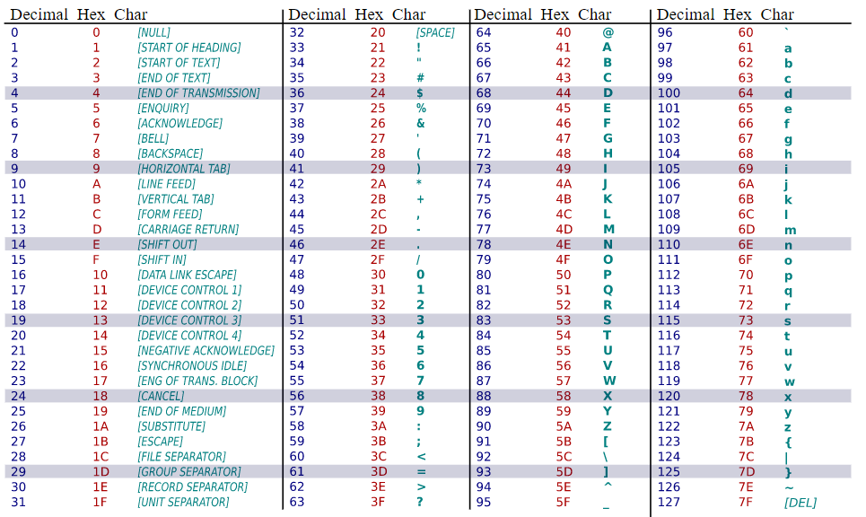
7-bit ASCII
Notes:
ASCII is short for American Standard Code for Information Interchange.
This is a table of the 7-bit ASCII characters, taken from Wikipedia.
https://upload.wikimedia.org/wikipedia/commons/1/1b/ASCII-Table-wide.svg

Slide 4
Some important 7-bit ASCII characters
Printable 7-bit ASCII
Decimal 34, Hex 22, straight double quote (")
Decimal 39, Hex 27, straight single quote (’)
Decimal 96, Hex 60, backtick (`)
Invisible 7-bit ASCII
Decimal 32, Hex 20, blank
Decimal 09, Hex 09, tab (also
Decimal 13, carriage return (also in r)
Decimal 12, line feed

Slide 5
Character to hexadecimal
charToRaw(" ")
## [1] 20
Notes:
If you have a character and you want to see what the hexadecimal value in the ASCII table would be, use the charToRaw function.

Slide 6
Hexadecimal to character
"\x20"
## [1] " "
"\040"
## [1] " "
"\U20"
## [1] " "
Notes:
If you precede a hexadecimal code with backslash-x, R will convert it to the appropriate ASCII character.
Just for reference, you can get Octal and unicode values. I’ll talk about these later.

Slide 7
Why are tab characters bad?
print("\x28\x09\x29")
## [1] "(\t)"
cat("\x28\x09\x29")
## ( )
print("\x28\x20\x09\x29")
## [1] "( \t)"
cat("\x28\x20\x09\x29")
## ( )
A tab character is shown as

