Slide 1
Introduction
Steve Simon

Slide 2

I will use my resume to introduce myself.
Resume, found at https://github.com/pmean/resume

Slide 3
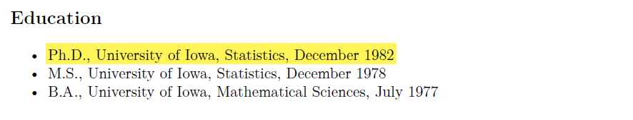
I got my degree almost 40 years ago
Education section of my resume

Slide 4
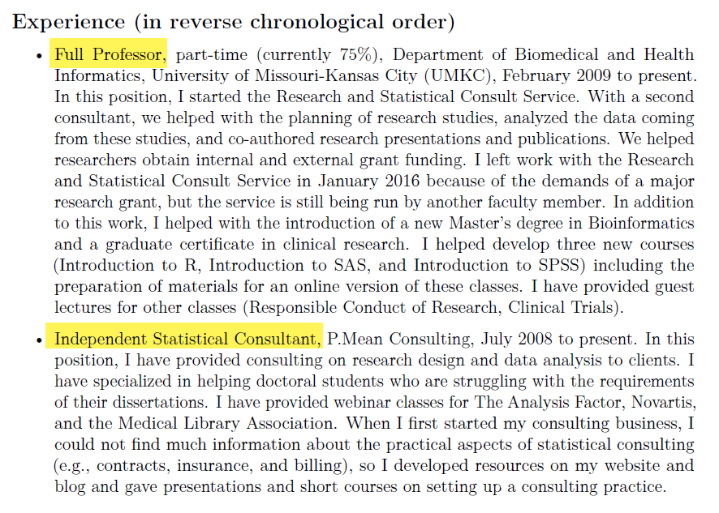
I juggle two part time jobs.
Experience section of my resume

Slide 5
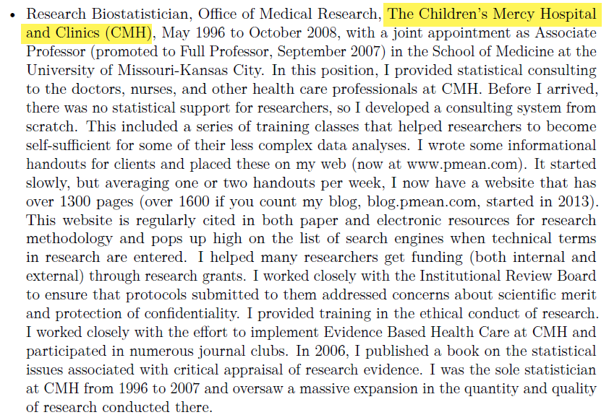
I used to work at a hospital, …
Work experience at Children’s Mercy Hospital

Slide 6
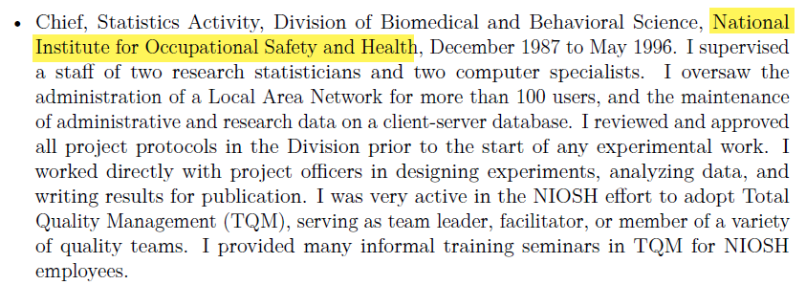
for Uncle Sam, …
Work experience at National Institute for Occupational Safety and Health

Slide 7
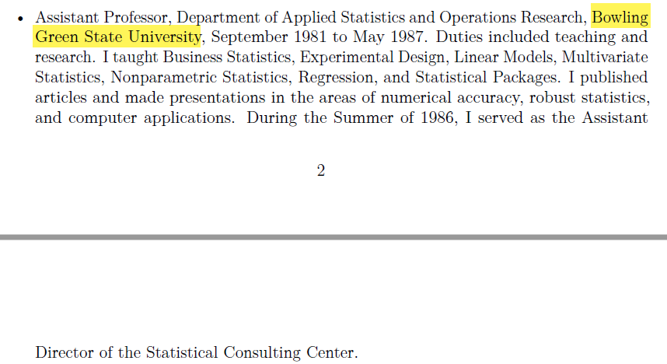
at a different University, …
Work experience at Bowling Green State University

Slide 8
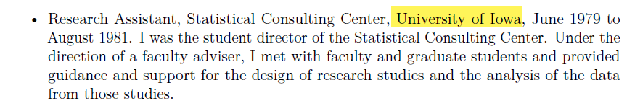
and as student director of a consulting center.
work experience at the Unversity of Iowa

Slide 9
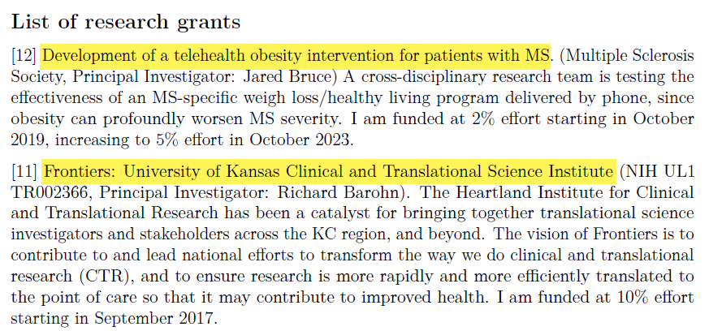
I’ve been on a few reserach grants, …
Two grants from my resume

Slide 10
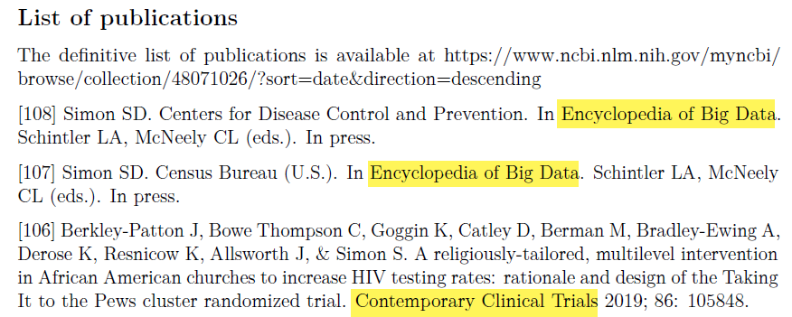
written a few papers, …
Three publications from my resume

Slide 11
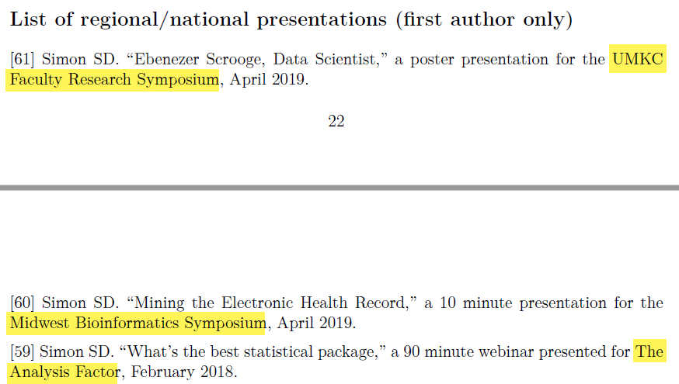
and given a few talks.
Three presentations from my resume

Slide 12
I’m not actively looking for a job, but …
These PowerPoint slides available at https://github.com/pmean/papers-and-presentations.
My resume available at https://github.com/pmean/resume.

