Slide 1
Sample markdown code for PowerPoint presentations
Steve Simon

Slide 2
Slide with Bullets
Bullet 1
Bullet 2
Bullet 3

Slide 3
Slide with R Output
summary(cars)
## speed dist ## Min. : 4.0 Min. : 2.00 ## 1st Qu.:12.0 1st Qu.: 26.00 ## Median :15.0 Median : 36.00 ## Mean :15.4 Mean : 42.98 ## 3rd Qu.:19.0 3rd Qu.: 56.00 ## Max. :25.0 Max. :120.00

Slide 4
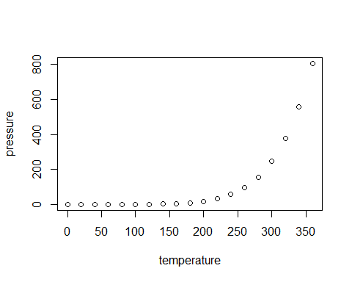
Slide with Plot

Slide 5
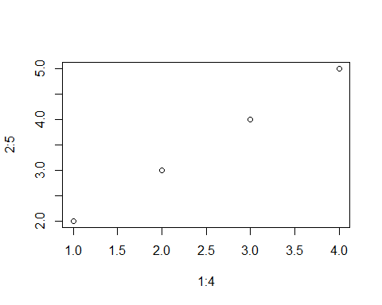
test

Slide 6
Column format
Content of the left column.
## [1] 0.08599447 1.07251431 0.06996104 -0.10503484 1.44718515 -0.69789493 ## [7] 0.65483521 -0.39636058 -0.40889247 -0.05079188
Content of the right column.

